Slide 1
When In-Network Processing Meets Time:
Complexity and Effects of Joint Optimization in Wireless Sensor Networks
Department of Computer Science, Wayne State University
Department of Computer Science, Indiana University
Applied Research and Technology Center, Motorola

Slide 2
Introduction
Wireless Sensor Networks
  Highly resource-constrained
In-Network Processing
  Reduce traffic flow → resource efficient
  End-to-end QoS are usually not considered
Mission-Critical Real-Time CPS:
  Close-loop control
  More emphasis on end-to-end QoS, especially latency and reliability

Slide 3
Introduction
Packet packing
  Application independent INP
  Simple yet useful INP in practice
    UWB intra-vehicle control
    IETF 6LowPAN: high header overhead
Our focus:
  Understanding problem complexity
  Designing simple distributed online algorithm
  Understanding systems benefits

Slide 4
Outline
System Model and Problem Formulation
Complexity Analysis
A Utility Based Online Algorithm
Performance Evaluation
Conclusion

Slide 5
System Model and Problem Formulation
System Model
  A directed collection tree T = (V,E)
  Edge (v_{i}, v_{j}) ∈ E with weight ETX_{vi, vj} (l)
  A set of information elements X = {x}
  Each element x: (v_{x}, l_{x}, r_{x}, d_{x})
Problem (P):
  Schedule the transmission of X to R
  Minimize the total number of transmissions
  Satisfy the latency constraints of each x ∈ X

Slide 6
Outline
System Model and Problem Formulation
Complexity Analysis
A Utility Based Online Algorithm
Performance Evaluation
Conclusion

Slide 7
Complexity Analysis
Problem P₀
  Elements are of equal length
  Each node has at most one element
Problem P₁
  Elements are of equal length
  Each node generates elements periodically
Problem P₂
  Elements are of equal length
  Arbitrary data generating pattern

Slide 8
Complexity Analysis
P_{0,} P₁, P₂, P | K ≥ 3 | K = 2
 |  | re-aggregation is not prohibited | re-aggregation is prohibited
Complexity | strong NP-hard | strong NP-hard | O(N³)
NP-hard to achieve approximation ratio
  K = Maximal packet length N = |X|
  Re-aggregation: a packed packet can be dispatched for further packing.

Slide 9
Complexity Analysis
K ≥ 3, P₀ is NP-hard in tree structures -- Reduction from SAT
Given a SAT instance with n clauses and m variables
For each clause j
For m variables

Slide 10
For each variable occurred in clause j
Auxiliary elements related to the red ones

Slide 11
Complexity Analysis
When K ≥ 3 and T is a tree, regardless of re-aggregation
  P₀ is NP-hard →P₁ is NP-hard → P₂ is NP-hard → P is NP-hard
When K ≥ 3, and T is a chain, regardless of re-aggregation
  The reduction from SAT still holds*
When K = 2 and re-aggregation is not prohibited
  The reduction from SAT still holds in both tree and chain structures
When K = 2 and re-aggregation is prohibited
  Problem P is equivalent to the maximum weighted matching problem in an interval graph.
  Solvable in O(N³) by Edmonds’ Algorithm
  * This solves an open problem in batch processing

Slide 12
Outline
System Model and Problem Formulation
Complexity Analysis
A Utility Based Online Algorithm
Performance Evaluation
Conclusion

Slide 13
A Utility Based Online Algorithm
When a node receives a packet pkt with length s_{f}
  Decisions: to hold or to transmit immediately
  Utility of action: Reduced Amortized Cost
  One-hop locality

Slide 14
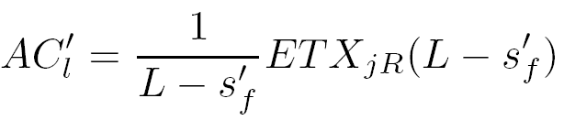
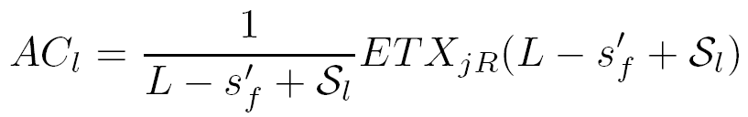

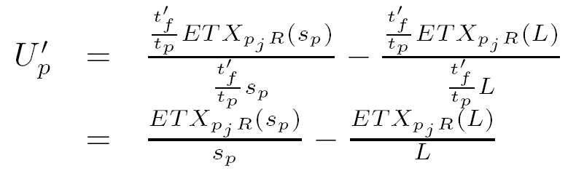
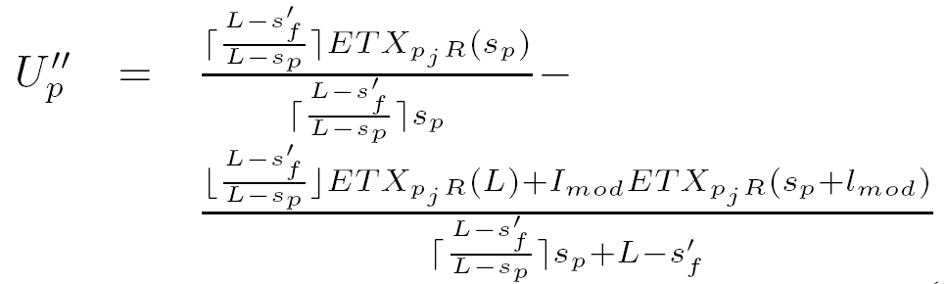
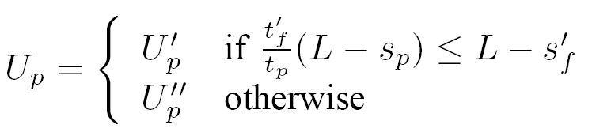
A Utility Based Online Algorithm
Utility of holding a packet:
Utility of transmitting a packet:
Cost with packing
Cost without packing
Every packet received by parent can get fully packed via pkt

Slide 15
A Utility Based Online Algorithm
Decision Rule
  The packet should be immediately transmitted if U_{p} > U_{l}
  The packet should be held if U_{p} ≤ U_{l}
Competitive Ratio
  Problem P’
    T is a complete tree
    Leaf nodes generate elements at a common rate
  Theorem: For problem P′, tPack is
-competitive, where K is the maximum number of information elements that can be packed into a single packet, V_{>1} is the set of nodes that are at least two hops away from the sink R.
  Example: When ETX is the same for each link, tPack is 2-comptetive

Slide 16
Outline
System Model and Problem Formulation
Complexity Analysis
A Utility Based Online Algorithm
Performance Evaluation
Conclusion

Slide 17
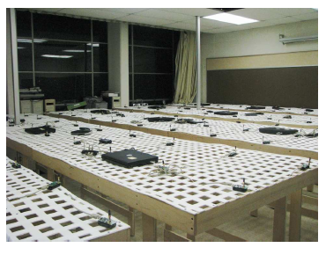
Performance Evaluation
Experiment Setting Up
  Testbed: NetEye, a 130-sensor testbed
  Topology: 120 nodes, half are source nodes
  Protocols compared: noPacking, simplePacking, tPack
  Traffic patterns: 6 second periodic traffic and event traffic
  Metrics:
    packing ratio
    delivery reliability
    delivery cost
    latency jitter

Slide 18
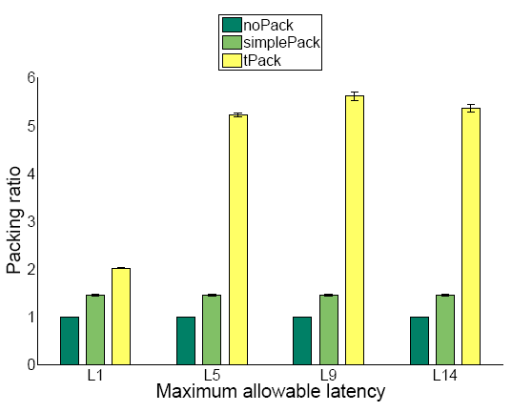
Packing Ratio

Slide 19
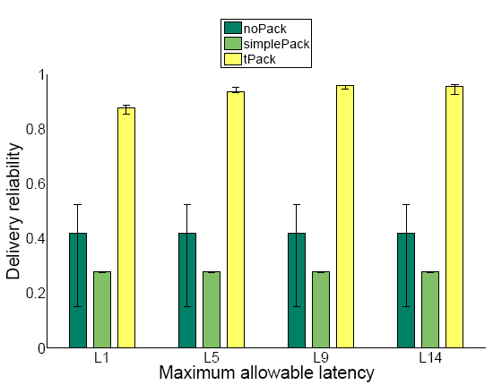
Delivery Reliability

Slide 20
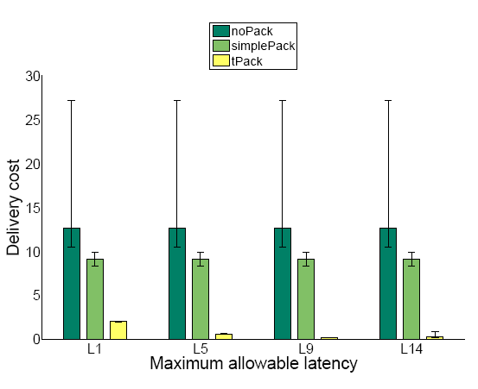
Delivery Cost

Slide 21
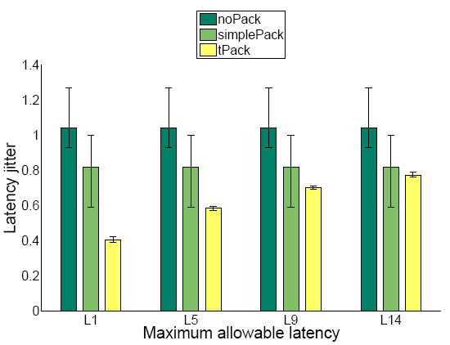
Latency Jitter

Slide 22
Outline
System Model and Problem Formulation
Complexity Analysis
A Utility Based Online Algorithm
Performance Evaluation
Conclusion

Slide 23
Conclusion and Future Work
Conclusion
  Impact of INP constraints on problem complexity
  Feasibility of a simple, distributed online algorithm
  Systems benefits in terms of efficiency and predictable latency
Future Work
  Complete competitive analysis on the utility based algorithm
  Joint optimization of other INP and QoS constraints in WCPS

