Slide 1


The Case for Addressing the Limiting Impact of Interference on Wireless Scheduling
Xin Che, Xi Ju, Hongwei Zhang
{chexin, xiju, hongwei}@wayne.edu
http://www.cs.wayne.edu/~hzhang/group

Slide 2
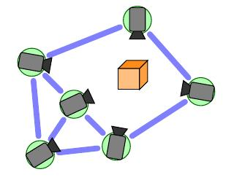
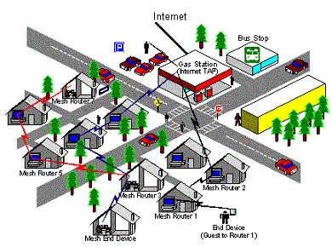

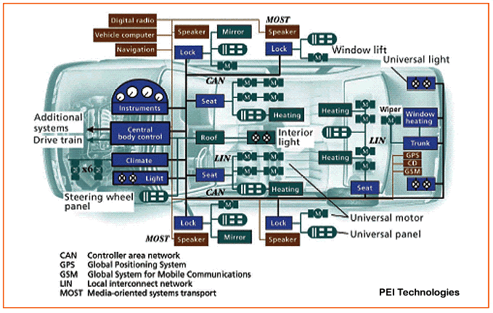
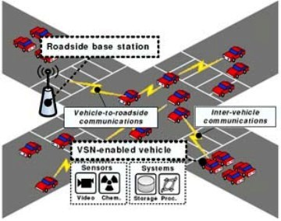




Interference-oriented scheduling as a basic element of multi-hop wireless networking
  Data-intensive wireless networks require high throughput
  E.g., camera sensor networks, community mesh networks
Wireless sensing and control networks require predictable reliability and real-time
  E.g., embedded sensing and control networks in industrial automation, smart transportation, and smart grid

Slide 3
Limiting impact of interference on scheduling
Concurrent transmissions are allowed if the signal-to-interference-plus-noise-ratio (SINR) is above a certain threshold
  Interference limits the number of concurrent transmissions
SINR threshold
}
# of concurrent
transmissions
Signal
Background
Noise
Max. allowable interference

Slide 4
Limiting impact (contd.)
For a time slot, the order in which non-interfering links are added determine the interference accumulation, thus affecting the number of concurrent transmissions allowed
  Similar to Knapsack problem
}
# of concurrent
Transmissions?
Max. allowable interference

Slide 5
Representative current approaches
Longest-queue-first (LQF) and its variants [7]
  For a time slot, add non-interfering links in decreasing order of queue length
GreedyPhysical and its variants [10]
  For a time slot, add non-interfering links in decreasing order of interference number
LengthDiversity [5]
  Group links based on their lengths, and schedule link groups independent of one another
Notes:
Interference number of a link l: the number of other links that do not share any end-node with l but can be interfered by l.

Slide 6
Back to the example network

Slide 7
Open questions
How to explicitly optimize the ordering of link addition in wireless scheduling ?
How does link ordering affect the throughput and delay of data delivery?

Slide 8
Outline
Algorithm iOrder
Evaluation of iOrder
Implementation of iOrder
Concluding remarks

Slide 9
Interference budget
Interference budget of a link
  additional interference that can be added to the receiver of the link without making the receiver-side SINR below a certain threshold γ_{t}
  Interference budget of a slot-schedule (i.e., the set of concurrent transmissions in a time slot)
  minimum interference budget of all the links of the slot-schedule
Notes:
Valid slot-schedule
a slot-schedule is valid if, in the presence of concurrent transmissions, the SINR at the receiver of each link is above a certain threshold γ_{t}

Slide 10
Algorithm iOrder
Main idea
  Maximize the interference budget when adding links to a slot-schedule
Backlogged traffic
  Schedule transmissions based on time slots
  For each slot,
    first pick the link with the longest queue as the starting slot schedule,
    then add non-interfering links to the schedule by maximizing the resulting interference budget when adding each link.
Online traffic
  At each decision instant, perform slot-scheduling as above

Slide 11
iOrder in the example network

Slide 12
Outline
Algorithm iOrder
Evaluation of iOrder
Implementation of iOrder
Concluding remarks

Slide 13
Approximation ratio
Focus on optimality of scheduling for a single time slot
Given a network and traffic, compute
  N_{opt}’: upper bound on the maximum # of concurrent transmissions allowable for a time slot
  N_{iOrder}: # of concurrent transmissions in the slot schedule by iOrder
Approximation ratio ≤

Slide 14
Approximation ratio (contd.)
For Poisson network G with n nodes, a nodes distribution density of λ nodes per unit area, and wireless path loss exponent α, the approximation ratio of iOrder is no more than
where
ε is any arbitrarily small positive number.

Slide 15
Approximation ratio (contd.)
For λ=3, γ_{t}= 5dB, γ_{b}= 3dB, P_{noise} = -95dBm, G0 = 1, ε=0.1,
Significantly lower than the approved approximation ratios in LQF, GreedyPhysical, and LengthDiversity
  E.g., by a factor up to θ(n), 10, and orders of magnitude respectively
iOrder | n=50 | n=100 | n=200
α=2.5 | 6.6 | 6.3 | 11.2
α=3.5 | 11.1 | 11.7 | 11.5
GreedyPhysical | n=50 | n=100 | n=200
α=2.5 | 50 | 79.2 | 118.4
α=3.5 | 32.8 | 45 | 60.8

Slide 16
Simulation
Network size: square area of side length k times average link length
  5 × 5: 70 nodes
  7 × 7: 140 nodes
  9 × 9: 237 nodes
  11 × 11: 346 nodes
Different wireless path loss exponent (2.5:0.5:6)
Average neighborhood size 10
Traffic
  Backlogged: One-hop unicast of m packets, being a Poisson r.v. with mean 30
  Online: Poisson arrival with a mean rate of 0.15 packets/time-slot
Notes:
Different network settings

Slide 17
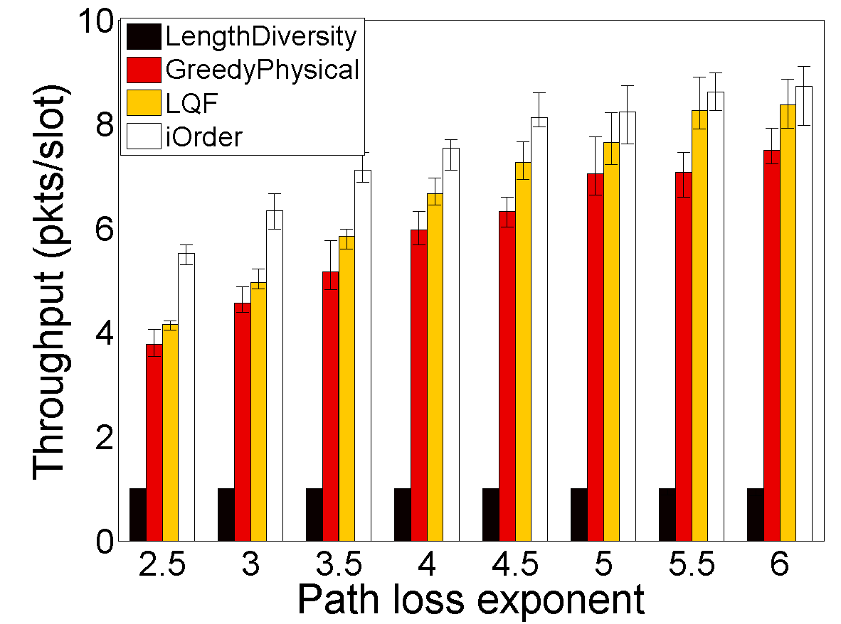
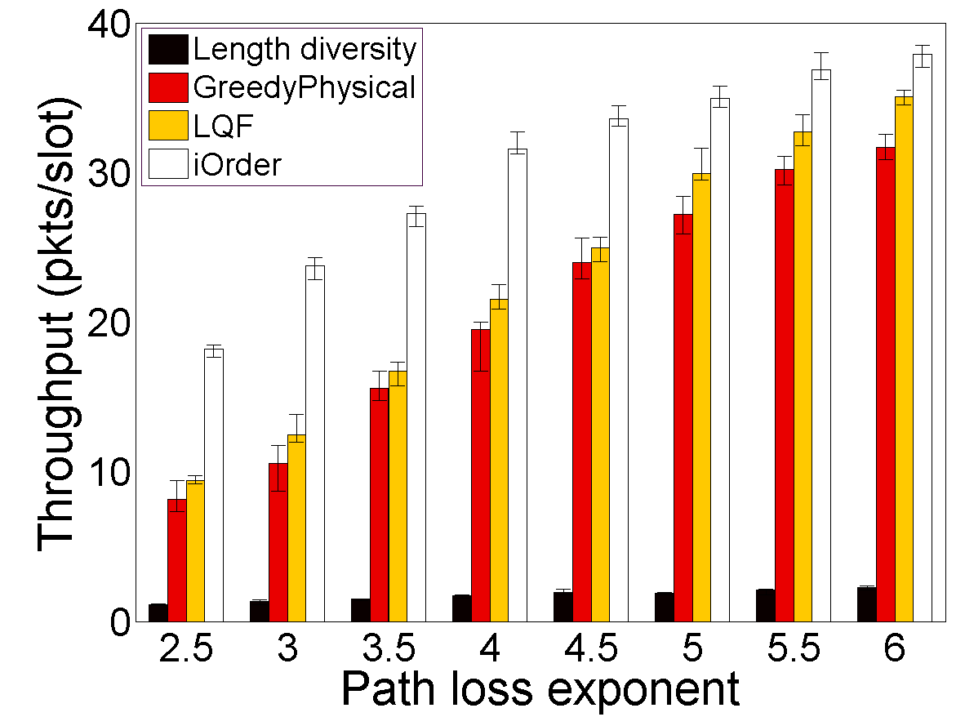
Backlogged traffic: throughput
5 × 5 network
11 × 11 network
For large networks of small path loss, iOrder may double the throughput of LQF
Improves the throughput of LengthDiversity by a factor up to 19.6
Notes:
Throughput increases as network size and path loss increases

Slide 18
Backlogged traffic: time series of slot-SINR
11×11 network, α = 2.5

Slide 19
Online traffic: packet delivery latency
5 × 5 network
11 × 11 network
For large networks of small path loss, iOrder may reduce delay by a factor up to 24

Slide 20
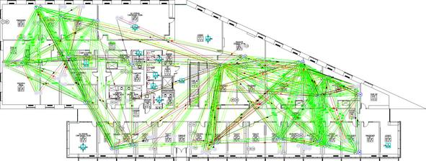
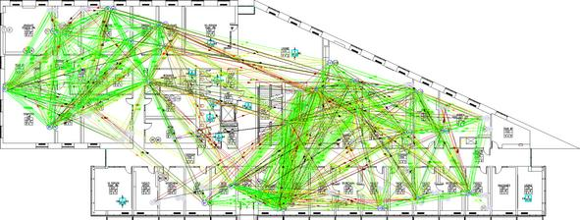
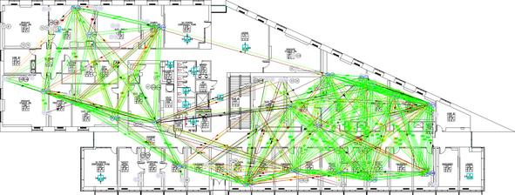
Measurement study in MoteLab
Convergecast, with mote #115 at the second floor serving as the base station
Each nodes generates 30 source packets

Slide 21
Measurement results
Throughput increases by 22.% and 28.9%

Slide 22
Outline
Algorithm iOrder
Evaluation of iOrder
Implementation of iOrder
Concluding remarks

Slide 23
Centralized vs. distributed implementation
Centralized implementation is possible for slowly time-varying networks and predictable traffic patterns
  wireless sensing and control networks
  WirelessHART, ISA SP100.11a
Distributed implementation feasible
  Effect of interference budget: SINR at receivers close to γ_{t}
    Scheduling based on the Physical-Ratio-K (PRK) interference model [16]
  Effect of queue-length-based scheduling
    Distributed, queue-length-based priority scheduling [7,23]
P(S,R)
K(T_{pdr})
S
R
C

Slide 24
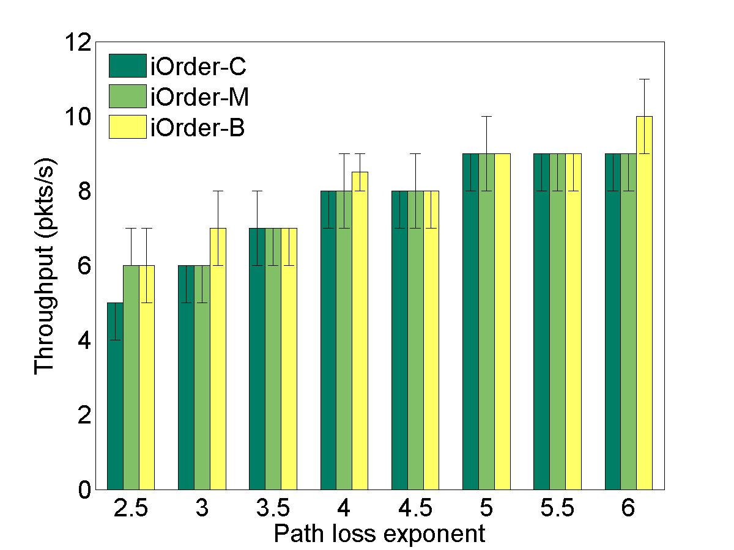
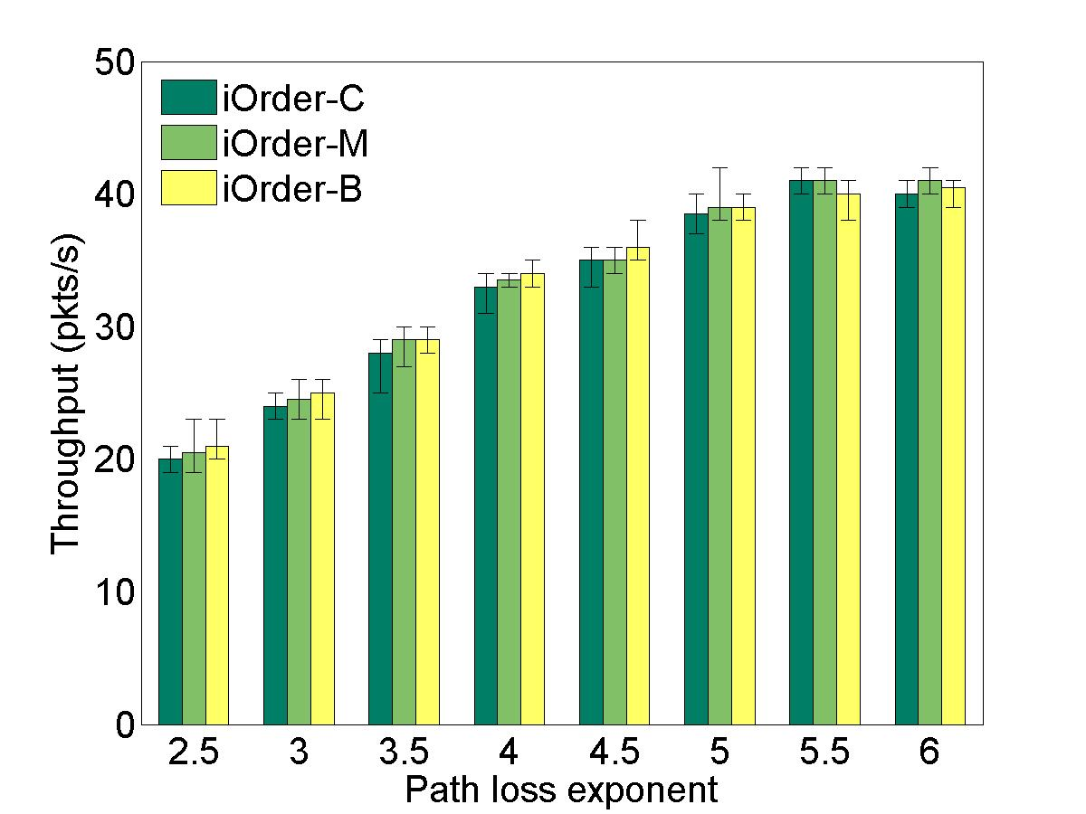
Insensitivity to starting link location
5 × 5 network
11 × 11 network

Slide 25
Outline
Algorithm iOrder
Evaluation of iOrder
Implementation of iOrder
Concluding remarks

Slide 26
Concluding remarks
First step towards characterizing the limiting impact of interference on wireless scheduling
iOrder, based on the concept of interference budget, outperforms well-known existing algorithms such as LQF, GreedyPhysical, and LengthDiversity
  Shows the benefits of explicitly addressing the limiting impact of interference
Future directions
  Distributed implementation of iOrder
  Real-time capacity analysis of iOrder-based scheduling

Slide 27
Backup Slides

Slide 28
Backlogged traffic: iOrder vs. LQF
Up to a factor of 115%
Throughput increase in Order improves with increasing network size and decreasing path loss
  More spatial reuse possible with larger networks and smaller path loss

Slide 29
Backlogged traffic:
Time series of slot-SINR
11×11 network, α = 2.5
11 × 11 network, α = 6

Slide 30
Online traffic: time series of queue length
5 × 5 network, α = 4.5
11 × 11 network, α = 4.5
Significantly more queueing in LQF

Slide 31
Introduction
Open Questions
1. How to explicitly optimize the ordering of link addition in wireless scheduling ?
2. How does link ordering affect the throughput of scheduling algorithm ?

Slide 32
Problem formulation
Channel Model
: transmission power
: the power decay at the reference distance d0
: Gaussian radnom variable with mean 0 and variance
: the path loss exponent

Slide 33
Problem formulation
Radio Model

Slide 34
Problem formulation
A network
: the set of nodes
: the set of directied links
: the SNR threshold at each receiver of the link in E
: A slot schedule for a time slot j
: the number of packets each transmitter has to deliver to
: the background noise power at of link
: the signal strength of link receives from of link

Slide 35
Problem formulation
The indicator variable

Slide 36
Problem formulation
A valid slot-schedule S_{j}
the SINRs at all the receivers of the schedule is no less than γ_{t} and there is no primary interference , in the presence of the concurrent transmissiions of the schedule.
in this paper γ_{t} =5 dB

Slide 37
Problem formulation
Scheduling problem P_{bl}
Given L_{i} queued packets at each transmitter T_{i} (i =1, …, |E| ), find a valid schedule such that
for every i and that for very valid schedule with for every i.
Notes:
The optimal schedule

Slide 38
Problem formulation
Problem P_{s} :
Given a link , find a valid slot-schedule such that and for every other valid slot-schedule with .

Slide 39
Problem formulation
Scheduling for maximal interference budget
: interference budget of a valid slot schedule .
Thus
Therefore

Slide 40
iOrder-slot
1:
2:
3: While E_{c} ≠ Ø do
4:
5:
6:
7: end while
8: Return schedule

Slide 41
iOrder-bl
Algorithm 2 iOrder-bl(E)
Input: a set E of non-empty links where each link ℓ_{i} has L_{i} queued packets
Output: a valid schedule S_{E} for transmitting all the queued packets
1: S_{E} = ∅, E′ = E;
2: While E′ ≠ Ø do
3: ℓ_{j} = arg max_{ℓk∈ E′} L_{k} ;
4: S_{ℓj}= iOrder-slot(ℓ_{j} , E′ \ {ℓ_{j}});
5: S_{E} = S_{E} ⋃ {S_{ℓj}};
6: for all ℓ_{k} ∈ S_{ℓj} do
7: L_{k} = L_{k} − 1;
8: if L_{k} = 0 then
9: E′ = E′ ∖ {ℓ_{k}};
10: end if
11: end for
12: end while
13: Return

Slide 42
Simulation
  α : {2.5, 3, 3.5, 4, 4.5, 5, 5.5, 6}
  γ_{t} = 5 dB, γ_{b} = 1 dB
    γ_{b} does not affect the relative performance significantly
  λ = 1 node/m²
  Fixed transmission P_{tx}
    Guarantee 10 neighbors with SINR = γ_{t} in the absence of interference
  the average link length to guarantee a SINR of γ_{t} + γ_{b} at the receiver.
  P_{noise} = − 95dBm

Slide 43
The ordering effect as a result of the limiting impact of interference
is not explicitly addressed or even considered
in the literature of wireless scheduling.

