Slide 1
Adaptive Instantiation of the Protocol Interference Model in Mission-Critical Wireless Networks
Xin Che, Xiaohui Liu, Xi Ju, Hongwei Zhang
Computer Science Department
Wayne State University

Slide 2
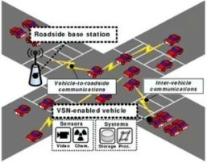


From open-loop sensing to closed-loop, real-time sensing and control
Sensing, networking, and computing tightly coupled with the physical process
Automotive, alternative energy grid, industrial monitoring and control
Industry standards: WirelessHART, ISA SP100.11a
Wireless networks as carriers of mission-critical sensing and control information
Stringent requirements on predictable QoS such as reliability and timeliness
Interference control is important for predictable network behavior
Interference introduces unpredictability and reduces reliability
A basis of interference control is the interference model
Notes:
Interference model, which tell who will interfere with whom in the wireless networks.
Our goal is to understand the impact of the interference model.
Co-channel interference can reduce reliability and increase uncertainty in data communication
The interference model which predict a set of concurrent transmissions may interfere with one another.

Slide 3
Ratio-K model (protocol model)
Interference range = K × communication range
RTS-CTS based approach implicitly assumes ratio-1 model
(+) defined local, pair-wise interference relation
(+) good for distributed protocol design
(-) approximate model; may lead to bad performance
Notes:
In the past decades ….

Slide 4
SINR model (physical model)
A transmission is successful if the signal-to-interference-plus-noise-ratio (SINR) is above a certain threshold
(+) high fidelity: based on communication theory
(-) interference relation is non-local: explicitly depends on all concurrent transmitters
(-) not suitable for distributed protocol design
Inconsistent observations on the performance of SINR-based scheduling (in comparison with ratio-K-based scheduling)

Slide 5
Questions
Why/how can ratio-K-based scheduling outperform SINR-based scheduling in network throughput?
Is it possible to instantiate the ratio-K model so that ratio-K based scheduling consistently achieve a performance close to what is enabled by SINR-based scheduling?
Notes:
given that the ratio-K model is an approximate model, our question is …

Slide 6
Outline
Behavior of ratio-K-based scheduling
Physical-ratio-K (PRK) interference model
Concluding remarks

Slide 7
Behavior of ratio-K-based scheduling: optimal instantiation of K
Analytical models of network throughput and link reliability
Based on optimal spatial reuse in grid and Poisson random networks
Spatial network throughput: T(K, P)
Other factors P: network traffic load, link length, wireless signal attenuation
Link reliability: PDR(K, P)
Example: optimal scheduling based on the ratio-2 model in grid networks
Notes:
Example: scheduling based on the ratio-2 model in grid networks
We notice that all the existing works only look at the case that K = 1 or 2, we decide to perform a very detail study on the performance the ratio-k-based scheduling.
For that purpse, we analyze the optimal ratio-k –based scheduling under different context such as the grid and Poisson random networks. The key metric we look at is the link quality and throughput.
If you are interested in the detail analysis, you can find it in our paper.

Slide 8
Numerical analysis
75,600 system configurations
Wireless path loss exponent: {2.1, 2.6, 3, 3.3, 3.6, 3.8, 4, 4.5, 5}
Traffic load: instant transmission probability of {0.05, 0.1, 0.15, . . . , 1}
Link length: 60 different lengths, corresponding to different interference-free link reliability (1%-100%)
Node distribution density: 5, 10, 15, 20, 30, and 40 neighbors on average
Parameter K of the ratio-K model
Grid networks: {√2, 2, √5, √8, 3, √10, √13, 4, √18, √20, 5, √26, √29, √34, 6}
Random networks: {1, 1.5, 2, 2.5, . . . , 10}
Notes:
Based on the analytic model, we perform a comprehensive numerical analysis.
Assume equal transmission power across nodes
Most of the existing MAC protocols use a fixed value of k for all cases, i.e., K = 2.
At the beginning, we want to find a certain K that can achieve the maximal throughput for the most of time; However, we find this K does not exist. In fact, the value of K in ratio-K model is highly sensitive to all these factors.
On the other side,. We find that this is the reason lead to the bad performance of the ratio-K model

Slide 9
Sensitivity: network/spatial throughput
1. Ratio-K-based scheduling is highly sensitive to the choice of K and traffic pattern
2. A single K value usually leads to a substantial throughput loss !
Notes:
Here is a frist set of data.
What we show here is that, how sensitive the network throughput of ratio-k based scheduling can is if we vary the K in ratio-K model a delta-k distance from the optimal K ( achieve a maximal throughput) . That is , you can have very bad/low network throughput if you don’t use the right k in the ratio-k based scheduling.
1. In the left figures,
2. The right figure shows that when k is small, the throughput loss tends to be small.

Slide 10
Optimal K: complex interaction of diff. factors
Path loss rate = 3.3
Path loss rate = 4.5
Notes:
Moreover, we find that the question of how choose the optimal k is quite complex.
as what we show in the fiugre, the optimal K value may vary as the network enviroment/ set-up changes. In general, it is hard to find a closed formed formular for the optimal K.
That’s for the throughput. We also observe similar pehnomena for link quality. For example, if the K vary a little bit from the minimum k to ensure a certain link quality, the link quality varies significantly.

Slide 11
Sensitivity: link reliability
PDR req. = 80%
Notes:
We also find that it is not practical to use a single fixed K to guarantee a certain link quality
(PDR_k – 0.8)/0.8
K is equal or less than 2 tend to be not good constant number for ensuring reliable data delievery(80%)
A constant K = 2 is unable to guarantee 80% link reliability with non-negligible probability
A constant k = 1.4 is most likely ensure 80% link reliability, even though it is the optimal k for maximizing the throughput with a wide variety of system configurations in our study.
A larger K can increase the link quality, but it usually comes at a cost of throughput due to the less spatial reuse.

Slide 12
Throughput-reliability tradeoff in ratio-K-based scheduling
PDR req. = 40% PDR req. = 100%
Highest throughput is usually achieved at a K less than the minimum K for ensuring a certain minimum link reliability;
This is especially the case when link reliability requirement is high, e.g., for mission-critical sensing and control.
Explained inconsistent observations in literature: only focused on throughput, link reliability is not controlled in their studies.
Notes:
Through the result shown above, the Problem is how can we choose the K of the ratio-k based scheduling in a very simple method.
Fortunately, we find a simple answer for that through the inherent relation of the throughput and reliability. we find that if we change the k from the minimum k to ensure a certain link reliability, the network throughput and reliability change differently : for example, the maximal throughput is usually achieved when you decrease the k from the minimum K that satisfy a certain link reliability, no matter it 40% or 100 %.
On the other hand, if you increase the K from this minimum K, the network throughput tends to decrease with high probability even though the link reliability gains.
At the mean time, the figure explain the inconsistent observations in the literature. That is, they only focus on the throughput (of ratio-k based scheduling with SINR-based scheduling while link reliability is not controlled.
So these figures suggest that we should use a minimum K that ensure a certain link reliability, since this helps avoid throughput loss while ensure a certain link quality. In fact, a good link quality is desirable for mission-critical wireless sensing and control system. ( That is, a good link quality means more predictable QoS and less energy consumption and lower delay.)
Given a network configuration, we find the minimum K that can ensure a link reliability requirement.
We compute the performance gain in link reliability in terms of PDR and throughput.
Explain the figure : 1). Point 1. 2). As K increase from this minimum K, the network tends to decrease with high probability even though the link reliability increases.

Slide 13
Link quality-Delay Relation (CSMA)
PDR req. = 40% PDR req. = 99%
Notes:
Another advantage of choosing the minimum K , is that it can also guarantee the minimum delay with a high probability.

Slide 14
Outline
Behavior of ratio-K-based scheduling
Physical-ratio-K (PRK) interference model
Concluding remarks

Slide 15
Physical-Ratio-K (PRK) interference model
Idea: use link reliability requirement as the basis of instantiating the ratio-K model
Model: given a transmission from node S to node R, a concurrent transmitter C does not interfere with the reception at R iff.
Suitable for distributed protocol design
Both signal strength and link reliability are locally measurable
K can be searched via local, control-theoretic approach
Signal strength based definition can deal with wireless channel irregularity
P(S,R)
K(T_{pdr})
S
R
C
Notes:
Based on the result above, we propose the Physical-Raio-K model.
Given a transmission from the sender to the receiver, the PRK model define a (signal-strength-based exclusive) region; the boundary of this exclusive region is such that an interferer will only one of k-th of received signal strength between the sender and the receiver. For any nodes outside this region, PRK model ignores its interference. For example, the interference from Node C’s transmission will be ingored in PRK model.
In the presence of dynamic interference, The value of K can change promptly so that the link quality is always above the threshold T_pdr.
Therefore, PRK model can facilitate the distributed protocol design while ensure the relibility.
As may notice that there is no closed-form formular for K. But if you look at the model carefully, all parameters, received signal strength and the reliability, are locally measurable. The K can be searched via local, control-theoretic approach.
We define the PRK model based on signal strength instead of geographic distance based on two reason: 1). The signal strength is locally measurable; 2). It can deal with wireless channel irregularity, (such as different transmission power or non-uniform signal attenuation, as we shown here).
As link quality is online, locally meaured metric. It can be obtained through real-time, data-driven, passive measurement.
It is desirable to use the minimum k that ensure a certain link quality, since it tends to avoid throughput loss cased by using any unnecessarily large K.
where P(ni, nr) and P(ns, nr) is the strength of signals reaching nr from ni and ns respectively, and
Benefits of PRK model:
1. K(ns, nr, Tpdr) is chosen such that the probability of nr successfully receiving packets from ns is at least Tpdr in the presence of interference from all concurrent transmitters

Slide 16
Optimality of PRK-based scheduling
Throughput loss is small, and it tends to decrease as the PDR requirement increases.
Notes:
To understand the potential performance of PRK-based scheduling, we compare it with sinr-based scheduling using a same centralized algorithm. What we have find that is that , the PRK based scheduling can achieved a throughput very close to the snr-based scheduling while ensuring the link reliability at the same time, especially when the link reliability is high. For example, when PDR requirement is more than 50%, the median throughput loss is less than 5%.
Throughput loss : ( T_sinr – T_prk ) / T_sinr

Slide 17
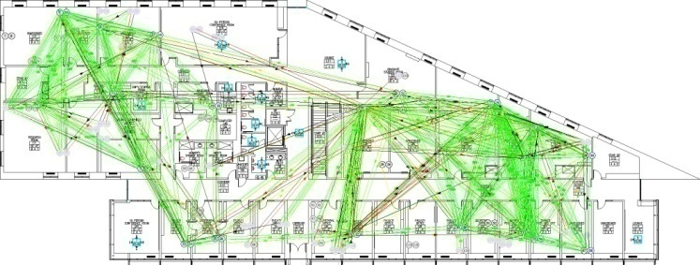

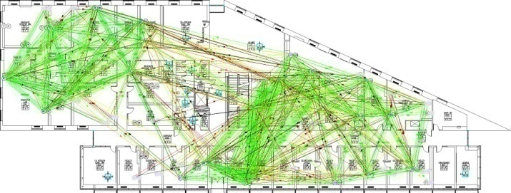
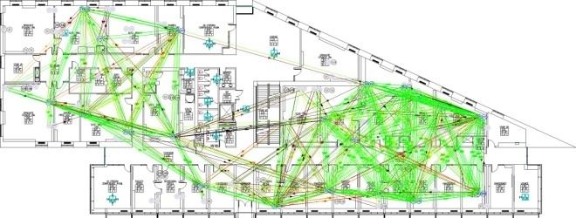
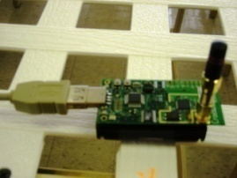

Measurement verification
NetEye @ Wayne State MoteLab @ Harvard
Notes:
To verfiy the analytic and simulation result, we perform experiments studies on two test beds: NetEye at Wayne State Unviversity, and Motelab atHarvard. (We choose these two testbeds so that we can verify our analytical and simulation result).

Slide 18
Measurement results (NetEye)
Higher throughput for PRK-based scheduling
Notes:
So here are the results. We look at two types of scheduling: for the objective of ensuring receiver side SINR to be 8dB or 5dB, or for the purpose of throughput maximization, we measure the link reliability and throughput. We observe similar phenomena between PRK-based and SINR-based scheduling, which verifies our analytical and simulation result. As you may already predict, the throughput-maximize algorithm gives you higher throughput, but lower link reliability.
For grid networks;
The PDR in PRK-based scheduling is slightly lower than that in SINRbased
scheduling, but the throughput tends to be higher in
PRK-based scheduling. The reason why PRK-based scheduling
tends to have slightly lower PDR and higher throughput is
because PRK schedules are slightly shorter (e.g., by 3-4 slots
less) than SINR schedules, and this is enabled by the fact that
silencing/removing links closer-by in the PRK model allows
more concurrently transmitting remote links (as discussed in
Proposition 4).

Slide 19
Measurement results (MoteLab)
Higher throughput for PRK-based scheduling
Notes:
Simular trend in the result of motelab.

Slide 20
Outline
Behavior of ratio-K-based scheduling
Physical-ratio-K (PRK) interference model
Concluding remarks

Slide 21
Concluding remarks
PRK model
Enables local protocols (e.g., localized, online search of K)
Locality implies responsive adaptation (to dynamics in traffic pattern etc)
Enables measurement-based (instead of model-based) online adaptation
No need for precise PDR-SINR models
Open questions
Distributed protocol for optimal selection of K
Control-theoretical approach: regulation control, model predictive control
Signaling mechanisms for K>1
Multi-timescale coordination
Real-time scheduling: rate assurance, EDF, etc
Notes:
To summarize,
To ensure predicable QoS in mission-critical wireless sensing and controlling system, we build a solid foundation, the PRK model, for the effective interference management. The higher link reliability requirement (of the mission-critical system )enable us to design the PRK model, which inherits the locality of the Protocol model and the high fidelity of the physical model.
Therefore, we believe that the PRK model enables us to design new distributed protocols, which has predictable performance in the presence of the dynamics.
Here are some on-going works we are studying :
1. how to identify the optimal K in the distributed protocol ? For example using some control theory.
2. How to coordinate among the nodes when the K is larger than 1, that ?
3. We also try to support some real-time scheduling, which is not supported by the current (inaccurate ratio-k model today)

