Slide 1


Scheduling with Predictable Link Reliability for Wireless Networked Control
Hongwei Zhang, Xiaohui Liu, Chuan Li, Yu Chen, Xin Che,
Feng Lin, Le Yi Wang, George Yin
Contact: hongwei@wayne.edu, http://www.cs.wayne.edu/~hzhang
Notes:
* Why … radical changes needed for wireless networking, co-design with control, innovation platforms?
Safety-critical
Cyber-physical uncertainties
Basic science challenges as well as (open-)innovation challenge

Slide 2
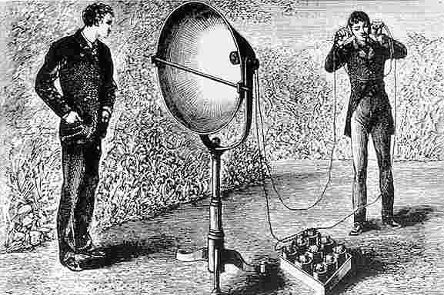
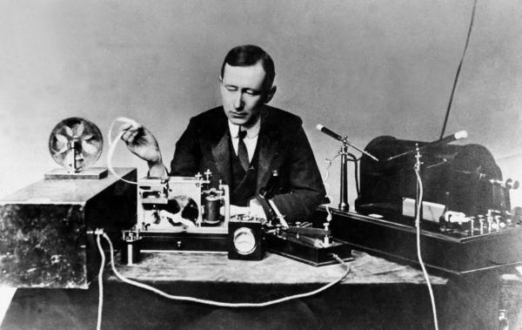
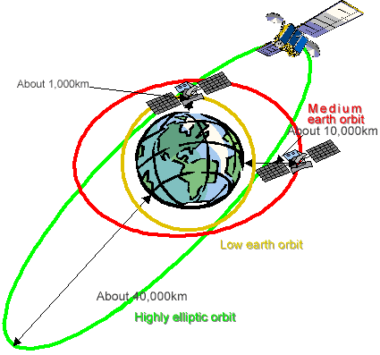
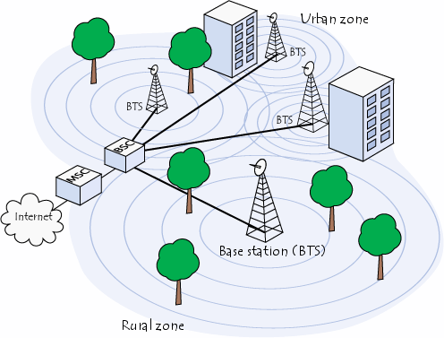



People-centric wireless communication (1880 -)
Photophone
by Bell & Tainter, 1880
Wireless telegraphy across Atlantic
by Marconi, 1901
Notes:
Electronic communications devices like cell phones and computers on the internet utilize satellite communications (SATCOM). Today's satellite communications can trace origins all the way back to the moon. A project named Communication Moon Relay, was a telecommunication project carried out by the United States Navy. Its objective was to develop a secure and reliable method of wireless communication by using the Moon as a natural communications satellite.
The first artificial satellite used solely to further advances in global communications was a balloon named Echo 1.ECHO 1 space.com Echo 1 was world's first artificial communications satellite capable of relaying signals to other points on Earth. It soared 1,000 miles (1,609 km) above the planet after its Aug. 12, 1960 launch, yet relied on humanity's oldest flight technology — ballooning. Launched by NASA, Echo 1 was a giant metallic balloon 100 feet (30 meters) across. The world's first inflatable satellite — or "satelloon," as they were informally known — helped lay the foundation of today's satellite communications. The idea behind a communications satellite is simple: Send data up into space and beam it back down to another spot on the globe. Echo 1 accomplished this by essentially serving as an enormous mirror 10 stories tall that could be used to bounce communications signals off of. The first American satellite to relay communications was Project SCORE in 1958, which used a tape recorder to store and forward voice messages. It was used to send a Christmas greeting to the world from U.S. President Dwight D. Eisenhower. NASA launched the Echo satellite in 1960; the 100-foot (30 m) aluminized PET film balloon served as a passive reflector for radio communications. Courier 1B, built by Philco, also launched in 1960, was the world's first active repeater satellite.
It is commonly believed that the first "Satellite" was Sputnik 1. Put into orbit by the Soviet Union, Sputnik 1, launched on October 4, 1957 and was equipped with an onboard radio-transmitter that worked on two frequencies: 20.005 and 40.002 MHz. Sputnik 1 Sputnik 1 had been launched as step in the exploration of space and rocket development. While incredibly important it was not placed in orbit for the purpose of sending data from one point on earth to another. Hence, it was not the first "communications" satellite but it is the first artificial satellite in the steps leading to today's satellite communications.
Telstar was the first active, direct relay communications satellite. Belonging to AT&T as part of a multi-national agreement between AT&T, Bell Telephone Laboratories, NASA, the British General Post Office, and the French National PTT (Post Office) to develop satellite communications, it was launched by NASA from Cape Canaveral on July 10, 1962, the first privately sponsored space launch. Relay 1 was launched on December 13, 1962, and became the first satellite to broadcast across the Pacific on November 22, 1963^{[1]}
An immediate antecedent of the geostationary satellites was Hughes' Syncom 2, launched on July 26, 1963. Syncom 2 revolved around the earth once per day at constant speed, but because it still had north-south motion, special equipment was needed to track it.

Slide 3

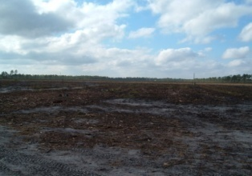
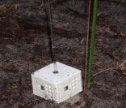




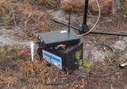


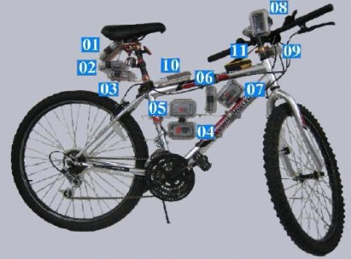
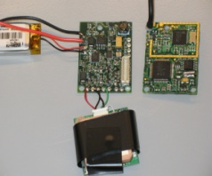
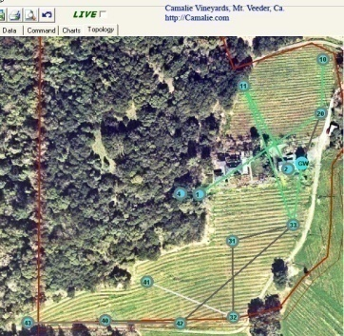

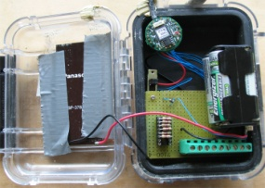





Wireless-networked sensing of physical world (2002 - )

Slide 4


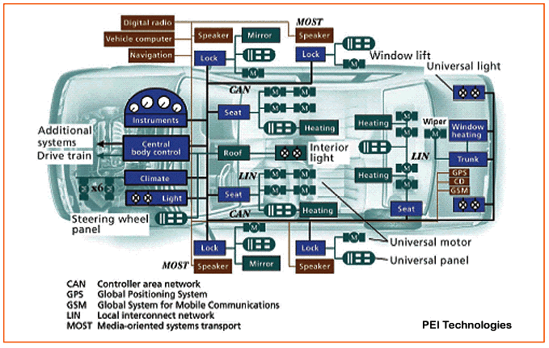

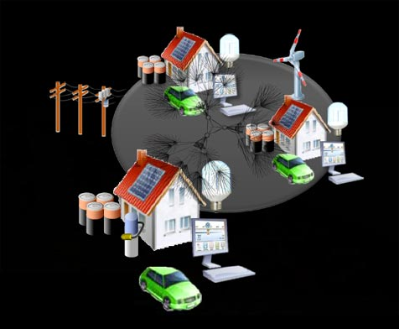


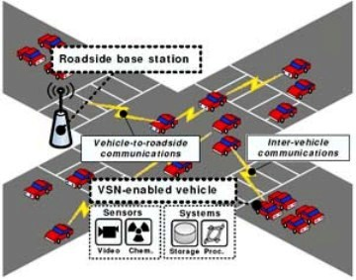
Wireless-networked real-time control
Industrial monitoring and control
WirelessHART, ISA 100.11a, IEEE 802.15.4e, IETF 6TiSch
Industrial Internet, Industry 4.0, Industry 2025
Smart power grid
IEEE 802.15.4g, NIST initiatives
Connected and automated vehicles
IEEE 802.11p/DSRC, IEEE 1609, SAE J2735
Notes:
IEEE 802.15.4g Smart Utility Networks (SUN) Task Group is chartered to create a PHY amendment to 802.15.4 to provide a global standard that facilitates very large scale process control applications such as the utility smart-grid network capable of supporting large, geographically diverse networks with minimal infrastructure, with potentially millions of fixed endpoints. Recently news came up they released the 802.15.4g radio standard
Wireless networks as carriers of mission-critical sensing and control information
Stringent requirements on predictable QoS such as reliability and timeliness

Slide 5

Wireless networking for real-time control
Wireless networks as carriers of mission-critical, real-time sensing and control information
Need predictable reliability, timeliness, and throughput in message delivery
Communication among vehicles and infrastructures
Communication among distributed energy sources, controllable loads, energy storage, etc
Notes:
Unreliability leads to estimation error
Delay affects system stability and settling-time
Throughput as a constraint on sampling rate
Unreliability leads to estimation error and increased delay
Sensing, networking, and control tightly coupled with physical processes

Slide 6
Complex cyber-physical dynamics/uncertainties
Physical-domain dynamics/uncertainties
Multipath signal propagation and power attenuation
Spatiotemporally dynamic, anisotropic, and asymmetric wireless communication
Collision of wireless signals
Uncertain communication reliability, timeliness, and throughput
Vehicle mobility
Dynamic vehicle spatial distribution and thus wireless channel properties
Cyber-domain dynamics/uncertainties
Real-time capacity of wireless networks
Optimal control strategy
Network traffic pattern and QoS requirements
Notes:
Cyber-domain dynamics/uncertainties
Dynamics in networking and control interact with one another during their adaptation to physical dynamics
Dynamic/uncertain real-time capacity of wireless networks due to physical-domain dynamics/uncertainties
Dynamic control strategy in adaptation to in-situ network real-time capacity and physical constraints
Dynamic network traffic pattern and QoS requirements due to dynamic control strategy
Systems dynamics
Dynamic, uncertain wireless communication
Dynamic, uncertain network traffic
Dynamic application properties (e.g., QoS requirements) across applications and over time
Mobile nodes
Environmental dynamics
Dynamic environments: human/object movement, temperature, etc.
Dynamic, interfering co-existing networks
Malicious attacks (e.g., jamming)
co-channel interference

Slide 7
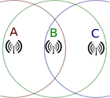
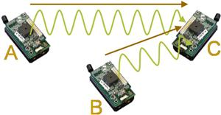
Co-channel interference: a major source of uncertainty
Open problem for over 40 years
ALOHA protocol considered interference from concurrent transmitters (1970)
Hidden terminal issue first identified by Dr. Leonard Kleinrock (1975)
Lack of field-deployable approaches to predictable interference control
Notes:
N. Abramson (1970). "The ALOHA System - Another Alternative for Computer Communications" (PDF). Proc. 1970 Fall Joint Computer Conference. AFIPS Press
ALOHAnet, also known as the ALOHA System,^{[1][2]} or simply ALOHA, was a pioneering computer networking system developed at the University of Hawaii. ALOHAnet became operational in June, 1971, providing the first public demonstration of a wireless packet data network.^{[3][4]}
The ALOHAnet used a new method of medium access (ALOHA random access) and experimental ultra high frequency (UHF) for its operation, since frequency assignments for communications to and from a computer were not available for commercial applications in the 1970s. But even before such frequencies were assigned there were two other media available for the application of an ALOHA channel – cables and satellites. In the 1970s ALOHA random access was employed in the widely used Ethernet cable based network^{[5]} and then in the Marisat (now Inmarsat) satellite network.^{[6]}
In the early 1980s frequencies for mobile networks became available, and in 1985 frequencies suitable for what became known as Wi-Fi were allocated in the US. These regulatory developments made it possible to use the ALOHA random access techniques in both Wi-Fi and in mobile telephone networks.
ALOHA channels were used in a limited way in the 1980s in 1G mobile phones for signaling and control purposes.^{[7]} In the late 1980s, the European standardisation group GSM who worked on the Pan-European Digital mobile communication system GSM greatly expanded the use of ALOHA channels for access to radio channels in mobile telephony. In addition SMS message texting was implemented in 2G mobile phones. In the early 2000s additional ALOHA channels were added to 2.5G and 3G mobile phones with the widespread introduction of GPRS, using a slotted ALOHA random access channel combined with a version of the Reservation ALOHA scheme first analyzed by a group at BBN

Slide 8
Hidden-terminal problem (Kleinrock’75)
A
B
C
D
Notes:
Collision avoidance is a challenging problem in wireless networks
Unlike in wired networks, sender-side collision detection is difficult
why is collision detection difficult in wireless networks? two reasons 1. In wireless each station has one antenna for both sending and receiving. hence we cant use the same antenna for both transmitting and at the same time detecting collisions. Further even if we have two antennas, it will be difficult to detect collision. because the transmitting signal power will be much higher than the incoming signal. hence if the sender senses signals it will fairly get a net result (an addition) of its transmitted signal and any other signal transmitted by others. it may be that its own signal is so much powerful than others that it will not recognize any collision. 2. In wireless, only the receiver is in problem. not the transmitter. so detecting for collisions at the senders end does not really make sense. we need to detect collision at the receivers end. the sender is not able to tell it whether there is a collision in receivers end.

Slide 9
RTS-CTS based interference control
RTS: request to send CTS: clear to send
Used in IEEE 802.11 MAC, which is the basis of DSRC
Data
RTS
CTS
CTS
Data
RTS
CTS
A
B
C
D
After receiving CTS from B, C waits until A’s transmission finishes
Notes:
why is collision detection difficult in wireless networks? two reasons 1. In wireless each station has one antenna for both sending and receiving. hence we cant use the same antenna for both transmitting and at the same time detecting collisions. Further even if we have two antennas, it will be difficult to detect collision. because the transmitting signal power will be much higher than the incoming signal. hence if the sender senses signals it will fairly get a net result (an addition) of its transmitted signal and any other signal transmitted by others. it may be that its own signal is so much powerful than others that it will not recognize any collision. 2. In wireless, only the receiver is in problem. not the transmitter. so detecting for collisions at the senders end does not really make sense. we need to detect collision at the receivers end. the sender is not able to tell it whether there is a collision in receivers end.

Slide 10
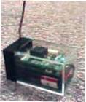
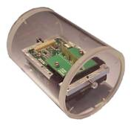
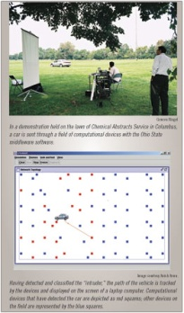
Does it work: multi-hop traffic?
A Line in the Sand:
RTS-CTS based S-MAC
Retransmission does not help much, and may even decrease reliability and throughput;
Similar observations when adjusting contention window.
One major reason: RTS-CTS based approach assumes equal comm. & interference ranges
Max. # of Tx | 1 | 2 | 3
Reliability (%) | 51.05 | 54.74 | 54.63
Latency (sec) | 0.21 | 0.25 | 0.26
throughput (pkt/sec) | 4.01 | 4.05 | 3.63

Slide 11
Negative impact of interference
PDR requirement = 90%
Cannot ensure packet delivery rate (PDR) as required by applications
Link reliability (i.e., PDR) can be very low
Notes:
117 and 250 nodes in small and large networks respectively

Slide 12
Wireless interference model: a basis for interference control
Predicts whether a set of concurrent transmissions may interfere with one another
Two commonly-used interference models
Protocol model
Physical model
Notes:
One basic reason for the low performance of existing protocols is due the lack of a wireless interference model that can serve as a basis for designing distributed protocols for predictable interference model.

Slide 13
Protocol interference model
Exclusion
region
S
R
C
Interference range = K × communication range
RTS-CTS based approach implicitly assumed ratio-1 model
Strengths
Local, pair-wise interference relation
Good for distributed protocol design
Weakness
Approximate model
May well lead to low performance

Slide 14
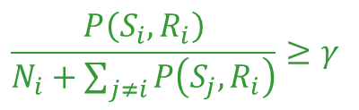


Physical interference model
A transmission is successful if the signal-to-interference-plus-noise ratio (SINR) is above a certain threshold γ
Strength
High fidelity: based on communication theory
Weaknesses
Interference relation is non-local and combinatorial: explicitly depends on all concurrent transmitters
Not suitable for distributed protocol design
$$S_{i}$$
?
$$R_{i}$$
$$\frac{P\left(S_{i}, R_{i}\right)}{N_{i}+\sum_{j≠i}{P\left(S_{j},R_{i}\right)}}≥γ$$
Notes:
Inconsistent observations on the performance of ratio-K- and SINR-based scheduling in literature

Slide 15
A basic question
Interference model for predictable interference control:
locality of protocol model + high-fidelity of physical model?
H. Zhang, X. Che, X. Liu, X. Ju, “Adaptive Instantiation of the Protocol Interference Model in Wireless Networked Sensing and Control”, ACM Transactions on Sensor Networks, 10(2), 2014
Notes:
X. Che, X. Ju, H. Zhang, The Case for Addressing the Limiting Impact of Interference on Wireless Scheduling, 19th IEEE International Conference on Network Protocols (ICNP), 2011
Why can ratio-K-based scheduling outperform optimal SINR-based scheduling in network throughput?
Is it possible to instantiate the ratio-K model so that ratio-K-based scheduling consistently achieve a performance close to what is enabled by SINR-based scheduling?
given that the ratio-K model is an approximate model
the parameter K of

Slide 16
Properties of protocol-model-based scheduling
Stochastic-geometry-based analysis of protocol-model-based scheduling
Observations
Protocol-model-based scheduling is highly sensitive to the choice of interference range parameter K
Inherent tradeoff between per-link reliability and network throughput
Highest throughput is usually achieved at a K less than the minimum K for ensuring a certain minimum link reliability, especially for mission-critical sensing and control where reliability requirement is high
Ensuring reliability tends to reduce delay
Idea
Instantiating the protocol interference model based on link reliability requirement (e.g., posed by control algorithms)
Notes:
K can be searched via local, control-theoretic approach
Based on the result above, we propose the Physical-Raio-K model.
Given a transmission from the sender to the receiver, the PRK model define a (signal-strength-based exclusive) region; the boundary of this exclusive region is such that an interferer will only one of k-th of received signal strength between the sender and the receiver. For any nodes outside this region, PRK model ignores its interference. For example, the interference from Node C’s transmission will be ingored in PRK model.
In the presence of dynamic interference, The value of K can change promptly so that the link quality is always above the threshold T_pdr.
Therefore, PRK model can facilitate the distributed protocol design while ensure the relibility.
As may notice that there is no closed-form formular for K. But if you look at the model carefully, all parameters, received signal strength and the reliability, are locally measurable. The K can be searched via local, control-theoretic approach.
We define the PRK model based on signal strength instead of geographic distance based on two reason: 1). The signal strength is locally measurable; 2). It can deal with wireless channel irregularity, (such as different transmission power or non-uniform signal attenuation, as we shown here).
As link quality is online, locally meaured metric. It can be obtained through real-time, data-driven, passive measurement.
It is desirable to use the minimum k that ensure a certain link quality, since it tends to avoid throughput loss cased by using any unnecessarily large K.
where P(ni, nr) and P(ns, nr) is the strength of signals reaching nr from ni and ns respectively, and
Benefits of PRK model:
1. K(ns, nr, Tpdr) is chosen such that the probability of nr successfully receiving packets from ns is at least Tpdr in the presence of interference from all concurrent transmitters

Slide 17
Physical-Ratio-K (PRK) interference model
signal strength from S to R
Given a transmission from S to R, a concurrent transmitter C is regarded as interfering with the reception at R iff.
S
function of required PDR T_{S,R}
R
C
Interference power from C to R
Suitable for designing distributed protocols:
Both signal strength and link reliability are locally measurable
K is locally controllable
Signal-strength-based definition can deal with wireless channel irregularity
Notes:
K can be searched via local, control-theoretic approach
Based on the result above, we propose the Physical-Raio-K model.
Given a transmission from the sender to the receiver, the PRK model define a (signal-strength-based exclusive) region; the boundary of this exclusive region is such that an interferer will only one of k-th of received signal strength between the sender and the receiver. For any nodes outside this region, PRK model ignores its interference. For example, the interference from Node C’s transmission will be ingored in PRK model.
In the presence of dynamic interference, The value of K can change promptly so that the link quality is always above the threshold T_pdr.
Therefore, PRK model can facilitate the distributed protocol design while ensure the relibility.
As may notice that there is no closed-form formular for K. But if you look at the model carefully, all parameters, received signal strength and the reliability, are locally measurable. The K can be searched via local, control-theoretic approach.
We define the PRK model based on signal strength instead of geographic distance based on two reason: 1). The signal strength is locally measurable; 2). It can deal with wireless channel irregularity, (such as different transmission power or non-uniform signal attenuation, as we shown here).
As link quality is online, locally meaured metric. It can be obtained through real-time, data-driven, passive measurement.
It is desirable to use the minimum k that ensure a certain link quality, since it tends to avoid throughput loss cased by using any unnecessarily large K.
where P(ni, nr) and P(ns, nr) is the strength of signals reaching nr from ni and ns respectively, and
Benefits of PRK model:
1. K(ns, nr, Tpdr) is chosen such that the probability of nr successfully receiving packets from ns is at least Tpdr in the presence of interference from all concurrent transmitters

Slide 18
Optimality of PRK-based scheduling
Throughput loss is small, and it tends to decrease as the PDR requirement increases.

Slide 19
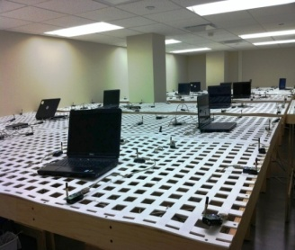
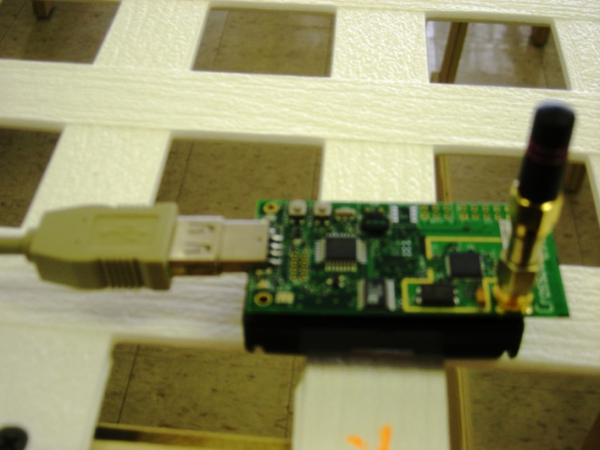
Measurement verification: NetEye

Slide 20
Irregularity of NetEye

Slide 21
Measurement results
Notes:
For grid networks;
The PDR in PRK-based scheduling is slightly lower than that in SINRbased
scheduling, but the throughput tends to be higher in
PRK-based scheduling. The reason why PRK-based scheduling
tends to have slightly lower PDR and higher throughput is
because PRK schedules are slightly shorter (e.g., by 3-4 slots
less) than SINR schedules, and this is enabled by the fact that
silencing/removing links closer-by in the PRK model allows
more concurrently transmitting remote links (as discussed in
Proposition 4).

Slide 22
A major challenge in PRK-based scheduling
S
R
C
Difficult to identify close-form relation between and network and environmental conditions
Dynamics and uncertainties in application requirements as well as network and environmental conditions
How to instantiate the PRK model parameter on the fly?
Notes:
PRK-based scheduling: Opportunities: PRK model
Enables local protocols (e.g., localized, online search of K)
Locality implies responsive adaptation (to dynamics in traffic pattern etc)
Enables measurement-based (instead of model-based) online adaptation
No need for precise PDR-SINR models

Slide 23
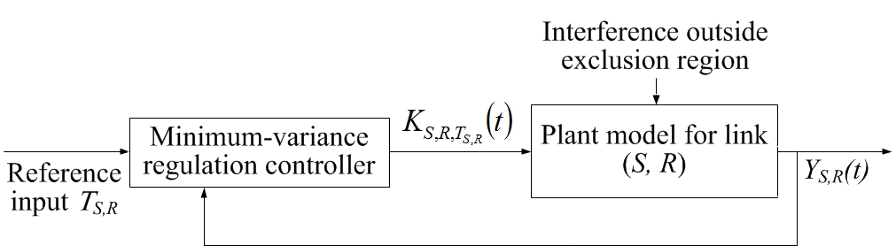
PRK model instantiation as a minimum-variance regulation control problem
Problem formulation
Objective: minimize while ensuring
Challenge
Difficult to identify closed-form relation between control and system output
disturbance
PRK model parameter
actual PDR
required PDR
Notes:
Reference input: desired link reliability
System output: actual link reliability
Control: PRK model parameter
Interference from outside exclusion region treated as disturbance

Slide 24
Refined problem formulation
“Desired change in receiver-side interference ” as control
Leverage communication theory result on the relation between and receiver-side SINR (i.e., )
Linearize the non-linear function f(.)

Slide 25
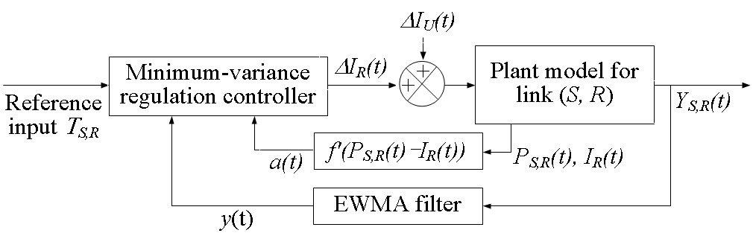
Refined formulation (contd.)
Plant model
System diagram
variation of interference power from outside exclusion region

Slide 26
Minimum-variance regulation controller
The control input that minimizes while ensuring
and the minimum value of is
the changes
of interference from outside the exclusion region

Slide 27
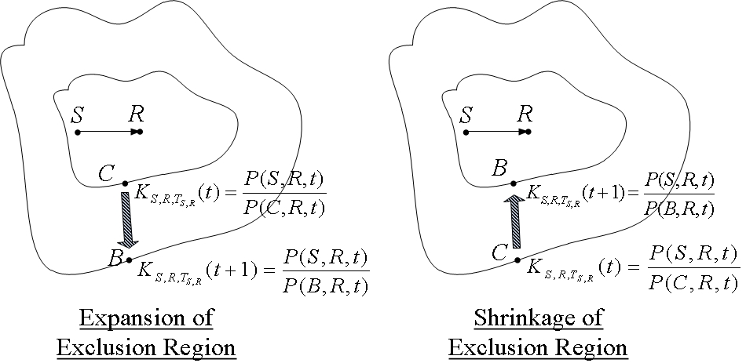
Expected interference from the nodes in the middle-band of the two exclusion regions is .

Slide 28
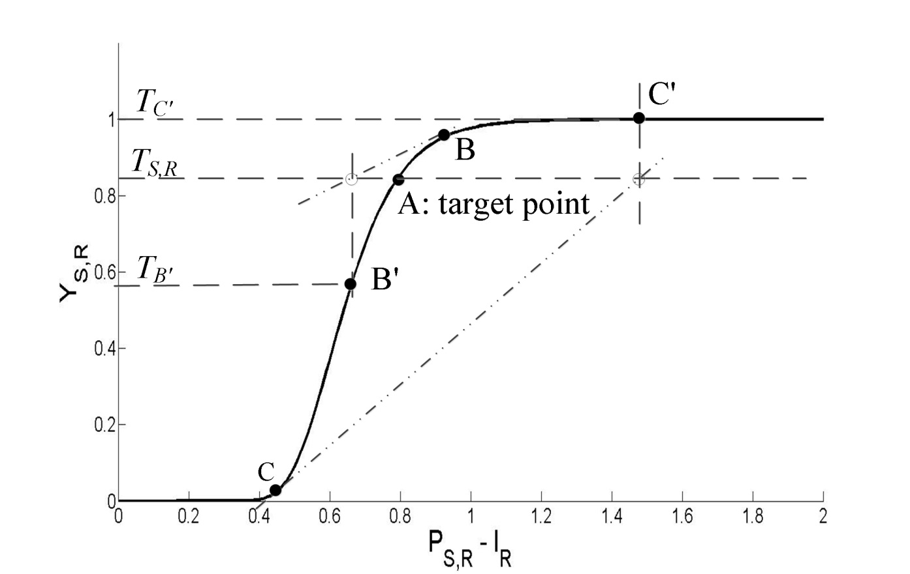
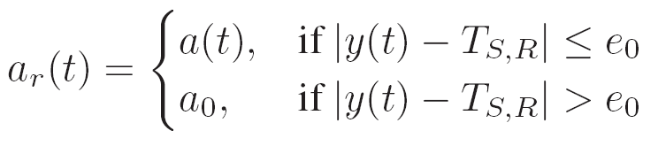
Stability of self-tuning adaptive control
Refined coefficient for the linear plant model is

Slide 29
PRKS: PRK-based scheduling
Mutual interference relation between links via instantiated PRK model
TDMA via the optimal-node-activation-multiple-access (ONAMA) algorithm
Xiaohui Liu, Yu Chen, Hongwei Zhang, “A maximal concurrency and low latency distributed scheduling protocol for wireless sensor networks”, International Journal on Distributed Sensor Networks, arxiv:1403.4637v2, 2014
Implemented in TinyOS

Slide 30
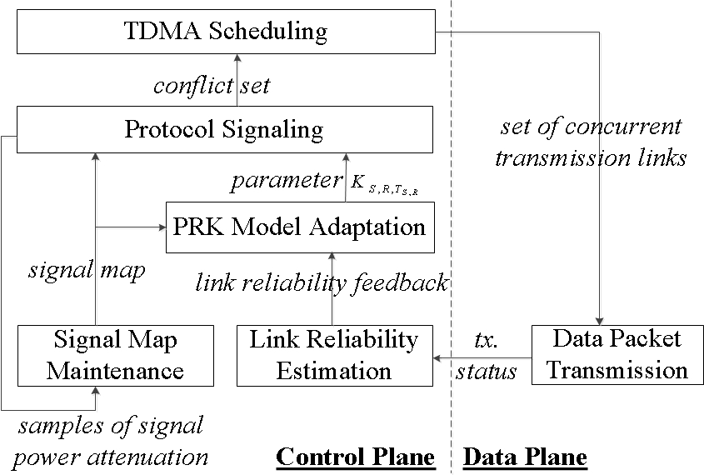
PRKS: architecture of PRK-based scheduling
Enables two-timescale separation of
protocol signaling and per-packet transmission
Notes:
TDMA scheduling: enables two-timescale separation of protocol signaling and per-packet transmission

Slide 31

Measurement evaluation
Multi-hop networks in NetEye and Indriya wireless network testbeds
Single-hop, saturated traffic
Multi-hop traffic, non-saturated traffic
Notes:
Random network by picking each mote with probability 0.8
Each mote has a receiver with SNR closest to 15dB

Slide 32
Predictable link reliability in distributed, PRK-based scheduling (PRKS)
Predictable link PDR through localized PRKS model adaptation
Concurrency and spatial reuse statistically equal or close to that in state-of-the-art centralized scheduling

Slide 33
??Convergence of distributed controllers
PDR time series of a typical link:
PDR req. = 90%
Median: 26 control steps??
90-percentile: 43 control steps
Settling time
Network-wide convergence
Notes:
From mean PDR guarantee to instantaneous PDR guarantee:
Extra SINR margin as a protection
Integrate with other techniques …

Slide 34
Heterogeneous settings
Heterogeneous PDR requirements in a network
Heterogeneous link transmission power
in a network
Predictable link PDR in the presence heterogeneous application requirements and network configurations

Slide 35
Temporally-varying PDR requirements: 70%→80%→90%→95%→90%→80%→70%
Settling time
PDR of a typical link
Notes:
Converges fast (or faster than bootup), with a median settling time around 18 control steps.

Slide 36
Comparison with existing protocols: PDR
PDR requirement = 90%
Notes:
Larger networks: even lower PDR in other protocols (except SCREAM), but predictably high pdr in PRKS

Slide 37
Current practice (1): Improve reliability by retransmission
Significantly longer delay in existing protocols due to retransmission

Slide 38
Spatial network throughput
Significantly lower throughput in existing protocols except SCREAM
PRKS with SCREM’s link PDRs as requirements: lower delay and higher throughput in PRKS
Confirms PDR-delay-throughput tradeoff

Slide 39
Current practice (2): Improve reliability by reducing traffic load
Significantly lower throughput in existing protocols due to low utilization of channel capacity

Slide 40
Summary
PRKS as a field-deployable approach to the 40+ years old problem of predictable co-channel interference control
Control-theoretic approach to PRK model instantiation
Signal maps as basis of protocol signaling
Two-timescale approach to TDMA
Predictable reliability as a basis for controllable reliability-delay-throughput tradeoff and thus co-design of control and networking
Notes:
In addition to theoretical good performance of PRK-based scheduling …
Completely eliminating the 40+ years old problem of hidden terminals
PRKS enables predictable link reliability in the presence of complex dynamics and uncertainties
Control-theoretic approach to PRK model instantiation
Signal maps as basis of protocol signaling
Separate channel for control plane and data plane, plush TDMA in data plane

Slide 41



Rethink wireless networking for control. PRK & PRKS for predictable wireless networking.
Hongwei Zhang
Wayne State University
hongwei@wayne.edu, http://www.cs.wayne.edu/~hzhang

