Slide 1




LENS: Resource Specification for WSN Experimentation Infrastructures
Xi Ju, Hongwei Zhang,
Wenjie Zeng, Mukundan Sridharan, Jing Li, Anish Arora, Rajiv Ramnath, Yufeng Xin
September 19, 2011
Notes:
Taming Uncertainty and Heterogeneity
in Resource Specification for WSN Federations

Slide 2
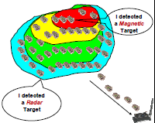

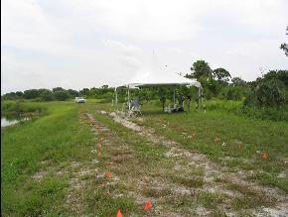
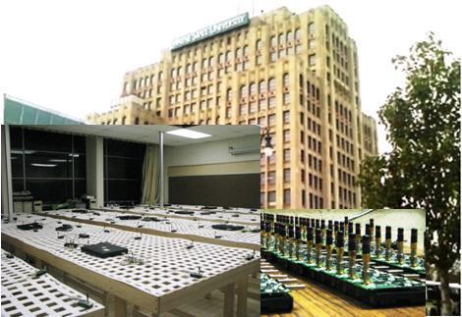


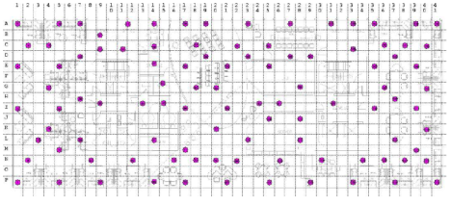
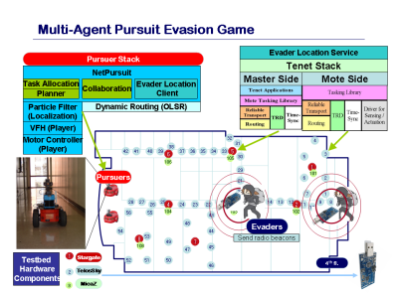
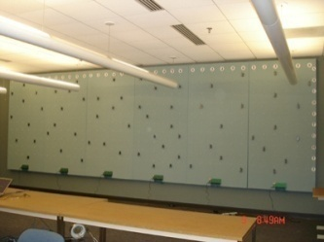

WSN experimental infrastructures
A Line in the Sand
ExScal
VigilNet
NetEye
WSU
Mirage
Intel
Tutornet
USC
Mirage
UMN
CitySense
Notes:
One time deployment
Perpetual deployment

Slide 3
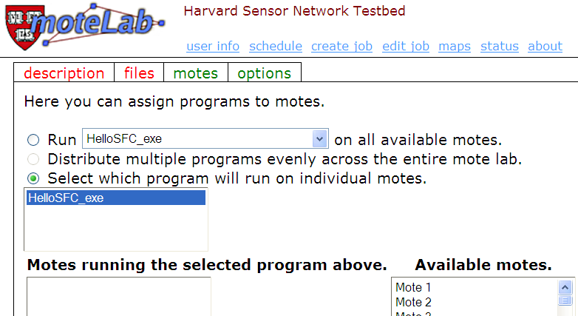
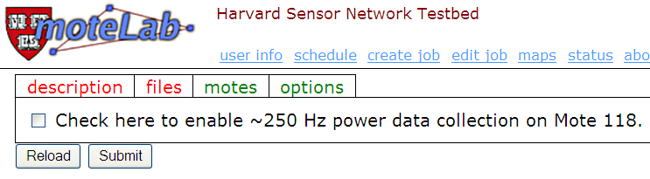
No specification for
Channels/LINKs

Slide 4
Lack of experiment predictability/repeatability
Conflicting experiment observations
  E.g., data collection protocol for periodic monitoring vs. bursty events
Major cause: many uncertainty factors are left unspecified, unmeasured, and implicit
WSN resource specification is difficult
  Complex dynamics and uncertainties in WSN
  Heterogeneous platforms, protocols, and applications
Our contribution
  LENS: Language for Embedded Networked Sensing
Notes:
wireless interference model (physical vs. protocol)

Slide 5
Outline
LENS design principles
LENS ontology
LENS in KanseiGenie
Example use cases of LENS
Concluding remarks
Notes:
site specific specification
common spec be abstract
where do we implement things? what questions get answered where?
ORCA support

Slide 6
Principle #1: Controllability vs. observability
Distinguish specified properties as controlled or observed
  Controllable factors: co-channel interference …
  Observable-only factors: slow time-varying wireless path loss …
  Controllability is context-specific: control by “choice” in WSN federations
    Path loss exponent …
System choose/maintains controllable factors, and monitor/measures observable factors
Users request satisfiability of controllable factors and measurement of observable factors
Notes:
Model wireless environment as part of high-level spec
map onto low-level properties such as wireless path loss & delay spread
To address system and environmental uncertainties (for predictable/ repeatable experimentation)

Slide 7
Principle #2: Network-centric specification
Enable reasoning about relationship/ dependencies among resources
  Channel relation (e.g., path loss) between nodes
    Transmission scheduling
  Correlation among links
    Broadcast, opportunistic routing
  Dependencies among node, radio, and spectrum
    Multi-channel scheduling
  Geometric relation among nodes
    Geographic routing
Notes:
Mechanism: Network-centric measurement and embedding
Passive/active monitoring techniques for characterizing relationships/dependencies
RSpec embedding
Characterize (physical) correlation within wireless networking and sensing
low-level

Slide 8
Principle #3: Whole-lifecycle resource management
Support different use cases in resource management
  Resource delegation/allocation
  Resource request
  Resource monitoring
    E.g., measurement of wireless path loss, monitoring of co-channel interference from external networks
  Resource release

Slide 9
Outline
LENS design principles
LENS ontology
LENS in KanseiGenie
Example use cases of LENS
Concluding remarks
Notes:
site specific specification
common spec be abstract
where do we implement things? what questions get answered where?
ORCA support

Slide 10
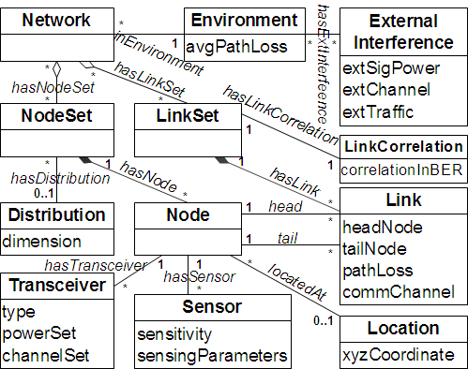
Notes:
why not existing ontology (wired)?
explicitly modeling environment
diff. from wifi?
multi-hop
Channel relation (e.g., path loss) between nodes
Transmission scheduling
Correlation among links
Broadcast, opportunistic routing

Slide 11
Outline
LENS design principles
LENS ontology
LENS in KanseiGenie
Example use cases of LENS
Concluding remarks
Notes:
site specific specification
common spec be abstract
where do we implement things? what questions get answered where?
ORCA support

Slide 12
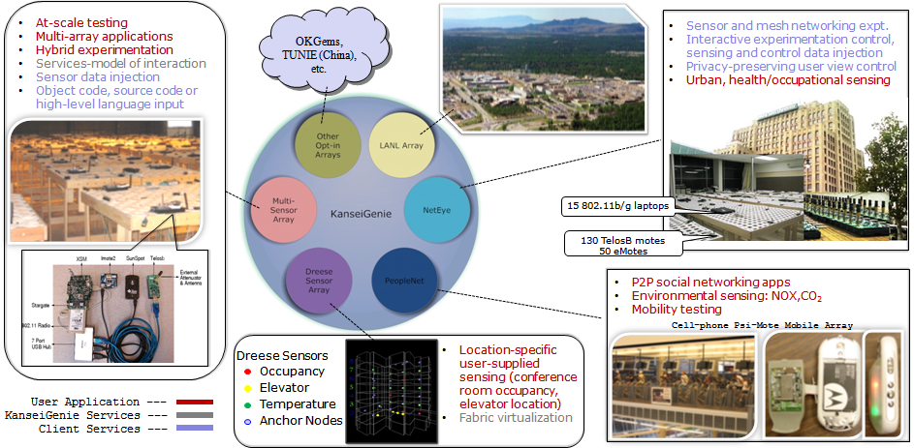
KanseiGenie in NSF GENI program

Slide 13
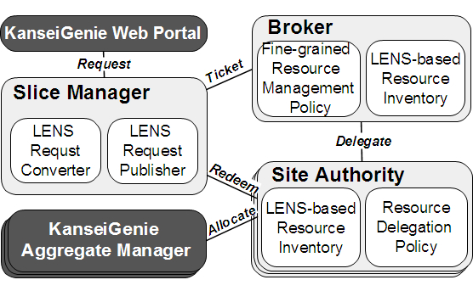
LENS in KanseiGenie Control Framework

Slide 14
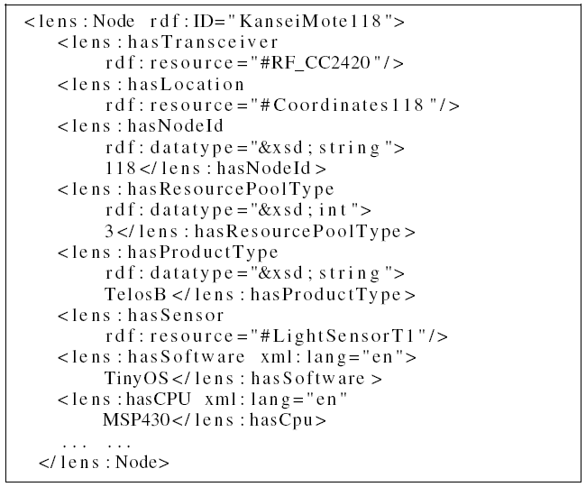
Example: a Node instance in LENS

Slide 15
Outline
LENS design principles
LENS ontology
LENS in KanseiGenie
Example use cases of LENS
Concluding remarks
Notes:
site specific specification
common spec be abstract
where do we implement things? what questions get answered where?
ORCA support

Slide 16
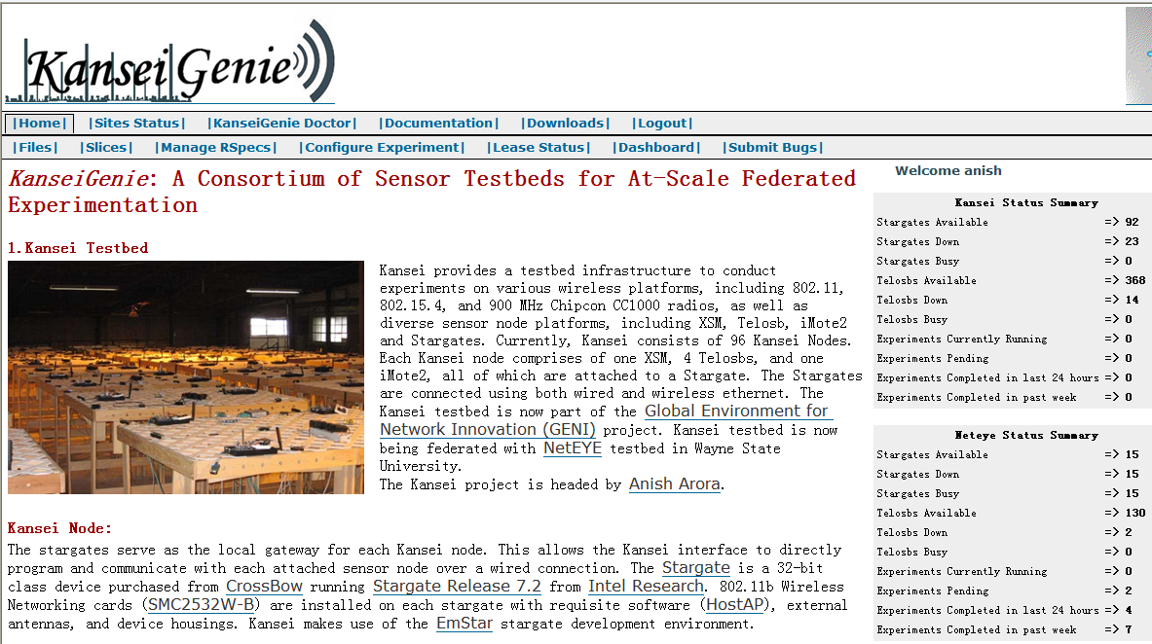
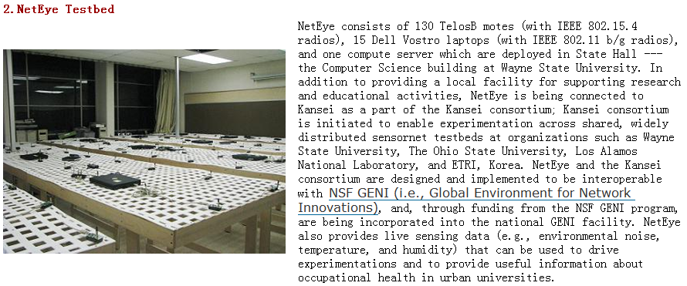

Slide 17
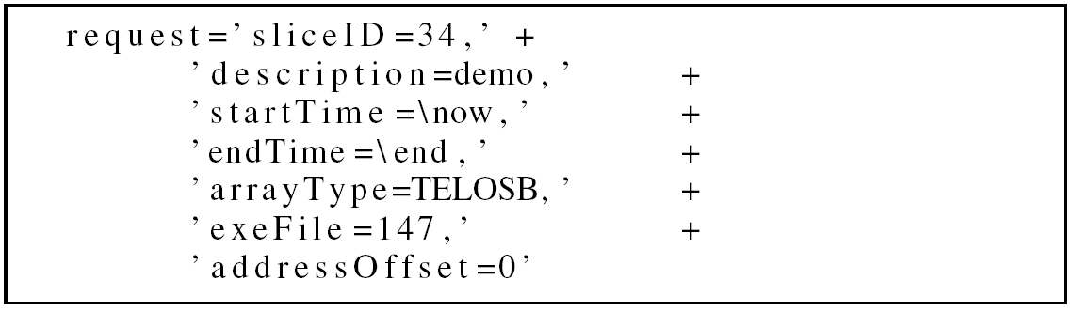
Resource request in KanseiGenie
A string-based experiment specification in KanseiGenie

Slide 18
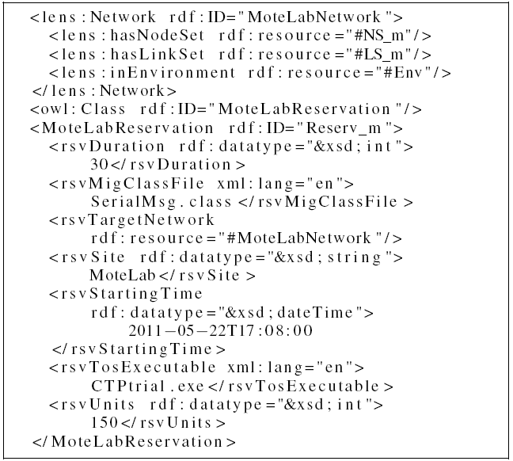
LENS-based resource specification for MoteLab

Slide 19
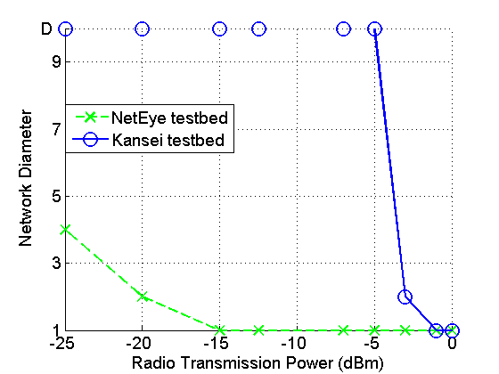
Observable factor: wireless path loss exponent
NetEye: 2.61 Kansei: 3.69

Slide 20
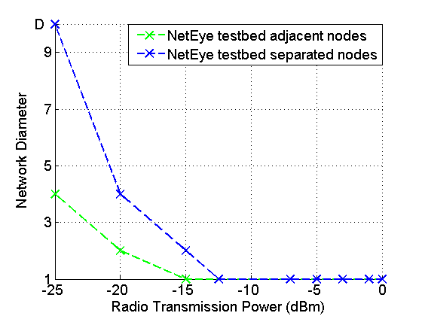
Controllable factor: node location
Control nodes locations and thus inter-node separation to achieve desired network diameter

Slide 21
Outline
LENS design principles
LENS ontology
LENS in KanseiGenie
Example use cases of LENS
Concluding remarks
Notes:
site specific specification
common spec be abstract
where do we implement things? what questions get answered where?
ORCA support

Slide 22
Concluding remarks
LENS as a basis for predictable/repeatable WSN experiments
  LENS integrated with the KanseiGenie control framework
LENS-based experimental modeling & analysis (in progress)
  Measurement services
  Protocol/network performance prediction
Other directions
  High-level spec: heterogeneous use cases and abstractions
  Integration: sensor network , mesh network, vehicular network, cellular network
Notes:
concrete, low-level examples
Bonsai: prediction?
low-level characteristics of environments, systems
Measurement
Granularity vs. overhead/cost
Experiment itself vs. system service
Dynamics vs. fidelity

Slide 23
LENS: Language for Embedded Networked Sensing
Notes:
Hollow diamond: aggregation
Filled diamond: composition

Slide 24
Backup slides

Slide 25
Principle #4:
Embrace heterogeneity/diversity in RSpec
Heterogeneity in resource and resource ontology
  No consensus on basic issues such as WSN addressing (IP or not)
Heterogeneity in RSpec use cases
  Multiple levels of abstraction: low-level specs for system interactions, high-level specs for researchers and opt-in users
Mechanism: Enable ontology mapping
  From high-level spec to low-level spec
  Between heterogeneous low-level specs
Notes:
Architecture of allocation framework
C-1) R&D on virtualized sensor network specification and interpretation
(US: Ohio State University and Wayne State University)
** Supplementary theme for NSF (3)
(Detail)
Investigate experiment specification and resource specification for heterogeneous sensor networks, including ontology interpretations to treat abstract requests and mapping to each resources.
Experiment specification, including workflow and resource specification (Ohio State Univ.)
Resource specification for predictable, repeatable experimentation (Wayne State Univ.)
(Goal in fiscal 2010)
Develop a prototype system and specification interpreter for primitive experimentation user services that connect X-Sensor and KanseiGenie.
Thesis
Agree on ontology-language (or resource description language), but allow for diverse ontology
Ontology mapping/merging at researcher portal or another entity
e.g., neighborhood (geometric vs. link set), addressing (IP vs. non-IP)
Differentiate “properties of interest” from “properties of control”: specify the latter, “monitor and feedback” uncontrollable but interesting properties
Properties of interest: e.g., exact width of reliable region and transition region; may not be controllable due to uncontrollable environmental factors (e.g., path loss, temperature, humidity, open vs. closed doors , human movement)
Properties of control: e.g., node locations, transmission power level, RTS-CTS in the presence of concurrent transmitters
Controllability is context-specific
E.g., wireless path loss exponent is generally not controllable for a single testbed (assuming fixed environmental setting), but becomes controllable if we have many testbeds from which to select a testbed with the desired path loss
Environment becomes a part of resource spec
Good for “researcher interface”: better than requiring researchers to specify path loss, multipath etc
Related to the notion of “context-specific controllability”
Measurement becomes a part of the high-level spec
For experiment predictability/repeatability in the presence of “uncontrollable properties of interest”
Multiple levels of abstraction
Researcher interface vs. system interface
One-to-one mapping across layers?
Differentiate experiment spec. abstraction (top level instead of low level) vs. system/programming abstraction
The former is application use-case driven; the latter is protocol-design driven.
e.g.,
Specifying relationship between resources
Geometric relation among nodes, channel relation (e.g., path loss) among nodes, correlation among links
e.g., network topology (connectivity among nodes etc), sensing coverage (point cover by multiple sensors)
Specifying dependency between resources
e.g., node, radio, and spectrum
Given a RSpec framework (classes, properties), the actual RSpec exchanged between actors is use-case dependent
e.g., power level (set), channel (set); researcher portal – site, site – broker
Top level: researcher interface, less specific/more abstract
System
Geometric node distribution: physical locations, mobility
Connectivity: neighborhood size (mean, variance), flat vs. hierarchical structure
Sensing coverage: per-node sensing coverage
Radio platform: frequency, modulation, etc
Computing platform: memory, disk etc
Environment
Based on application use case: indoor vs. outdoor , degree of multipath (e.g. dense distribution of moving machinery), degree of external interference, industrial process control vs. power grid vs. vehicular (intra-/inter-vehicle)
Stability of specified resources
(Time duration? Required for mobility)
Temporal dynamics
Measurement spec
For experiment predictability/repeatability in the presence of “uncontrollable properties of interest”
Bottom level: system-level interface (e.g., between sites and clearinghouses), specific/concrete
System
Node location
Radio: freq, modulation, tx. power set
Wireless channel:
path loss (large scale, small scale)
delay spread
Abstraction for link/neighborhood/linkSet?
Clustered link properties of links associated with same node, in a close spatial domain?
Link set?
Correlation across links?
Sensor
Computing platform
Environment
(overall) path loss, (overall) delay spread (in multipath environment), co-existing networks/external interfering networks
Measurement capability
NDL classes & properties [to be extended]
Basic classes
Location, device, interface
Basic properties
locatedAt, name, description, capacity, encodingType, encodingLabel
hasInterface
connectedTo, switchedTo
Sensornet classes & properties
Radio
Wireless spectrum
Modulation
Network stack (MAC, addressing, routing etc): whether include in a spec depends on whether the corresponding network stack is programmable: if no, should include as RSpec; otherwise, a part of experiment spec to identify the “missing” stack component(s)
Sensor
Sensed attribute(s)
Sensing radius/sensitivity
Neighborhood
Correlation among links etc
Environment
Based on application use cases: indoor vs. outdoor, degree of multipath (e.g. dense distribution of moving machinery), degree of external interference, industrial process control vs. power grid vs. vehicular (intra-/inter-vehicle)
Measurement capability
Measured attributes, fidelity/frequency etc
General properties
hasReliability/Stability/Predictability/Repeatability
specific attributes to specify resource/system *-bility

Slide 26
LENS: examples
Radio
  High-level: standard-based spec such as Zigbee and WiMedia
  Low-level: wireless spectrum, modulation , (programmable) network stack
Neighborhood
  High-level: connectivity (e.g., neighborhood size)
  Low-level: node location, link properties, correlation among links …
Environment
  High-level: application context (e.g., home vs. industrial)
  Low-level: path loss, interference from co-existing nets …
Notes:
Network stack (MAC, addressing, routing etc): whether include in a spec depends on whether the corresponding network stack is programmable: if no, should include as RSpec; otherwise, a part of experiment spec to identify the “missing” stack component(s)
Sensor
Sensed attribute(s)
Sensing radius/sensitivity
Neighborhood
Connectivity: neighborhood size (mean, variance), flat vs. hierarchical structure
Environment
Based on application use cases: indoor vs. outdoor, degree of multipath (e.g. dense distribution of moving machinery), degree of external interference, industrial process control vs. power grid vs. vehicular (intra-/inter-vehicle)
(overall) path loss, (overall) delay spread (in multipath environment), co-existing networks/external interfering networks
node location
Model wireless environment as part of high-level spec
map onto low-level properties such as wireless path loss & delay spread

Slide 27
