Slide 1



Cyber-Physical Scheduling for Predictable Reliability of Inter-Vehicle Communications
Chuan Li, Hongwei Zhang, Jayanthi Rao, Le Yi Wang, George Yin

Slide 2

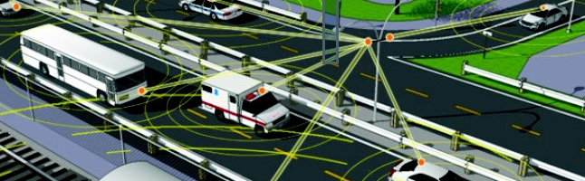
connected & automated vehicle
solo vehicle
Notes:
Other paradigm shift in transportation engineering exist, e.g., in infrastructure

Slide 3
Connected & Automated Vehicles
Small Spatiotemporal Scale
Sensing and Control
Active Safety
Fuel Economy & Emission Control
Networked Vehicle Automation
Infotainment
R. Johri, J. Rao, H. Yu, H. Zhang, “A Multi-Scale Spatiotemporal Perspective of Connected and Automated Vehicles: Applications and Networking”, IEEE Intelligent Transportation Systems, 8(2):65-73, 2016
Notes:
Pre-crash sensing (PCS)
Emergency brake lights (EBL)
Collaborative collision warning (CCW)
Left turn assistant (LTA)
Lane change warning (LCW)
Traffic signal violation warning (TSV)
Stop sign violation warning (SSV)
Curve speed warning (CSW)
Stop-start
Platoon
Preview-based fuel economy optimization (PFO)
Low emission zone (LEZ)
Fuel-economy-oriented trip planning (FEP)
Adaptive vehicle tuning (AVT)
Collaborative failure-mode-effect-management (CFEM)
Traffic jam assist (TJA)
Supercruise with opportunistic lane change (SCLC)
Automated valet/street parking (AP)
Extended surrounding sensing (ESS)
Geographic proximity applications (GPA)
Real-time cloud services to vehicle (RTCS)
Remote vehicle command (RVC)
Remote vehicle status (RVS)
Crowd-sourced sensing (CSS)
Delay-insensitive downloads (DID)
Cloud-based diagnostics/prognostics/analytics (CDPA)
Multi-Scale Spatiotemporal Perspective

Slide 4
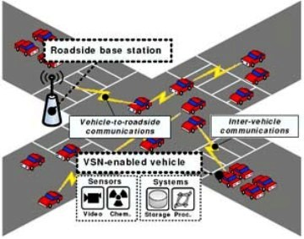
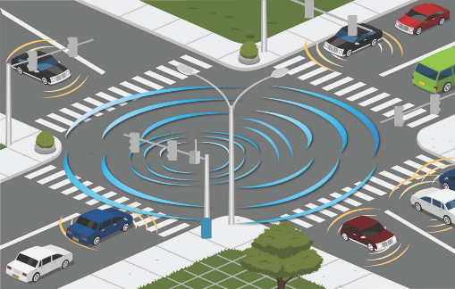
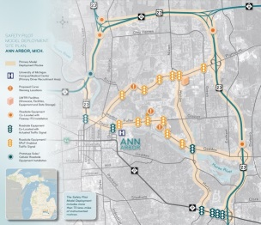
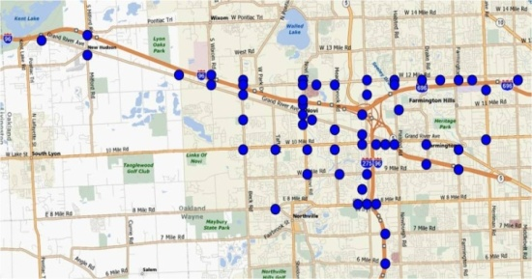

Active Safety
Eliminate up to 90% accidents
Save 1.3 million lives and avoid 45 million injuries per year
Eliminate 23% congestion
Notes:
===
Crash Avoidance Metrics Partnership (CAMP) industry consortium
Ford, GM, Mercedes–Benz, Toyota, Honda, Nissan, Hyundai/Kia, Volkswagen
USDOT initiatives
Safety Pilot Model Deployment in Ann Arbor
2,800+ vehicles & multiple road side equipment
Planned large scale pilot deployments across USA
Michigan testbeds
Safety Pilot Model Deployment in Ann Arbor
2,800+ vehicles & multiple road side equipment
Michigan testbed(s)
79+ roadside equipment sites
12 freeway, 42 signalized intersections
45 square miles of coverage
75 center-line miles of roadway
Interstate and divided highway: ~32 center-line miles
Signalized intersections: ~43 center-line miles
10 vehicles with on-board equipment
Electronic equipment cost over 60% of overall vehicle cost
Smart transportation
DSRC/IEEE802.11p, WAVE

Slide 5
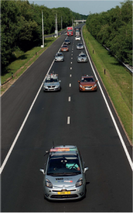

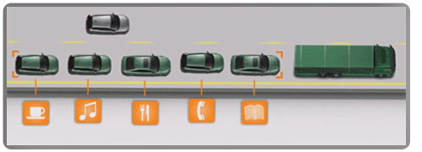
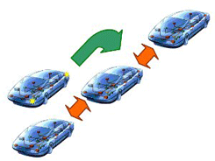
Vehicle Platooning
Simple platooning strategy saves up to 16% fuel consumption!
Notes:
Having vehicles coordinate their driving behavior based on in-situ road and traffic conditions can also significantly enhance fuel efficiency and reduce emissions. For instance, by having vehicles form platoons and coordinate their acceleration, deceleration, and inter-vehicle distance, we can easily save up to 16% fuel consumption based on existing road tests. In transportation, every 1% fuel savings is actually significant!
===
Grand Cooperative Driving Challenge, Netherlands (2011)
Safe Road Trains for the Environment (SARTRE), Sweden (2009-2012)
Field trials showed 8%-16% reduction in fuel consumption from semi-automated ‘road trains’ (SARTRE, Energy ITS)
SARTRE project:
Observations from SARTRE project: 10-20% fuel economy savings
Up to 90 miles per hour with inter-vehicle distance no more than four meters

Slide 6
Wireless as a Basic Enabler!
Notes:
Other paradigm shift in transportation engineering exist, e.g., in infrastructure

Slide 7
IEEE 802.11p
Foundation for today’s DSRC implementation
Inherit basic principles of WiFi
  Carrier Sensing Multiple Access (CSMA)
  OFDM
WiFi has never been designed for safety-critical control ☹

Slide 8
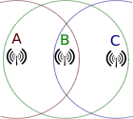
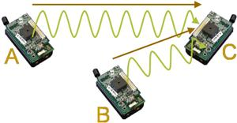
Control of co-channel interference: a basic challenge in wireless communication
Open problem for over 40 years
  ALOHA protocol considered interference from concurrent transmitters (1970)
  Hidden terminal issue first identified by Leonard Kleinrock (1975)
Lack of field-deployable approaches to predictable interference control
Notes:
N. Abramson (1970). "The ALOHA System - Another Alternative for Computer Communications" (PDF). Proc. 1970 Fall Joint Computer Conference. AFIPS Press
ALOHAnet, also known as the ALOHA System,^{[1][2]} or simply ALOHA, was a pioneering computer networking system developed at the University of Hawaii. ALOHAnet became operational in June, 1971, providing the first public demonstration of a wireless packet data network.^{[3][4]}
The ALOHAnet used a new method of medium access (ALOHA random access) and experimental ultra high frequency (UHF) for its operation, since frequency assignments for communications to and from a computer were not available for commercial applications in the 1970s. But even before such frequencies were assigned there were two other media available for the application of an ALOHA channel – cables and satellites. In the 1970s ALOHA random access was employed in the widely used Ethernet cable based network^{[5]} and then in the Marisat (now Inmarsat) satellite network.^{[6]}
In the early 1980s frequencies for mobile networks became available, and in 1985 frequencies suitable for what became known as Wi-Fi were allocated in the US. These regulatory developments made it possible to use the ALOHA random access techniques in both Wi-Fi and in mobile telephone networks.
ALOHA channels were used in a limited way in the 1980s in 1G mobile phones for signaling and control purposes.^{[7]} In the late 1980s, the European standardisation group GSM who worked on the Pan-European Digital mobile communication system GSM greatly expanded the use of ALOHA channels for access to radio channels in mobile telephony. In addition SMS message texting was implemented in 2G mobile phones. In the early 2000s additional ALOHA channels were added to 2.5G and 3G mobile phones with the widespread introduction of GPRS, using a slotted ALOHA random access channel combined with a version of the Reservation ALOHA scheme first analyzed by a group at BBN

Slide 9
Wireless Interference Model:
A Basis for Interference-Oriented Scheduling
Predicts whether a set of concurrent transmissions may interfere with one another
Two commonly-used interference models
  Protocol model
  Physical model
Notes:
One basic reason for the low performance of existing protocols is due the lack of a wireless interference model that can serve as a basis for designing distributed protocols for predictable interference model.

Slide 10
Physical-Ratio-K (PRK) Interference Model
signal strength from S to R
  Given a transmission from S to R, a concurrent transmitter C is regarded as not interfering with the reception at R iff.
S
function of required PDR T_{S,R}
R
C
Interference power from C to R
Suitable for designing distributed protocols:
  Both signal strength and link reliability are locally measurable
  K is locally controllable
Generally applicable
  Only assumption: non-increasing “BER vs. SINR” function
H. Zhang, X. Che, X. Liu, X. Ju, “Adaptive Instantiation of the Protocol Interference Model in Wireless Networked Sensing and Control”, ACM Transactions on Sensor Networks, 10(2), 2014
Notes:
Signal-strength-based definition can deal with wireless channel irregularity
===
K can be searched via local, control-theoretic approach
Based on the result above, we propose the Physical-Raio-K model.
Given a transmission from the sender to the receiver, the PRK model define a (signal-strength-based exclusive) region; the boundary of this exclusive region is such that an interferer will only one of k-th of received signal strength between the sender and the receiver. For any nodes outside this region, PRK model ignores its interference. For example, the interference from Node C’s transmission will be ingored in PRK model.
In the presence of dynamic interference, The value of K can change promptly so that the link quality is always above the threshold T_pdr.
Therefore, PRK model can facilitate the distributed protocol design while ensure the relibility.
As may notice that there is no closed-form formular for K. But if you look at the model carefully, all parameters, received signal strength and the reliability, are locally measurable. The K can be searched via local, control-theoretic approach.
We define the PRK model based on signal strength instead of geographic distance based on two reason: 1). The signal strength is locally measurable; 2). It can deal with wireless channel irregularity, (such as different transmission power or non-uniform signal attenuation, as we shown here).
As link quality is online, locally meaured metric. It can be obtained through real-time, data-driven, passive measurement.
It is desirable to use the minimum k that ensure a certain link quality, since it tends to avoid throughput loss cased by using any unnecessarily large K.
where P(ni, nr) and P(ns, nr) is the strength of signals reaching nr from ni and ns respectively, and
Benefits of PRK model:
1. K(ns, nr, Tpdr) is chosen such that the probability of nr successfully receiving packets from ns is at least Tpdr in the presence of interference from all concurrent transmitters

Slide 11
Predictable Link Reliability in
Distributed PRK-based Scheduling (PRKS)
Predictable link PDR through localized PRKS model adaptation
Concurrency and spatial reuse statistically equal or close to that in state-of-the-art centralized scheduling

Slide 12
Convergence of distributed controllers
PDR time series of a typical link:
PDR req. = 90%
Median: 26 control steps
90-percentile: 43 control steps
Settling time
Network-wide convergence
Notes:
From mean PDR guarantee to instantaneous PDR guarantee:
Extra SINR margin as a protection
Integrate with other techniques …

Slide 13
Heterogeneous Settings
Heterogeneous PDR requirements in a network
Heterogeneous link transmission power
in a network
Predictable link PDR in the presence heterogeneous application requirements and network configurations

Slide 14
Temporally-Varying PDR Requirements:
70%→80%→90%→95%→90%→80%→70%
Settling time
PDR of a typical link
Notes:
Converges fast (or faster than bootup), with a median settling time around 18 control steps.

Slide 15
Comparison with Existing Protocols: PDR
PDR requirement = 90%
Notes:
Larger networks: even lower PDR in other protocols (except SCREAM), but predictably high pdr in PRKS

Slide 16
Current Practice (1):
Improve Reliability by Retransmission
Significantly longer delay in existing protocols due to retransmission

Slide 17
Current Practice (2):
Improve Reliability by Reducing Traffic Load
Significantly lower throughput in existing protocols due to low utilization of channel capacity

Slide 18
PRK-based scheduling in vehicular networking?

Slide 19
Vehicular Networks: Challenges of Vehicle Mobility & Broadcast
Fast-varying interference relations between vehicles
  Highly-dynamic network topology
  Highly-dynamic wireless channels
Challenges
  Identification of interference relations
  Signaling of interference relations
Single-hop broadcast as a fundamental vehicular networking primitive
  Lack of simultaneous receiver feedback
  Correlated receiver exclusion regions
In collaboration with Ford Research

Slide 20
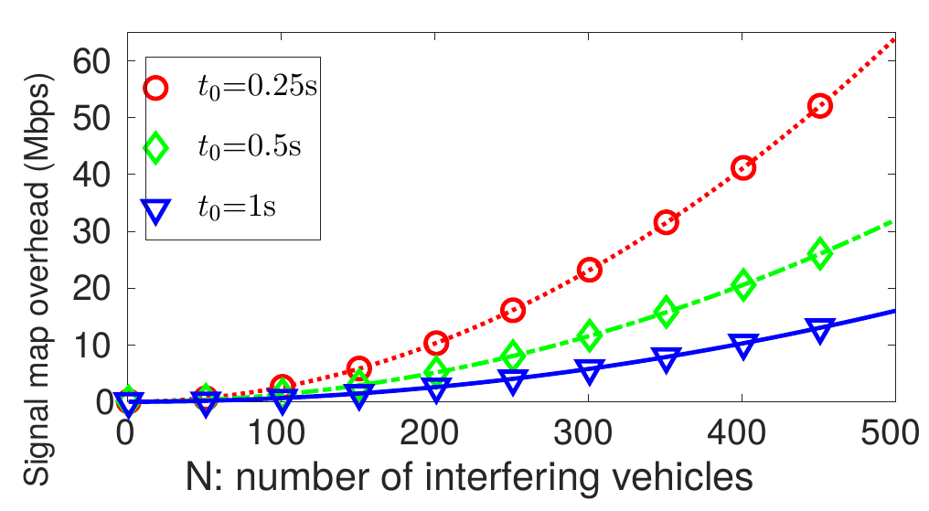
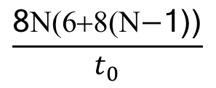
Challenge of Interference Relation Signaling
PRKS: maintain signal maps on channel gains among potentially- interfering vehicles
Signaling overhead
            N: # of interfering vehicles
            t₀: information update interval
Costly or even infeasible to maintain accurate signal maps
$$\frac{\text{8}\text{N}\text{(6+8(}\text{N}\text{−}\text{1))}}{t_{0}}$$
Notes:
V2V communication standard IEEE 802.11p can only support a transmission rate of 6Mbps - 27Mbps

Slide 21


gPRK Model:Geometric Approximation of PRK Model
Vehicle location information readily available through GPS, SLAM etc
gPRK interference model
gPRK vs. PRK model: distance vs. signal power attenuation
  Stronger interference from closer-by vehicles
  Additive interference
distance from S to R
function of required PDR T_{S,R}
$$D(S, R){⋅K}_{S,R,T_{S,R}}$$
  Given a transmission from S to R, a concurrent transmitter C is regarded as not interfering with the reception at R iff.
S
$$D\left(C, R\right)>D(S, R){⋅K}_{S,R,T_{S,R}}$$
R
distance from
C to R
C

Slide 22

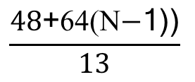
Signaling overhead in gPRK-based Scheduling
Factor of overhead reduction as compared with PRK-based scheduling:
  Orders of magnitude reduction
$$\frac{\text{48}\text{+}\text{64}\text{(}\text{N}\text{−}\text{1))}}{13}$$
$$\frac{\text{N}\text{(}\text{48}\text{+}\text{64}\text{(}\text{N}\text{−}\text{1))}}{t_{0}}$$

Slide 23
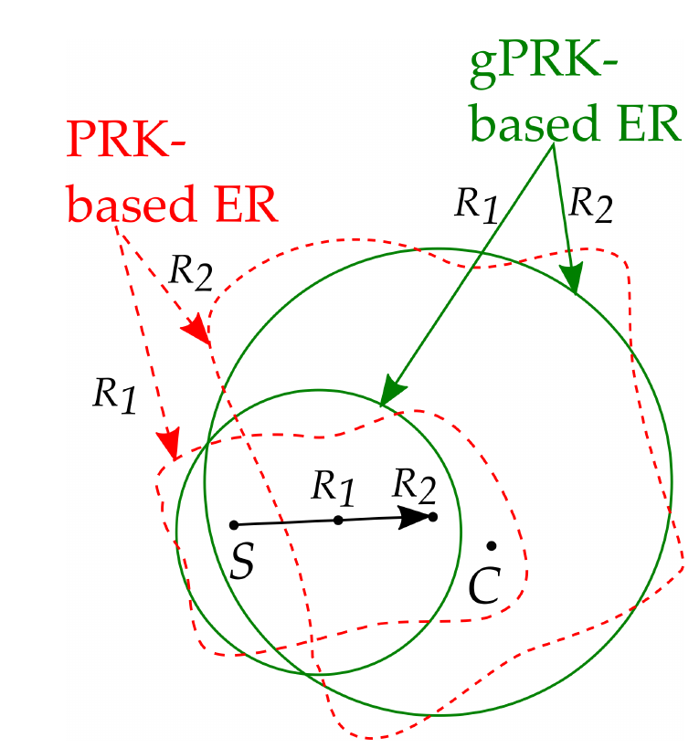

gPRK Model: Efficiency & PRK Similarity
Signaling overhead:
  Orders of magnitude reduction as compared with PRK-based scheduling (i.e., )
(Broadcast) exclusion region similar to PRK-based scheduling
$$\frac{\text{48}\text{+}\text{64}\text{(}\text{N}\text{−}\text{1)) }}{13}$$
$$\frac{\text{N}\text{(}\text{48}\text{+}\text{64}\text{(}\text{N}\text{−}\text{1))}}{t_{0}}$$

Slide 24
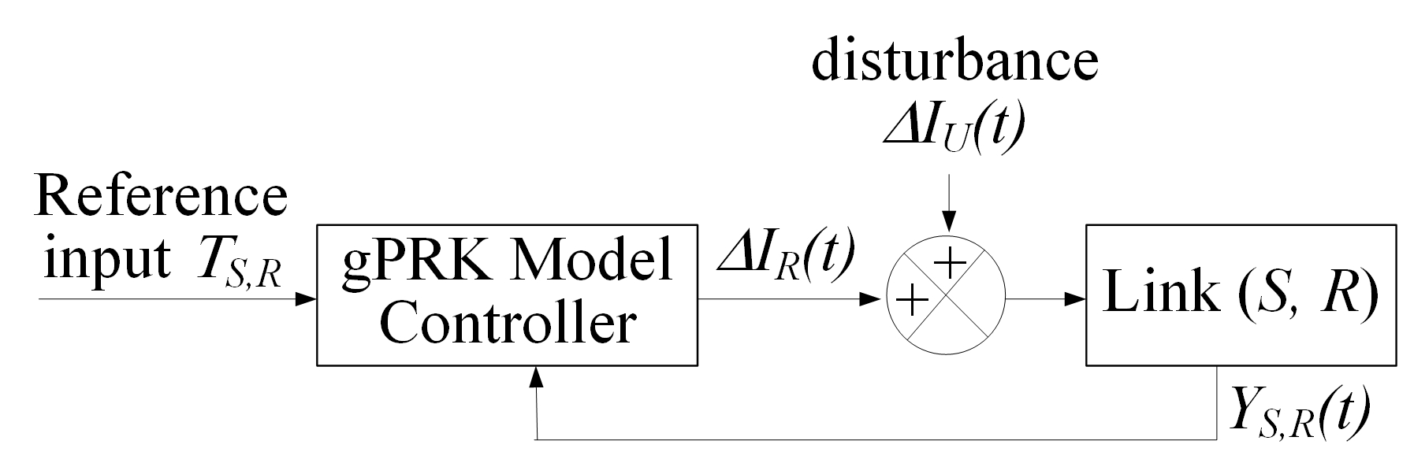
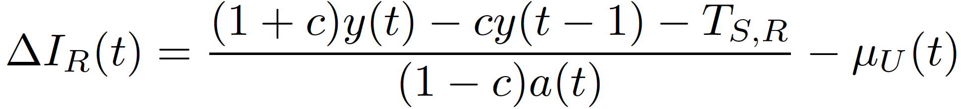
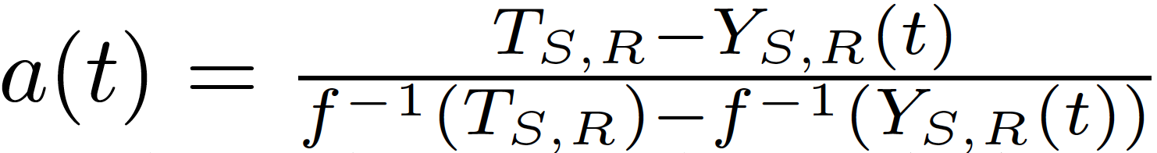
gPRK Model Instantiation
interference beyond
exclusion region
Distributed regulation control
gPRK model controller:
desired receiver-side interference change
required PDR
actual PDR

Slide 25
Use of gPRK model in highly-dynamic vehicular networks?
Effectiveness of gPRK-based scheduling?

Slide 26
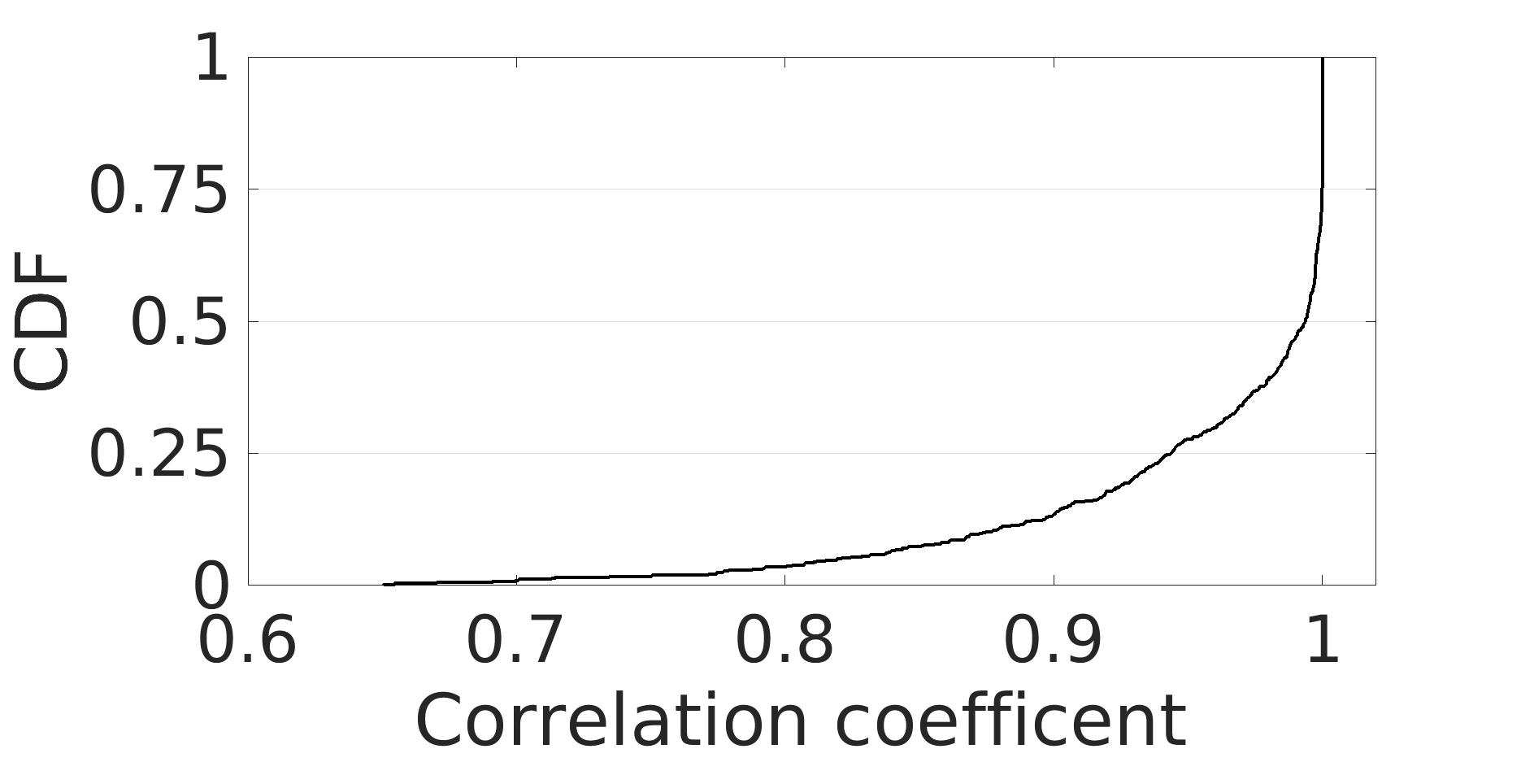
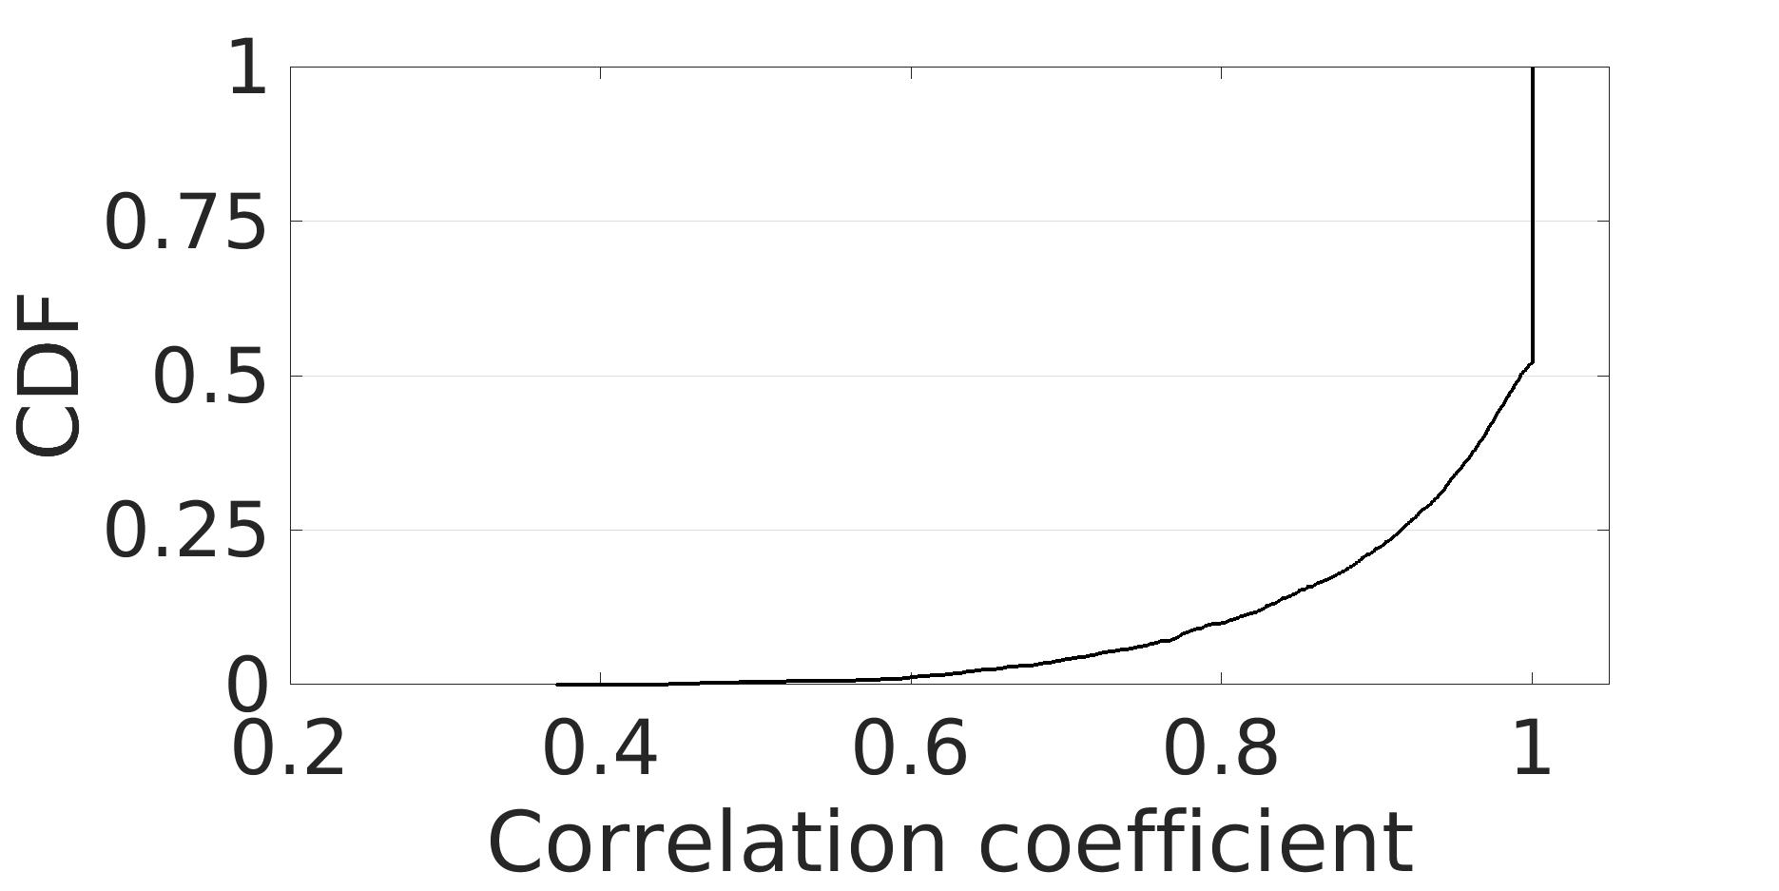
Cyber-Physical Structures of Vehicle Traffic Flow
Physical structures
  Macroscopic vehicle clustering effect
  Microscopic vehicle dynamics
Cyber structures
  Spatial interference correlation
  Temporal interference correlation
In collaboration with Ford Research
Notes:
Spatial correlation: links of distance no more than 30 meters
Temporal correlation: time lag of two seconds

Slide 27
Addressing Vehicle Mobility (1): gPRK Model Instantiation & transient links
Relatively-stable vehicle clustering effect in a traffic flow
  Facilitate control-theoretic gPRK model instantiation
gPRK model instantiation for transient links
  Spatial interference correlation
  Temporal interference correlation
Notes:
gPRK model initialization leveraging spatial interference correlation

Slide 28
Addressing Vehicle Mobility (2):
Effective Use of gPRK Model
Vehicle location prediction in between location updates
  E.g., up to 22.22 meters inter-vehicle distance change at speed of 80km/h and update interval of 0.5 second
Well-understood microscopic vehicle dynamics
  E.g., Intelligent Driver Model (IDM) for acceleration/ deceleration
Unscented Kalman Filter (UKF) for nonlinear systems

Slide 29
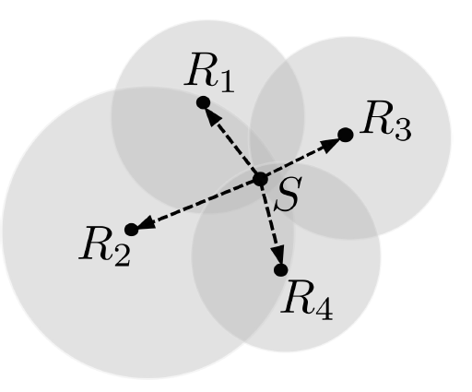
Ensuring Reliable Inter-Vehicle Broadcast
Broadcast exclusion region (ER) as union of receiver ERs
Correlation in ER adaptation across receivers

Slide 30
Cyber-Physical Scheduling (CPS) for Inter-Vehicle Communication
Multi-scale structure in adaptation
Leveraging cyber-physical structures of vehicular networks in identification and signaling of interference relations

Slide 31
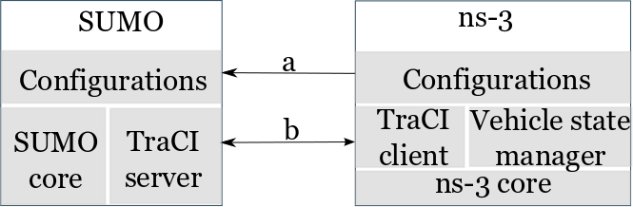
Multi-Dimensional Simulation of Vehicular Networks

Slide 32
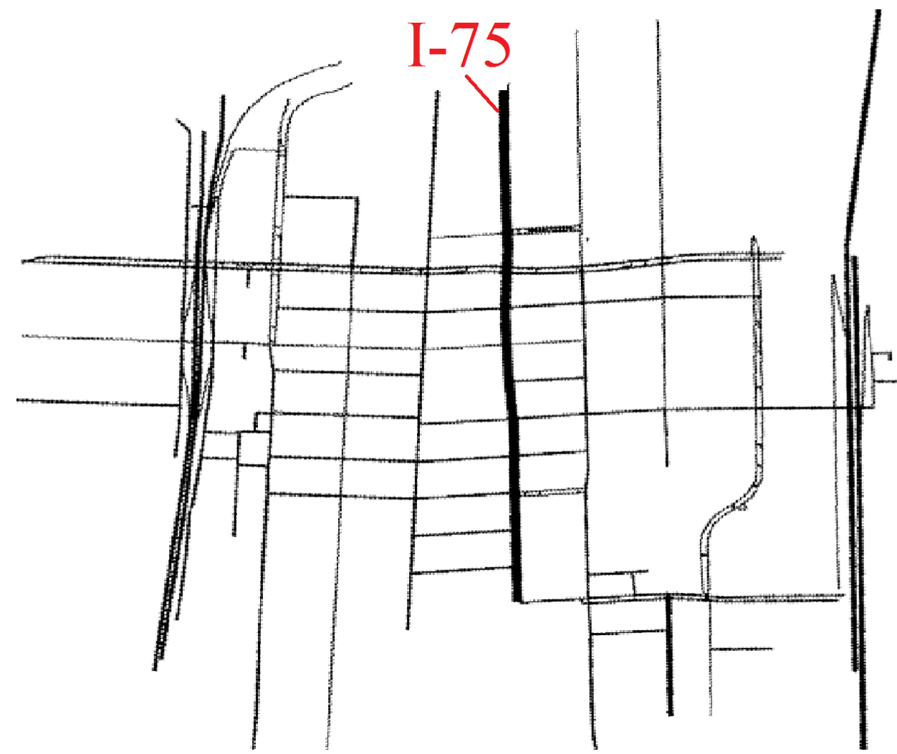
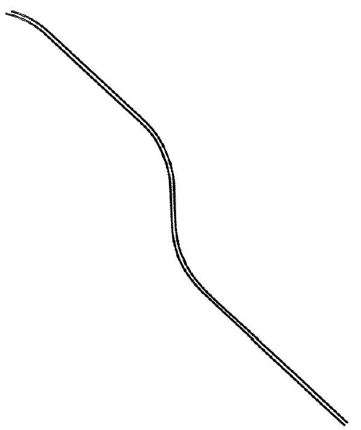
Experimental Study of CPS Behavior
Midtown Detroit
I-75 in
Southeast Michigan

Slide 33
CPS for Predictable Inter-Vehicle Communication
Predictable reliability
Significantly lower delay, higher throughput

Slide 34
Cyber-Physical Scheduling (CPS)
Leverage cyber-physical structures of vehicle traffic flows
  Physical structures
    gPRK interference model: distance vs. signal power attenuation
    Microscopic vehicle dynamics
    Macroscopic vehicle clustering effect
  Cyber structures: spatiotemporal interference correlation
PRK-based scheduling (and variants) as a general framework for interference-oriented scheduling
  Static & mobile networks
Hongwei Zhang
hongwei@iastate.edu
http://www.ece.iastate.edu/~hongwei
In collaboration with Ford Research

