Slide 1
Fundamentals of Control Theory
Hongwei Zhang
hongwei@iastate.edu, 515 294 2143
http://www.ece.iastate.edu/~hongwei
Acknowledgment: Joseph Hellerstein, Sujay Parekh, Chenyang Lu

Slide 2
Outline
Examples and Motivation
Control Theory Vocabulary and Methodology
Modeling Dynamic Systems
Transient Behavior Analysis
Standard Control Actions
Advanced Topics
Issues for Computer Systems

Slide 3
Outline
Examples and Motivation
Control Theory Vocabulary and Methodology
Modeling Dynamic Systems
Transient Behavior Analysis
Standard Control Actions
Advanced Topics
Issues for Computer Systems

Slide 4
Example 1: Liquid Level System
(input flow)
Goal: Design the input valve control to maintain a constant height regardless of the setting of the output valve
Input valve control
float
(resistance)
(height)
(output flow)
(volume)
Output
valve
Notes:
This can be applied to computer systems as a fluid model of queues: inflow is in work/sec; volume represents work in system; R relates to service rate.

Slide 5
Example 2: Admission Control
Goal: Design the controller to maintain a constant queue length regardless of the workload
Users
RPCs
Reference
Tuning
value
control
Controller
Sensor
Server
Administrator
Server
Log
Queue
Length
Notes:
Jlh: May want a slide that explains how this controller works?

Slide 6
Open-loop control
Compute control input without continuous variable measurement
Simple
Need to know EVERYTHING ACCURATELY to work right
Cruise-control car: friction(t), ramp_angle(t)
E-commerce server: Workload (request arrival rate? resource consumption?); system (service time? failures?)
Open-loop control fails when
We don’t know everything
We make errors in estimation/modeling
Things change
Notes:
Open-loop: Non adaptive system
Close-loop: Adaptive system
Feedback control is Everywhere. Aircrafts, cruise control, chemical processes, even economics …

Slide 7
Feedback (closed-loop) Control
Controlled System
Controller
control
function
control
input
manipulated
variable
Actuator
error
sample
controlled
variable
+
Monitor
-
reference

Slide 8
Measure variables and use it to compute control input
More complicated (so we need control theory)
Continuously measure & correct
Cruise-control car: measure speed & change engine force
E-commerce server: measure response time & admission control
Embedded network: measure collision & change scheduling
Feedback control theory makes it possible to control well even if
We don’t know everything
We make errors in estimation/modeling
Things change
Notes:
Open-loop: Non adaptive system
Close-loop: Adaptive system
Feedback control is Everywhere. Aircrafts, cruise control, chemical processes, even economics …

Slide 9
Why feedback control in computing? Open, unpredictable environments
Deeply embedded networks: interaction with physical environments
Number of working nodes
Number of interesting events
Number of hops
Connectivity
Available bandwidth
Congested area
Internet: E-business, on-line stock broker
Unpredictable off-the-shelf hardware
Notes:
Performance control becomes harder and harder!

Slide 10
Why feedback control in computing? We want QoS guarantees
Deeply embedded networks
Report/share vehicle locations every 100ms
Update intruder position every 30sec
Report fire <= 1min
E-business server
Purchase completion time <= 5 sec
Throughput >= 1000 transaction/sec
The challenge:
provide QoS guarantees in open, unpredictable environments
Notes:
Performance control becomes harder and harder!

Slide 11
Advantages of feedback control theory
Systematic approach to analysis and design
Transient response
Consider sampling times, control frequency
Taxonomy of basic controls;
Select controller based on desired characteristics
Predict system response to some input
Speed of response (e.g., adjust to workload changes)
Oscillations (variability)
Approaches to assessing stability and limit cycles

Slide 12
In comparison
Adaptive resource management heuristics
Laborious design/tuning/testing iterations
Not enough confidence in face of untested workload
Queuing theory
Doesn’t handle feedbacks
Not good at characterizing transient behavior in overload

Slide 13
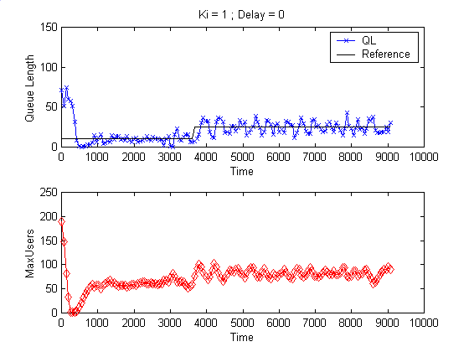
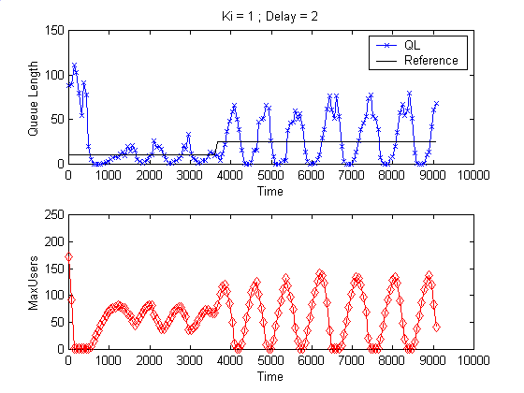
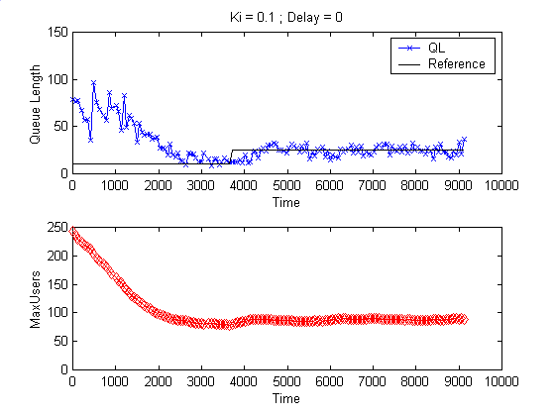
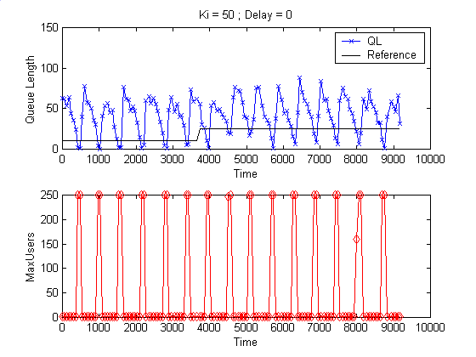
Example: Control & Response in an Email Server
Response
(queue length)
Good
Bad
Control
(MaxUsers)
Slow
Useless
Notes:
Explain the organization of the figure and how this relates to the Lotus Notes example. Justify having target queue lengths. Explain the reference values.

Slide 14
Examples of applying control theory in computing systems
Network flow controllers (TCP/IP – RED)
C. Hollot et al. (U.Mass)
Lotus Notes admission control
S. Parekh et al. (IBM)
QoS in Caching, Apache QoS differentiation
C. Lu et al. (U.Va)
Predictable interference control in wireless
H. Zhang et al. (ISU)

Slide 15
Outline
Examples and Motivation
Control Theory Vocabulary and Methodology
Modeling Dynamic Systems
Transient Behavior Analysis
Standard Control Actions
Advanced Topics
Issues for Computer Systems

Slide 16
Feedback Control System
Reference Value
Disturbance
+
Σ
Controller
Plant
–
Transducer/Sensor
Notes:
Examples of transducers in computer systems are mainly surrogate variables. For example, we may not be able to measure end-user response times. However, we can measure internal system queueing. So we use the latter as a surrogate for the former and sometimes use simple equations (e.g., Little’s result) to convert between the two.
Jlh: Be careful here since Little’s result only applies to steady state, not transients.
Another aspect of the transducer are the delays it introduces. Typically, measurements are sampled. The sample rate cannot be too fast if the performance of the plant (e.g., database server) is slower.

Slide 17
Controller Design Methodology
Start
System Modeling
Controller Design
Block diagram construction
Controller Evaluation
Transfer function formulation and validation
Objective achieved?
Y
Stop
Model Ok?
N
Y
N

Slide 18
Control System Goals
Regulation
thermostat, target service levels
Tracking
robot movement, adjust TCP window to network bandwidth
Optimization
best mix of chemicals, minimize response times

Slide 19
Outline
Examples and Motivation
Control Theory Vocabulary and Methodology
Modeling Dynamic Systems
Transient Behavior Analysis
Standard Control Actions
Advanced Topics
Issues for Computer Systems

Slide 20
System Models
Linear vs. non-linear
Principle of superposition: for linear systems, the net response at a given place and time caused by two or more stimuli is the sum of the responses which would have been caused by each stimulus individually.
Deterministic vs. Stochastic
Time-invariant vs. Time-varying
Are coefficients functions of time?
Continuous-time vs. Discrete-time
t ∈ R vs. k ∈ Z
Notes:
Stochastic control is a subfield of control theory which deals with the existence of uncertainty in the data. The designer assumes, in a Bayesian probability-driven fashion, that a random noise with known probability distribution affects the state evolution and the observation of the controllers. Stochastic control aims to design the optimal controller that performs the desired control task with minimum average cost despite the presence of these noises.^{[1]}
An extremely well studied formulation in stochastic control is that of linear-quadratic-Gaussian problem. Here the model is linear, and the objective function is the expected value of a quadratic form, and the additive disturbances are distributed in a Gaussian manner. A basic result for discrete time centralized systems is the certainty equivalence property:^{[2]} that the optimal control solution in this case is the same as would be obtained in the absence of the additive disturbances. This property is applicable to all systems that are merely linear and quadratic (LQ), and the Gaussian assumption allows for the optimal control laws, that are based on the certainty-equivalence property, to be linear functions of the observations of the controllers.
This property fails to hold for decentralized control, as was demonstrated by Witsenhausen in the celebrated Witsenhausen's counterexample.
Any deviation from the above assumptions—a nonlinear state equation, a non-quadratic objective function, or noise in the multiplicative parameters of the model—would cause the certainty equivalence property not to hold. In the discrete-time case with uncertainty about the parameter values in the transition matrix and/or the control response matrix of the state equation, but still with a linear state equation and quadratic objective function, a matrix Riccati equation can still be obtained for iterating to each period's solution.^{[3][2]ch.13} The discrete-time case of a non-quadratic loss function but only additive disturbances can also be handled, albeit with more complications.^{[4]}
Linear systems satisfy the properties of superposition and scaling
Typical differential equations of linear time-invariant systems are well adapted to analysis using the Laplace transform in the continuous case, and the Z-transform in the discrete case (especially in computer implementations).
Another perspective is that solutions to linear systems comprise a system of functions which act like vectors in the geometric sense.
A common use of linear models is to describe a nonlinear system by linearization. This is usually done for mathematical convenience.

Slide 21
Approaches to System Modeling
First Principles
Based on known laws
Physics, Queueing theory
Difficult to do for complex systems
Experimental (System ID)
Statistical/data-driven models
Requires data
Is there a good “training set”?

Slide 22
The Complex Plane (review)
Imaginary axis (j)
argument of u
Real axis
modulus or absolute value of u
(complex) conjugate
Notes:
In mathematics, the complex plane or z-plane is a geometric representation of the complex numbers established by the real axis and the orthogonal imaginary axis. It can be thought of as a modified Cartesian plane, with the real part of a complex number represented by a displacement along the x-axis, and the imaginary part by a displacement along the y-axis.^{[1]}
The complex plane is sometimes called the Argand plane because it is used in Argand diagrams. These are named after Jean-Robert Argand (1768-1822), although they were first described by Norwegian-Danish land surveyor and mathematician Caspar Wessel (1745-1818).^{[2]} Argand diagrams are frequently used to plot the positions of the poles and zeroes of a function in the complex plane.
The concept of the complex plane allows a geometric interpretation of complex numbers. Under addition, they add like vectors. The multiplication of two complex numbers can be expressed most easily in polar coordinates – the magnitude or modulus of the product is the product of the two absolute values, or moduli, and the angle or argument of the product is the sum of the two angles, or arguments. In particular, multiplication by a complex number of modulus 1 acts as a rotation.
A complex number, in mathematics, is a number comprising a real number and an imaginary number; it can be written in the form a + bi, where a and b are real numbers, and i is the standard imaginary unit, having the property that i² = −1.^{[1]} The complex numbers contain the ordinary real numbers, but extend them by adding in extra numbers and correspondingly expanding the understanding of addition and multiplication. This is in order to form a closed field, where any polynomial equation has a root, including examples such as x² = −1.
Complex numbers were first conceived and defined by the Italian mathematician Gerolamo Cardano, who called them "fictitious", during his attempts to find solutions to cubic equations.^{[2]} The solution of a general cubic equation may require intermediate calculations containing the square roots of negative numbers, even when the final solutions are real numbers, a situation known as casus irreducibilis. This ultimately led to the fundamental theorem of algebra, which shows that with complex numbers, a solution exists to every polynomial equation of degree one or higher.
The rules for addition, subtraction, multiplication, and division of complex numbers were developed by the Italian mathematician Rafael Bombelli.^{[3]} A more abstract formalism for the complex numbers was further developed by the Irish mathematician William Rowan Hamilton, who extended this abstraction to the theory of quaternions.
Complex numbers are used in a number of fields, including: engineering, electromagnetism, quantum physics, applied mathematics, and chaos theory. When the underlying field of numbers for a mathematical construct is the field of complex numbers, the name usually reflects that fact. Examples are complex analysis, complex matrix, complex polynomial, and complex Lie algebra.

Slide 23
Basic Tool For Continuous Time: Laplace Transform
Convert time-domain functions and operations into frequency-domain
f(t) → F(s)
Linear differential equations (LDE) → algebraic expression in Complex plane
Graphical solution for key LDE characteristics
Discrete systems use the analogous z-transform
Notes:
Jlh: First red bullet needs to be fixed?

Slide 24
Laplace Transforms of Common Functions
Name
f(t)
F(s)
Impulse
1
Step
Ramp
Exponential
Sine
Notes:
Jlh: function for impulse needs to be fixed

Slide 25
Properties of Laplace Transform

Slide 26
Insights from Laplace Transforms
What does the Laplace Transform say about f(t)?
Value of f(0)
Initial value theorem
Value of f(t) at steady state (if it converges)
Final-value theorem
Does f(t) converge to a finite value
Poles of F(s): whether negative (why?)
Does f(t) oscillate?
Poles of F(s): whether the imaginary part is 0

Slide 27
Digital/Discrete Control
More useful for computer systems
Time is discrete
denoted k instead of t, in general
Main tool is z-transform
f(k) → F(z) , where z is complex
Analogous to Laplace transform for s-domain
Notes:
Root-locus analysis has similar flavor (discussed later)
Root-locus analysis has similar flavor (discussed later)
Insights are slightly different

Slide 28
z-Transforms of Common Functions
Name
f(t)
F(s)
F(z)
Impulse
1
1
Step
Ramp
Exponential
Sine

Slide 29
Properties of z-Transforms

Slide 30
Z-Transform: Final Value Theorem
Z-Transform provides a convenient way to determine the steady state value of a signal, if one exists (i.e., poles within unit circle)
If poles within unit circle but is negative, signal will oscillate as it converges to a limit
Example:
Notes:
Why should the poles lie in the unit circle if we’re talking about a “final value”?

Slide 31
Transfer Function
Definition
H(s) = Y(s) / X(s)
Relates the output of a linear system (or component) to its input
Describes how a linear system responds to an impulse (where X(s)=1)
All linear operations allowed
Scaling, addition, multiplication
X(s)
H(s)
Y(s)

Slide 32
Block Diagrams
Pictorially expresses flows and relationships between elements in system
Blocks may recursively be systems
Rules
Cascaded elements: convolution
Summation and difference elements
Notes:
Can simplify

Slide 33
Block Diagram of System
Disturbance
Reference Value
+
Σ
Controller
Σ
Plant
–
Transducer

Slide 34
Combining Blocks
Reference Value
+
Σ
Combined Block
–
Transducer

Slide 35
Block Diagram of Access Control
Users
Controller
Sensor
Server
Server
Log
E(z)
U(z)
Q(z)
R(z)
+
Σ
G(z)
N(z)
S(z)
-
Controller
Notes
Sensor
Server
M(z)
Notes:
Jlh: Can we make the diagram bigger and the title smaller?

Slide 36
Key Transfer Functions
Reference
+
Σ
Controller
Plant
–
Transducer
Closed-Loop/

Slide 37
What can we do with Transfer Functions?
Predict output for a given input (e.g., impulse)
Predict Stability of system
Unstable systems are highly undesirable
Calculate steady-state gain
Compute operating ranges, state space reachability
Use it as a basis for lowering system order
Lower-order systems are easier to work with
Compose TFs to build/study complex systems (block diagram)
Easily simulate the system behavior

Slide 38
Rational Laplace Transforms
Notes:
Jlh: Need to give insights into why poles and zeroes are important. Otherwise, the audience will be overwhelmed.

Slide 39
Bounded Signals
Definition:
{u(k)} is bounded if there exists a constant M such that |u(k)| ≤ M for all k.
Which of these outputs are undesirable?
Lets Formalize this…
Notes:
Intuitively, stable system should have a “reasonable” output behavior.

Slide 40
BIBO Stability
Definition:
A system is BIBO stable if for any bounded input {u(k)}, its output {y(k)} is bounded.
NOTE: Bad reaction to unbounded inputs is OK?!
Are these systems BIBO stable?
Unity | y(k+1) = 1
P Controller | y(k+1) = K_{P} u(k)
Integrator | y(k+1) = y(k) + u(k)
I Controller | y(k+1) = y(k) + K_{I} u(k)
M/M/1/K | y(k+1) = 0.49y(k) + 0.033u(k)
Mystery | y(k+1) = -1.3y(k) + 2.3u(k)
There must be a better way…
Notes:
It is tedious to figure out whether or not something is BIBO stable from its time-domain eqn… leads to next slide.

Slide 41
BIBO Stability Theorem
Theorem:
A system G(z) is BIBO stable iff all the poles of G(z) are inside the unit circle.
System | Time domain Eq | Transfer Function | Poles
Unity | y(k+1) = 1 | G(z) = 1 | N/A
P Controller | y(k+1) = K_{P} u(k) | G(z) = K_{P} | N/A
Integrator | y(k+1) = y(k) + u(k) | G(z) = 1/(z-1) | z=1
I Controller | y(k+1) = y(k) + K_{I} u(k) | G(z) = K_{I}/(z-1) | z=1
M/M/1/K | y(k+1) = 0.49y(k) + 0.033u(k) | G(z) = 0.033/(z-0.49) | z = 0.49
Mystery | y(k+1) = -1.3y(k) + 2.3u(k) | G(z) = 2.3/(z+1.3) | z = -1.3

Slide 42
Steady-state Gain
G(z) can be used to characterize steady-state reaction of system
Reaction to a constant input
Given
BIBO stable system G(z)
Apply step input U(z)
NOTE
Output MUST converge
Definition: Steady-state Gain (aka DC Gain)

Slide 43
Steady-state Gain Theorem
Theorem: Steady state gain of a system G(z) is given by G(1)
Proof
System response to a unit step (ie u_{ss}=1) is given by
Applying final-value theorem to get y_{ss}
For a general ARX transfer function, steady-state gain is

Slide 44
System Order
System order = # poles
Same as m in ARX formula
Same as # initial conditions needed to seed the difference equation
Why does it matter?
“Complexity” of system response proportional to system order
Higher (¸ 2nd) order systems have complex poles
Implies oscillatory factors in system response
More difficult to design/analyze higher-order systems

Slide 45
First Order System
Reference
Σ
1
Notes:
K is usually small for proportional controllers.
Examples of transducers in computer systems are mainly surrogate variables. For example, we may not be able to measure end-user response times. However, we can measure internal system queueing. So we use the latter as a surrogate for the former and sometimes use simple equations (e.g., Little’s result) to convert between the two.
Use the approximation to simplify the following analysis
Another aspect of the transducer are the delays it introduces. Typically, measurements are sampled. The sample rate cannot be too fast if the performance of the plant (e.g., database server) is

Slide 46
Impulse response |  | Exponential
Step response |  | Step, exponential
Ramp response |  | Ramp, step, exponential
No oscillations (as seen by poles)

Slide 47
Second Order System
Notes:
See pages 112-113 of “Feedback control of dynamic systems”.
Zeta
Get oscillatory response if have poles that have non-zero Im values.

Slide 48
Notes:
Get oscillatory response if have poles that have non-zero Im values.
In engineering, the damping ratio is a measure of describing how oscillations in a system die down after a disturbance. Many systems exhibit oscillatory behavior when they are disturbed from their position of static equilibrium. A mass suspended from a spring, for example, will, if pulled and released, bounce up and down. On each bounce, the system is trying to return to its equilibrium position, but overshoots it. Frictional losses damp the system and cause the oscillations to gradually decay in amplitude towards zero. The damping ratio is a measure of describing how rapidly the oscillations decay from one bounce to the next.

Slide 49
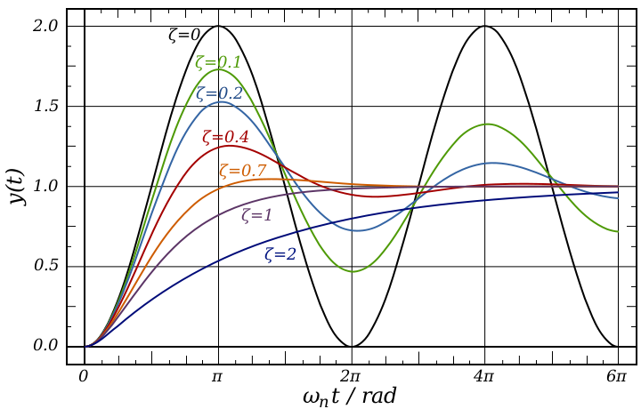
Notes:
The radian is a unit of plane angle, equal to 180/π (or 360/2π) degrees, or about 57.2958 degrees, or about 57°17′45″. It is the standard unit of angular measurement in all areas of mathematics beyond the elementary level.

Slide 50
Simulating Transfer Functions
For complex transfer functions, cannot analyze
Solution: Simulate
Observation:
Inputs
Initial conditions (depends on system order)
u(k)

Slide 51
Transfer Functions: Summary
Transfer Functions are expressed as polynomials in z
We can predict BIBO stability from the poles of a TF
We can calculate steady-state gain from a TF
We can build simplified TF from a high-order TF that has similar steady-state gain and settling time (see Chapter 6 of [1])
It is usually easy to convert a difference eq to a TF
Can usually plug into the general ARX form
One can simulate a TF by converting back to difference equation

Slide 52
Outline
Examples and Motivation
Control Theory Vocabulary and Methodology
Modeling Dynamic Systems
Transient Behavior Analysis
Standard Control Actions
Advanced Topics
Issues for Computer Systems

Slide 53
Objectives of Control for Computing Systems: SASO
Stability
Accuracy
Settling time
Overshoot
Notes:
The stability of a general dynamical system with no input can be described with Lyapunov stability criteria.
A linear system is called bounded-input bounded-output (BIBO) stable if its output will stay bounded for any bounded input.
Stability for nonlinear systems that take an input is input-to-state stability (ISS), which combines Lyapunov stability and a notion similar to BIBO stability.
For simplicity, the following descriptions focus on continuous-time and discrete-time linear systems.
Mathematically, this means that for a causal linear system to be stable all of the poles of its transfer function must have negative-real values, i.e. the real part of each pole must be less than zero. Practically speaking, stability requires that the transfer function complex poles reside
in the open left half of the complex plane for continuous time, when the Laplace transform is used to obtain the transfer function.
inside the unit circle for discrete time, when the Z-transform is used.

Slide 54
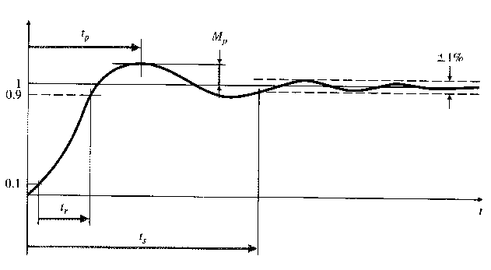
Characteristics of Transient Response
Controlled
variable
Overshoot
Steady state error
±ε%
Reference
Transient State
Steady State
Time
Settling time
Rise time

Slide 55
Transient Response
Estimates the shape of the curve based on the foregoing points on the x and y axis
Typically applied to the following inputs
Impulse
Step
Ramp
Quadratic (Parabola)

Slide 56
Effect of pole locations: continuous time
Oscillations
(higher-freq)
Im(s)
Faster Decay
Faster Blowup
(e^{-at})
Re(s)
(e^{at})

Slide 57
Root-Locus Analysis
Based on characteristic equation of closed-loop transfer function
Plot location of roots of this equation
Same as poles of closed-loop transfer function
Parameter (gain) varied from 0 to ∞
Multiple parameters are ok
Vary one-by-one
Plot a root “contour” (usually for 2-3 parameters)
Quickly get approximate results
Range of parameters that gives desired response
Notes:
characteristic eqn: denominator of transfer function = 0
https://en.wikipedia.org/wiki/Root_locus

Slide 58
Root Locus analysis of Discrete Systems
Stability boundary: |z|=1 (Unit circle)
Settling time: distance from Origin
Oscillation frequency: location relative to Im. axis
Right half => slower
Left half => faster
Notes:
Jlh: Can this be combined with the picture on the next page?

Slide 59
Effect of discrete poles
Im(s)
Higher-frequency
response
Longer settling time
Stable
Re(s)
Unstable
|z|=1

Slide 60
Admission Control for Lotus Notes Server
E(z)
U(z)
Q(z)
R(z)
+
Σ
G(z)
N(z)
S(z)
-
Controller
Notes
Sensor
Server
M(z)
Transfer Functions
ARMA Models
Control Law
Open-Loop:

Slide 61
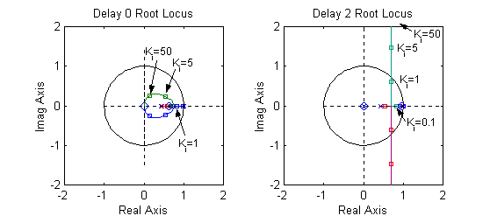
Root Locus Analysis of Admission Control
Predictions:
K_{i} small => No controller-induced oscillations
K_{i} large => Some oscillations
K_{i} v. large => unstable system (when delay=2)
Usable range of K_{i} for delay=2 is small

Slide 62
Experimental Results
Response
(queue length)
Good
Bad
Control
(MaxUsers)
Slow
Useless

Slide 63
Outline
Examples and Motivation
Control Theory Vocabulary and Methodology
Modeling Dynamic Systems
Transient Behavior Analysis
Standard Control Actions
Advanced Topics
Issues for Computer Systems

Slide 64
Basic Control Actions: u(t)
Notes:
Jlh: Can we give more intuition on control actions. This seems real brief considering its importance.

Slide 65
Effect of Control Actions
Proportional Action
Adjustable gain (amplifier)
May have non-zero steady-state error
Integral Action
Eliminates bias (steady-state error)
Can cause oscillations
Derivative Action (“rate control”)
Effective in transient periods
Provides faster response (higher sensitivity)
Never used alone

Slide 66
Basic Controllers
Proportional control is often used by itself
Integral and differential control are typically used in combination with at least proportional control
eg, Proportional Integral (PI) controller:

Slide 67
Summary of Basic Control
Proportional control
Multiply e(t) by a constant
PI control
Multiply e(t) and its integral by separate constants
Avoids bias for step
PD control
Multiply e(t) and its derivative by separate constants
Adjust more rapidly to changes
PID control
Multiply e(t), its derivative and its integral by separate constants
Reduce bias and react quickly

Slide 68
Outline
Examples and Motivation
Control Theory Vocabulary and Methodology
Modeling Dynamic Systems
Transient Behavior Analysis
Standard Control Actions
Advanced Topics
Issues for Computer Systems

Slide 69
Advanced Control Topics
MIMO Control
Multiple inputs and/or outputs
Robust Control
Can the system tolerate noise?
Adaptive Control
Controller changes over time (adapts)
Stochastic Control
Controller minimizes variance
Optimal Control
Controller minimizes a cost function (e.g., function of error)
Nonlinear systems
Challenging to derive analytic results
Notes:
Stochastic control is a subfield of control theory which addresses the design of a control methodology to address the probability of uncertainty in the data. In a stochastic control problem, the designer assumes that random noise and disturbances exist in the model and in the controller, and the control design must take into account these random deviations.^{[1]}
Stochastic control aims to predict and to minimize the effects of these random deviations, by optimizing the design of the controller.[
Optimal Control
Controller minimizes a cost function of error and control energy
Nonlinear systems
Neuro-fuzzy control
Challenging to derive analytic results
A fuzzy control system is a control system based on fuzzy logic - a mathematical system that analyzes analog input values in terms of logical variables that take on continuous values between 0 and 1, in contrast to classical or digital logic, which operates on discrete values of either 0 and 1 (true and false).

Slide 70
Outline
Examples and Motivation
Control Theory Vocabulary and Methodology
Modeling Dynamic Systems
Transient Behavior Analysis
Standard Control Actions
Advanced Topics
Issues for Computer Systems

Slide 71
Issues for Computer Science
Most systems are non-linear
But linear approximations may do
E.g., fluid approximations
First-principle modeling is difficult
Use empirical techniques
Control objectives are different
Optimization rather than regulation
Multiple Controls
State-space techniques
Advanced non-linear techniques (e.g., neural networks)
Notes:
https://www.uni-obuda.hu/journal/Zilkova_Timko_Girovsky_8.pdf

Slide 72
Summary
Examples and Motivation
Control Theory Vocabulary and Methodology
Modeling Dynamic Systems
Transient Behavior Analysis
Standard Control Actions
Advanced Topics
Issues for Computer Systems

Slide 73
References
Control Theory Basics
[1] Joseph L. Hellerstein, Yixin Diao, Sujay Parekh, Dawn M. Tilbury, Feedback Control of Computing Systems, Wiley-IEEE Press, 2004. (ISBN: 978-0-471-26637-2)
[2] G. Franklin, J. Powell and A. Emami-Naeini. “Feedback Control of Dynamic Systems, 3rd ed”. Addison-Wesley, 1994.
[3] K. Ogata. “Modern Control Engineering, 3rd ed”. Prentice-Hall, 1997.
[4] K. Ogata. “Discrete-Time Control Systems, 2nd ed”. Prentice-Hall, 1995.
Applications in Computer Science
C. Hollot et al. “Control-Theoretic Analysis of RED”. IEEE Infocom 2001
C. Lu, et al. “A Feedback Control Approach for Guaranteeing Relative Delays in Web Servers”. IEEE Real-Time Technology and Applications Symposium, June 2001.
S. Parekh et al. “Using Control Theory to Achieve Service-level Objectives in Performance Management”. Int’l Symposium on Integrated Network Management, May 2001
Y. Lu et al. “Differentiated Caching Services: A Control-Theoretic Approach”. Int’l Conf on Distributed Computing Systems, Apr 2001
S. Mascolo. “Classical Control Theory for Congestion Avoidance in High-speed Internet”. Proc. 38th Conference on Decision & Control, Dec 1999
S. Keshav. “A Control-Theoretic Approach to Flow Control”. Proc. ACM SIGCOMM, Sep 1991
D. Chiu and R. Jain. “Analysis of the Increase and Decrease Algorithms for Congestion Avoidance in Computer Networks”. Computer Networks and ISDN Systems, 17(1), Jun 1989

Slide 74
Assignment
Module 2 Quiz-B
Fundamentals of Real-Time Scheduling
Fundamentals of Control Theory

