Slide 1
Fundamentals of Computer Networking
Hongwei Zhang
hongwei@iastate.edu, 515 294 2143
http://www.ece.iastate.edu/~hongwei
Ref. book: Anurag Kumar, D. Manjunath, Joy Kuri, Communication Networking: An Analytical Approach, Morgan Kaufmann, 2004.
Acknowledgement: this lecture is partially based on the slides of Dr. D. Manjunath
Notes:
Chapter 2, 4, 5

Slide 2
Outline
Functional elements of networking
Deterministic traffic models and network calculus
Stochastic analysis

Slide 3
Outline
Functional elements of networking
Deterministic traffic models and network calculus
Stochastic analysis

Slide 4
Functional Elements of Networking
Networking as resource sharing
Functional elements
Multiplexing
Switching
Routing
Network management
Traffic controls and timescales

Slide 5
Functional Elements of Networking
Networking as resource sharing
Functional elements
Multiplexing
Switching
Routing
Network management
Traffic controls and timescales

Slide 6
A layered view
A three-layered view of a communication network. “Networking” is concerned with resource sharing mechanisms that efficiently share the bit carrier infrastructure, and control the quality of service provided to the various applications using the network

Slide 7
Computer OS Analogy
Distributed
Applications
information
(e.g., calculation, accounting,
applications
database)
(e.g., www, e-commerce, teleconf, CPS)
Distributed
Computer
algorithms for
operating system
information transport
(e.g., Unix, Linux, Windows)
(e.g., X.25, Internet, CPN)
Hardware
Network of
(e.g., processor, memory,
communication links
disk drives, sound card)
Networking is concerned with distributed algorithms for efficient sharing of bit carrier network resources. Very similar to OS of a computer helping applications to use and share hardware resources

Slide 8
Functional Elements of Networking
Networking as resource sharing
Functional elements
Multiplexing
Switching
Routing
Network management
Traffic controls and timescales

Slide 9
Functional elements: consider a sample information flow
After source prepares the bits for transportation, “network” decides how to route flow over physical network
Infrastructure is shared by many such flows. Hence network has to decide how to multiplex this flow with other flows.
Flow may traverse multiple links. At junction of two links, switch flow elements to target link.
Need to monitor network behavior and collect status information; possibly handle situations for which network is not engineered. i.e., perform network management.

Slide 10
Multiplexing
Sharing a communication link is multiplexing
Systematically merging several data flows into one bit-pipe
Two types of multiplexing:
Circuit multiplexing
Packet multiplexing

Slide 11
Circuit Multiplexing on a Link
Link capacity is statically partitioned into channels (possibly different capacities)
Frequency, Time, Space and Code Division Multiplexing
Each conversation (flow) is allocated to a channel for the entire duration of call — the call holds the channel
Connection setup is required to allocate resources
Fixed rate allocated at time of connection setup determines the peak rate at which the source can transmit data
A call (request for resources) can be blocked if all the channels are busy

Slide 12
Performance measures:
Connection setup delay
Call blocking probability
A typical design problem:
What should be the link capacity for a given load and specified blocking probability?
The link may also have to handle different classes of flows, each with a different blocking probability requirement

Slide 13
Circuit multiplexing: resource allocation model
Static partitioning of bandwidth in a circuit switched network

Slide 14
Inefficiency of Circuit Multiplexing: Not Always?
Traditional Internet traffic sources and some cyber-physical network (CPN) sources generate data in bursts:
Traditional Internet
Voice: Talk and silence spurts
Video: Scene changes
Telnet: Typing behaviour
Web browsing patterns: Think times between downloads
Event detection CPN applications
Some CPN sources may generate periodic traffic, which is suitable for (virtual) circuit multiplexing

Slide 15
Motivation for packet multiplexing
Bursty traffic sources
Average rate is much lower than peak rate
Capacity is wasted during “lean periods”

Slide 16
Packet multiplexing
No partitioning of the bit pipe
Apply entire bit rate to a source and hence, each packet gets the entire bit pipe for shorter periods of time
Packets need to contain header and trailer information to identify with a specific information flow (source, destination, application, etc.)

Slide 17
Source peak rate can exceed link rate
Packets may need to be queued;
If buffer capacity is not sufficient, packets may be dropped and hence lost
Abstraction:
Link is a server serving customers waiting in a queue
Performance measures:
Packet delay
Loss characteristics

Slide 18
Multiplexing summary

Slide 19
Switching: motivation
A six node network constructed in three ways—(a) A brute force way. (b) Every node is connected to a central switch that selectively establishes paths between nodes and (c) Hierarchical network with inter-switch links with possibly multiplexing on it.

Slide 20
Switching
Information flow will traverse more than one link
Switch is required at junction of two or more links
Switch selectively establishes and releases connections between communication links to allow sharing of these links among a number of flows (connections)
Switch moves information from link to link by demultiplexing on the inbound link and multiplexing on the selected outbound link
Notes:
A switch is required with circuit multiplexing and centralised packet multiplexing

Slide 21
Components of a packet switch

Slide 22
Functions of a switch
Two categories, also called planes, of functions
data plane
control plane
Data plane functions
Demultiplex the flow (e.g., packet or time slot) on the input link
Switch the flow element onto the appropriate output link
Multiplex the flows on the output link
Fast timescale functions: performed per packet/frame
Specialized hardware may be used for these high speed functions
Notes:
Every packet or slot in a TDM frame needs to be processed

Slide 23
Control plane functions
Connection setup and resource allocation/reservation
Achieved through source-network and switch-switch signaling
Functions performed over connection (flow) arrival timescales
General purpose processors can be used
Routing and local conditions information dissemination
Usually performed at timescales at which traffic characteristics change
Notes:
Increasing interest in parallelization

Slide 24
Design issues in a packet switch
Control and signaling functions include
populating the routing table
participating in distributed algorithms associated, for example, with routing
Datagram packet switches:
every packet of a flow is treated independent of previous packets in the flow: queueing, address lookup, packet classification, etc.
Virtual circuit packet switches:
Connection setup to allocate path and resources on links on path to the flow
Packets are assigned link level labels, and switched based on labels
Performance measures
switching delay in getting to the output queue
packet loss rate
Notes:
Input and output lines could be slotted or unslotted
Correspondingly, packets lengths and interarrival time have discrete or continuous distributions
Packet lengths could be fixed or variable

Slide 25
Routing
A route is an ordered sequence of links between a source and a destination
A network node, or a switch, performs the routing function along with multiplexing and switching;
Nonetheless, routing is a “network wide” function and the nodes collaborate in making routing decisions

Slide 26
Design and Performance Issues
Routing protocols:
What information to exchange, how often, how to exchange
Source routing vs. hop-by-hop routing
Hop-by-hop routing: distance vector vs. path-vector vs. link-state routing
Routing Algorithms:
Objective functions for best effort routing and QoS routing

Slide 27
Performance measures
Connection blocking probability
only relevant in circuit multiplexed networks
Load imposed on the network
Adaptation to changes in the network conditions
Notes:
In datagram networks, connections are not set up. Hence no concept of connection blocking.
Virtual circuit based networks use packet multiplexing but set up a connection before data transfer begins to alert the switches of the creation of a flow

Slide 28
Network management
Handle conditions for which the network is not engineered
Different from ‘congestion control’ where the overload conditions are short lived
All operational networks define a management architecture to collect information and control the network resources
Performance data are collected by managed network devices, these in turn are gathered by a network management station in the network that will analyze the data that has been collected

Slide 29
The management architecture provides some control functions that can be performed on remote managed devices by management stations either in a programmed manner or through an operator
Security issues are also handled by a network management architecture

Slide 30
Traffic controls and timescales
Network functions cover a wide variety of timescales
a few microseconds to minutes to months and years
Four relative timescales:
Packet timescale (packet transmission time; seconds or milliseconds/ microseconds)
Session, call or flow timescale (typically minutes)
Busy hour or traffic variation timescale (typically hours)
Provisioning timescale (usually hours to days or weeks/months/years)

Slide 31
Summary: Functional Elements of Networking
Networking as resource sharing
Functional elements
Multiplexing
Switching
Routing
Network management
Traffic controls and timescales

Slide 32
Outline
Functional elements of networking
Deterministic traffic models and network calculus
Stochastic analysis

Slide 33
Deterministic traffic models & network calculus
Events and processes: universal concepts
Deterministic traffic models and network calculus
Connection setup: RSVP approach

Slide 34
Deterministic traffic models & network calculus
Events and processes: universal concepts
Deterministic traffic models and network calculus
Connection setup: RSVP approach

Slide 35
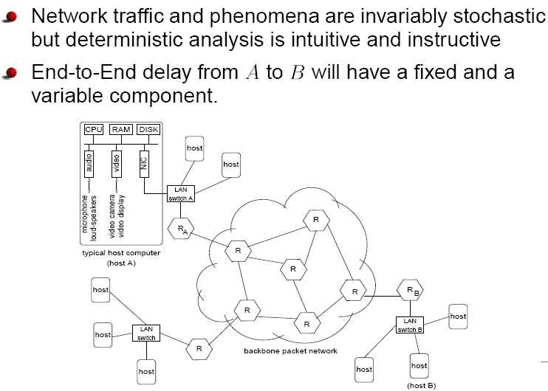
Introduction

Slide 36
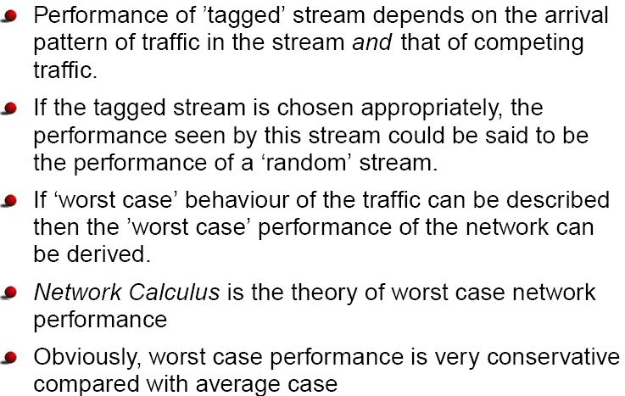

Slide 37
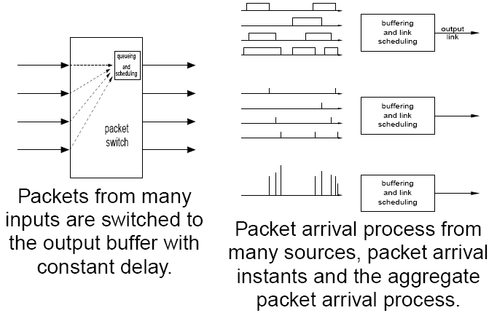
Model and notation
time
Assume output queueing

Slide 38
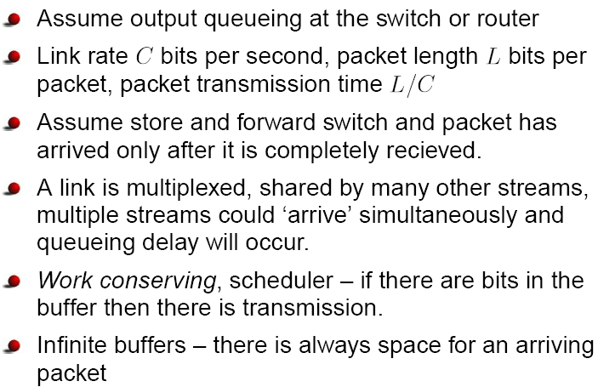
Also called non-idling scheduler

Slide 39
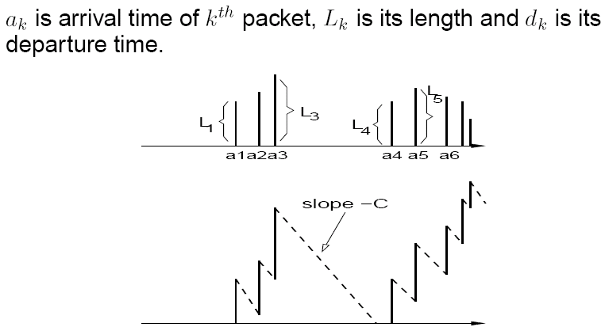

Slide 40
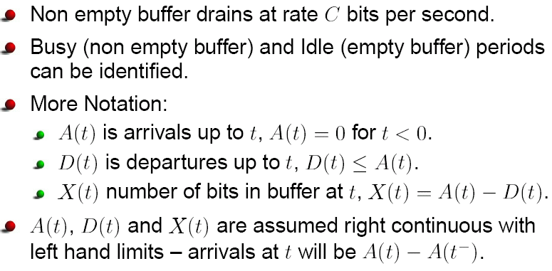
A packet arrival at t is included in the cumulative arrivals counted by A(t)

Slide 41
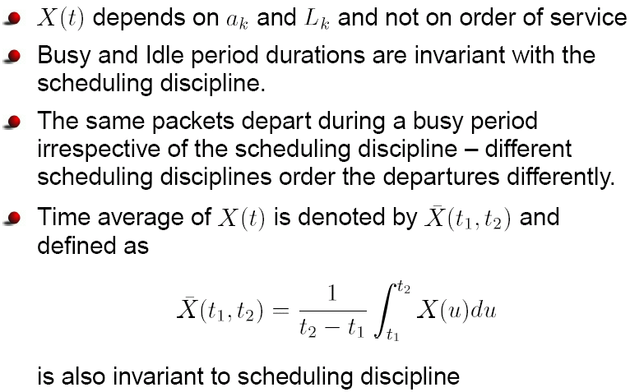
Some simple analysis
For work-conserving/non-idling schedulers

Slide 42
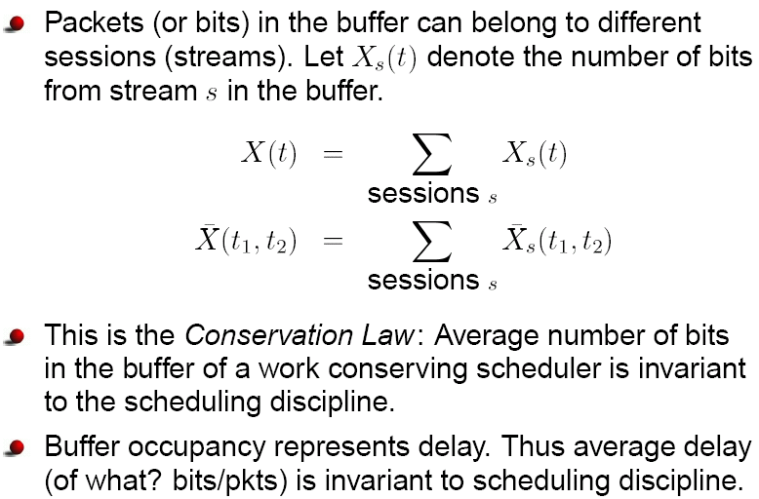

Slide 43
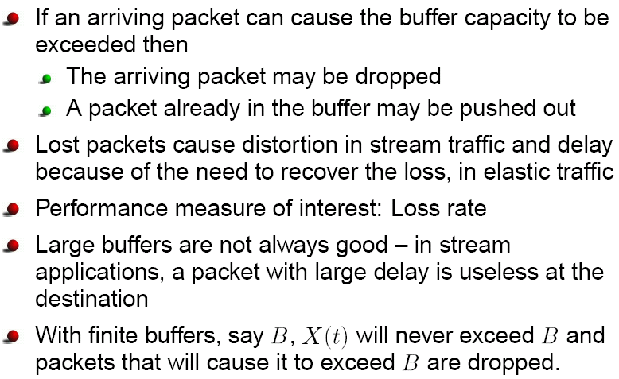
Finite buffer

Slide 44

Finite buffer: conservation law

Slide 45
Deterministic traffic models & network calculus
Events and processes: universal concepts
Deterministic traffic models and network calculus
Connection setup: RSVP approach

Slide 46

Reich’s Equation
Reich’s Equation
The supremum is achieved when s = v, i.e., the last time before t when buffer was empty

Slide 47
Network calculus
A view of network calculus: Work with sample paths of a random process.
Networks see a sample path of a random process, e.g., X(t, ω)
Network calculus is a sample path analysis in which the sample path satisfies certain properties.
It can be assumed that these properties are satisfied by all sample paths. Thus network calculus or the deterministic analysis is a worst-case analysis.
An example objective is to obtain X(t) from A(t) and C of a work conserving scheduler
We are also interested in other processes such as D(t) and other performance parameters such as worst-case latency

Slide 48
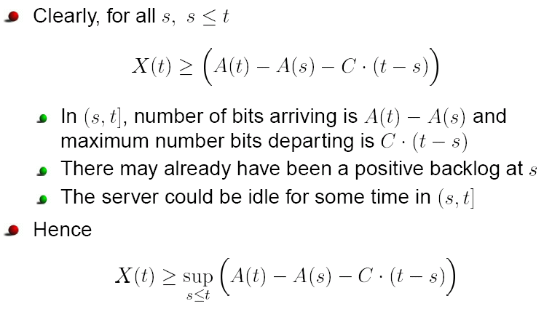
Derivation of Reich’s equation

Slide 49
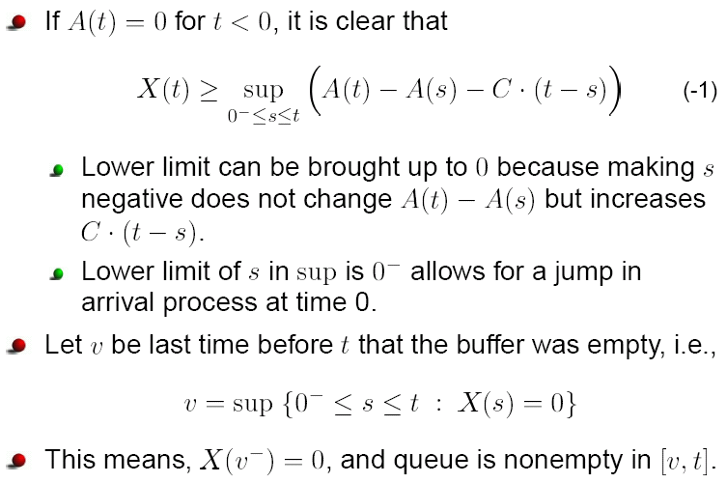

Slide 50
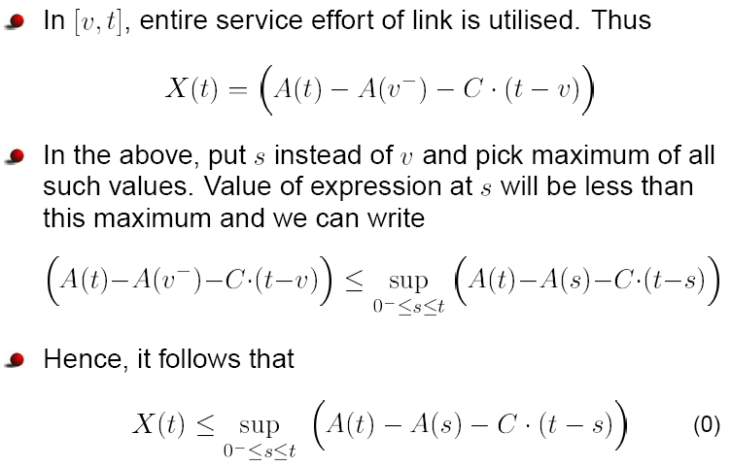

Slide 51
Combine equations (-1) and (0), we get Reich’s Equation
The supremum is achieved when s = v, i.e., the last time before t when buffer was empty

Slide 52
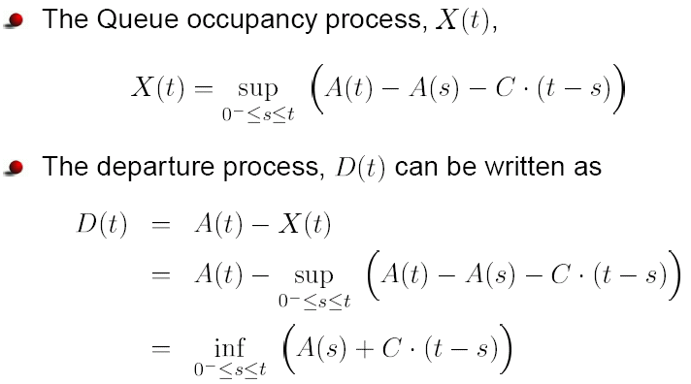
An equation for the departure process D(t)

Slide 53
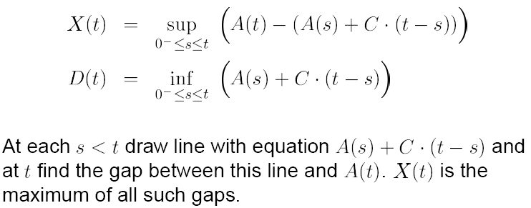
Interpretation of Reich’s Equation

Slide 54
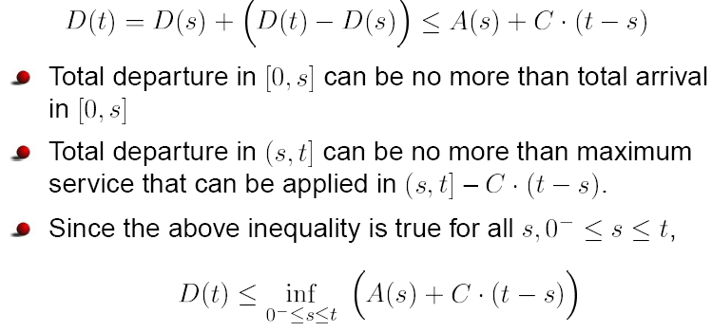
Alternative/direct derivation of D(t) equation

Slide 55
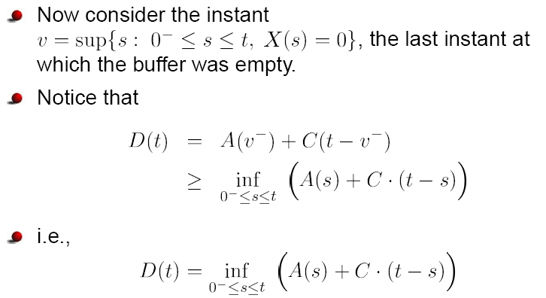
Direct derivation of D(t) (contd.)

Slide 56
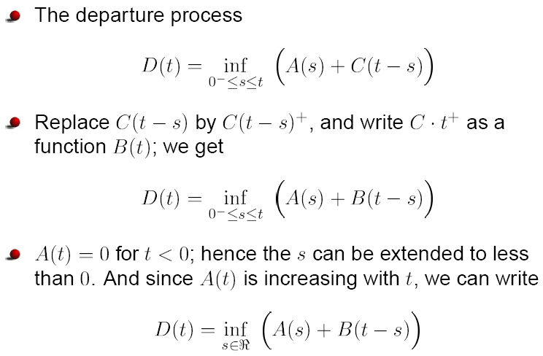
A convolution operation: *
nondecreasing

Slide 57
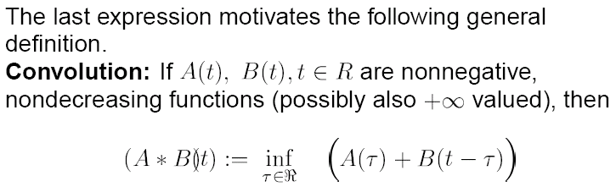

Slide 58
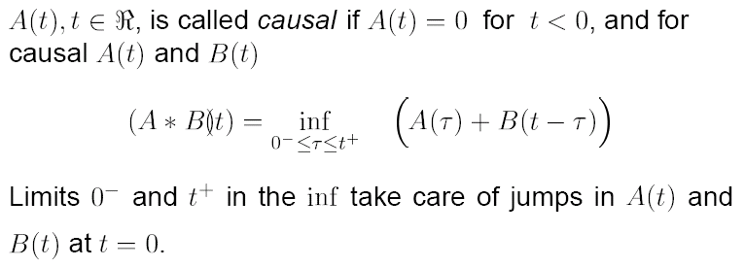
Remarks

Slide 59
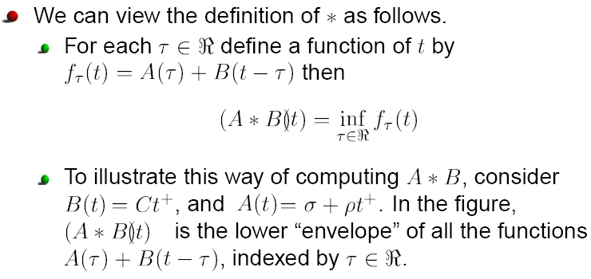
Remarks (contd.)

Slide 60
Illustration
A
(
t
)
slope
r
B
(
t
)
slope
C
s
t
t
B
(
t
)
B(τ)+A(t-τ)
(
B
*
A
)(
t
)
slope
r
τ
t
slope
C

Slide 61
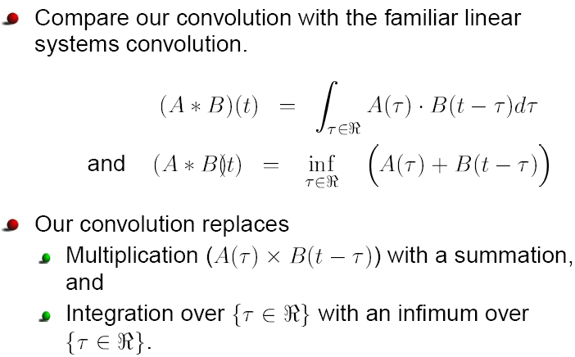
Compare * with standard convolution

Slide 62
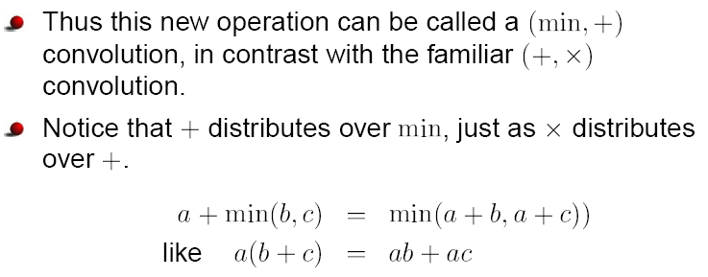

Slide 63
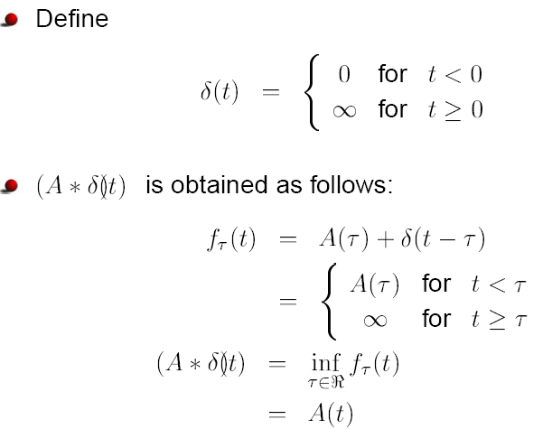
An example

Slide 64
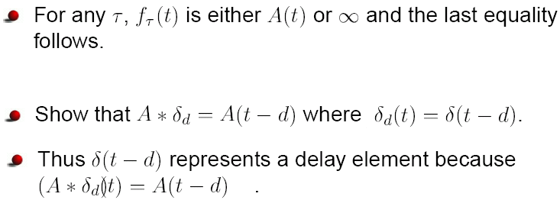

Slide 65
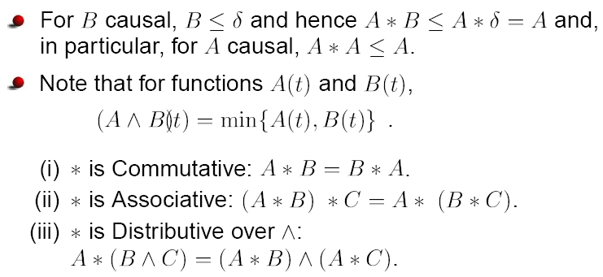
Properties of *

Slide 66
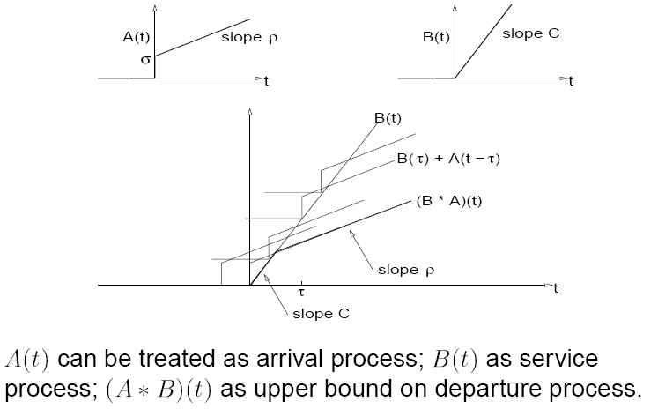
Service curves
the

Slide 67
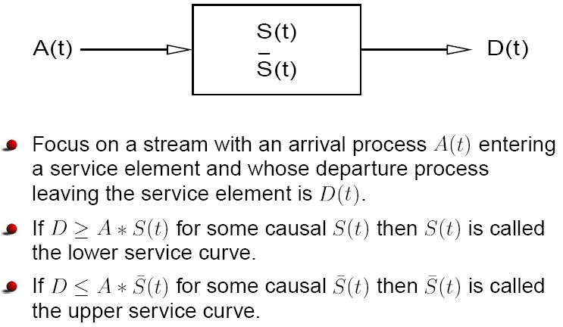

Slide 68
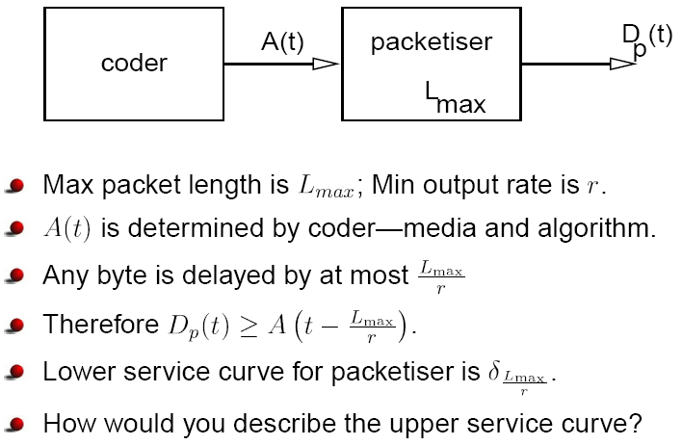

Example network elements: packetizer
Notes:
δ(t)

Slide 69
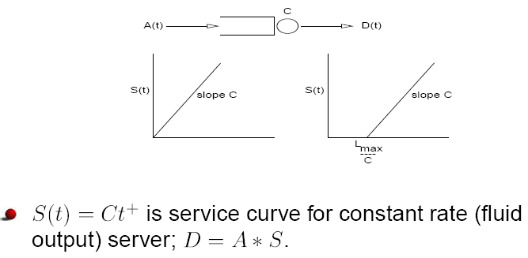
Example elements: constant rate server

Slide 70
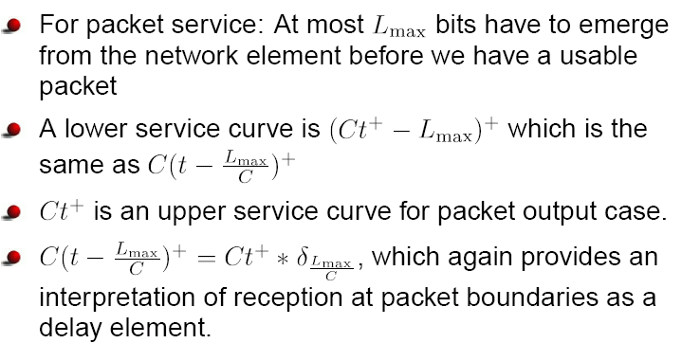

Slide 71
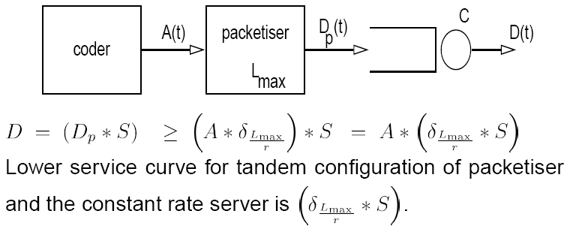
Network elements: packetizer + constant rate server

Slide 72
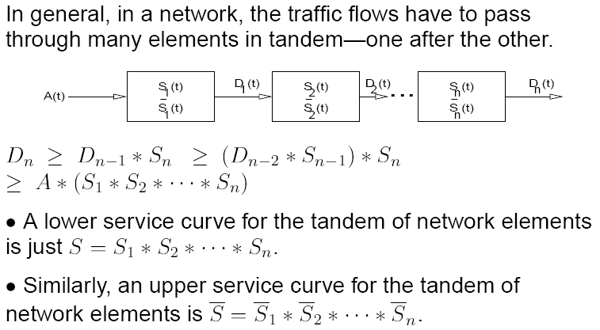
Network elements in tandem

Slide 73
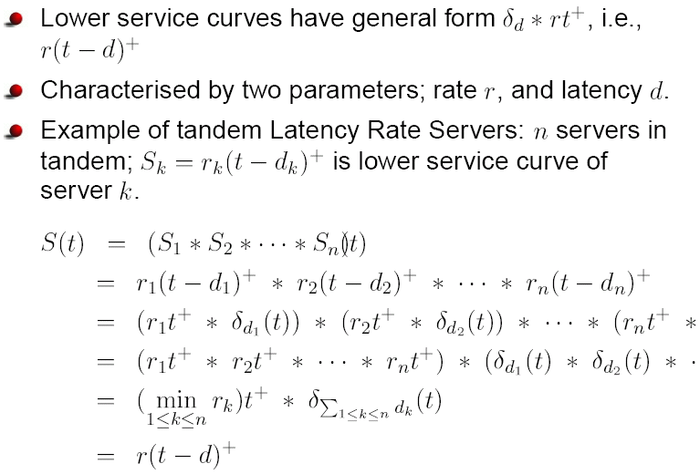
Latency rate servers in tandem

Slide 74
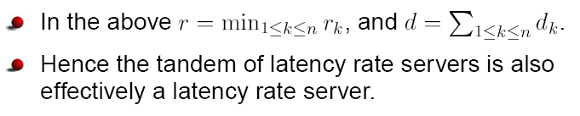

Slide 75
Delay in a service element

Slide 76
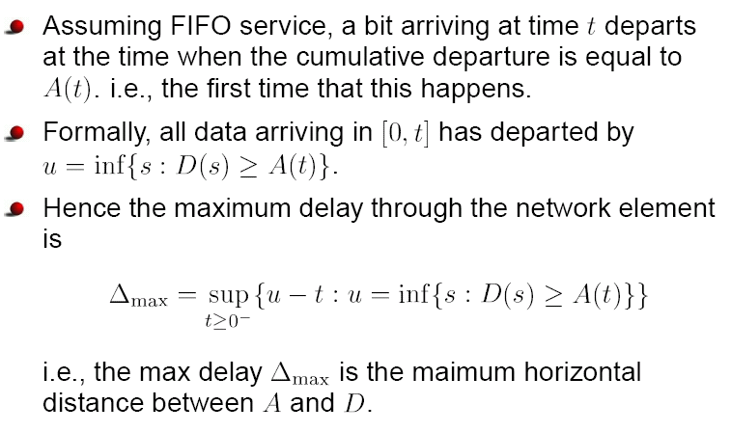

Slide 77
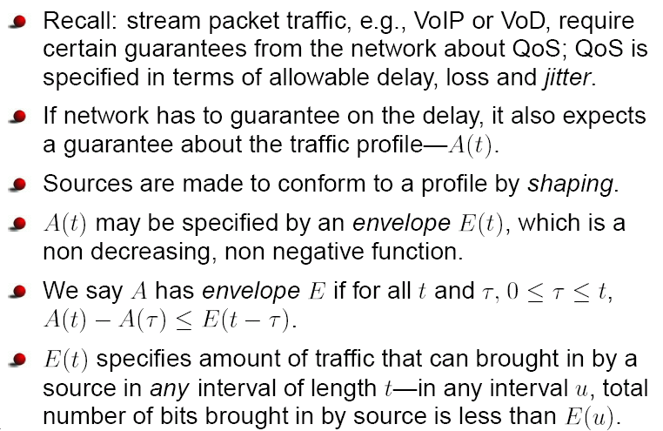
Stream traffic, QoS, envelop, regulator

Slide 78
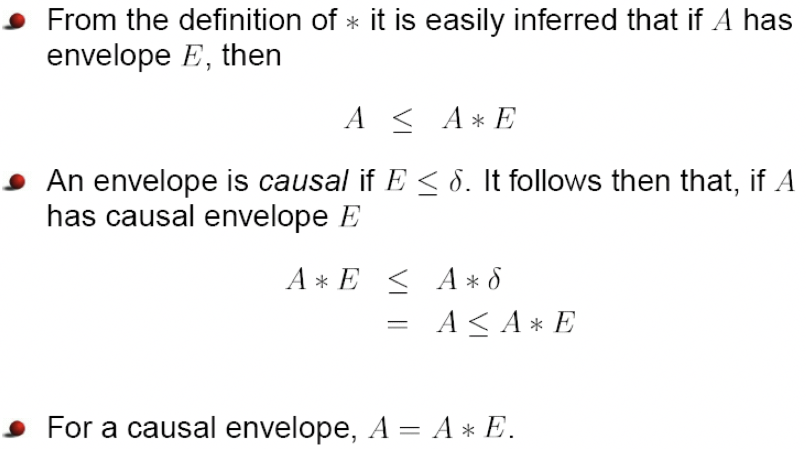
Envelope (contd.)

Slide 79
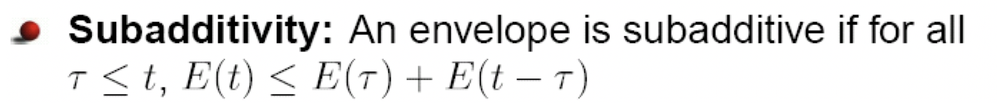
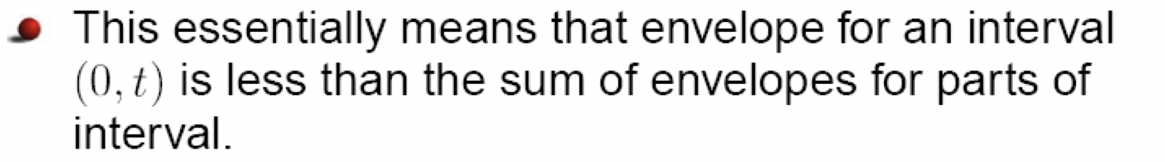



Slide 80
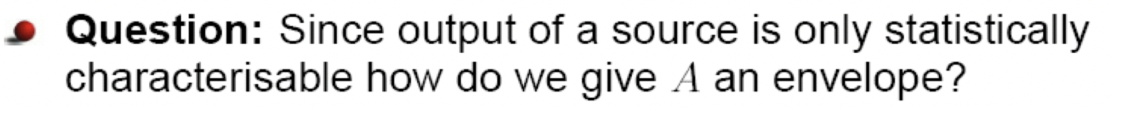
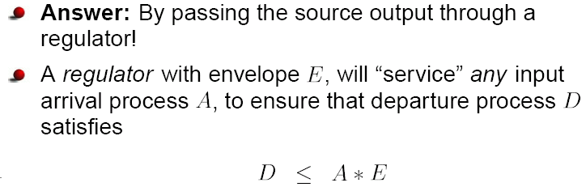
Regulator

Slide 81
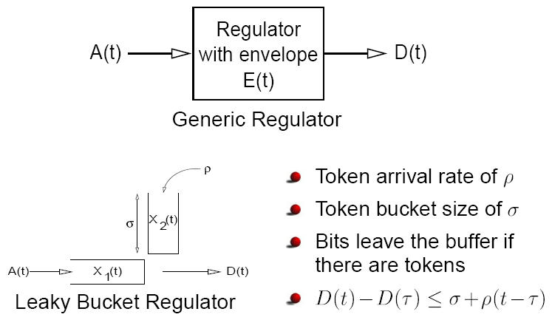
Regulator example: leaky bucket

Slide 82
Token arrival process
σ

Slide 83
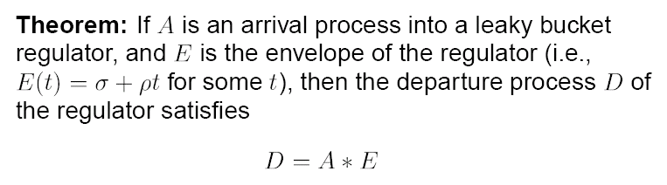
E(t) = 0 for t < 0

Slide 84
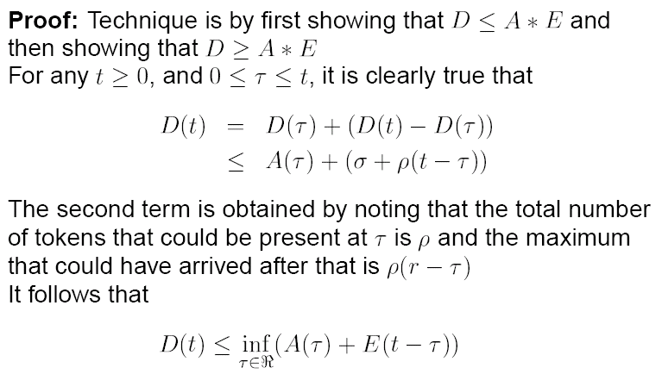

Slide 85
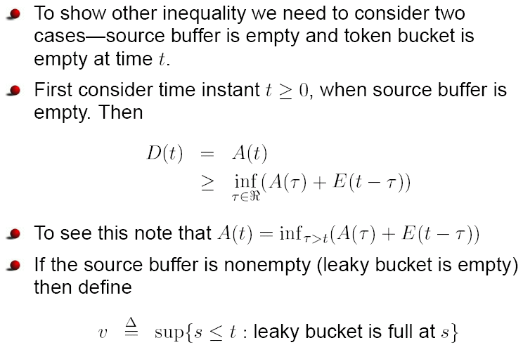

Slide 86
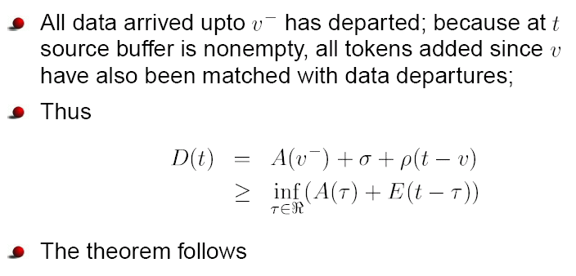

Slide 87
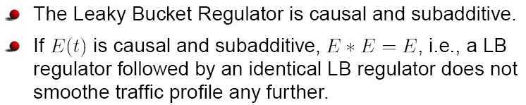
Sequence of regulators

Slide 88
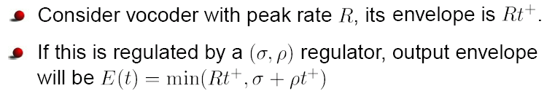
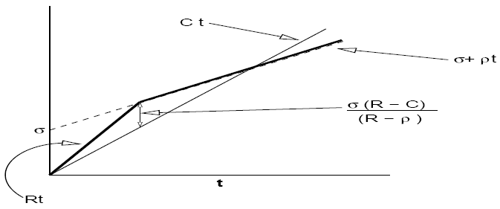
An example

Slide 89
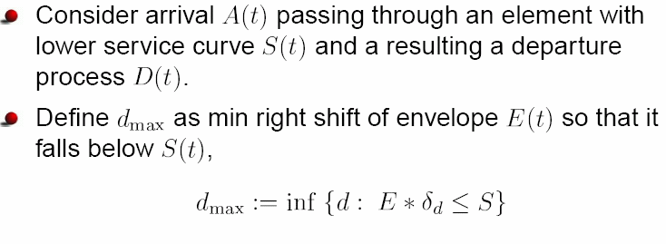
Network performance and design
With envelop E(t)

Slide 90


Slide 91


Slide 92


Slide 93

Otherwise, C_{min} is not the minimum capacity (see book by Anurag Kumar et al.)

Slide 94


Slide 95

Theory applied in practice: an example

Slide 96


Slide 97
Deterministic traffic models & network calculus
Events and processes: universal concepts
Deterministic traffic models and network calculus
Connection setup: RSVP approach

Slide 98
RSVP and IntServ

Slide 99
(σ, ρ, R)
0
1
K
−
1
K
max packet
LAN
Γ
Γ
Γ
C
Γ
=
∞
length
L
c
0
c
1
c
k
−
1
k
`
WAN
- LAN router
transmission rate at each link i is G_{i}
Notes:
Transmission rate at each link i is \tau_i

Slide 100


Slide 101



Slide 102


How to compute c in RSVP?

Slide 103
Outline
Functional elements of networking
Deterministic traffic models and network calculus
Stochastic analysis
Notes:
To check: “A basic stochastic network calculus”, 2006

Slide 104
Stochastic Analysis
Loose bounds by deterministic calculus
Stochastic traffic models
Performance measures
Little’s Theorem, Brumelle’s Theorem and applications
Multiplexer analysis with stationary and ergodic traffic
Effective bandwidth approach to admission control
Stochastic analysis with shaped traffic
Multihop networks
Long-range-dependent traffic

Slide 105
Stochastic Analysis
Loose bounds by deterministic calculus
Stochastic traffic models
Performance measures
Little’s Theorem, Brumelle’s Theorem and applications
Multiplexer analysis with stationary and ergodic traffic
Effective bandwidth approach to admission control
Stochastic analysis with shaped traffic
Multihop networks
Long-range-dependent traffic

Slide 106

Recap of deterministic analysis

Slide 107

Review: Law of large numbers & central limit theorem

Slide 108

Deterministic analysis can yield loose bounds: an motivating example

Slide 109


Slide 110


Slide 111


Slide 112


Slide 113


Slide 114
Stochastic Analysis
Loose bounds by deterministic calculus
Stochastic traffic models
Performance measures
Little’s Theorem, Brumelle’s Theorem and applications
Multiplexer analysis with stationary and ergodic traffic
Effective bandwidth approach to admission control
Stochastic analysis with shaped traffic
Multihop networks
Long-range-dependent traffic

Slide 115

Stochastic traffic model

Slide 116

Model for a single stream source

Slide 117


Slide 118

Superposition of sources

Slide 119

# of active sources

Slide 120


Slide 121


Slide 122
Stochastic Analysis
Loose bounds by deterministic calculus
Stochastic traffic models
Performance measures
Little’s Theorem, Brumelle’s Theorem and applications
Multiplexer analysis with stationary and ergodic traffic
Effective bandwidth approach to admission control
Stochastic analysis with shaped traffic
Multihop networks
Long-range-dependent traffic

Slide 123

Some (additional) notation

Slide 124

Performance measures

Slide 125



Slide 126


Slide 127
Stochastic Analysis
Loose bounds by deterministic calculus
Stochastic traffic models
Performance measures
Little’s Theorem, Brumelle’s Theorem and applications
Multiplexer analysis with stationary and ergodic traffic
Effective bandwidth approach to admission control
Stochastic analysis with shaped traffic
Multihop networks
Long-range-dependent traffic

Slide 128

Little’s Theorem

Slide 129


Slide 130

Derivation

Slide 131


Slide 132


Slide 133


Slide 134


Slide 135


Slide 136

Discussion

Slide 137

Invariance of mean system time

Slide 138


Slide 139

Generalization of Little’s Theorem: Brumelle’s Theorem

Slide 140


Slide 141

Recall: queueing system notation

Slide 142

Mean queue length in an M/G/1 queue

Slide 143


Slide 144

M/G/1 queue: remarks

Slide 145
Stochastic Analysis
Loose bounds by deterministic calculus
Stochastic traffic models
Performance measures
Little’s Theorem, Brumelle’s Theorem and applications
Multiplexer analysis with stationary and ergodic traffic
Effective bandwidth approach to admission control
Stochastic analysis with shaped traffic
Multihop networks
Long-range-dependent traffic

Slide 146

Multiplexer analysis

Slide 147

Recall: Birkhoff’s Ergodic Theorem

Slide 148

Analysis with marginal buffering (i.e., bufferless)

Slide 149


Slide 150


Slide 151

Marginal buffering: example

Slide 152

Recall: inequalities

Slide 153


Slide 154

by

Slide 155

Special case: let y = 0
$Pr\left(Y ≥0\right)≤E(e^{θY})$

Slide 156

Recall: limit theorems

Slide 157

Link design: taking advantage of statistical multiplexing

Slide 158


Slide 159

Analysis using central limit theorem

Slide 160


Slide 161

Analysis using Chernoff bound

Slide 162


Slide 163


Slide 164

From (ii) and (iii): for α > E(X1), l(α) is nondecreasing

Slide 165

Example 5.4: the two-state Markov source

Slide 166


Slide 167


Slide 168


Slide 169

Cramer’s theorem

Slide 170


Slide 171

Multiplexing gain, link engineering, and admission control

Slide 172

But, given the same resource provisioning, N would be larger in packet switching.

Slide 173


Slide 174

Analysis with arbitrary buffering

Slide 175

Stationary queue length: continuous time

Slide 176


Slide 177


Slide 178


Slide 179

Stationary queue length: discrete time

Slide 180


Queue length analysis using Chernoff’s Bound: Effective bandwidth

Slide 181



Then
, for some constant K

Slide 182


Slide 183


Slide 184

)

Slide 185


Slide 186

Example

Slide 187


Slide 188

Some properties of e(θ)

Slide 189


Slide 190


Slide 191

Calculating Γ(θ) for a Discrete Time Markov Source

Slide 192


Slide 193


Slide 194


Slide 195


Slide 196

Stationary Buffer Distribution Asymptotics: A Review

Slide 197
Remark
A capacity of C = Γ(θ)/ θ is not only sufficient but also necessary for achieving the desired QoS objective θ
See analysis on PP. 227 – 230 of Anurag book for the analysis

Slide 198

An Approximation to the Stationary Buffer Distribution

Slide 199


Slide 200


Slide 201
Stochastic Analysis
Loose bounds by deterministic calculus
Stochastic traffic models
Performance measures
Little’s Theorem, Brumelle’s Theorem and applications
Multiplexer analysis with stationary and ergodic traffic
Effective bandwidth approach to admission control
Stochastic analysis with shaped traffic
Multihop networks
Long-range-dependent traffic

Slide 202


For large x,

Slide 203


Slide 204

(only) for small x
Notes:
n2, n1: # of sources

Slide 205


Slide 206

Guerin, Ahmadi, Nagshineh (GAN) approach

Slide 207


Slide 208

X_{max} affects whether C₀ or C_{EBW} is chosen

Slide 209
Stochastic Analysis
Loose bounds by deterministic calculus
Stochastic traffic models
Performance measures
Little’s Theorem, Brumelle’s Theorem and applications
Multiplexer analysis with stationary and ergodic traffic
Effective bandwidth approach to admission control
Stochastic analysis with shaped traffic
Multihop networks
Long-range-dependent traffic

Slide 210
Stochastic Analysis
Loose bounds by deterministic calculus
Stochastic traffic models
Performance measures
Little’s Theorem, Brumelle’s Theorem and applications
Multiplexer analysis with stationary and ergodic traffic
Effective bandwidth approach to admission control
Stochastic analysis with shaped traffic
Multihop networks
Long-range-dependent traffic

Slide 211
Stochastic analysis with shaped traffic
Leaky bucket (LB) shaped traffic
Challenge for stochastic analysis and traffic engineering with LB parameters alone is that they only specify the worst case behavior and do not uniquely specify a statistical characterization of the source
Solution
To analyze by assuming, for each source, a model compatible with the LB parameters but one that leads to the worst performance
Thus, the problem reduces to one of determining the worst case stochastic models for a set of independent LB shaped sources

Slide 212
The case of marginal buffering
For m statistically independent sources with LB parameters (σ_{i}, ρ_{i}, R_{i}), 1 ≤ i ≤ m
For maximizing packet loss rate,
Each source be an on-off source (taking values R_{i} and 0) with mean rate r_{i}
Packet loss rate is maximized when r_{i} = ρ_{I}
For maximizing fraction of packets lost,
Each source be an on-off source (taking values R_{i} and 0) with mean rate r_{i}
Nonetheless, packet loss rate is not maximized in general when r_{i} = ρ_{i}

Slide 213
The case of arbitrary buffering
LB parameters: (σ, ρ, R)
Extremal on-off source: switching between R and 0, with maximum possible burst length σ/(R-ρ)
In general, extremal on-off source does not give the worst performance
Two-level source can yield worse performance
Intuition: by being active longer, the source can sustain congestion longer, thus causing loss for other sources in the multiplexer
R
r
T
1
T
2
T
1
T
2
T
1

Slide 214
Stochastic Analysis
Loose bounds by deterministic calculus
Stochastic traffic models
Performance measures
Little’s Theorem, Brumelle’s Theorem and applications
Multiplexer analysis with stationary and ergodic traffic
Effective bandwidth approach to admission control
Stochastic analysis with shaped traffic
Multihop networks
Long-range-dependent traffic

Slide 215
Challenges of multihop networks
Need to characterize the departure process of each flow from each hop
Flows become dependent within the network, and dependence is very difficult to characterize
A network may carry both elastic and stream traffic, and the different flows interact whose impact is difficult to account for in design
E.g., resources are used for stream traffic in the absence of elastic traffic bursts

Slide 216
Status of the art
End-to-end stochastic analysis of multihop packet networks has not yet yielded a complete solution
With solutions to limited situation only, e.g., the effective envelope approach (see Section 5.10 of R0)
Definition: for a given ε>0, a function E_{ε}(t) is an ε-effective envelope for A(t) if, for every t and τ≥0, Pr(A(t+τ)-A(t)> E_{ε}(τ)) ≤ ε
One (approximate) approach: splitting end-to-end QoS objectives (e.g., latency) into per-hop objectives
Existence of optimal splitting

Slide 217
Stochastic Analysis
Loose bounds by deterministic calculus
Stochastic traffic models
Performance measures
Little’s Theorem, Brumelle’s Theorem and applications
Multiplexer analysis with stationary and ergodic traffic
Effective bandwidth approach to admission control
Stochastic analysis with shaped traffic
Multihop networks
Long-range-dependent traffic

Slide 218

Long-range-dependent traffic

Slide 219


Slide 220


Slide 221


Slide 222
Additional readings
Admission control and QoS
E. W. Knightly and N. B. Shroff, “Admission control for statistical QoS: Theory and practice”, IEEE Network Magazine, pp. 20-29, March/April 1999
Long range dependent (LRD) traffic
W. E. Leland et al., “On the self-similar nature of Ethernet traffic”, IEEE/ACM Transactions on Networking, 2(1):1-15, Feb. 1994
W. Willinger et al., “Self-similarity in high-speed packet traffic: analysis and modeling of Ethernet traffic measurements”, Statistical Science, 10(1):67-85, 1995

Slide 223
Summary
Functional elements of networking
Networking as resource sharing
Functional elements: multiplexing, switching, routing, network management
Deterministic traffic models and network calculus
(min, +) calculus: convolution operator
Arrival process, service process, departure process
Delay-rate servers, tandem networks
Max. delay analysis for FIFO servers
Traffic regulator: leaky bucket
Capacity planning
Stochastic analysis
Little’s Theorem
Probability inequalities
Effective bandwidth
Admission control

