Slide 1
Introduction to Wireless CPN
Hongwei Zhang
hongwei@iastate.edu, 515 294 2143
http://www.ece.iastate.edu/~hongwei

Slide 2
Outline
From Internet to sensornet/IoT
From sensornet/IoT to WCPS
General challenges of WCPS
Challenges to wireless networking

Slide 3
Outline
From Internet to sensornet/IoT
From sensornet/IoT to WCPS
General challenges of WCPS
Challenges to wireless networking

Slide 4
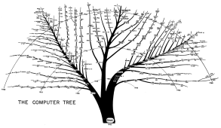
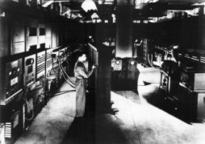
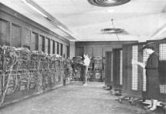
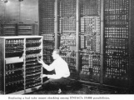
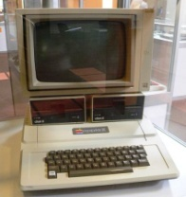
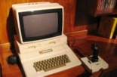
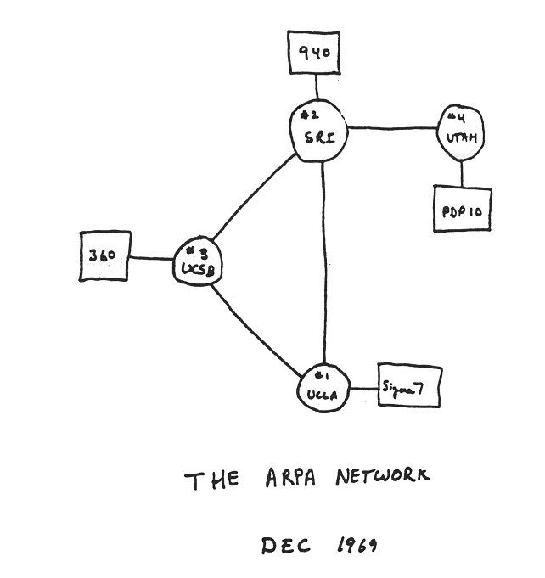

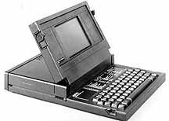
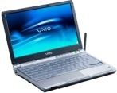

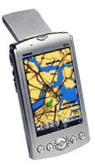
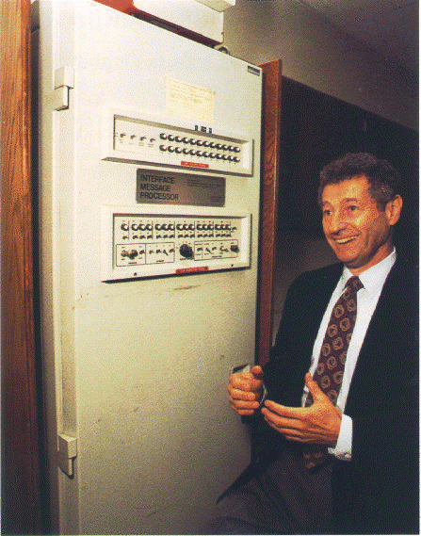
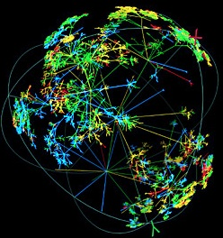
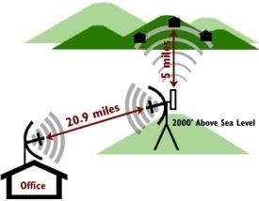
Retrospect on computing & networking
ISU Atanasoff-Berry Computer (1937-1942)
ENIAC: first computer (1945)
Apple II: first successful PC (1977)
Laptop, PDA … (1979 -)
First computer network (1969)
Internet, wireless …
Notes:
ENIAC acronym from "electronic numeral integrator and computer," device built 1946 at University of Pennsylvania by John W. Mauchly Jr., J. Presper Eckert Jr., and J.G. Brainerd. It cost $400,000, used 18,000 radio tubes, and was housed in a 30-foot-by-50-foot room.
The History of Computing at BRL
A transcript of the BRL story, as told by Mike Muuss on September 25, 1992 to the current laboratory staff and many distinguished former employees and retirees, on the occasion of "Vulnerability Day". This was a part of the celebration commemorating the incorporation of the Ballistic Research Lab (BRL), home of the ENIAC, into the new Army Research Laboratory (ARL). ---DRAFT---
This document is still being converted from an oral presentation to something really worth reading. Please forgive the rough edges. In particular, all the Figures have yet to be scanned in. This is a rather serious deficiency.
There is additional information in my History of Computing Information page.
The history of computing at BRL is inextricably linked with the history of vulnerability/lethality and survivability assessments here at BRL. What I am going to do in this talk is give you a very quick dance through some of the hardware, some of the software, and some of the networking techniques that we have developed. Many of these things were done first here at BRL.
I am going to start by telling you a little bit about the early years when I wasn't here -- my arrival matched up with the advent of mini-computers becoming popular in the labs. I'll tell you in somewhat more detail about that and then end with just a brief taste of what all this technology is good for.
Overview
The story begins back in 1935 with a mechanical computer called the Bush Differential Analyzer which showed up here at BRL and it moves forward from there. The proposal for the ENIAC was put together in 1943 and as the ENIAC development proceeded plans for the ORDVAC and EDVAC also came together. Pennsylvania did ENIAC and the Edvac and the University of Illinois contributed on the ORDVAC.
Here is the now classic picture of the ENIAC as it was installed at the Moore School of Engineering, University of Pennsylvania, with a soldier loading some parameters in. You can tell it is not at BRL because the ENIAC was in building 328, and we don't have ceilings like that.
Here is a photo of the ENIAC located in the upper floor of building 328, at Aberdeen Proving Ground. Even after the newer machines ORDVAC and EDVAC showed up, the ENIAC kept being upgraded. In 1953, it got a gigantic 1,000 words of memory added to it. Down here in 1956, ORDVAC got an astonishing 4,000 words of memory.
In 1962, when the BRLESC-I went operational at BRL, it was the fastest computer in the world, continuing the tradition started by ENIAC, ORDVAC, and EDVAC. It lost out to the IBM stretch almost immediately, but there weren't very many of those.
Around 1978, BRL got out of the computer-making business and went commercial for it's big machines, and there followed a period of doing things with traditional machines, commercially made machines. I will tell you a little bit more about what happened there in the second part of the talk.
The ENIAC
The ENIAC was a decimal machine operating internally on base ten only, using pulse trends to transmit information around. So, to send a nine from one bank of circuits to another bank of circuits, the ENIAC would send nine pulses down the wire, all synchronized by a master clock. This machine sped along at a gargantuan 5,000 operations a second in fixed point only. It is roughly comparable to an HP45 calculator that many of you may have had on your desks when you were working here. Internally, it stored 20 ten-digit numbers, all operating in base ten, and there was no central memory at all. When the machine was originally designed, it was actually a data-flow computer. Numbers moved through the machine along the wiring banks from calculation point to calculation point.
It was John Von Neumann who proposed changing that around and storing the program on two columns of dials in the parameter tables. In the process, this managed to slow the machine down tremendously -- he had created the first Von Neumann bottleneck! I understand he was quite unpopular over at Launch and Flight Division for making their ballistic programs go so much slower. The big advantage to this change was that it was much quicker then to program the machine because you just dialed your program in, rather than having to get an engineer to wire the program for you.
The ENIAC was a gargantuan beast made from over 19,000 vacuum tubes. Here you can see some poor technician of the day trying to figure out which one to replace -- a job I don't envy him at all. To interface to the IBM card punch equipment took 15,000 relays because IBM used high current circuits to run all their accounting machines, and the vacuum tubes could not sink enough current in order to please IBM.
ENIAC used 175 kilowatts of power, and it lasted about 5.6 hours, according to the historical reports, between repairs. This is an interesting thread, there have been periods of time when we have enjoyed very reliable computers and periods when we didn't. It is fun to watch the reliability figures bounce back and forth.
The EDVAC
The next machine which showed up here at BRL not long after the ENIAC was the EDVAC. Because of a change in the number coding system, this machine achieved a tremendous decrease in size, dropping from 19,000 to 5,000 tubes Instead of sending decimal around internally as pulse trains, it was built using Binary Coded Decimal (BCD). This was the first time BCD was ever used inside a computer.
EDVAC had both fixed and floating point which is another major innovation. Already for the second computer on the planet, we have floating point hardware in the machine. I might also add, the ENIAC had hardware divide and hardware square root, which are things you still rarely find built into CPUs today.
The EDVAC CPU had four registers and a 44-bit word, in keeping with BCD coding system and the ten decimal digits of significance. It had mercury delay lines for memory. According to the history books, there was no problem with vibration from the firing range at the main front, but they had a tremendous problem with thermal stability. They eventually had to put it into an elaborate oven with all sorts of thermostats and thermal buffers. They made it work, but heat and not vibration turned out to be the challenge in making this machine go.
Interestingly enough, this -- the second machine on the planet -- had a tape drive that ran at 75 inches per second. Many computers we buy today have tape drives that are not even this fast. It is fun to watch how storage technology goes faster, then slower, then faster again. EDVAC lasted about eight hours between repairs.
The ORDVAC
The machine after EDVAC, this time coming from Illinois, was the ORDVAC. They were thoughtful enough to put the name of it on top so I don't get the picture mixed up. This one here has another main major change in the way it was built. This one is a pure binary machine using two's complement fixed point. This machine here, the third machine at BRL and about the fourth or fifth machine around in the world, set the pace for all the computers we know today. Two's complement binary mathematics is how all the machines from IBM PCs to the Cray-II operate.
This machine is getting pretty speedy, it can do 71,000 additions per second. A little bit more than 1,000 multiplications per second. It had three registers and a 15 microsecond core memory. This is a prototype, a forerunner of all the machines that are going to follow for decades after.
This was the first computer that had a real compiler on it. No longer did you have to write machines codes every time you wanted to get something done. The BRL folks thought up this language called FORAST and built a compiler. So now the programmers could write much higher level instructions and let the machines do the translation to machine code. There was a time in the early 1950s where BRL employees were worrying about portable software. When almost nobody else even had computers, we had people here worrying about how to make programs work on different kinds of computers. The FORAST language worked both on the BRLESC and on the ORDVAC, and people ported software back and forth very happily. This has been a theme that has continued for a long time.
In the ORDVAC, the tube counts have gone way down, only 3,000, and the number of transistors is coming up. By today's microprocessing standards, this isn't very many parts -- we have half a million or a million transistors on a single integrated circuit in a package only an inch or two long. Building a computer out of basically 5,000 parts, 5,000 transistor-like parts, is really unthinkable. Considering that there were not very many gates inside this machine, they got a lot of performance out of it!
The BRLESC-I
The next one along was BRLESC-I, and it looked like this. Something to make any science-fiction buff drool a little bit. This is a marvelous display panel. You can see what is happening anywhere inside the machine. As an engineer, I really appreciate things like that!
This system was built entirely by BRL engineers from some standard parts that were developed at the National Bureau of Standards (NBS, now NIST). Originally it was going to be a joint project all the way, but NBS wound up contributing just the submodules, and BRL designed and built those into a real working computer. This is getting pretty fast, this is a fifth of a million instructions per second now, really getting up there. It retains the pure binary two's-complement notion, has a reasonable amount of memory, has a drum on it, and, in order to get to speed, the parts count started creeping back up a little bit, but they still managed to get it into a fairly small package there.
Four Generations of Circuits
Army photographers took this photo in 1962 to show a comparison between the different technologies used in the first four computers. From left to right, these boards are out the ENIAC, Edvac, ORDVAC, and BRLESC-I. To the best of my understanding, these are roughly comparable circuits. You can see how technology allowed the machines to get smaller. As you make the machines smaller, then you can make them go faster.
The Advent of Mini-Computers
The next step really came about for mini computers. Industry was going along the same projection I showed there with parts getting smaller and smaller, and at some point hardware started getting very cheap. So much so that an average Lab Division or department of a University could manage to afford a little computer of their own. Something like a PDP-8 or a PDP-11/20 or eventually, for us, a PDP-11/70. Minicomputers were a lot easier to program than the big machines of the day, and that meant there were a lot more people who wanted to use them. This pushed computing power more and more out to the masses. At this point, technology splits into three main tracks: workstations, mini computers or departmental machines, and super computers.
Our goal in 1980, which we articulated in the ARRADCOM blueprint for the 1980s, was that everybody should have a desk, a chair, a telephone, a computer terminal (which is all we were looking for at the time), a tenth of a million instructions per second per employee (which is basically to say a personal BRLESC-1 for everybody here), and ten megabytes of disk storage. We thought that if we got through this by 1989, if we got this to everybody by 1989, we would be doing very well. In VLD, we actually hit this goal around 1986. That was mostly thanks to aggressive purchasing on the part of Paul Deitz. Here is a picture of kind of where it starts. I'll give you a table and briefly run through some of the developments here.
Background: In 1976 we had remote job entry and some teletype ASR33 type machines with the yellow paper and the punched paper tape -- many of you probably remember them. Special purpose mini computers for laboratory data acquisition, the NOVA, the PDP-8s, we found out in some of the ranges where people had just built a brand new facility and were doing some really good data acquisition. The super computers of the day were the BRLESC-II and some of the analog hybrid machines that Bill Barkuloo had salted away in the basement of building 394 and other places.
The DEC PDP-11/70, our first UNIX machine
In 1978, we finally started to see ASCII, cathode tube terminals, terminals we all are familiar with now. Harry Reed went out and boldly bought a PDP-11/70 from Digital Equipment Corporation (DEC), and that is the machine you see in the background with the black cabinets and the purple and red controls on the front.
My first visit ever to BRL was in May of 1978, when I was invited by Dr. Steve Wolff (now of NSFNET fame) to give a talk about UNIX, and incidentally, write a driver for an incompatible disk controller that procurement had stuck him with, and install a working system on the new machine.
This picture was taken in 1980, and already I was working on applications of interactive graphics. There is the (then) XM1 tank design on the Vector-General "3D" display. I'm sitting there operating it. Next to me, Earl Weaver is consulting a print out of the COMGEOM description representing that XM1 design. I might add, the target description is much thicker now then it was back then. That was all being done on the PDP-11/70 there.
The Cyber 7600
At the same time as the mini-computers were starting to arrive, we had the next generation of large machines show up -- our first generation of commercial machines. Our supercomputer of the day was the Control Data Corporation (CDC) Cyber 7600, which looked like this. It had this really cool wood and blue glass look to it which, looks kind of dated these days, but was really spectacular back then. This was a very fast machine. This system here ran in the 20 to 40 million instruction per second range. Nearly a hundred times faster than the BRLESC-II.
The VAX-11/780
The next stage in the evolution goes back in the mini-computer category. This is a VAX 11/780. These are the machines, 32-bit computers, that started replacing the minis. These are every bit as capable as the super computers we were using just a few years ago. This machine here blows BRLESC-II off the map. This is the sort of thing you would find in every division, in every computer room sprinkled around all over the place. So you see how this technology keeps moving diagonally across this chart.
The Denelcor HEP
The super computer of the day then was the Denelcor HEP which was largely due to the vision of Dr. Eichelberger and this man here, Clint Frank. Here, Clint is holding one of the processor boards from the Denelcor HEP. This system was a behemoth, and took up a lot of floor space, yet still to this day it is the most elegantly designed parallel processing system around. This is the machine that all the text books that teach parallel processing refer to. It was built for BRL to BRL specs by a little firm in Colorado. It could deliver 40 MIPS, and had a theoretical peak of almost 40 MFLOPS. Each of the four Process Execution Modules (PEMs) ran eight different threads in parallel, context switching between them on an instruction-by-instruction basis to keep all the pipelines filled.
Workstations: The Sun-2 and SGI-3030
Work stations finally came to life. The Sun-2 computers started showing up, and that changed what was happening at the desk top quite a bit. This is a picture of my desk in 1985. This sets the trend for everything that has followed. It was a Sun-2 workstation here on the left. This was a quarter million instruction per second black and white workstation and a Silicon Graphics 3030 which had real-time, wire-frame rotation. We could do target descriptions very, very rapidly on them. This really set the whole direction for VLD.
The Gould 9000
At the same time, departmental computers got a whole heck of a lot faster. This is a Gould 9000, it has a dual CPU system delivering ten million instructions per second; a pretty good fraction of what the Cyber 7600 was giving just a few years earlier. Amusingly enough, this machine was created for BRL; Chuck Kennedy and I managed to convince Gould management that it would be very inexpensive to add virtual memory to their speedy Concept 32/87 CPU.
Between BRL and HEL, we bought 14 of these machines at a very low price in the space of about two years. Really goosing up the amount of compute power available locally in the divisions.
The Cray XMP
In 1986, things go a little further and the Cray XMP shows up. This really blasts us ahead. Here you can see Phil Dykstra helping to unpack this box on the very first week the XMP was being installed. This machine, a super computer of the day, is still running here at BRL today, but its performance is no longer particularly considered in the super computer category.
The Cray-2
A year later, this machine rolled in. The Cray-2 called "Bob" in honor of Dr. Robert Eichelberger. This machine, at the time, was the fastest machine on the planet, again putting BRL back on the forefront. With an astonishing two gigabytes of main memory, this machine has so much main memory sitting inside this tank that it takes two full hard disk drives just to take a crash dump when the machine goes down. The disk drives only hold one gigabyte (memory was two gigabytes) and these are big quarter million dollar disk drives this thing uses. It is kind of a strange twist where main memory is getting to be bigger than disk drives in some cases.
The Cray YMP
Just a few years ago the Corps of Engineers finally got a Cray YMP, which we can use over the network. This is what is looks like, if you were to go down there and visit it. So, there has been a tremendous amount of evolution here.
Silicon Graphics "Predators"
In the mini computer department, SGI predators (which I don't have a picture of), are machines that now rival the performance of the Cray XMP48. They cost about one-quarter million dollars and are turning up all over the place. So you can see with a time lag of about five years what is over here moves over to the center column and what is over here in the center column moves on to the desk top. This is a trend that is just going to keep going.
The Evolution of Software
Now with all this evolution in hardware, what has been happening in software? We made some very good choices back in 1979 and 1980 which have stood us in tremendous good stead. Our first 11/70 ran UNIX and, as part of that plan for the 1980s, we said all the computers at BRL really ought to run UNIX if they can.
Some advantages from this include portable code, and portable scientists. When you replace the hardware instead of going through a massive retraining switching from the BRLESC to the Cyber, from Cyber to the UNIX, it now means just changing from one variant of UNIX to the other. Instead of requiring weeks and weeks to refamiliarize yourself, it is just a matter of a few hours learning this little nit, that little nit, some new performance options. Also, as software developers, you save a lot of time porting software. Most of our software has run across five generations of hardware now with little or no changes. Considering some of our big packages are huge, million-line and above type, software packages developed locally, the portable application software is not to be sneezed at.
This gave us the ubiquitous standardized environment for doing everything; for doing scientific calculations, for doing document processing, for doing E-mail communicating with the outside world. All happening in this one platform. I note, sadly, that a lot of Army facilities, even some parts of ARL, don't even have working e-mail yet. So we managed to knock all this off in the early 1980s and not struggle a lot on the simple things.
There have been a few things that have changed in UNIX over the years and I won't bore you with all the computer science details other than to note that now it is available in almost everything all the way from the MAC-II and the PC up to the Cray-II. UNIX grew to embody network services adding network file systems, remote procedure calls, distributed compilations and all that graphically user interfaces with bit maps especially using MIT's X-window system, parallel processing, virtual memory. The ANSI version of the C programming language was done in large measure by Doug Gwyn here at BRL. He gets a tremendous amount of credit for helping to take the C programming language which UNIX is based on and turning it into a standardized computing language, which is used now the world over.
The Evolution of Networks
To make these machines all talk together, we needed to invent some networks. Originally, computing was easy. There were one or two computers and you went to them and did your work there. But when we started having first a dozen and then hundreds of machines around here, computers became much more distributed, and it was not always easy to get your data from the computer on which the data were stored to the one you wanted to use to compute these data on. To solve that problem, we needed to build networks.
The ARPANET
BRL was one of the first nodes on the ARPANET back in the time of the earliest experiments. 1974 is the year I think all that equipment was installed; it was a long, long time ago. That really carried us through more than ten years before there was a change in that technology. In local area nets, 16 megabits, ten megabits, and then 50 megabits communication links between them and then nothing really since 1985. Local area networking technology matured fast.
It was the campus area net hooking together the buildings and the laboratory that really took the most work. We did some really interesting experiments here in 1980 duplicating what the ARPANET had done using 56 kilobit communication lines and that served us very well all the way up to 1985 when we finally got fiber optics in the ground - a task that took three years from start to finish.
Here is the main hub of the Building 328 fiber optics patchbay. The photograph is from 1985, it's actually jammed full now. Each of these colored ribbons here is a thin piece of glass fiber optic carrying, in some cases, as much as 100 megabits of data on it. You can see this is a lot like the plug boards of old. You can plug these ultra high bandwidth fiber optics into these little bi-conic sockets, screw them down, and make a super high bandwidth connection from building to building. That spurred the growth of first ten, then 80, and now 100 megabits per second communication links between the buildings.
I also want to note that there was a matching effort replicating all of this network connectivity at the SECRET level. That work started around 1985 and has carried forward as well. So that now in VLD we have secret level communication between buildings 394, 328, and some of the other parts of BRL compound here, with direct connectivity across the wide-area DISNET to many other secret facilities inside the DoD.
Historic Events in Networking
These are some historic events in networking. I don't want to bore you with all these, except to note that in history books remote computing was first done around 1965 or so. BRL did it first in 1953 using the then extensive teletype network of Western Union. The ORDVAC computer had the option of reading and writing its output on paper tapes. What people would do is they would send a telex to BRL with the program on paper tape. The people at University of Illinois, National Bureau of Standards, and other institutions would Western Union in one of these paper tapes, the operator at the ORDVAC would tear it off, stick it in the machine, and it would calculate for while, they would tear the paper off the output punch, send it back to Western Union, and zip it across the country - in 1953, network computing.
We spent a lot of time in the early 1980s working on electronic mail and the TCP/IP protocols. It was very gratifying in 1984, all this home brew stuff that we had been fussing around with DARPA became military standard. All the work that we did here wound up embodied in Military Standard 1777 and 1778. This is now the foundation for the communications throughout the world. All the universities everywhere run these communications protocols, and we had a big hand in building that. First super computer on the internet, first classified campus nets are some other firsts that happened here at BRL.
Applications
But what is it all for? We are really the Vulnerability Division we are not Computing Division. VL calculations, experimental data reduction, geometric modeling, weapons system analysis, these are really our bread and butter. Over here you see a glass rendering of the Bradley. I went and looked back in the history books a little bit to find out what was the first use of computers for VL calculations and found that in 1952 the EDVAC was being used for lethal area calculations for both mine problems and for missile problems, and, in a trend that repeats to this very day, by 1953 45% of the ORDVAC was being consumed for vulnerability calculations. We basically mushroomed into the machine and took over.
Solid Modeling and BRL-CAD®
In the software department, BRL invented a whole technology - solid modeling. Dave Rigotti, I think, gets the credit for starting this one in 1958, the year I was born. He was thinking about nuclear problems and stimulated the research that wound up in MAGIC in the SAM-C codes being built about the year 1967. (Editor's comment: While a good deal of inspiration came from the nuclear people, there was also heavy involvement of more conventional ballisticians such as Hoyt and Peterson.) That was the foundation of everything BRL and then AMSAA went off to do looking both at computerized conventional vulnerability and computerized nuclear vulnerability.
The second generation of software was GIFT geometric information from targets and then around 1985 we began a transition to what we now calling BRL-CAD® which is a UNIX based C implementation of this same solid modeling technology. Most of you probably know BRL-CAD® best for MGED its geometry editor program. But it is also LIBRT, the library for ray tracing geometry, and this is a nice object oriented separation of the geometry part which us computer scientists types worry about and the applications part which more physics oriented people might concern themselves with. This allows advances in each of those to be decoupled so that as the geometry stuff gets better the applications automatically benefit, as the applications gets smarter they do not necessarily impact what has to be provided to them on the geometry side.
There is a whole family of codes; RT and LGT, for making nice shaded pictures like this one over here; SQuASH, which you are going to hear about more later on; stochastic high res modeling; SPRAE, you are going to hear about a fantastic piece of work done with the Command Post using this; and MUVES, our brand new modular environment for doing all new vulnerability codes in.
In addition to all this, there are 174 other tools and 14 software libraries which comprise this product called BRL-CAD®. It is supported on ten different kinds of hardware and in use by more than 800 institutions world wide which makes it, I think, one of our premier technology transfer examples as well. This is all stuff that was done first here at BRL. So to show you just a hint of the complexity of all this each of the ovals here is a library, each of the double boxes is a file format, each of the single boxes is an analysis program. I don't expect you to understand all this but to merely use this as a big picture road map of some of the complexity involved in doing all of this CAD work. A tremendous amount of software and a significant amount of design went into that, and a lot of that research continues on to this day with new techniques being added like n-manifold geometry and a lot of sophisticated visualization techniques.
So where do we stand in 1992?
We have ubiquitous unix based computing and printing, we have had it for a long time. I might point out that these slides here are all done on a UNIX based printer. This is really nice being able to just say "print me up an ENIAC" and you get this marvelous viewgraph of an ENIAC. Lee Butler over here gets the credit for acquiring the scanning and printing hardware that made this talk possible.
We have a workstation and a PC for every employee -- more than ten MIPS of CPU power for every employee in VLD. Now I don't say that its evenly distributed, some have a little more, some have a little less. But if you tally it all up, there is a tremendous amount of power here. More than 150 computer systems, Chuck Kennedy might have an even better number, you almost have to track this daily as the trucks keep rolling in with more and more computers. More than 100 gigabytes of on-line storage. This isn't tapes, this isn't stuff found in a closet. This is 100 gigabytes of storage that is running right now that anybody could get access to at 1 or 3 megabytes per second, zoom that data in, and process it. Even taking out target libraries and system overhead and all of that, that is more than 100 megabytes per employee -- an order of magnitude higher than the goal we had set for 1989.
We have separate unclassified and SECRET level networks and while the secret level network does not get everywhere yet (in particular it is not on every desk top) it will be in another couple of years and that is going to really revolutionize the way things are done.
Distributed computing: The file server and compute server that I use now today has the same performance as the Cray XMP. Well, it has a 5 year technology advantage, so that is not as surprising as I made it sound. But it really boggles my mind to think that the computer that we struggled so hard to buy from 1980 to 1985, the Cray, you can now go out and duplicate for one-quarter million dollars!
Sophisticated color scanning, printing, computer generated video tapes (which I do not have time in this talk to show you) -- all this we have now at VLD and use it to great advantage.
A good news chart is shown in Figure 36. Our computing capacity in 1983 was one VAX-11/780 equivalent and was 3,155 times that capacity by 1989. The numbers just keep going up from there. I'll try to show you how price and performance change with time, time is not an axis on here, we have price versus performance and log-log plot you can see super computers lie over in here, the departmental machines lie in the middle, and the workstations tend to lie over here. The dots just keep drifting off. In terms of ray-tracing performance, which is what most of our vulnerability calculations require, here is a plot of relative performance on that problem of the different kinds of machines. You can see right here the Cray XMP and the Silicon Graphics predator. For this particular test, the XMP has very slight edge. But these predators are just riddled throughout the place. They are located all over now. So that everyone has access to their "own" XMP-class machine. And that is how it should be.
Acknowledgements
I would like to acknowledge a bunch of people for helping me collect the facts I used to prepare this talk. Harold Breaux, Chuck Kennedy, Lee Butler , Phil Dykstra , Bob Reschly, and Bert Meyer all contributed background material that I synthesized together to give you this. Because especially for the first part, I was not around.
That is the end of my presentation. I would actually like to keep going for another hour or more, but you are probably going to throw me out. I am afraid there is no time for questions.
Mike Muuss <mike@arl.army.mil>
I welcome comments, suggestions, and additional information -- especially URLs or written references to other historic computers. Please feel free to send me E-mail, or FAX me at USA 410-278-5058.
Images of all of the computers mentioned in this talk are available in RGB, GIF, and JPEG format for anonymous FTP from host FTP.ARL.MIL, as are photo credits and photo captions .
Copies of a 30-minute videotape of this talk are available to US Government facilities. Contact Carol Ellis by E-mail at <cae@arl.army.mil> for details.
========================
The First Laptop?
By Ian McKay
The following claim is the sort of thing that can get you into trouble, but only M.A.D. offers you the chance to verify the news of what I imagine is the first auction appearance of the Grid Compass Computer 1109 that Bonhams, which offered it in a "20th Century Design" sale of June 1, claimed is "the first ever lap-top computer."
Designed in 1979 by a Briton, William Moggridge, for Grid Systems Corporation, the Grid Compass was one fifth the weight of any model equivalent in performance and was used by NASA on the space shuttle program in the early 1980's.
The sale catalog describes it as a "340K byte bubble memory lap-top computer with die-cast magnesium case and folding electroluminescent graphics display screen."
Complete with manual, it sold for $800.

Slide 5
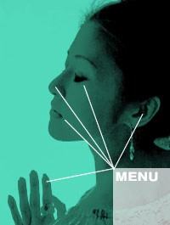
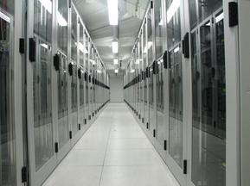
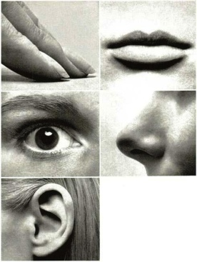
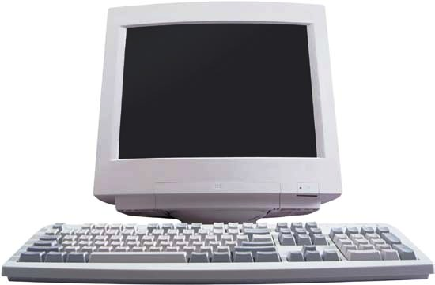
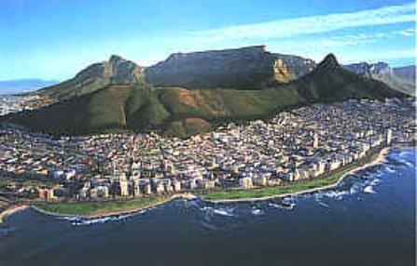
?
What if
Ubiquitous Computing & Networking + Sensing & Control ?
Ubiquitous, fine-grained sensing & control

Slide 6
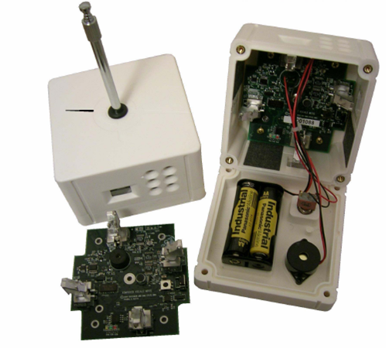
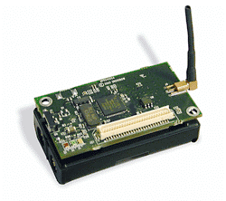
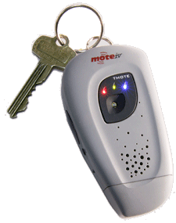
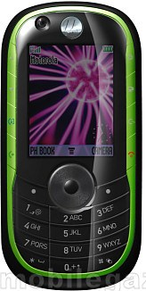
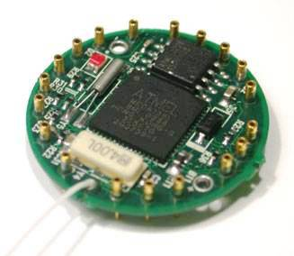
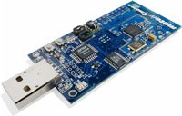
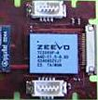

Sensor nodes
A XSM sensor node (2004)
8MHz CPU, 4KB RAM, 128KB ROM
Chipcon CC1000 radio: 19.2 kbps
Infrared, acoustic, and magnetic sensors
Sounder
…
Many more (2001 - )
Notes:
128KB internal flash, 512KB external flash
Tornado explorer
Technology push; Application push
technology push: (low-power) low cost wireless technology, Micro-Electro-Mechanical-Systems (MEMS), embedded software technology …
New ways of exploring the world
Applications:
remote sensing, environment monitoring, community networks, etc.
Application push: widespread use of networks, web; large geographic coverage …
Shortening the distance of the world
Internet: thousands to billions of nodes; Widespread adoption (e.g., the Internet)

Slide 7
TinyOS: an open-source OS for WSNs
Contiki / Contiki-NG
application
sensing application
routing
Routing Layer
messaging
Messaging Layer
packet
Radio Packet
UART Packet
byte
Radio byte
Sensor
Sensor
SW
bit
HW
RFM
UART
clocks
ADC
ADC

Slide 8
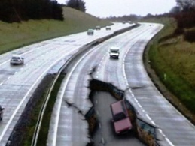
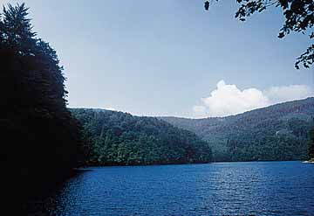
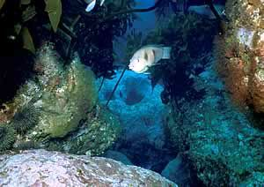
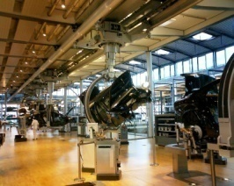
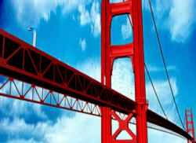
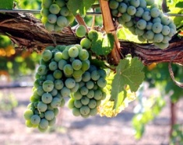
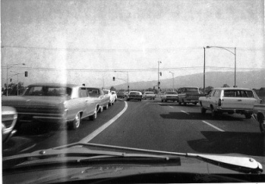
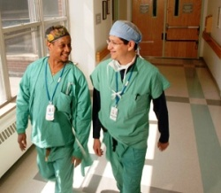
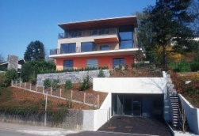
Wireless sensor networks: innovative ways of interacting with the world …
Science: ecology, seismology, oceanography …
Engineering: industrial automation, precision
agriculture, structural monitoring …
Daily life: traffic control, health care, home security, disaster recovery, virtual tour …

Slide 9

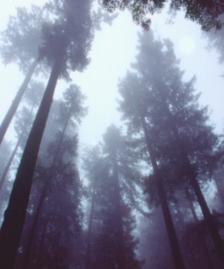

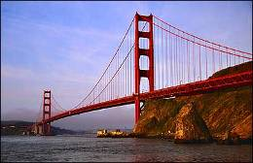
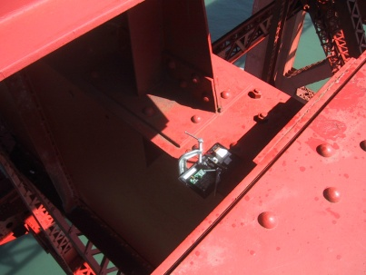
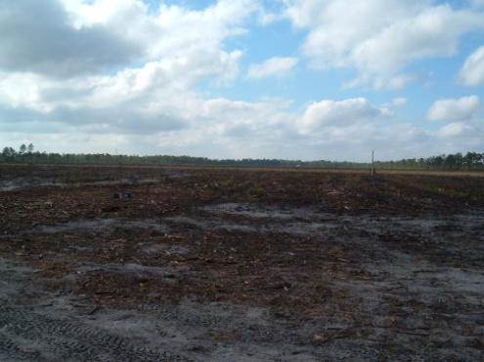
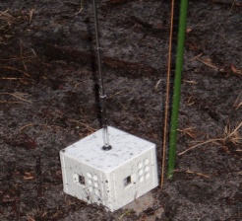
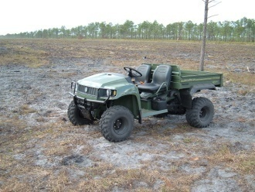
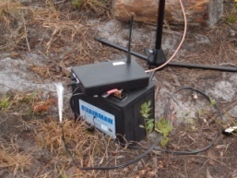
Sensor networks in early days
Redwood ecophysiology
Wind response of Golden Gate Bridge
Intruder detection, classification, and tracking

Slide 10
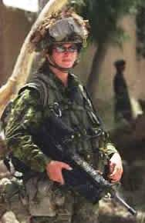
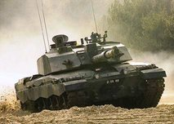
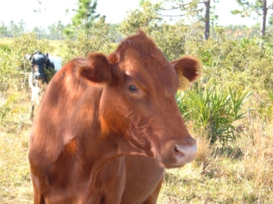

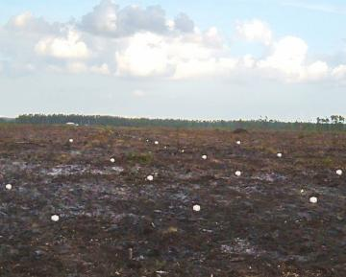
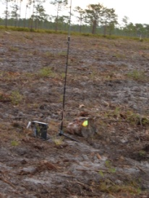
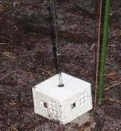
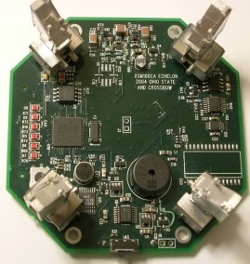
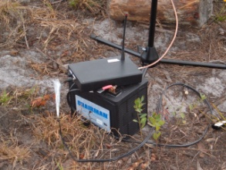
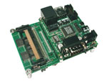


ExScal
Field project to study scalability of middleware and applications in sensornets
Deployed in an area of ~1,300m × 300m
2-tier architecture
Lower tier: ~ 1,000 XSM, ~210 MICA2 sensor nodes (TinyOS)
Higher tier: ~ 210 IEEE 802.11b Stargates (Linux)
• • • • … •
• • • • … •
• • • • … •
• • • • … •
• • • • … •
• • • • … •
• • • • … •
• • • • … •
• • • • … •
• • • • … •
• • • • … •
• • • • … •
• • • • … •
• • • • … •
• • • • … •
• • • • … •
• • • • … •
• • • • … •
• • • • … •
• • • • … •
• • ………... •
• • ………... •
• • ………... •
Base Station
• • ………... •
• • ………... •
• • ………... •
• • ………... •
• • ………... •

Slide 11


Industrial monitoring: Intel Semiconductor Factory monitoring …
Preventative equipment maintenance: monitoring vibration signals …

Slide 12




Precision agriculture: smart vineyard
monitor soil humidity, temperature, chemistry …
Notes:
Camalie Net
Wireless Sensor Network at Camalie Vineyards - Mt. Veeder, Napa Valley, California.
Status 5/1/07
Status 4/13/07
Status 12/29/06
Status As of April 2006:
Camalie vineyards currently has one of the most advanced soil moisture monitoring systems in operation in U.S. agriculture today. We call it Camalie Net. It uses the wireless sensor networking technology developed by UC Berkeley in collaboration with Intel Corp and commercialized by Crossbow Inc. It is used for optimization of irrigation; reducing water consumption and associated pumping energy costs as well as increasing grape quality without sacrificing yield. It also serves as a monitor of the irrigation system which if it fails can cause substantial long term impact on the large capital investment in the vines; a type of insurance policy or risk management.
Thirty Mica2dot motes from Crossbow currently comprise the network. Mark Holler, owner of Camalie Vineyards, adapted the TinyOS firmware and developed interface circuitry for the specific soil moisture and water pressure sensors used in this system. He is also the grower who looks at the data and makes the irrigation decisions.
Camalie Net was used during the 2005 and 2006 growing seasons to guide irrigation decisions in the 4.4 acres of Camalie Vineyards. Yield per vine in 2005 was double that of the 2004 yields for same age vines yet water consumption was constant. Water consumption normally goes up with canopy size which more than doubled for these 2.5 year old vines in 2005. Grape quality was excellent. Some of this success was due to generally better than average weather in 2005 but, we believe our visibility of the soil moisture played a significant role. Extra drippers were added to some areas of the vineyard based on the soil moisture data. Also irrigation intervals were shortened based on sensor data to reduce the amount of water that penetrated below the root zones where it would be wasted.
In 2006, the third year for our vines, the yields again doubled from 4 tons to 8 tons.
Camalie Net It is currently active, monitoring the vineyard and wine storage temperatures while it is being upgraded and expanded for the 2006 growing season. We feel strongly that the consistency of soil moisture we can provide because of the tight monitoring of soil moisture has contributed significantly to the well being of the vines. In 2006 our water utililization was actually less than 2005 in spite of the canopies being substantially larger in 2006 and the fruit load double the 2005 weight.
Below you can see an image of the vineyard with the sensor node connectivity map superimposed on it. This network map is updated in real time but is not accessable from a web browser yet. The motes send data once every 10 minutes. We currently use Microsoft's remote desktop to access the machine connected to the sensor network gateway in Napa. From Palo Alto we run Crossbow's Moteview in a remote desktop window to view the data.
Five of the motes are each connected to a soil moisture sensor pair and a soil temperature sensor. These motes are distributed in the vineyard, one per irrigation block. The soil moistures are measured to monitor the irrigation water flow in the soils which is very useful data for sheduling irrigation events and identifying problems with the irrigation system.
Nodes 1 and 4 are located in a cave, monitoring the temperature where wine will be stored. Node 2 is monitoring the utility structure where our 2005 Cabernet Sauvignon is currently stored. Node 11 is placed at the irrigation manifold and is connected to two pressure sensors which sense water pressure before and after the main filter. The pre-filter sensor has enough resolution to tell us the water level in the up hill storage tank. The pressure differential between the sensors during an irrigation cycle is a good indicator of the state of the filter and lets us know when it needs to be cleaned.
Below is an irrigation block map of Camalie Vineyards showing the network topology active in the vineyard as of 7/13/05 superimposed on an exported image from our Manifold GIS system.
Below is a plot of all the soil moisture data from the shallow five of 10 soil moisture sensors for the 2005 growing season. Lower values are wetter. The system was offline most of the winter.
Below is a recent weeks data showing the soil wetting due to a rain storm on 2/27/06. The jump up in the pink curve was due to a battery replacement.
Below is a week worth of temps from across the vineyard and storage facilities. The green curve with the highest peaks is from a mote without a shroud to block sunlight from impinging on it. The turquoise curve is from inside the utility shed where the wine is currently stored. A nice even 50-60 degrees F for now.
Below is a graph of the wine storage temps both cave and garage. Note the mote list of 21 motes all transmitting except for node 41 which has been taken offline due to a moisture related failure of the hardware.
Here is a vineyard mote minus its aluminum foil shroud. It is a $10 Pelican 1010 waterproof box. Note also the hook at the top that enables this mote to be easily hung at the top of a line stake.
Here are the internals of Mote 40 showing the NiMH bateries, solar panel, 3V regulator, fixed resistors, sensor connection terminal strip and the Crossbow mica2dot mote. The antenna and feedthrough have been changed to a more reliable configuration since this photo.
Four vineyard motes ready for placement in the vineyard. Note aluminum foil to reflect sunlight, keeping the internal temperature down and protecting the plastic from UV damage. It also seems to help improve the range.
A vineyard mote on a line stake with soil moisture sensor (green) and soil temp sensor (black) dangling before they are planted in the soil.
This is a picture of mote 32 in the vineyard showing the distance to the utility building on the right where the gateway node is connected to a computer with a satellite internet connection.
I am currently looking for a web serving data visualization app the equivalent of MoteView but with the ability to present web pages. Moteview requires connecting to the machine in the vineyard with the database. It then must query the data base over the internet and transfer all data across the link, which is very slow. Setting security on firewalls and the database is also a nightmare for each additional client computer that is to be allowed to access the data.
I believe this is a great opportunity for someone to demo their software on a sensor network that is in commercial use today. You can count on the demo to keep running because I will be using it.
If you know of or have an application like this its worth a case of very fine Mt. Veeder Cabernet Sauvignon to me and you if we put it to use.
Camalie Vineyards Case Study in Crossbow Mote Deployment Powerpoint presentation for Crossbow user's group 4/11/06
More of Camalie Net Wireless Vineyard Soil Moisture Sensing
You can contact me on my cell at 650-799-6571 or via e-mail at mholler@pacbell.net
Camalie Vineyards Home
Last edited by Mark Holler, 3/29/07

Slide 13







TurtleNet: track wood-turtles …
the turtle came out of the water to sun itself for only brief periods and went back into the colder water …
Notes:
TurtleNet
We are currently investigating methods to use DTNs, energy management, and programming languages to improve the state of the art in tracking small, mobile wildlife.
Faculty: Mark D. Corner, and Emery D. Berger, and Brian Levine
Students: Jacob Sorber, Alexander Kostadinov, Matthew Garber, Matthew Brennan.
The motivation for our research comes, in part, from the efforts of conservation biologists to protect threatened turtles. The Wood Turtle (Clemmys insculpta) is found throughout the Northeast and Great Lakes regions and into Canada. They live primarily in and along streams; however, they are also terrestrial for about 4 months of the year. Wood Turtles are of particular interest since their numbers are rapidly declining due to habitat destruction and highway mortality. Unfortunately, conservation efforts have been hindered by a general lack of data due to current tracking methods. Researchers currently track turtles manually using radio telemetry and are limited to taking a single location fix every 2-3 days for each animal being studied. The turtles often travel up to 1 kilometer between fixes and practical concerns preclude the collection of location information at night. In order to more accurately understand how these turtles behave and use their habitat, new tracking methods are required to collect data at finer granularity. Recent advances in sensing platforms make it possible to use more sophisticated sensors, such as a GPS receiver, to collect more frequent movement information. A sensor platform such as a Crossbow Mica2Dot, a GPS receiver, a flexible solar panel, and a small 250mAhr lithium polymer battery are within the acceptable weight and size requirements for studying these animals; however, energy management remains a significant concern. A typical GPS receiver will completely drain a 250mAhr battery in less than 2 hours, which necessitates carefully selecting an appropriate duty cycle based on the energy stored in the battery as well as the expectation of energy from its solar panel. Due to the high variance of solar radiation and the unknown mobility patterns of the individual turtles, it is necessary for us to dynamically adjust device behavior during operation. Our goal is to provide a simple networking, energy managment, and programming that meets these needs. The data-flow oriented programming style used in the Flux language (another UMass project) has many similarities with the programming style used in many sensor systems. A Flux program is a directed acyclic graph that describes how data and control flow from event sources through computational tasks. While this program style was originally designed to support the programming needs of high-performance servers, network embedded sensor applications also typically consist of a sequence of tasks that are performed in response to an event, such as an expired timer or the arrival of a network message. Along these lines, we are developing Eon, which extends Flux to include an application adaptation policy which describes an ordering of behavior adjustments, which include alternate control paths and adjustable timers. We are developing an Eon compiler and runtime system that implements this policy, by profiling the energy cost and frequency of individual execution paths and determining an appropriate operating state.
Turtle Graphs
A sample graph of data collected from a turtle. "Wetness" is a measure of current in the water sensor. As the graph demonstrates, the turtle came out of the water to sun itself for only brief periods and went back into the colder water.

Slide 14

SealNet: use nature to help scientific study
To measure ocean’s temperature and salinity levels, as well as the seal’s location and depth.
Sensing data are collected for every dive; Each time the seals resurfaced to breathe, that data was relayed via satellite to certain data centers in US and France
As the seals migrated and foraged for food during their winter journey, they circumnavigated the Antarctic continent and its continental shelf, diving down to 2,000 feet more than 60 times a day
Notes:
The bottom image shows the path of eight elephant seals leaving the Kerguelen Islands after their mating season. The colored ribbons represent temperature bands that are based on data gathered by the seals.
An international team of scientists have devised a system that could help obtain better real-time coverage of the Antarctic Ocean's temperature changes and current flows: they've stuck sensors on the heads of migrating elephant seals. The information could provide new insights into the effects of climate change in the ocean, stemming from inflows of freshwater from melting ice and warmer water from the north.
In the past, obtaining information about the region's waters, especially about winter temperatures, has proved extremely difficult. It's costly and sometimes impossible to send ships through the ice-filled waters, and each ship covers only a thin stretch of ocean. Now a small navy of seals has collected data inexpensively where no ship has gone before.
"It's a win-win situation," says Daniel Costa, an ecologist from the University of California, Santa Cruz, who was part of the research, called the SEaOS project (Southern Elephant Seals as Oceanographic Samplers). "We're getting an amazing data set about the ocean's properties and how the animals' feeding habits react to changes in their environment."
The research, conducted by a diverse team of scientists from the University of St. Andrews, the University of Tasmania, the University of California, France's Centre National de la Recherche Scientifique, and other institutions, will be published online this week in the Proceedings of the National Academy of Sciences.
In their two-year study, the scientists recruited 85 elephant seals from four points around the Antarctic region: South Georgia, the Kerguelen Islands, Macquarie Island, and Livingston Island. As the seals migrated and foraged for food during their winter journey, they circumnavigated the Antarctic continent and its continental shelf, diving down to 2,000 feet more than 60 times a day.
With every dive, the seal's sensors collected information about the animal's location and depth, and about the ocean's temperature and salinity levels. Each time the seals resurfaced to breathe, that data was relayed via satellite to the National Oceanographic Data Center (NODC) in the United States and the Coriolis center in France, where oceanographers can disseminate and use it to test climate models and track developments in the region.
Once the seals returned home from their journey, they molted, shedding the equipment from their heads.
The Antarctic Ocean is important to global climate change: it's home to the world's largest current, and it's also where some water masses of key importance in the climate system are formed. One fear is that increasing average temperatures could lure too much freshwater into the Antarctic, bringing cooling and sinking processes in ocean currents to a halt and ultimately causing a dramatic effect on the global climate.
"The elephant seals are an interesting attempt to use nature to help obtain a valuable data set," says Carl Wunsch, a professor of physical oceanography at MIT who is unaffiliated with the SEaOS team. "We use the data here, knowing that our control over the seals is not perfect. But we need to understand what the ocean is doing."
The SEaOS project is a continuation of earlier, smaller programs involving placing similar sensors on penguins and seals. Costa is also part of a group that uses crab-eater seals to measure how quickly the temperature changes in the Antarctic waters from summer to winter.

Slide 15




Social dynamics and networking

Slide 16




BikeNet: mobile sensing system for cyclist experience mapping
Monitor cyclist performance/fitness: speed, distance traveled, calories burned, heart rate, galvanic skin response, etc
Collect environmental data: pollution, allergen, noise, and terrain condition monitoring/mapping, etc

Slide 17
Outline
From Internet to sensornet/IoT
From sensornet/IoT to WCPS
General challenges of WCPS
Challenges to wireless networking

Slide 18







From open-loop sensor networks to closed-loop cyber-physical systems (CPS)
Sensing, networking, and computing tightly coupled with the control of the physical world
Automotive
Alternative energy grid
Industrial monitoring and control
Wireless networks as carriers of mission-critical sensing and control information
Stringent requirements on predictable QoS such as reliability and latency

Slide 19


Vehicular CPS

Slide 20

Micro power grid
Coordination among distributed energy sources, controllable loads, energy storage, etc
EVs as
distributed storage
EVs as
controllable load
Notes:
It is conceivable that distributed energy sources, controllable loads, energy storage in a geographic region may form micro power grid to coordination power generation, consumption, and storage so as to address intermittancy of renewables and to smooth out power consumption peaks …
xEV as active participants, both as controllable load and as large-scale, distributed storage
From CAV to MG
MTE/MTA
LOF
LSRP

Slide 21







Industrial Automation
Worldwide Market for Wireless Devices in Process Manufacturing
($Millions) ©2008 ARC Advisory Group

Slide 22

Standardization efforts
WirelessHART
Part of HART Field Communication Specification, Revision 7.0
Ratified September 2007
Allows for wireless transmission of HART protocol
Based on IEEE 802.15.4 PHY with modified MAC Layer
Adaptive frequency hopping
Time-division multiple access (TDMA)
Full mesh network topology

Slide 23

Network Manager
Makes all decisions
Devices can be “dumb”
Presently mainly supported by “Dust Networks Inc.”
SoC and module products

Slide 24
ISA SP100.11a
ISA: Instrumentation, Systems, and Automation Society
ISA develops standards for ANSI
ISA SP100 scope includes all types of manufacturing
ISA 100.11a is first standard for wireless industrial monitoring and control
WIA-PA (China-led effort)

Slide 25
IETF
6TiSCH
RFC 4944 (6LowPAN)
IPV6 over 802.15.4
ROLL Working Group
Began May 2007
Routing over low-power lossy nets
Application areas:
Industrial
Home
Buildings
Etc.

Slide 26
Others
IEEE 802.15.4e: time-synchronized frequency hopping
IEEE 802.15.4g: grid smart metering
IEEE 802.15.4a: UWB/CSS physical layer
IEEE 802.11s: mesh networking
Notes:
CSS: chirp spread spectrum

Slide 27



Healthcare CPS
Medical implant: artificial retina …
Remote, robotic surgery
Assisted living: health monitoring & coordination …

Slide 28
Outline
From Internet to sensornet/IoT
From sensornet/IoT to WCPS
General challenges of WCPS
Challenges to wireless networking

Slide 29
Complex systems
Integrated sensing, communication, computing, control, and physical systems
Complex interactions among potentially conflicting actuations
E.g., in vehicular CPS, numerous safety features, such as adaptive cruise control, forward/rear crash avoidance, and curve speed control, may desire to apply varying amounts of braking torque at various rates under various, potentially overlapping conditions
Continuous & discrete dynamics + discrete control
Dynamics and uncertainties in all aspects of CPS: cyber and physical
Notes:
Design, analysis, and implementation

Slide 30
Real-time, networked control
Communication requirements
Large delay implies reduced stability region (e.g., in proportional-integral control), longer settling time, larger maximum overshoot in control
Low latency is even more important than information accuracy, since control systems are usually robust to information inaccuracy
Many control techniques have been developed for systems with constant time delay; variable time delays can be much more difficult to compensate for, especially if delay jitter is large;
Large jitter in messaging latency also increases max. end-to-end latency (see next slide).
To stabilize a system that is open-loop unstable, we need certain minimum rate of quantized feedback information which depends on the open-loop poles

Slide 31
End-to-end real-time scheduling in networked, distributed systems
Large jitter in job completion time increases the maximum end-to-end completion time and reduces schedulability of end-to-end tasks
Implication to communication: large jitter in messaging latency increases max. end-to-end latency
Implications
Low delay and delay jitter in network data delivery
Jitter control in priority-based network real-time scheduling
Necessary data rate/throughput, even though small in some cases
Control-networking co-design requires predictability

Slide 32
Outline
From Internet to sensornet/IoT
From sensornet/IoT to WCPS
General challenges of WCPS
Challenges to wireless networking

Slide 33
Dynamics and uncertainties in WCPS
Within system
Complex spatial and temporal dynamics in wireless communication
Potentially unpredictable network traffic dynamics
Dynamic application properties (e.g., QoS requirements and INP methods) across applications and over time
From environment
Dynamic environments: human/object movement, temperature, etc.
Dynamic, interfering co-existing networks
Malicious attacks (e.g., jamming)
Notes:
co-channel interference

Slide 34



Mote testbed
We use Mica2 motes that are deployed in a 14×7 grid
Focus on links of the middle row
Interferers randomly distributed in the rest 6 rows, with 7 motes on each row on average; interfering traffic is controlled by the probability d of generating a packet at an arbitrary time

Slide 35
Complex properties of wireless links
5.5 meters
(×2 secs)
transitional region (unstable & unreliable)
Link estimation becomes a basic element of routing in wireless networks.
Notes:
Unlike in wireline networks, we observe unreliable and unstable transitional region (i.e., spatial variation), temporal variation, etc
Indoor testbed at OSU; 3 feet node separation
300 data points for each distance, with each data points representing the status of 100 broadcast transmissions

Slide 36


Co-Channel Interference Control: A Fundamental Problem in Wireless Communication
Open problem for over 40 years
ALOHA protocol considered interference from concurrent transmitters (1970)
Hidden terminal issue first identified by Dr. Leonard Kleinrock (1975)
Lack of field-deployable approaches to predictable interference control
Notes:
N. Abramson (1970). "The ALOHA System - Another Alternative for Computer Communications" (PDF). Proc. 1970 Fall Joint Computer Conference. AFIPS Press
ALOHAnet, also known as the ALOHA System,^{[1][2]} or simply ALOHA, was a pioneering computer networking system developed at the University of Hawaii. ALOHAnet became operational in June, 1971, providing the first public demonstration of a wireless packet data network.^{[3][4]}
The ALOHAnet used a new method of medium access (ALOHA random access) and experimental ultra high frequency (UHF) for its operation, since frequency assignments for communications to and from a computer were not available for commercial applications in the 1970s. But even before such frequencies were assigned there were two other media available for the application of an ALOHA channel – cables and satellites. In the 1970s ALOHA random access was employed in the widely used Ethernet cable based network^{[5]} and then in the Marisat (now Inmarsat) satellite network.^{[6]}
In the early 1980s frequencies for mobile networks became available, and in 1985 frequencies suitable for what became known as Wi-Fi were allocated in the US. These regulatory developments made it possible to use the ALOHA random access techniques in both Wi-Fi and in mobile telephone networks.
ALOHA channels were used in a limited way in the 1980s in 1G mobile phones for signaling and control purposes.^{[7]} In the late 1980s, the European standardisation group GSM who worked on the Pan-European Digital mobile communication system GSM greatly expanded the use of ALOHA channels for access to radio channels in mobile telephony. In addition SMS message texting was implemented in 2G mobile phones. In the early 2000s additional ALOHA channels were added to 2.5G and 3G mobile phones with the widespread introduction of GPRS, using a slotted ALOHA random access channel combined with a version of the Reservation ALOHA scheme first analyzed by a group at BBN

Slide 37
Hidden-Terminal Problem (Kleinrock’75)
A
B
C
D
A fundamental problem for real-time cyber-physical-human systems
Notes:
Collision avoidance is a challenging problem in wireless networks
Unlike in wired networks, sender-side collision detection is difficult
why is collision detection difficult in wireless networks? two reasons 1. In wireless each station has one antenna for both sending and receiving. hence we cant use the same antenna for both transmitting and at the same time detecting collisions. Further even if we have two antennas, it will be difficult to detect collision. because the transmitting signal power will be much higher than the incoming signal. hence if the sender senses signals it will fairly get a net result (an addition) of its transmitted signal and any other signal transmitted by others. it may be that its own signal is so much powerful than others that it will not recognize any collision. 2. In wireless, only the receiver is in problem. not the transmitter. so detecting for collisions at the senders end does not really make sense. we need to detect collision at the receivers end. the sender is not able to tell it whether there is a collision in receivers end.

Slide 38
RTS-CTS Based Interference Control
RTS: request to send CTS: clear to send
Used in IEEE 802.11 MAC, which is the basis of DSRC
Data
RTS
CTS
CTS
Data
RTS
CTS
A
B
C
D
After receiving CTS from B, C waits until A’s transmission finishes
Notes:
why is collision detection difficult in wireless networks? two reasons 1. In wireless each station has one antenna for both sending and receiving. hence we cant use the same antenna for both transmitting and at the same time detecting collisions. Further even if we have two antennas, it will be difficult to detect collision. because the transmitting signal power will be much higher than the incoming signal. hence if the sender senses signals it will fairly get a net result (an addition) of its transmitted signal and any other signal transmitted by others. it may be that its own signal is so much powerful than others that it will not recognize any collision. 2. In wireless, only the receiver is in problem. not the transmitter. so detecting for collisions at the senders end does not really make sense. we need to detect collision at the receivers end. the sender is not able to tell it whether there is a collision in receivers end.

Slide 39



Does It Work: Multi-Hop Traffic?
A Line in the Sand:
RTS-CTS based S-MAC
Retransmission does not help much, and may even decrease reliability and throughput;
Similar observations when adjusting contention window.
One major reason: RTS-CTS based approach assumes equal comm. & interference ranges
Max. # of Tx | 1 | 2 | 3
Reliability (%) | 51.05 | 54.74 | 54.63
Latency (sec) | 0.21 | 0.25 | 0.26
throughput (pkt/sec) | 4.01 | 4.05 | 3.63

Slide 40
Negative Impact of Interference
PDR requirement = 90%
Cannot ensure packet delivery rate (PDR) as required by applications
Link reliability (i.e., PDR) can be very low
Notes:
117 and 250 nodes in small and large networks respectively

Slide 41

Traffic pattern affects link ETX
Unicast ETX (expected # of transmissions to success)
in different traffic/interference scenarios
Notes:
Due to co-channel interference

Slide 42
Interactions among dynamics
Traffic pattern ⇒ co-channel interference ⇒ link properties ⇒ link est. & routing
Co-existing network ⇒ cognitive channel hopping & routing ⇒ traffic pattern

Slide 43
Challenges for predictable wireless communication
How to model systems and environmental dynamics, uncertainties, and their impacts? How to use these models in capacity planning and admission control?
How to effectively address these dynamics, uncertainties and their interactions?
Implications for MAC, routing, transport control, as well as capacity planning and admission control with new, specific algorithmic solutions?
How to evaluate protocols in realistic settings of systems and environmental dynamics?

Slide 44












Mixed Reality
agriculture
telesurgery
industrial systems
public safety
transportation
power grid
Real-Time Sensing & Control
Predictable, Ultra-Reliable & Low Latency Wireless
Notes:
In what follows, I’ll use a few examples in … to illustrate this.

Slide 45
References
James Moyne et al., “The emergence of industrial control networks for manufacturing control, diagnostics, and safety data”, Proceedings of the IEEE, Jan. 2007
Proceedings of IEEE, Feb. 2007, special issue on “Advanced Automobile Technologies”
Rajit Johri et al., A Multi-Scale Spatiotemporal Perspective of Connected and Automated Vehicles: Applications and Wireless Networking, IEEE Intelligent Transportation Systems, 8(2):65-73, 2016
A. Arora et al., A Line in the Sand: A Wireless Sensor Network for Target Detection, Classification, and Tracking, Computer Networks (Elsevier), 46(5):605-634, December 2004
Chuan Li et al., Cyber-Physical Scheduling for Predictable Reliability of Inter-Vehicle Communications, short paper, ACM/IEEE International Conference on Internet-of-Things Design and Implementation (IoTDI), 2018
Hongwei Zhang et al., Scheduling with Predictable Link Reliability for Wireless Networked Control, IEEE Transactions on Wireless Communications (TWC), 16(9):6135-6150, 2017
Xiaohui Liu et al., Taming Uncertainties in Real-Time Routing for Wireless Networked Sensing and Control, IEEE Transactions on Smart Grid (TSG), 4(1):288-301, March 2013
Hongwei Zhang et al., Link Estimation and Routing in Sensor Network Backbones: Beacon-based or Data-driven?, IEEE Transactions on Mobile Computing (TMC), 8(5), May 2009
Hongwei Zhang et al., Reliable Bursty Convergecast in Wireless Sensor Network, Computer Communications (Elsevier), special issue on "Sensor-Actuator Networks", 30(13), September 2007
John Baillieul et al., “Control and Communication Challenges in Networked Real-Time Systems”, Proceedings of the IEEE, Jan. 2007
Joseph Hellerstein et al., “Feedback control of computing systems”, Wiley-IEEE, 2004
Jane Liu, “Real-Time Systems”, Prentice Hall, 2nd edition, 2000

Slide 46
Summary
From Internet to sensornet/IoT
From sensornet/IoT to WCPS
General challenges of WCPS
Challenges to wireless networking
Notes:
Summary/Review of key points (principles, techniques) at end of each topic/module

Slide 47
Assignment
Module 1 Quiz
Open book, open notes
Collaborations prohibited
Timed (to be completed in 10 minutes once opened); so you need to be really familiar with the topics covered (and assuming you may not have time to go through the book/notes during the quiz)
Multiple answer questions
Partial point for each correct answer
Deduction of partial point for each incorrect answer
Hint: number of points equals to the number of correct answers
Regular section: to be held in class one week from today
Online section: students complete the timed quiz via Canvas by 11:50pm on the same day as the regular section
Notes:
Quiz 1 on Tuesday, Sept. 17th
---
Dear All,
As we have discussed in today's class, we will have the Quiz 1 for Module 1 on Sept. 17th. The quiz will be held through Canvas; it is timed such that, once opened, it has to be completed within 10 minutes.
For students in the regular lecture section, please do come to class on time since the quiz will start at 3:40pm and will end at 3:50pm. For students in the online section, please complete the quiz by 11:50pm on Tuesday, Sept. 17th.
Please note that collaboration is NOT allowed in the quizzes. For students in the regular lecture section, please do not discuss or share information with any student in the online section about the quiz until after Sept. 17th; for students in the online section, please do not discuss with any other student in the class (whether regular section or online section) about the quiz until after Sept. 17th.
Best,
Hongwei

Slide 48
Quiz questions Test your understanding of basic concepts, protocols, etc
Examples
What are essential properties of cyber-physical systems (CPS)? What are the differences between CPS and IoT?
What are the typical time resolutions of CPS?
How to do well?
Understand lectures, read relevant materials from the textbook
Ask questions, if any, well before the quiz
Notes:
Work on homework questions

