Slide 1
Introduction to Fieldbus Systems (Wired CPN)
Hongwei Zhang
hongwei@iastate.edu, 515 294 2143
http://www.ece.iastate.edu/~hongwei

Slide 2
Outline
Context
History
Fieldbus characteristics
Industrial Ethernet: the new Fieldbus
Future evolution

Slide 3
Fieldbus: definition
IEC 61158 fieldbus standard
  A fieldbus is a digital, serial, multidrop, data bus for communication with industrial control and instrumentation devices such as – but not limited to – transducers, actuators and local controllers
Fieldbus Foundation
  A Fieldbus is a digital, two-way, multidrop communication link among intelligent measurement and control devices. It serves as a Local Area Network (LAN) for advanced process control, remote input/output and high speed factory automation applications
(-) Limited in application scope; only focused on industrial sectors

Slide 4
Wiki
  Fieldbus is the name of a family of industrial computer network protocols used for real-time distributed control, standardized as IEC 61158 in 1999.
Our focus
  A fieldbus is simply a network used in automation, irrespective of topology, data rates, protocols, or real- time requirements.
  Broad application domains
    industrial process monitoring/control
    ground vehicles, avionics, trains
    building automation
    energy and power systems
    etc
Notes:
Fieldbus is the name of a family of industrial computer network protocols used for real-time distributed control, standardized as IEC 61158.
A complex automated industrial system — such as manufacturing assembly line — usually needs a distributed control system—an organized hierarchy of controller systems—to function. In this hierarchy, there is usually a Human Machine Interface (HMI) at the top, where an operator can monitor or operate the system. This is typically linked to a middle layer of programmable logic controllers (PLC) via a non-time-critical communications system (e.g. Ethernet). At the bottom of the control chain is the fieldbus that links the PLCs to the components that actually do the work, such as sensors, actuators, electric motors, console lights, switches, valves and contactors.

Slide 5
Main features/motivations
Focused solutions for specific application fields
Smart devices
Limited resources
Distribution (i.e., distributed systems)
Comprehensive concepts (beyond networks, including applications)
Flexibility & modularity
Maintainability
Very much similar to those for “networked embedded systems”, a term not coined yet in 1980s when fieldbus development began

Slide 6
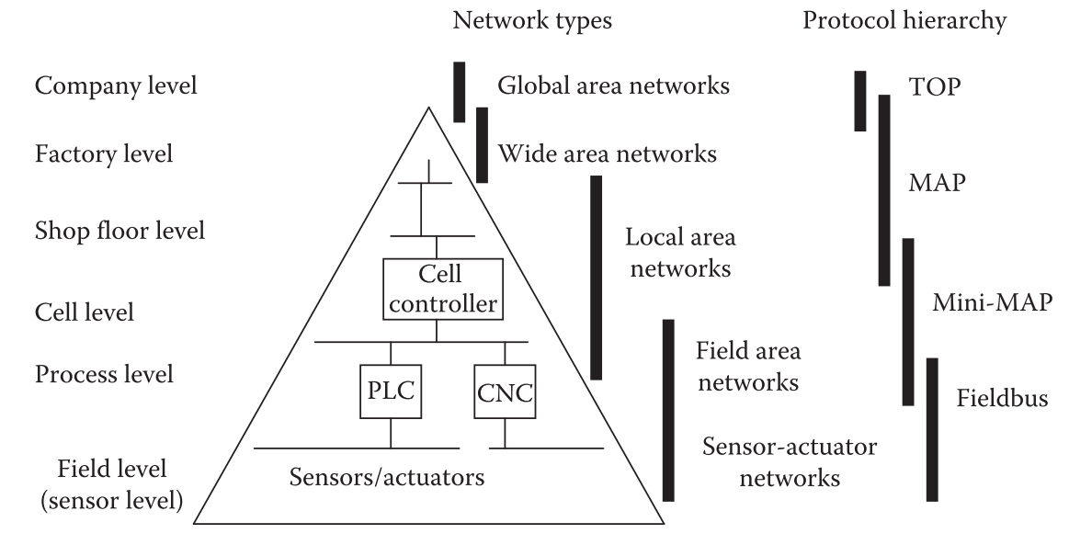
Hierarchical network levels in automation & original protocols
PLC: Program Logic Controller
CNC: Computer Numeric Controller
MAP: Manufacturing Automation Protocol
TOP: Technical Office Protocol
Notes:
Manufacturing Automation Protocol (MAP) was a computer network standard released in 1982 for interconnection of devices from multiple manufacturers. It was developed by General Motors to combat the proliferation of incompatible communications standards used by suppliers of automation products such as programmable controllers.^{[1]} By 1985 demonstrations of interoperability were carried out and 21 vendors offered MAP products. In 1986 the Boeing corporation merged its Technical Office Protocol with the MAP standard, and the combined standard was referred to as "MAP/TOP". The standard was revised several times between the first issue in 1982 and MAP 3.0 in 1987, with significant technical changes that made interoperation between different revisions of the standard difficult.
Although promoted and used by manufacturers such as General Motors, Boeing, and others, it lost market share to the contemporary Ethernet standard and was not widely adopted. Difficulties included changing protocol specifications, the expense of MAP interface links, and the speed penalty of a token-passing network.^{[2]} The token bus network protocol used by MAP became standardized as IEEE standard 802.4 but this committee disbanded in 2004 due to lack of industry attention.

Slide 7
Networks for control
Lower level
  A high level of determinism
  Deterministic network (e.g., CAN)
  Switched Ethernet is becoming common
Intermediate /high Level
  Token passing and Ethernet-based networks are commonly used
  Communicate larger amount of data and support network service
Wireless networks are not commonly utilized for control yet
  Extensive and costly verification before deployment
Notes:
Chapter 2 “Networked Control Systems for Manufacturing: Parameterization, Differentiation, Evaluation, and Application”

Slide 8
Networks for Diagnostics
Features
  Support large amounts of data
  Emphasis speed over determinism
  Wireless network is an ideal medium (flexibility)

Slide 9
Networks for Safety
Features
  Have the strongest determinism and jitter requirement
  CAN-based and switched Ethernet-based networks are popular candidates
  Wireless network is possible (tradeoff between flexibility and reduced guaranteed response time)

Slide 10
Outline
Context
History
Fieldbus characteristics
Industrial Ethernet: the new Fieldbus
Future evolution

Slide 11
Early stages: major sources of influence
Communication engineering with large-scale telephone networks
Instrumentation and measurement systems with parallel buses and real-time requirements
Computer science with the introduction of high-level protocol design

Slide 12
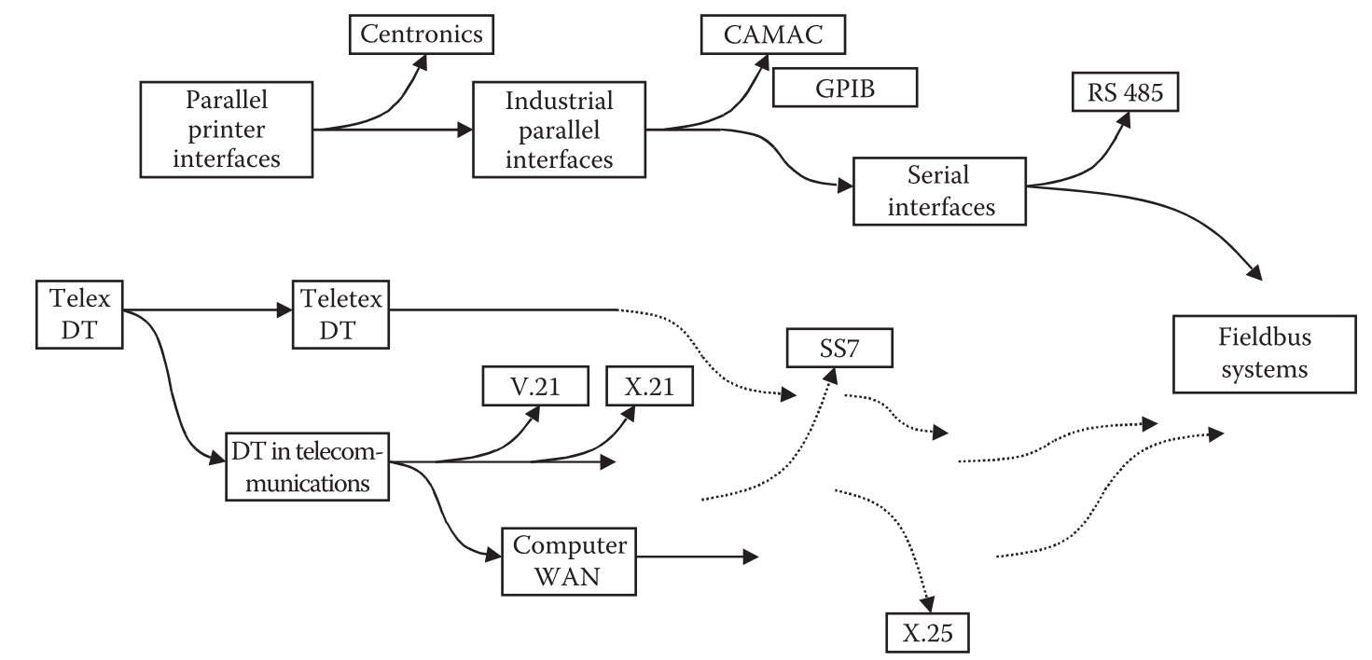

Slide 13
Evolution of fieldbuses
Different application requirements generated different solutions
A fierce selection process where not always the fittest survived, but often those with the highest marketing power behind them
  Consequently, most of the newly developed systems vanished or remained restricted to small niches
Then, user organizations were founded to carry on the definition and promotion of the fieldbus systems independent of individual companies

Slide 14
After the race for fieldbus developments, a race for standardization was launched
  National standardization relatively easy
  International standardization difficult
Status quo
  Factory and process automation
    Multiprotocol standards IEC 61158: support 8 technologies, i.e., Foundation Fieldbus H1, ControlNet, PROFIBUS, P-Net, FOUNDATION fieldbus HSE (High Speed Ethernet), SwiftNet (developed for Boeing, later withdrawn), WorldFIP, Interbus
    IEC 61784-1: industrial communication networks - profiles
  Standards in other domains
Notes:
The International Electrotechnical Commission^{[3]} (IEC; in French: Commission électrotechnique internationale) is an international standards organization^{[4][5]} that prepares and publishes International Standards for all electrical, electronic and related technologies – collectively known as "electrotechnology". IEC standards cover a vast range of technologies from power generation, transmission and distribution to home appliances and office equipment, semiconductors, fibre optics, batteries, solar energy, nanotechnology and marine energy as well as many others. The IEC also manages three global conformity assessment systems that certify whether equipment, system or components conform to its International Standards.
The IEC charter embraces all electrotechnologies including energy production and distribution, electronics, magnetics and electromagnetics, electroacoustics, multimedia, telecommunication and medical technology, as well as associated general disciplines such as terminology and symbols, electromagnetic compatibility (by its Advisory Committee on Electromagnetic Compatibility, ACEC), measurement and performance, dependability, design and development, safety and the environment.
Although fieldbus technology has been around since 1988, with the completion of the ISA S50.02 standard, the development of the international standard took many years. In 1999, the IEC SC65C/WG6 standards committee met to resolve difference in the draft IEC fieldbus standard. The result of this meeting was the initial form of the IEC 61158 standard with eight different protocol sets called "Types" as follows:
Type 1 Foundation Fieldbus H1
Type 2 ControlNet
Type 3 PROFIBUS
Type 4 P-Net
Type 5 FOUNDATION fieldbus HSE (High Speed Ethernet)
Type 6 SwiftNet (a protocol developed for Boeing, since withdrawn)
Type 7 WorldFIP
The Factory Instrumentation Protocol or FIP is a standardized field bus protocol. Its most current definition can be found in the European Standard EN50170.
There are three transmission speeds specified as 31.25kbit/s, 1Mbit/s and 2.5Mbit/s for cable and optical fibre. There may be 255 stations per segment with an overall address range of 65536 communication ports. The messaging protocol uses synchronized access to the channel with messages of 128 bytes length.
The FIP standard is based on a French initiative in 1982 to create a requirements analysis for a future field bus standard. The study led to the European Eureka initiative for a field bus standard in June 1986 that included 13 partners. The development group (réseaux locaux industriels) created the first proposal to be standardized in France. The name of the FIP field bus was originally given as an abbreviation of the French "Flux d'Information vers le Processus" while later referring to FIP with the English name "Factory Instrumentation Protocol" (some references also use the hybrid "Flux Information Protocol").
Based on the requirements study other manufacturers created similar protocol definitions - starting in 1990 a number of partners from Japan and America merged with FIP to the WorldFIP standardization group (that later merged into the Fieldbus Foundation group). Along with the competing German Profibus the field buses were submitted for European standardization by CENELEC in 1996. Along with other field bus standards these CENELEC standards were included to the international IEC 61158 and IEC 61784 standards by 1999 where FIP is listed as the Communication Profile Family 5. Eventually FIP has lost ground to Profibus which came to prevail the market in Europe in the following decade - the WorldFIP homepage has seen no press release since 2002 (with the US based Fieldbus Foundation to haven taken the lead in ongoing development which however promotes H1 fieldbus for process automation).
The closest cousin of the FIP family can be found today in the Wire Train Bus for train coaches. However a specific subset of WorldFIP - known the FIPIO protocol - can be found widely in machine components.
Type 8 Interbus
INTERBUS is a serial bus system which transmits data between control systems (e.g., PCs, PLCs, VMEbus computers, robot controllers etc.) and spatially distributed I/O modules that are connected to sensors and actuators (e.g., temperature sensors, position switches).
The INTERBUS system was developed by Phoenix Contact and has been available since 1987. It is one of the leading Fieldbus systems in the automation industry and is fully standardized according to European Standard EN 50254 and IEC 61158.
At the moment, more than 600 manufacturers are involved in the implementation of INTERBUS technology in control systems and field devices.
This form of standard was first developed for the European Common Market, concentrates less on commonality, and achieves its primary purpose—elimination of restraint of trade between nations. Issues of commonality are now left to the international consortia that support each of the fieldbus standard types. Almost as soon as it was approved, the IEC standards development work ceased and the committee was dissolved. A new IEC committee SC65C/MT-9 was formed to resolve the conflicts in form and substance within the more than 4000 pages of IEC 61158. The work on the above protocol types is substantially complete. New protocols, such as for safety fieldbuses or real-time Ethernet-fieldbuses are being accepted into the definition of the international fieldbus standard during a typical 5-year maintenance cycle.
Both Foundation Fieldbus and Profibus technologies are now commonly implemented within the process control field, both for new developments and major refits. In 2006, China saw the largest FF (Foundation Fieldbus) systems installations at NanHai and SECCO, each with around 15000 fieldbus devices connected
IEC 61158 specification[edit]
There were many competing technologies for fieldbus and the original hope for one single unified communications mechanism has not been realized. This should not be unexpected since fieldbus technology needs to be implemented differently in different applications; automotive fieldbus is functionally different from process plant control. The final edition of IEC standard IEC 61158 allows 8 technologies. This are the some hierarchic layer of the automation protocols.
IEC 61158 consists of the following parts, under the general title Digital data communications for measurement and control – Fieldbus for use in industrial control systems:
Part 1: Overview and guidance for the IEC 61158 series
Part 2: Physical Layer specification and service definition
Part 3: Data Link Service definition
Part 4: Data Link Protocol specification
Part 5: Application Layer Service definition
Part 6: Application Layer Protocol specification
IEC61784-1
The standard consists of 36 documents that define a set of protocol specific communication profiles based primarily on the IEC 61158 series, to be used in the design of devices involved in communications in factory manufacturing and process control. It also defines additional fieldbus profiles for real-time networks based on ISO/IEC 8802-3. it provides general rules and profile Installation of fieldbuses. This standard contains several Communication Profile Families (CPF), which specify one or more communication profiles. Such profiles identify, in a strict sense, protocol subsets of the IEC 61158 series via protocol specific communication profiles. The PROFIBUS and PROFINET are always in the CPF 3 section.

Slide 15
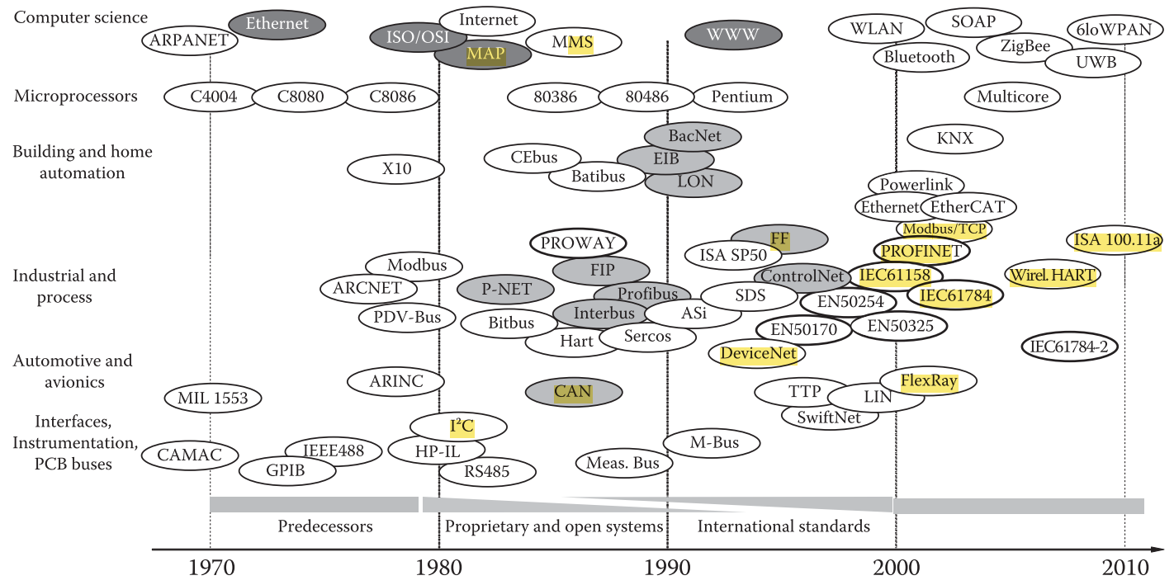

Slide 16
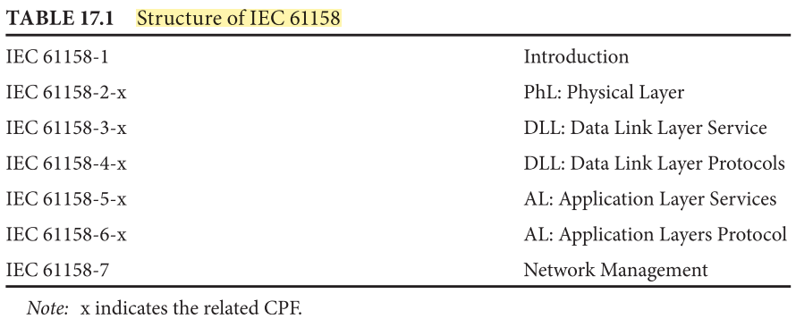

Slide 17
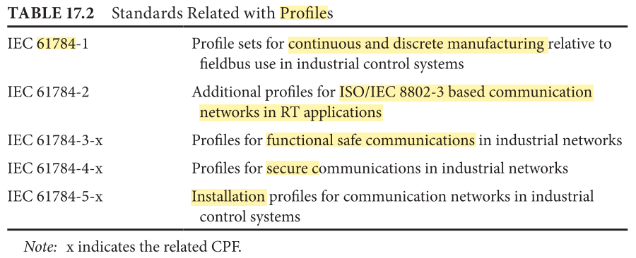

Slide 18
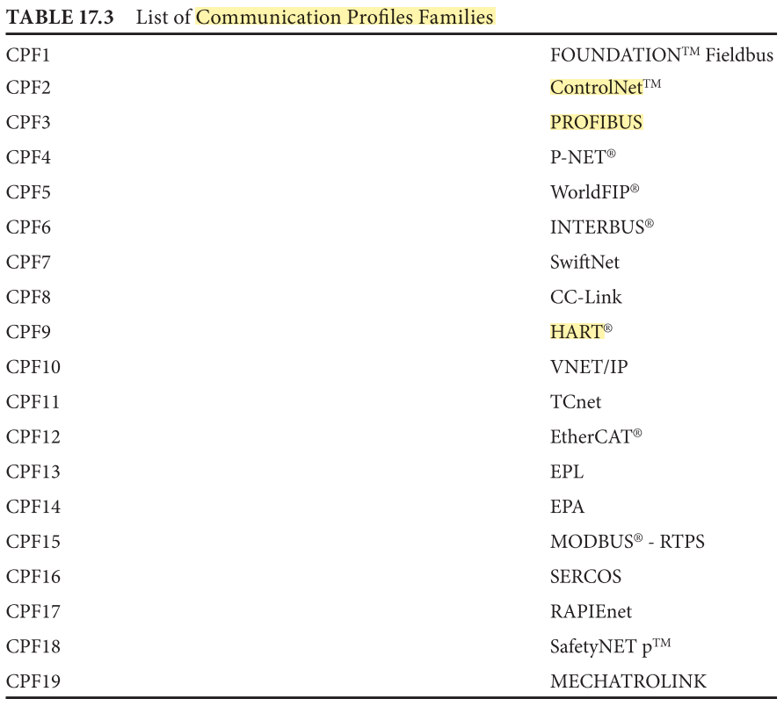
(CPF)

Slide 19
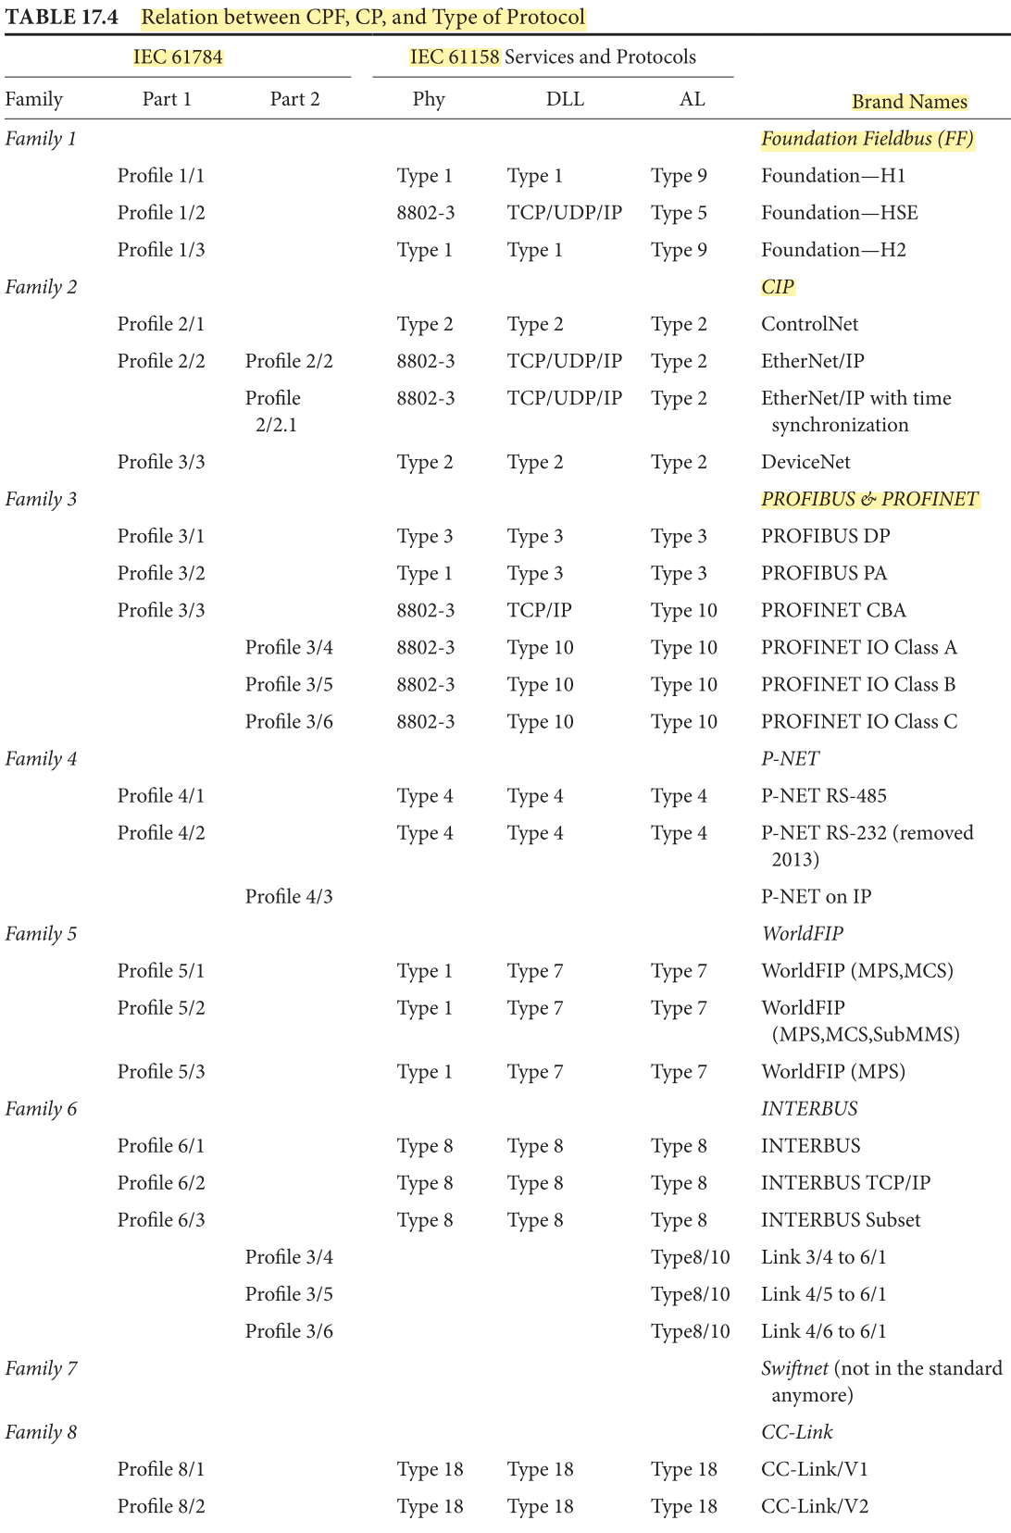
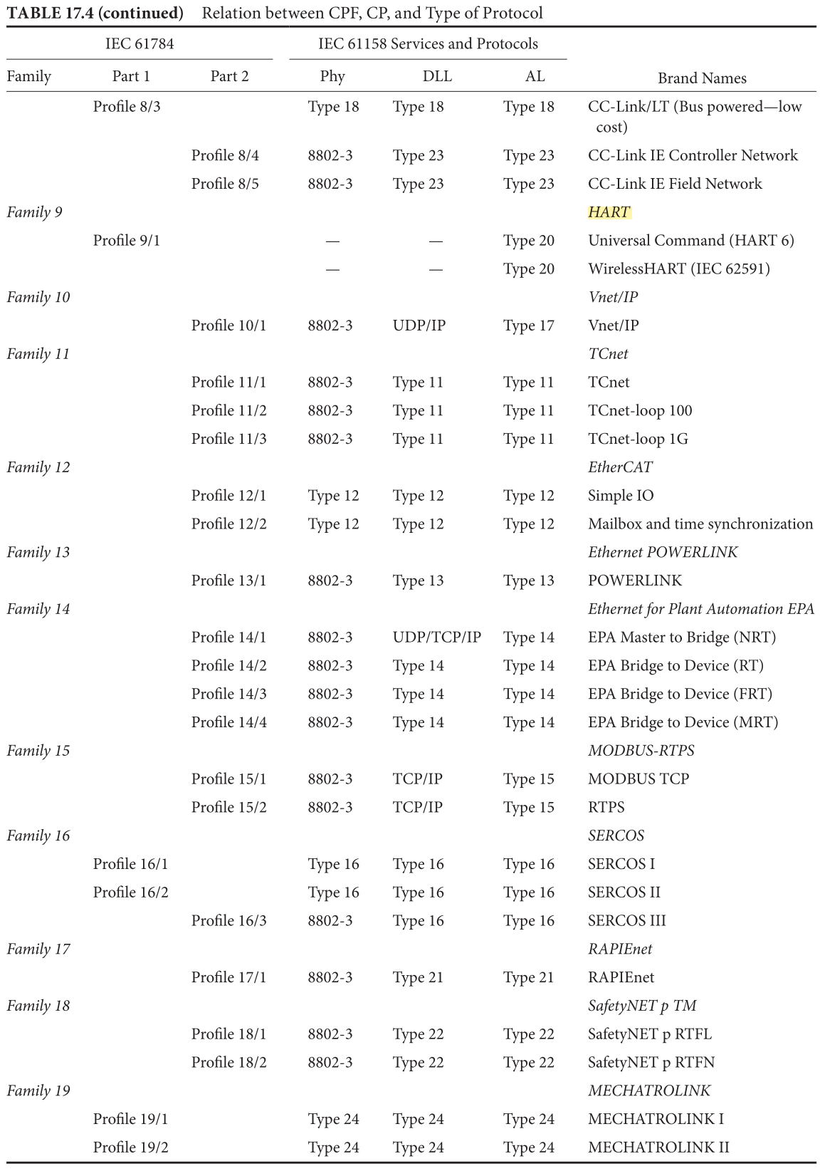

Slide 20
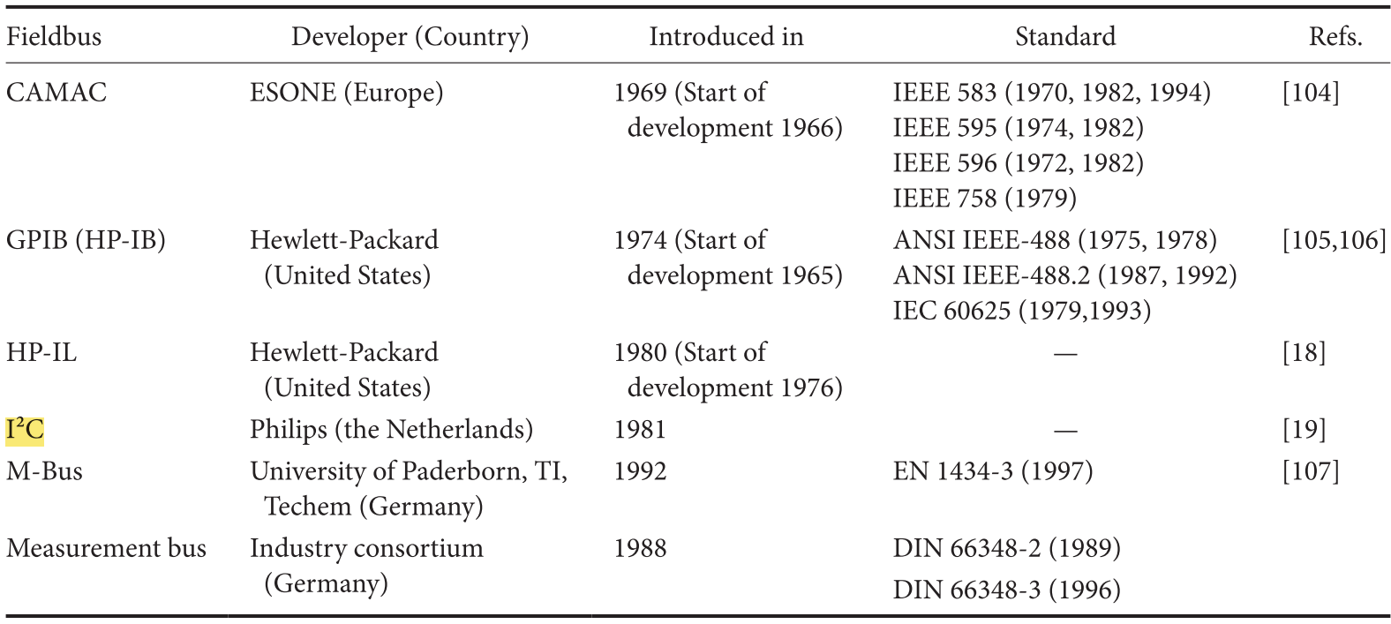
Instrumentation and PCB-level buses
Notes:
PCB: Printed Circuit Board
I²C (Inter-Integrated Circuit), pronounced I-squared-C, is a synchronous, multi-master, multi-slave, packet switched, single-ended, serial computer bus invented in 1982 by Philips Semiconductor (now NXP Semiconductors). It is widely used for attaching lower-speed peripheral ICs to processors and microcontrollers in short-distance, intra-board communication. Alternatively I²C is spelled I2C (pronounced I-two-C) or IIC (pronounced I-I-C).

Slide 21
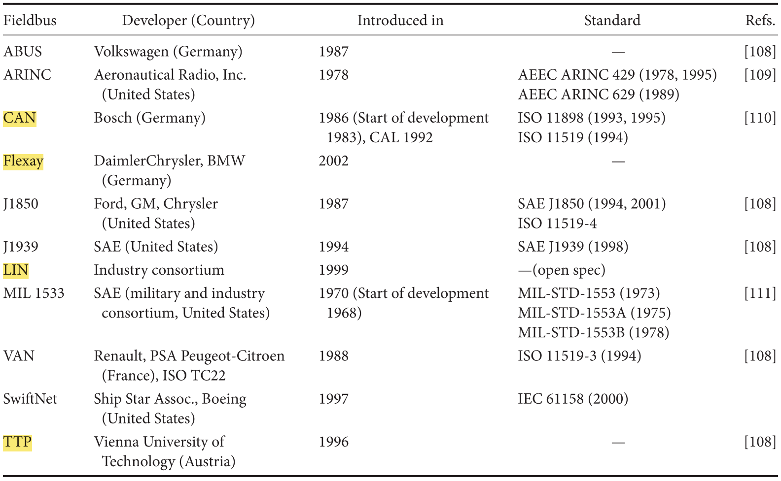
Automotive and aircraft Fieldbuses

Slide 22
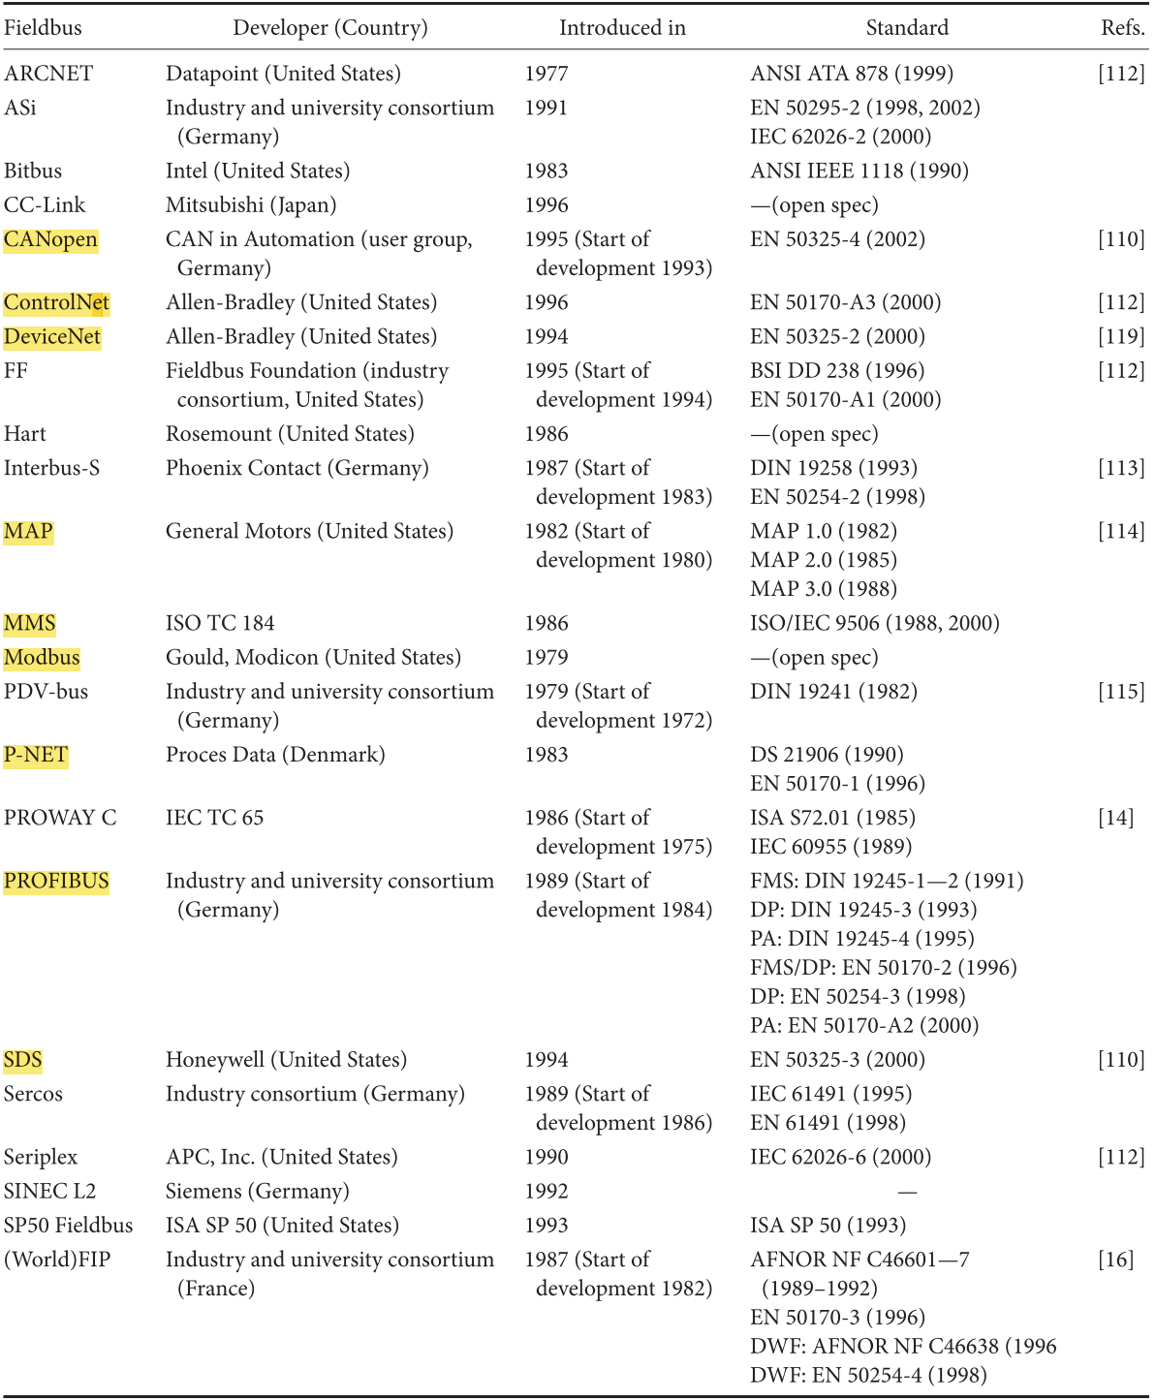
Fieldbuses for industrial and process automation

Slide 23
Outline
Context
History
Fieldbus characteristics
Industrial Ethernet: the new Fieldbus
Future evolution

Slide 24
Fieldbus characteristics
Just like today’s embedded system networks, fieldbus systems were always designed for efficiency
  Data transfer: messages are rather short according to the limited size of process data that must be transmitted at a time
  Protocol design and implementation: typical field devices do not provide ample computing resources
    For wireless networks, resources also constrained in power, radio bandwidth etc
Characteristic application requirements in individual areas w.r.t. real-time, topology, and economic constraints

Slide 25
Characteristic dimensions
Traffic characteristics and requirements
Fieldbus systems w.r.t OSI network model
Network topologies
Medium access control
Communication paradigms
Fieldbus management

Slide 26
Traffic characteristics and requirements
Properties of the various data types inside a fieldbus system differ strongly according to the processes that must be automated
Application areas like manufacturing, process, and building automation pose different timing and consistency requirements that are not even invariant and consistent within the application areas

Slide 27
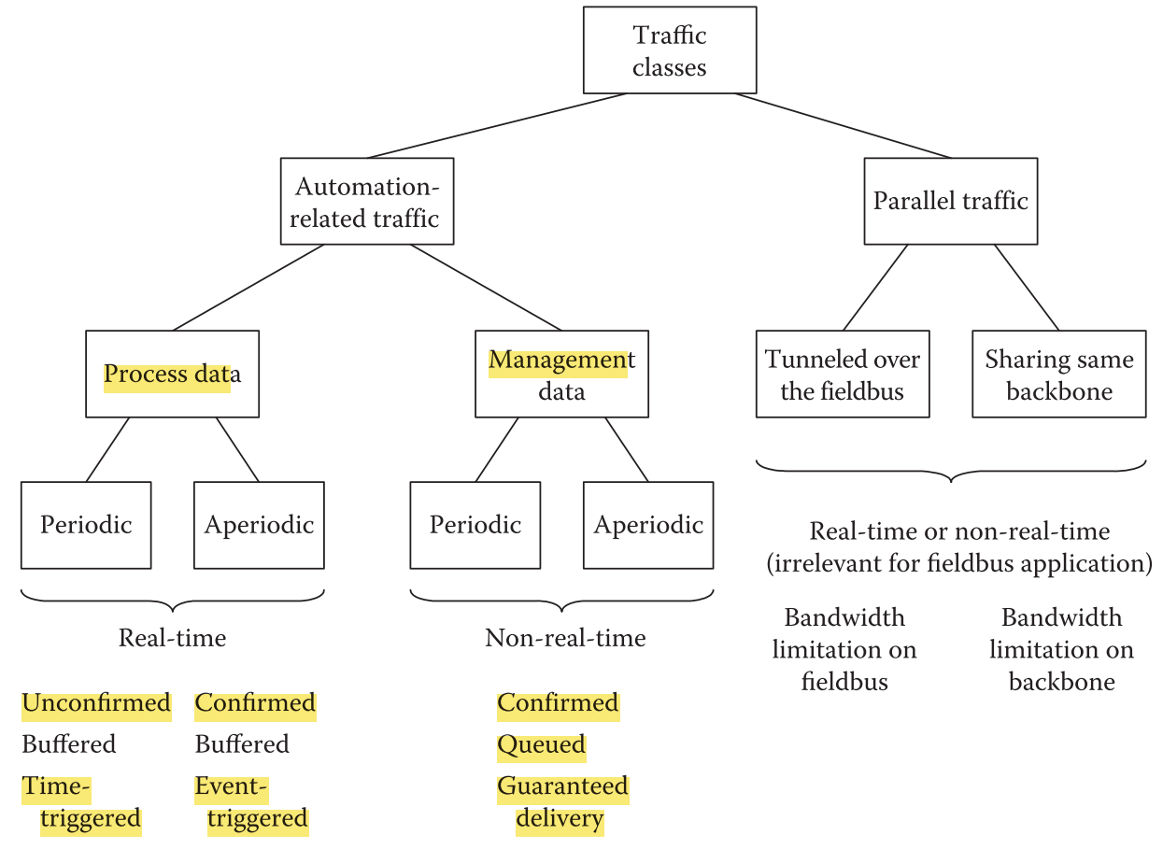
Notes:
Parallel Traffic:
This traffic type does not belong to the applications processes concerned with the actual control of the technical process. Rather, it is generated by independent parallel processes and shares the communication medium. In traditional fieldbus systems, which were closed environments, this type of traffic did not exist. With growing interconnection of automation networks, however, it becomes relevant, either because external traffic (such as IP traffic) may be routed or tunneled through the fieldbus or because fieldbus traffic may be routed through a shared backbone network [33,34]. In particular, this is an issue for industrial Ethernet solutions, which in general foresee some sort of general-purpose IP channel for devices not belonging to the automation system

Slide 28
Implications for Fieldbus
  Data that are exchanged on a cyclic basis are usually sent via connectionless services; most recent values matter
  Acyclic data need special precautions, whether or not they are related to process variables or management data
  Data exchange paradigms
    Time-triggered: specifically suited for periodic real-time data; used in many fieldbus systems in one form or another
    Event-triggered: 1) only changes in process variables are relevant for transmission, 2) such events should be broadcasted across a network, so that every node potentially interested in the data can receive them and network is easily extensible

Slide 29
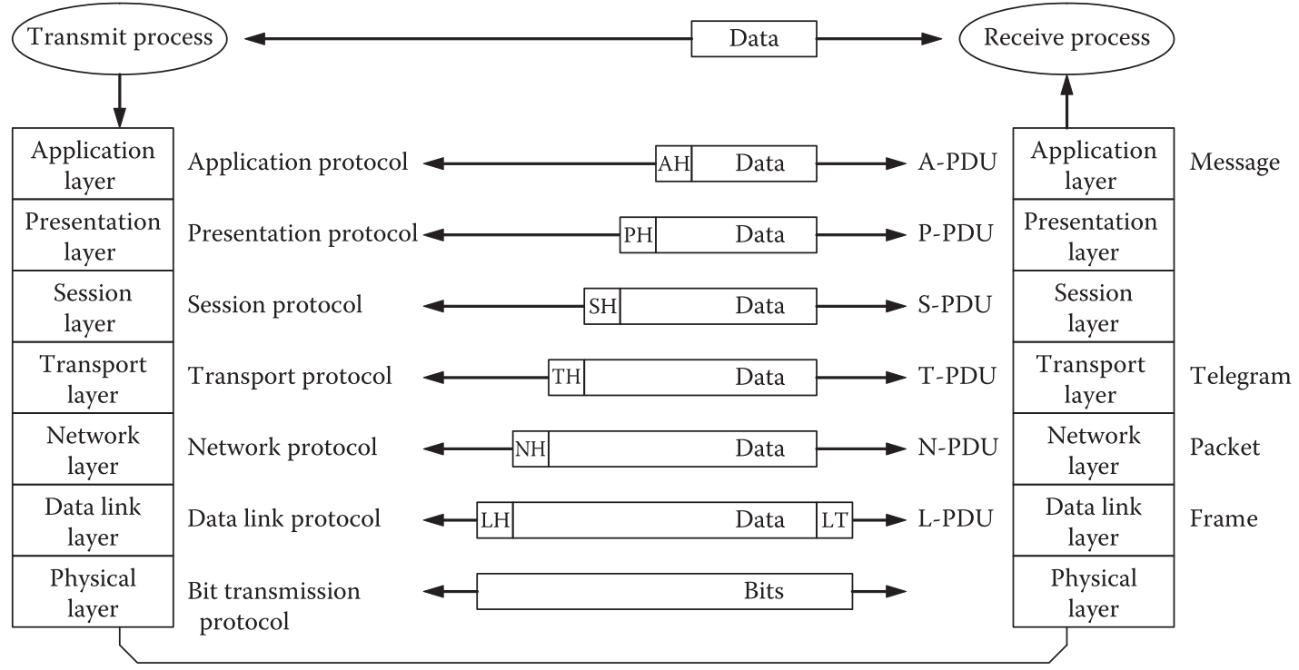
OSI network model

Slide 30
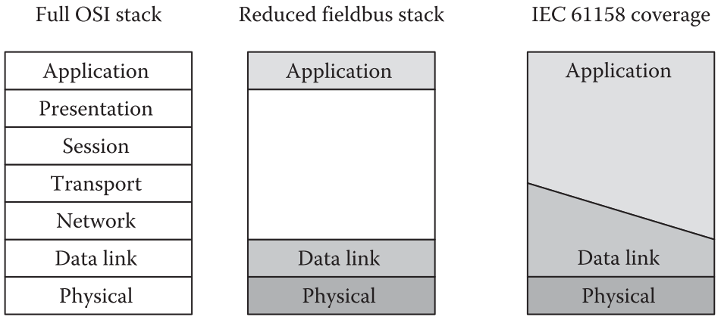
Fieldbus systems and OSI model
For the IEC 61158 fieldbus standard, the rule is that layer 3 and 4 functions can be placed either in layer 2 or layer 7, whereas layer 5 and 6 functionalities are always covered in layer 7

Slide 31
Exceptions: several examples where other layers were explicitly defined, particularly in the building automation domain with possibly a large number of nodes
  Building automation
    European Installation Bus (EIB) and KNX use the network and transport layers to implement routing and transport functionalities
    BACnet uses the network layer as well, which is especially important as BACnet was devised as higher-layer protocol to operate on different lower-layer protocols and links such as Ethernet, MS/TP (master–slave/token passing), and LonTalk

Slide 32
  LonWorks (LON: Local Operating Networking)
    Designed as a general-purpose control network, even though mostly used for building automation today
    In the LonTalk protocol, all seven OSI layers are defined, even though layer 6 is rather thin
  Industrial and process automation
    ControlNet and P-NET also implement layers 3 and 4

Slide 33
Network topologies
Influenced by the target applications and available interface technologies
Physical layer has to meet demanding requirements
  Robustness
  Immunity to electromagnetic disturbances
  Intrinsic safety for hazardous areas
  Cost

Slide 34
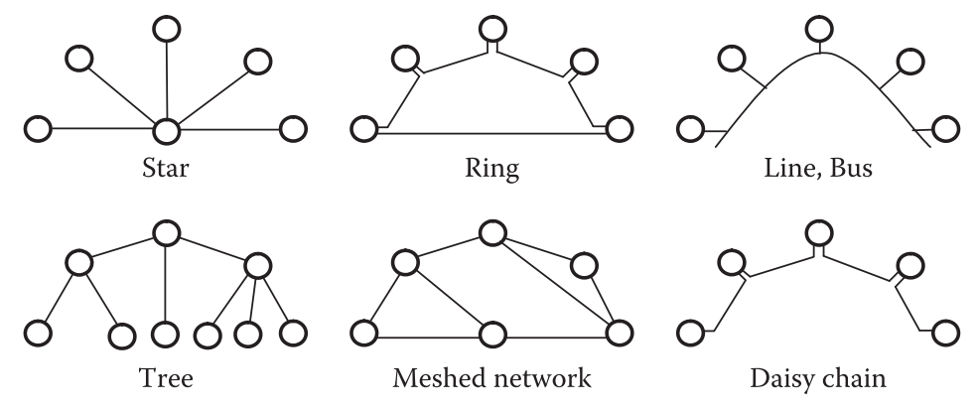
Typical Fieldbus network structures

Slide 35
Star: early Fieldbus, switched Ethernet
Ring: INTERBUS, SERCOS
  Daisy-chain: variant of ring; used in industrial Ethernet (e.g., PROFINET) where nodes are attached to ring via small switches
Line/bus: most successful & commonly used fieldbus topology
  Usually based on RS 485 interface
  Up to 1200m, 10Mbps, and 256 nodes per segment, with repeaters between segments
  Need proper electrical termination of the bus line to avoid signal reflections disturbing data transfer

Slide 36
Tree
  A common way to build hierarchical, relatively complex networks
  Very common in building automation networks such as EIB, LonWorks, or BACnet
Mesh
  LonWorks and P-NET offer the possibility for building meshes

Slide 37
Medium access control
Single-master vs. multi-master systems
  Single-master (or master–slave) approach
    Reflects the tradition of centralized, PLC-based automation systems
    Typically used for fieldbus systems in the lowest levels of the automation pyramid where the roles of the nodes in the network can be clearly distributed
  Multi-master approach
    All nodes are equal and must share the communication medium in a fair manner
    Mostly in building automation or in the middle level of the automation pyramid (i.e., the cell level)
All fieldbus systems use a time division multiple access (TDMA)

Slide 38
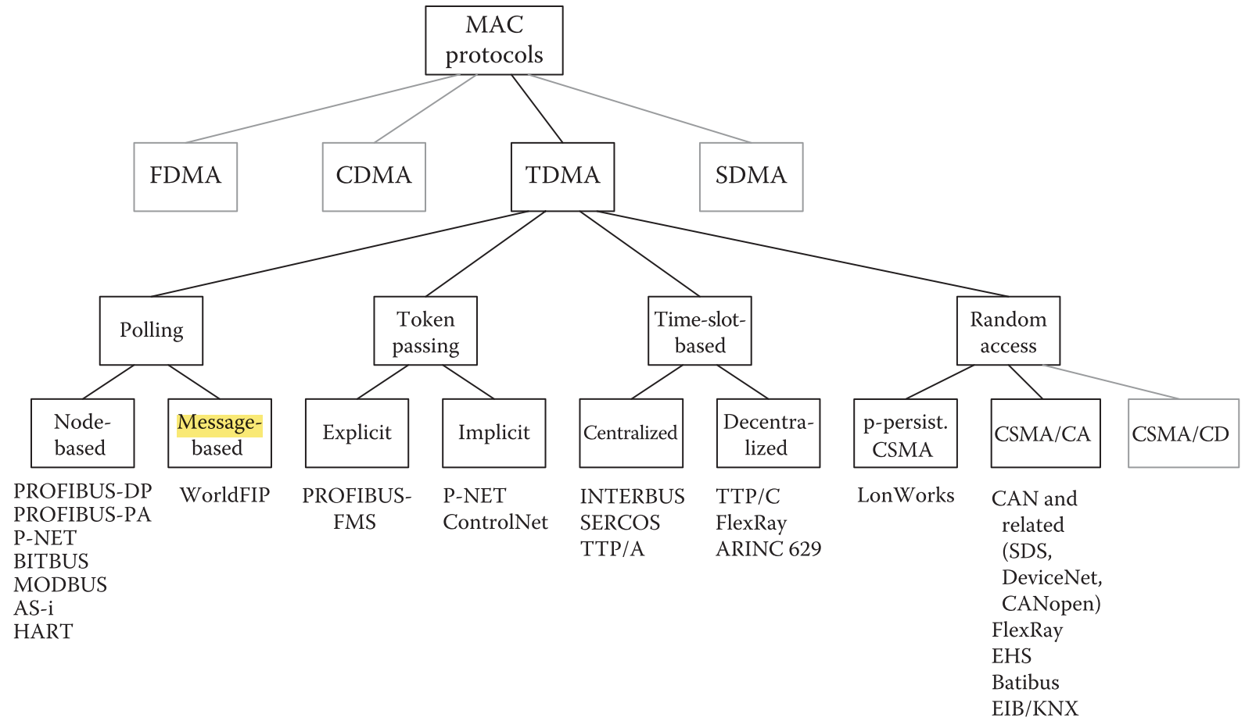

Slide 39
Polling
A master–slave access scheme where a slave node is allowed to send data only when explicitly told so by a central master
Data addressing
  Device-centric: explicit node addressing
  Data-centric: master requesting specific process variables (instead of addressing individual nodes)
Polling rates can be adaptive
  In WorldFIP, the polling mechanism accounts also for different periodicity requirements of the individual variables

Slide 40
PROFIBUS-DP/PA and many Ethernet-based automation networks (such as PROFINET) use a dedicated portion of the bus cycle after the periodic traffic for aperiodic traffic

Slide 41
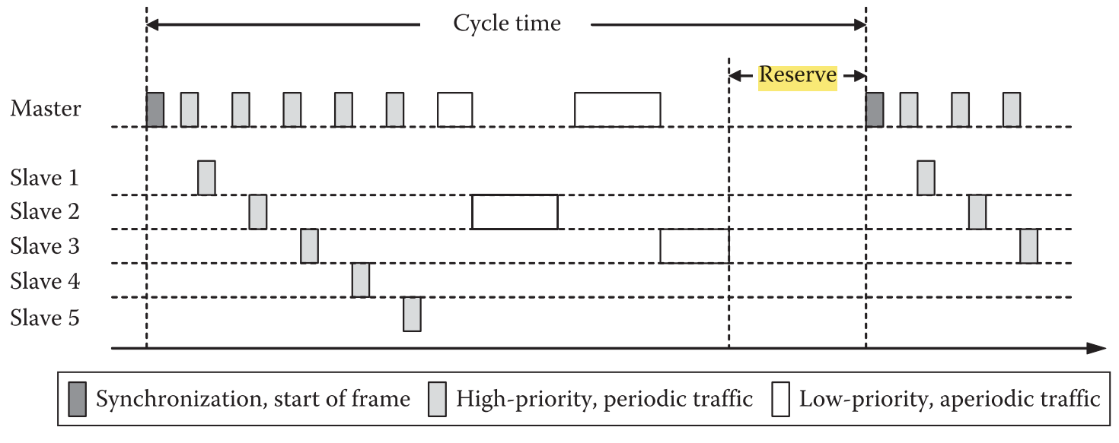
Example: PROFIBUS-DP V2

Slide 42
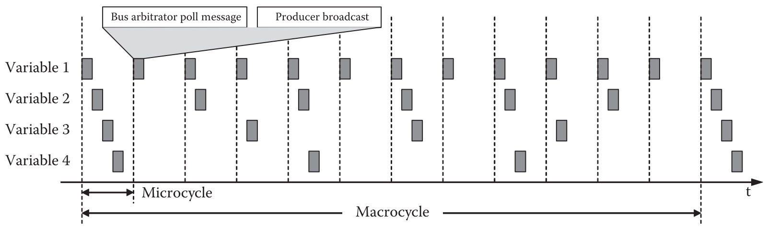
Example: WorldFIP

Slide 43
Toking passing (TP)
Two forms of tokens
  explicitly by means of a dedicated short message
  implicitly by distributed, synchronized access counters (ACs) in all nodes
Rules for ensuring
  token is passed in a fair manner
  errors such as lost or duplicate tokens are detected and resolved
TP is often combined with an underlying master–slave mechanism for each node (i.e., master) to control a subset of nodes

Slide 44
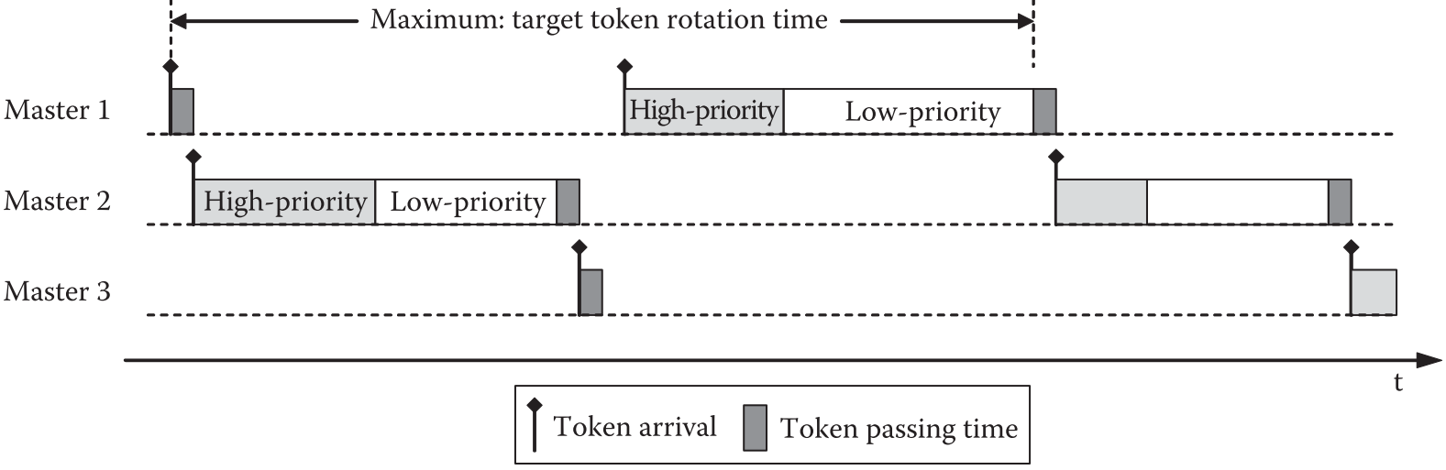
Explicit token example: PROFIBUS

Slide 45
Student Survey

Slide 46
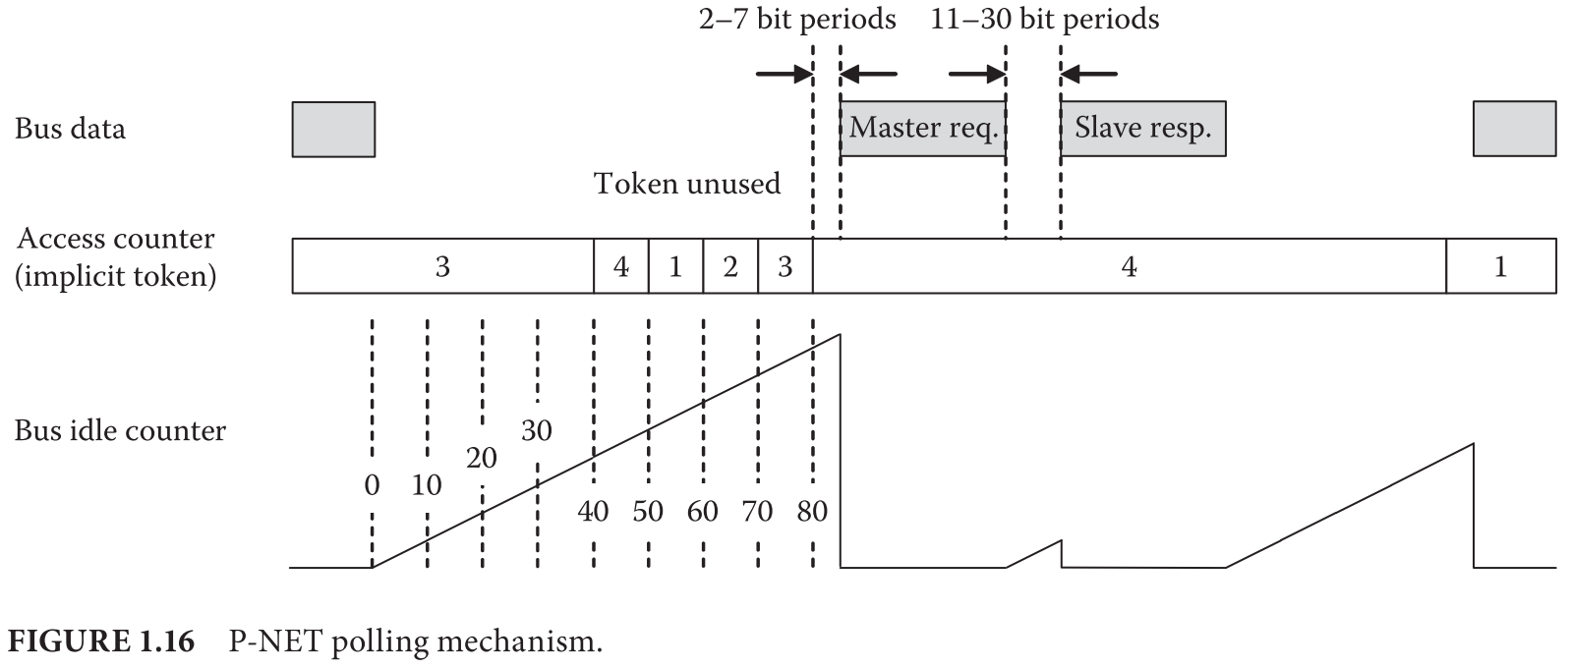
Implicit token example: P-NET
Notes:
The “bus idle period counter” (IC) is incremented every bit period as long as the bus is free and is reset as soon as some node sends data. The Access Counter (AC) is incremented whenever the IC reaches the values 40, 50, 60 … 360. If the AC status matches the address of a master, this means that the master has the token and is therefore able to access the bus for one single request–response data exchange with some other node. To ensure that the token is not passed on, there are maximum values for the time a master can wait before sending a request to a slave and also for the time a slave may take until it starts its response. If the master has no data to send, it remains silent, and aſter a further 10 increments, the token is handed over. Once the AC reaches the number of masters contained within the bus system, up to a maximum of 32, it is reset to the value 1. To avoid loss of synchronization due to the freely running system clocks in the nodes during long idle periods, a master has to send at least a syn- chronization message if the IC value reaches 360. Since

Slide 47
Time-slot-based access
Centralized TDMA
  Dedicated bus master sending synchronization message at start of cycle
  E.g., TTP/A, SERCOS
Distributed TDMA
  All devices synchronize themselves either by explicit clock synchronization mechanisms or by a set of timers that settle bus operation down to a stable steady state
    requires proper error containment mechanisms to prevent faulty nodes from blocking the medium and jeopardizing real-time behavior
  (+) no single point of failure; suitable for safety-critical applications
  Examples
    TTP/C, FlexRay, ARINC 629
    Time-triggered CAN (TT-CAN) or flexible time-triggered CAN (FTT-CAN): CAN was enhanced by superimposing TDMA structures

Slide 48
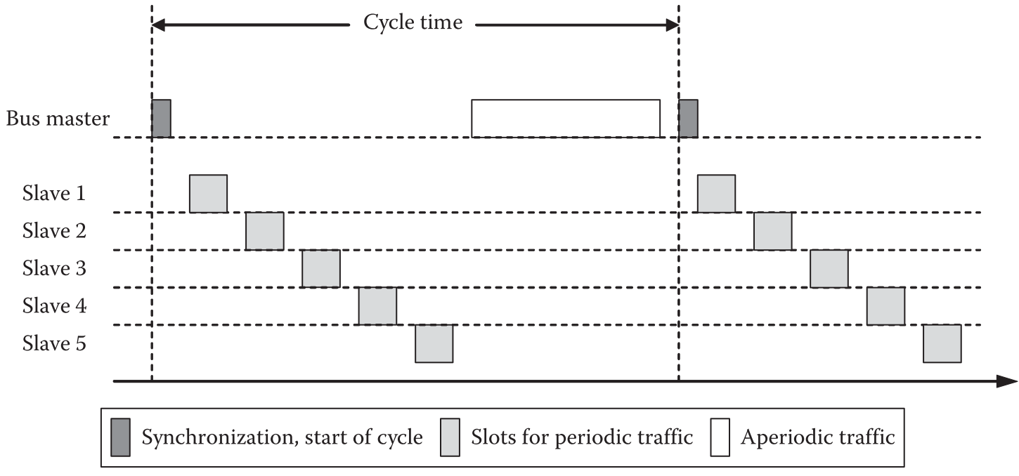
Centralized TDMA example: SERCOS

Slide 49
Random access
p-persistent CSMA (e.g., in LonWorks)
CSMA-CD (collision detection)
CSMA-CA (collision avoidance)
  Sometimes called CSMA-BA (bitwise arbitration); first used in CAN (controller area network)
  Low level is dominant and the high level is recessive, that is, a “1” sent from a device can be overwritten by a “0”; CAN uses message/data-based addressing
  The propagation time of the signals on the line must be short compared with the bit time to yield quasi-simultaneity for all nodes
    The highest bit rate of 1Mbps => a maximum bus length of only 40m
Notes:
The bus line is designed as an open collector bus so that the low level is dominant and the high level is recessive, that is, a “1” sent from a device can be overwritten by a “0”; CAN uses message/data-based addressing

Slide 50
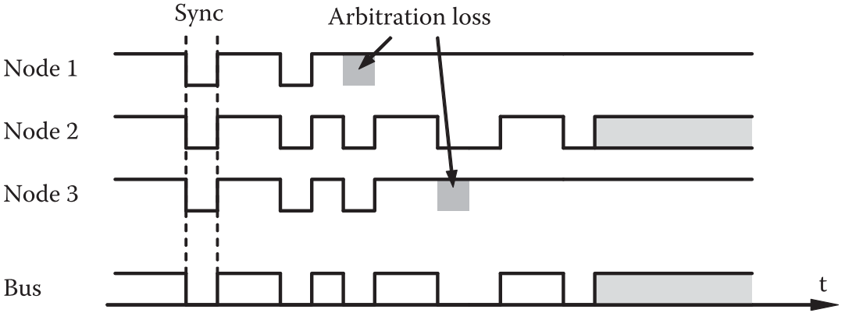
CAN: bitwise arbitration method

Slide 51
CSMA-BA was used in several other fieldbus systems in similar form
  building automation networks such as EIB, BATIBUS, or EHS
  other automotive networks such as VAN and FlexRay (for aperiodic traffic)
CAN was also used as a basis for further extension
  CAN-in-Automation user group defined the CAN application layer and then the CANopen protocol
  DeviceNet and SDS are based on CAN
  CAN Kingdom protocol has been specially developed for machine controls and safety-critical applications
Notes:
Smart Distributed System (SDS) protocol was developed by Honeywell and is supported by Holjeron. SDS is an open event-driven protocol used over Controller area network based industrial networks. It is used for a highly reliable Smart device-level network. The SDS Application Layer Protocol is optimized for smart sensors and actuators, where configuration, diagnostic, and process information can be embedded cost-effectively in a very small footprint. https://en.wikipedia.org/wiki/SDS_Protocol

Slide 52
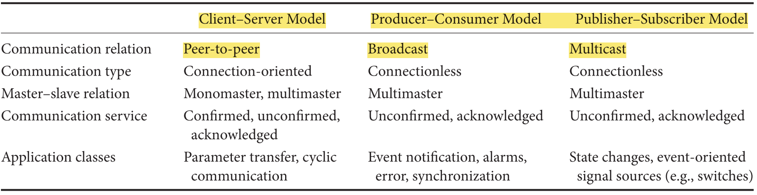
Communication paradigms
(between software processes)
Notes:
The basic idea of the publisher–subscriber model is that certain nodes (the publishers) produce information that they post into the network. The subscribers are typically groups of nodes that listen to information sources. Relating publishers and subscribers can be done at runtime. The producer– consumer model uses very similar mechanisms; the only difference is that broadcast services are being employed instead of multicast communication as in the case of the publisher–subscriber model. However, this distinction is rather subtle and not very relevant in practice.
Confirmed vs. acknowledged: in confirmed mode, a special message is used to just to confirm receipt; in acked mode, confirmation information is piggybacked with another data message.

Slide 53
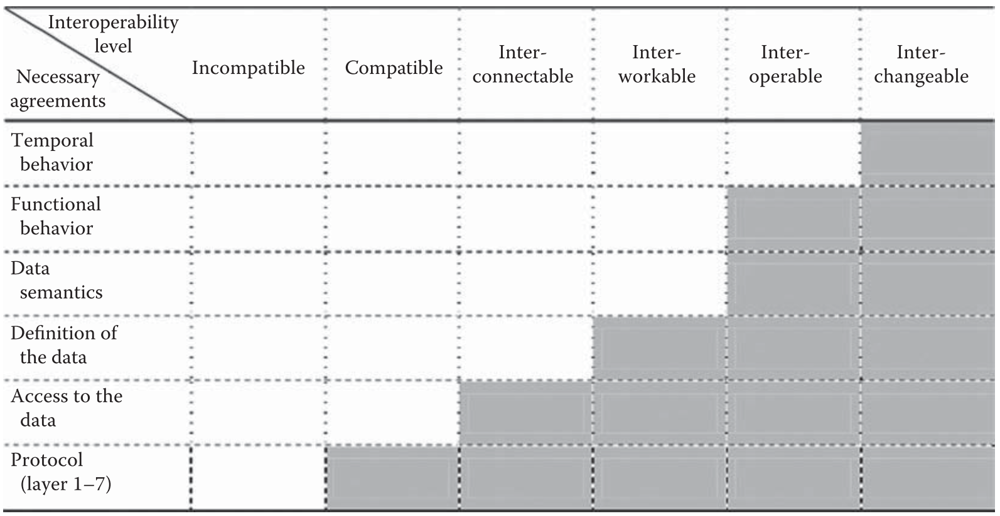
Above the OSI Layers: interoperability and profile
Varying degrees of interoperability

Slide 54
“Profile” for application-level interoperability: layer 8 or user layer
A profile defines which variables carry which data, how they are coded, what physical units they have, etc
Three types
  Bus-specific communication profile: defines the mapping of communication objects onto the services offered by the fieldbus
  Branch profile: specifies common definitions within an application area concerning terms, data types, their coding, and physical meaning
  Device profile: built on communication and branch profiles and describes functionality, interfaces, and in general the behavior of entire device classes such as electric drives, hydraulic valves, or simple sensors and actuators

Slide 55
Fieldbus management
Proprietary, bus-specific solutions
Standard-based solutions
  SNMP
  XML as description language

Slide 56
Outline
Context
History
Fieldbus characteristics
Industrial Ethernet: the new Fieldbus
Future evolution

Slide 57
Industrial Ethernet: the new Fieldbus
Real-time Ethernet (RTE) performance classes based on application requirements on reaction time
  ~100ms: human-in-the-loop observation, process monitoring
  <10ms: most tooling machine control systems, e.g., PLCs or PC-based control
  <1ms: motion control
Interoperability
  As with traditional fieldbus systems, industrial Ethernets were tailored to specific needs => heterogeneity
  Common time sync protocols based on IEEE 1588

Slide 58
  Main benefit of industrial Ethernet
    All approaches allow for a standard TCP/UDP/IP communication channel in parallel to fieldbus communication
    Separation of real-time and non-real-time traffic is accomplished at the Ethernet MAC level with
      prioritization or TDMA schemes, and
      appropriate bandwidth allocation strategies

Slide 59
Outline
Context
History
Fieldbus characteristics
Industrial Ethernet: the new Fieldbus
Future evolution

Slide 60
Future evolution
Wireless industrial networks
  Addresses dynamics and uncertainties of wireless communication
Safety-critical industrial networks
  E.g., x-by-wire for vehicles and avionics
  Mechanisms for enhancing reliability
    sequence numbers
    additional CRCs and confirmations
    timestamps
    heartbeat functions
    timeouts together with safety monitors and built-in test functions for the hardware components

Slide 61
Summary
Context & history
Fieldbus characteristics
  Traffic, topology
  Network architecture, medium access control
  Communication paradigm, application profile, management
Industrial Ethernet: the new fieldbus
Future directions
  Wireless
  Safety-critical industrial network

