Slide 1
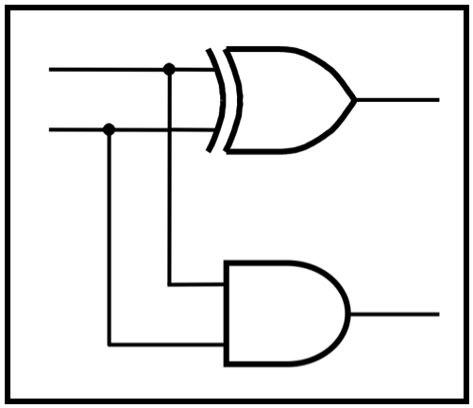
CprE 2810: Digital Logic
Instructor: Alexander Stoytchev
http://www.ece.iastate.edu/~alexs/classes/

Slide 2
Multiplication
CprE 2810: Digital Logic
Iowa State University, Ames, IA
Copyright © Alexander Stoytchev

Slide 3
Administrative Stuff
No HW is due today
HW 6 is due on Monday Oct. 13 @ 10 pm.
Posted on the class web page.

Slide 4
Administrative Stuff
Labs this week
Mini-Project
This is worth 3% of your grade (x2 labs)
https://www.ece.iastate.edu/~alexs/classes/ 2025_Fall_2810/labs/Project-Mini/

Slide 5
Multiplication and division by 10 in the decimal system

Slide 6
Decimal Multiplication by 10
What happens when we multiply a number by 10?
4 x 10 = ?
542 x 10 = ?
1245 x 10 = ?

Slide 7
Decimal Multiplication by 10
What happens when we multiply a number by 10?
4 x 10 = 40
542 x 10 = 5420
1245 x 10 = 12450

Slide 8
Decimal Multiplication by 10
What happens when we multiply a number by 10?
4 x 10 = 40
542 x 10 = 5420
1245 x 10 = 12450
You simply add a zero as the rightmost number

Slide 9
Decimal Division by 10
What happens when we divide a number by 10?
14 / 10 = ?
540 / 10 = ?
1240 / 10 = ?

Slide 10
Decimal Division by 10
What happens when we divide a number by 10?
14 / 10 = 1 //integer division
540 / 10 = 54
1240 / 10 = 124
You simply delete the rightmost number

Slide 11
Multiplication and division by 2 in the binary system

Slide 12
Binary Multiplication by 2
What happens when we multiply a number by 2?
011 times 2 = ?
101 times 2 = ?
110011 times 2 = ?

Slide 13
Binary Multiplication by 2
What happens when we multiply a number by 2?
011 times 2 = 0110
101 times 2 = 1010
110011 times 2 = 1100110
You simply add a zero as the rightmost number

Slide 14
Binary Multiplication by 4
What happens when we multiply a number by 4?
011 times 4 = ?
101 times 4 = ?
110011 times 4 = ?

Slide 15
Binary Multiplication by 4
What happens when we multiply a number by 4?
011 times 4 = 01100
101 times 4 = 10100
110011 times 4 = 11001100
add two zeros in the last two bits and shift everything else to the left

Slide 16
Binary Multiplication by 2^{N}
What happens when we multiply a number by 2^{N}?
011 times 2^{N} = 01100…0 // add N zeros
101 times 4 = 10100…0 // add N zeros
110011 times 4 = 11001100…0 // add N zeros

Slide 17
Binary Division by 2
What happens when we divide a number by 2?
0110 divided by 2 = ?
1010 divides by 2 = ?
110011 divides by 2 = ?

Slide 18
Binary Division by 2
What happens when we divide a number by 2?
0110 divided by 2 = 011
1010 divides by 2 = 101
110011 divides by 2 = 11001
You simply delete the rightmost number

Slide 19
Multiplication of two unsigned binary numbers

Slide 20
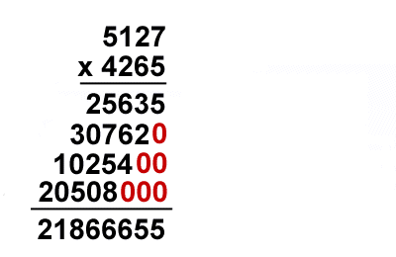
Decimal Multiplication By Hand
[http://www.ducksters.com/kidsmath/long_multiplication.php]

Slide 21
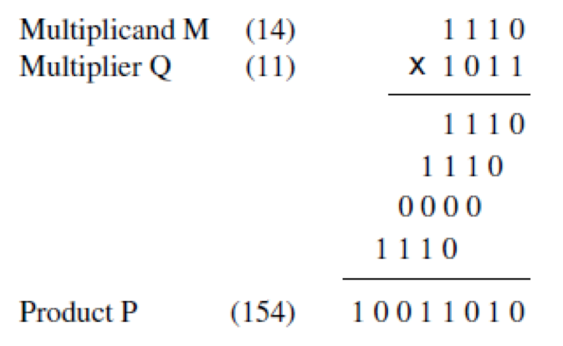
Binary Multiplication By Hand
[Figure 3.34a from the textbook]

Slide 22
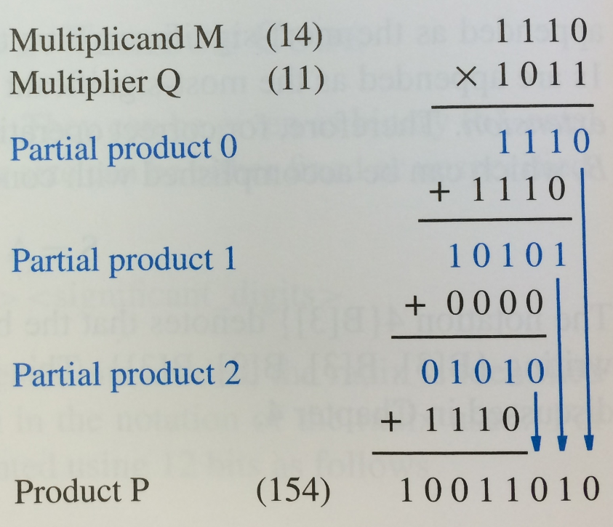
Binary Multiplication By Hand
[Figure 3.34b from the textbook]

Slide 23
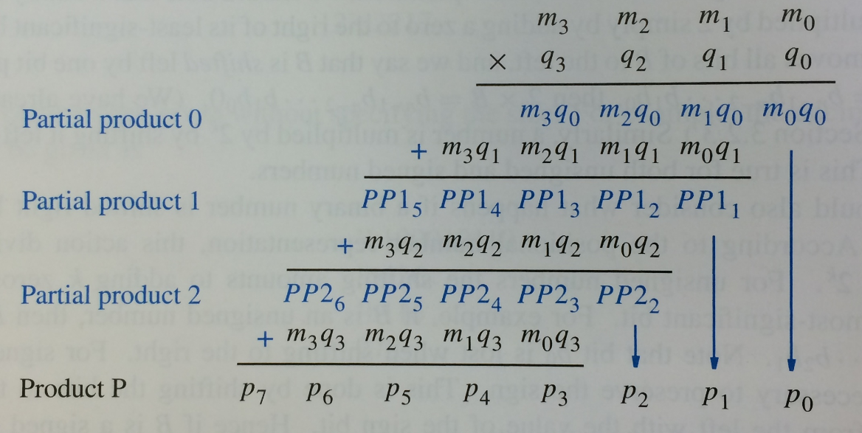
Binary Multiplication By Hand
[Figure 3.34c from the textbook]

Slide 24
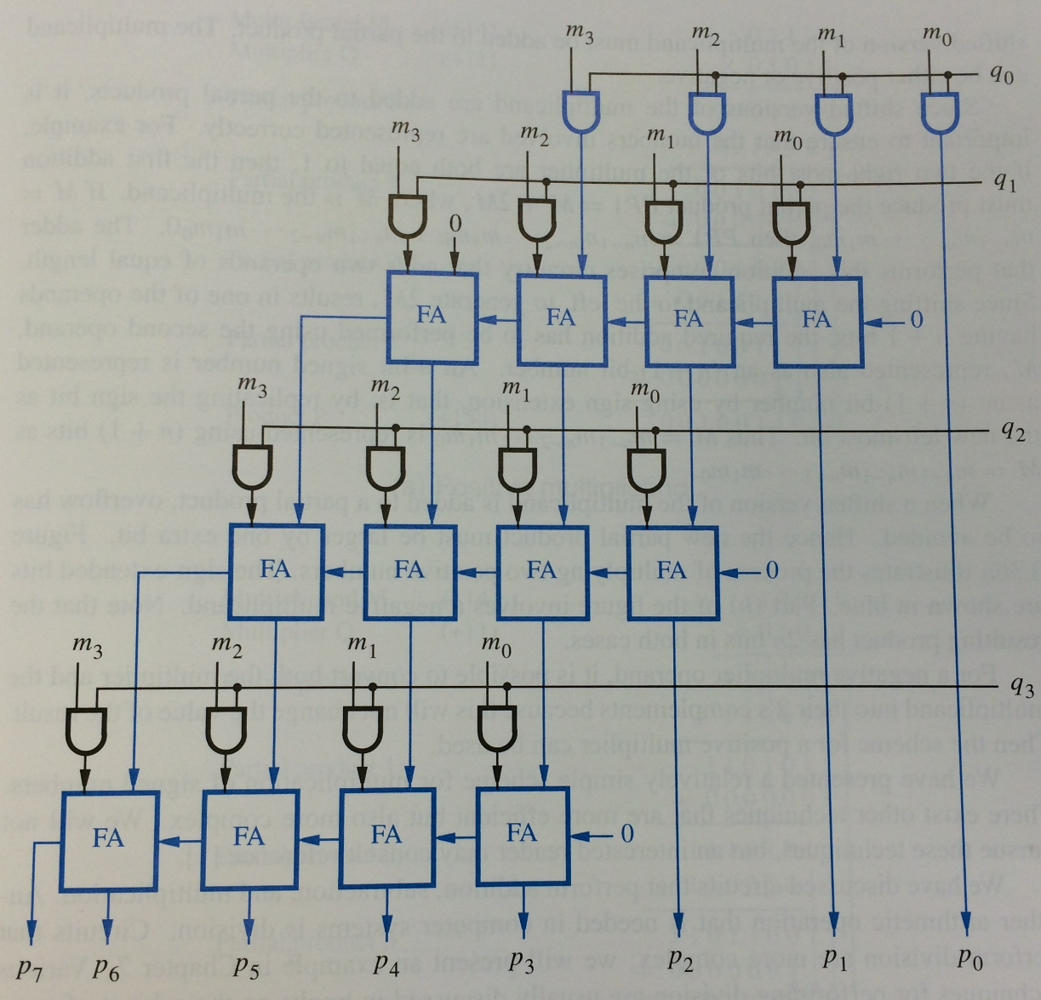
Figure 3.35. A 4x4 multiplier circuit.

Slide 25
Figure 3.35. A 4x4 multiplier circuit.

Slide 26
Sign Extension

Slide 27
Sign extension for positive numbers
If we want to represent the same positive number with more bits, we simply pad it on the left with zeros.
For example:
0110 (+6 with 4-bits)
00110 (+6 with 5-bits)
000110 (+6 with 6-bits)

Slide 28
Sign extension for negative numbers
If we want to represent the same negative number with more bits, we simply pad it on the left with ones.
For example:
1011 (-5 with 4-bits)
11011 (-5 with 5-bits)
111011 (-5 with 6-bits)

Slide 29
Multiplication of two signed binary numbers

Slide 30
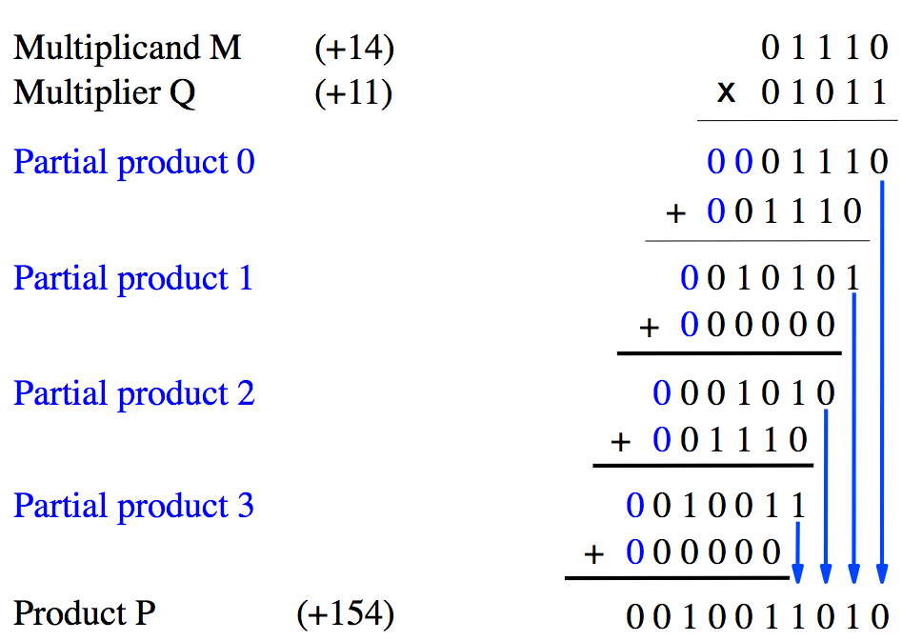
Positive Multiplicand Example
[Figure 3.36a in the textbook]

Slide 31
Positive Multiplicand Example
add an extra bit
to avoid overflow
[Figure 3.36a in the textbook]

Slide 32
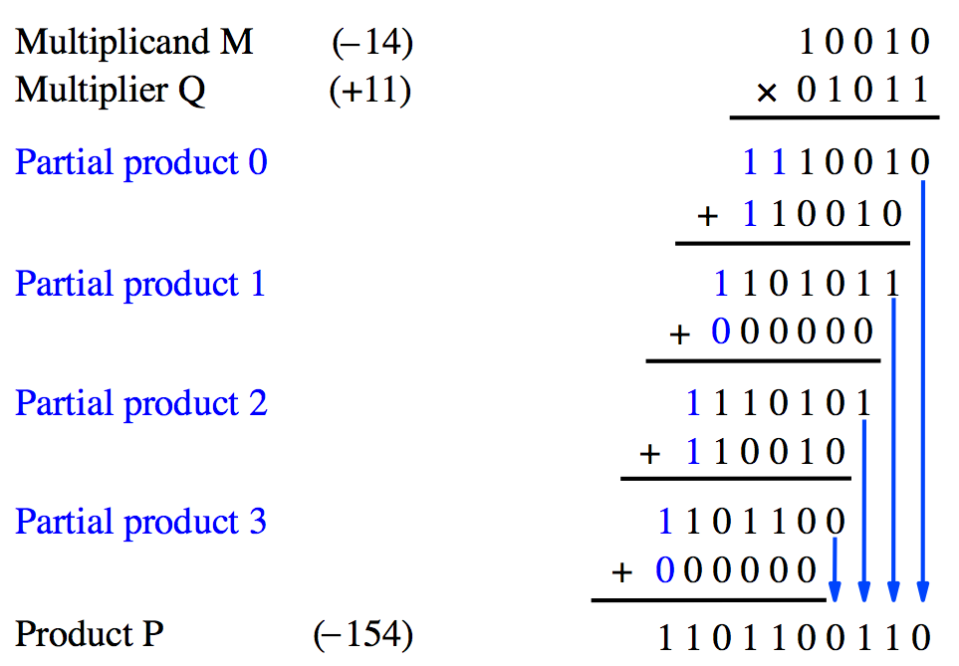
Negative Multiplicand Example
[Figure 3.36b in the textbook]

Slide 33
Negative Multiplicand Example
add an extra bit
to avoid overflow
but now it is 1
[Figure 3.36b in the textbook]

Slide 34
What if the Multiplier is Negative?
Negate both numbers.
This will make the multiplier positive.
Then proceed as normal.
This will not affect the result.
Example: 5*(- 4) = (- 5)*(4)= - 20

Slide 35
Arithmetic Comparison Circuits

Slide 36
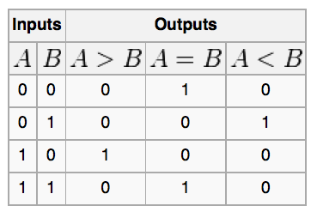
Truth table for a one-bit digital comparator
[http://en.wikipedia.org/wiki/Digital_comparator]

Slide 37
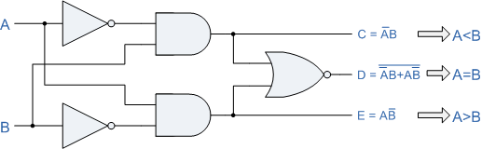
A one-bit digital comparator circuit
[http://www.personal.psu.edu/users///c/w/cwb5096/Old%20Site/index_files/cmpenlab4.htm]

Slide 38
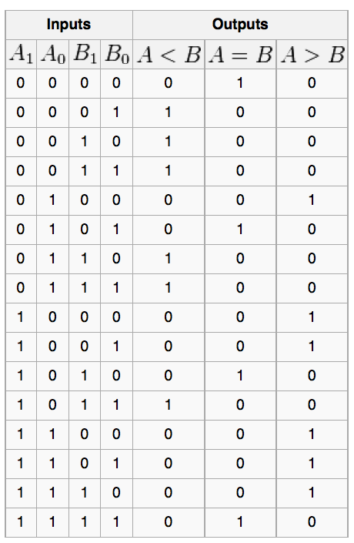
Truth table for a two-bit digital comparator
[http://en.wikipedia.org/wiki/Digital_comparator]

Slide 39
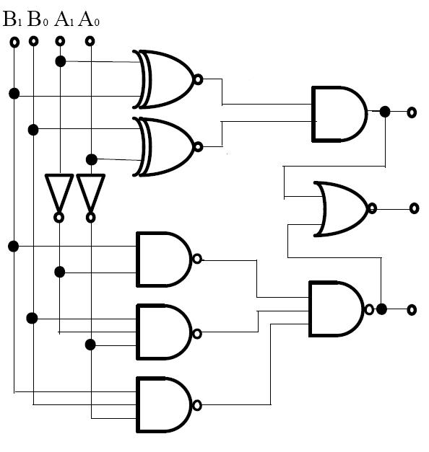
A two-bit digital comparator circuit
[http://forum.allaboutcircuits.com/showthread.php?t=10561]

Slide 40
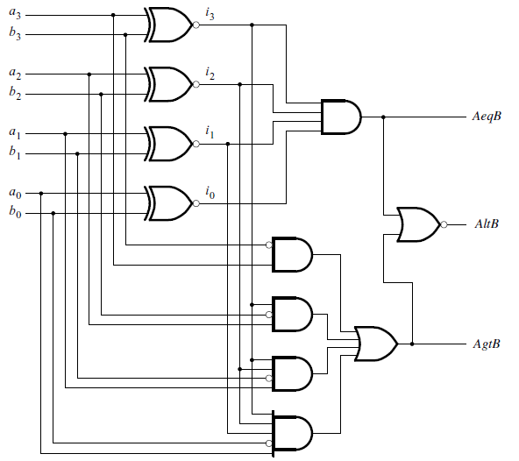
A four-bit comparator circuit
[ Figure 4.22 from the textbook ]

Slide 41
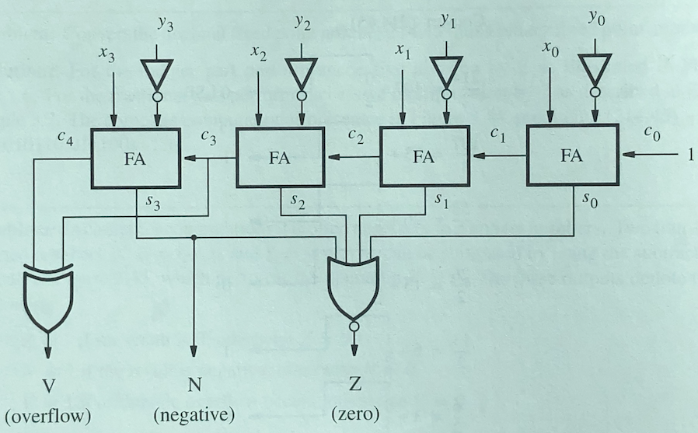
Another four-bit comparator circuit
[ Figure 3.45 from the textbook ]

Slide 42
Another four-bit comparator circuit
[ Figure 3.45 from the textbook ]

Slide 43
Another four-bit comparator circuit
0
0
1
1
1
0
0
1
Compare 6 with 5 by subtraction (6-5).

Slide 44
Another four-bit comparator circuit
0
0
1
1
1
0
0
1
0
1
1
0
1
1
0
0

Slide 45
Another four-bit comparator circuit
0
0
1
1
1
0
0
1
0
1
1
0
1
1
0
0
1
0
0
0
1
1
0 1 1 0
1 0 1 0
1 0 0 0 1
+

Slide 46
Another four-bit comparator circuit
0
0
1
1
1
0
0
1
0
1
1
0
1
1
0
0
1
0
0
0
1
1
0 1 1 0
1 0 1 0
1 0 0 0 1
+
Ignore

Slide 47
Another four-bit comparator circuit
0
0
1
1
1
0
0
1
0
1
1
0
1
1
0
0
1
1
1
1
0
0
0
0
1
. . . 1
0 1 1 0
1 0 1 0
1 0 0 0 1
+

Slide 48
Another four-bit comparator circuit
0
0
1
1
1
0
0
1
0
1
1
0
1
1
0
0
1
1
1
1
0
0
0
0
1
. . . 1
0 1 1 0
1 0 1 0
1 0 0 0 1
+
0
0
0

Slide 49
Binary Coded Decimal (BCD)

Slide 50
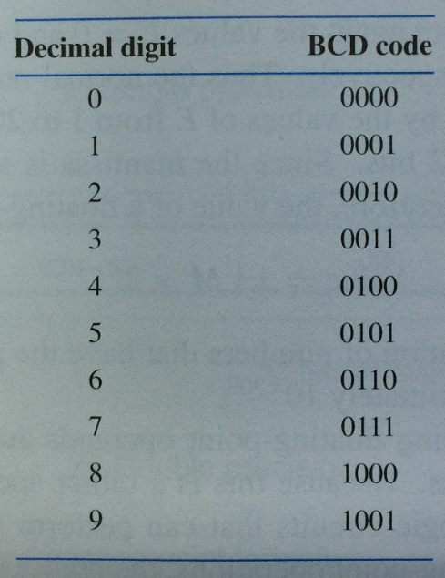
Table of Binary-Coded Decimal Digits

Slide 51
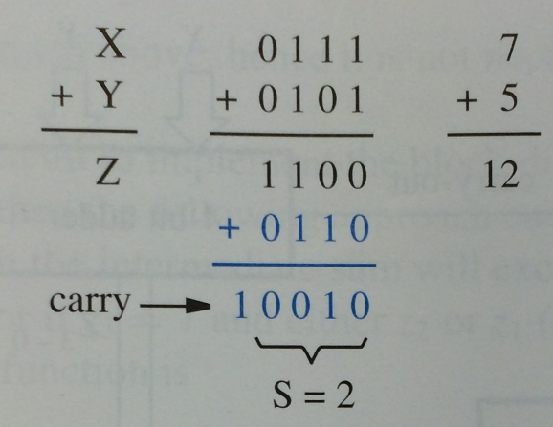
Addition of BCD digits
[Figure 3.38a in the textbook]

Slide 52
Addition of BCD digits
The result is greater than 9, which is not a valid BCD number
[Figure 3.38a in the textbook]

Slide 53
Addition of BCD digits
add 6
[Figure 3.38a in the textbook]

Slide 54
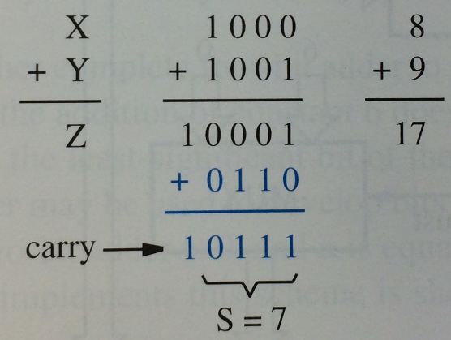
Addition of BCD digits
[Figure 3.38b in the textbook]

Slide 55
Addition of BCD digits
The result is 1, but it should be 7
[Figure 3.38b in the textbook]

Slide 56
Addition of BCD digits
add 6
[Figure 3.38b in the textbook]

Slide 57
Why add 6?
Think of BCD addition as a mod 16 operation
Decimal addition is mod 10 operation

Slide 58
BCD Arithmetic Rules
Z = X + Y
If Z <= 9, then S=Z and carry-out = 0
If Z > 9, then S=Z+6 and carry-out =1

Slide 59
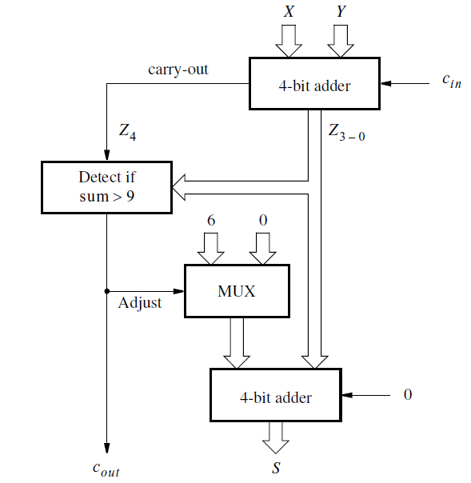
Block diagram for a one-digit BCD adder
[Figure 3.39 in the textbook]

Slide 60
How to check if the number is > 9?
7 - 0111
8 - 1000
9 - 1001
10 - 1010
11 - 1011
12 - 1100
13 - 1101
14 - 1110
15 - 1111

Slide 61
A four-variable Karnaugh map
x1 | x2 | x3 | x4
0 | 0 | 0 | 0 | m0
0 | 0 | 0 | 1 | m1
0 | 0 | 1 | 0 | m2
0 | 0 | 1 | 1 | m3
0 | 1 | 0 | 0 | m4
0 | 1 | 0 | 1 | m5
0 | 1 | 1 | 0 | m6
0 | 1 | 1 | 1 | m7
1 | 0 | 0 | 0 | m8
1 | 0 | 0 | 1 | m9
1 | 0 | 1 | 0 | m10
1 | 0 | 1 | 1 | m11
1 | 1 | 0 | 0 | m12
1 | 1 | 0 | 1 | m13
1 | 1 | 1 | 0 | m14
1 | 1 | 1 | 1 | m15
0
0
0
0
0
0
0
0
0
0
1
1
1
1
1
1

Slide 62
How to check if the number is > 9?
z3 | z2 | z1 | z0
0 | 0 | 0 | 0 | m0
0 | 0 | 0 | 1 | m1
0 | 0 | 1 | 0 | m2
0 | 0 | 1 | 1 | m3
0 | 1 | 0 | 0 | m4
0 | 1 | 0 | 1 | m5
0 | 1 | 1 | 0 | m6
0 | 1 | 1 | 1 | m7
1 | 0 | 0 | 0 | m8
1 | 0 | 0 | 1 | m9
1 | 0 | 1 | 0 | m10
1 | 0 | 1 | 1 | m11
1 | 1 | 0 | 0 | m12
1 | 1 | 0 | 1 | m13
1 | 1 | 1 | 0 | m14
1 | 1 | 1 | 1 | m15
0
0
0
0
0
0
0
0
z
3
z
2
z
1
z
0
00
01
11
10
00
0
0
1
0
01
0
0
1
0
0
0
1
1
1
1
1
1
11
0
0
1
1
10
0
0
1
1

Slide 63
How to check if the number is > 9?
z3 | z2 | z1 | z0
0 | 0 | 0 | 0 | m0
0 | 0 | 0 | 1 | m1
0 | 0 | 1 | 0 | m2
0 | 0 | 1 | 1 | m3
0 | 1 | 0 | 0 | m4
0 | 1 | 0 | 1 | m5
0 | 1 | 1 | 0 | m6
0 | 1 | 1 | 1 | m7
1 | 0 | 0 | 0 | m8
1 | 0 | 0 | 1 | m9
1 | 0 | 1 | 0 | m10
1 | 0 | 1 | 1 | m11
1 | 1 | 0 | 0 | m12
1 | 1 | 0 | 1 | m13
1 | 1 | 1 | 0 | m14
1 | 1 | 1 | 1 | m15
0
0
0
0
0
0
0
0
z
3
z
2
z
1
z
0
00
01
11
10
00
0
0
1
0
01
0
0
1
0
0
0
1
1
1
1
1
1
11
0
0
1
1
10
0
0
1
1
f = z₃z₂ + z₃z₁

Slide 64
How to check if the number is > 9?
z3 | z2 | z1 | z0
0 | 0 | 0 | 0 | m0
0 | 0 | 0 | 1 | m1
0 | 0 | 1 | 0 | m2
0 | 0 | 1 | 1 | m3
0 | 1 | 0 | 0 | m4
0 | 1 | 0 | 1 | m5
0 | 1 | 1 | 0 | m6
0 | 1 | 1 | 1 | m7
1 | 0 | 0 | 0 | m8
1 | 0 | 0 | 1 | m9
1 | 0 | 1 | 0 | m10
1 | 0 | 1 | 1 | m11
1 | 1 | 0 | 0 | m12
1 | 1 | 0 | 1 | m13
1 | 1 | 1 | 0 | m14
1 | 1 | 1 | 1 | m15
0
0
0
0
0
0
0
0
z
3
z
2
z
1
z
0
00
01
11
10
00
0
0
1
0
01
0
0
1
0
0
0
1
1
1
1
1
1
11
0
0
1
1
10
0
0
1
1
f = z₃z₂ + z₃z₁
In addition, also check if there was a carry
f = carry-out + z₃z₂ + z₃z₁

Slide 65
Verilog code for a one-digit BCD adder
module
bcdadd(Cin,
X,
Y,
S, Cout);
input
Cin;
input
[3:0] X,
Y;
output
reg [3:0] S;
output
reg Cout;
reg
[4:0] Z;
always
@ (X,
Y,
Cin)
begin
Z
=
X
+
Y
+
Cin;
if
(Z
<
10)
{Cout,
S}
=
Z;
else
{Cout,
S}
=
Z
+
6;
end
endmodule
[Figure 3.40 in the textbook]

Slide 66
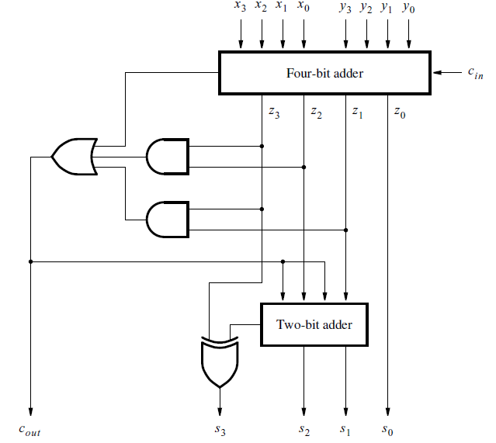
Circuit for a one-digit BCD adder
[Figure 3.41 in the textbook]

Slide 67
Circuit for a one-digit BCD adder
carry-out + z₃z₂ + z₃z₁
[Figure 3.41 in the textbook]

Slide 68
Circuit for a one-digit BCD adder
1
[Figure 3.41 in the textbook]

Slide 69
Circuit for a one-digit BCD adder
1
1
1
1
[Figure 3.41 in the textbook]

Slide 70
Circuit for a one-digit BCD adder
1
1
1
0
1
[Figure 3.41 in the textbook]

Slide 71
Circuit for a one-digit BCD adder
1
implicit 0
1
1
0
add 6
1
[Figure 3.41 in the textbook]

Slide 72
Circuit for a one-digit BCD adder
1
1
1
0
?
1
[Figure 3.41 in the textbook]

Slide 73
Simplification of the Full-Adder
circuit when x_{i}=0
c
i
s
i
x
i
y
i
c
i
+
1
[ Figure 3.4b from the textbook ]

Slide 74
Simplification of the Full-Adder
circuit when x_{i}=0
c
i
s
0
i
y
i
c
i
+
1

Slide 75
Simplification of the Full-Adder
circuit when x_{i}=0
c
i
s
0
i
y
i
0
c
i
+
1
0

Slide 76
Simplification of the Full-Adder
circuit when x_{i}=0
c
i
s
0
i
y
i
c
i
+
1

Slide 77
Simplification of the Full-Adder
circuit when x_{i}=0
c
i
s
0
i
y
y
i
i
c
i
+
1

Slide 78
Simplification of the Full-Adder
circuit when x_{i}=0
c
i
s
i
y
i
c
i
+
1

Slide 79
Simplification of the Full-Adder
circuit when x_{i}=0
c
i
s
y
i
i
c
i
+
1
It reduces to a half-adder.

Slide 80
Simplification of the Full-Adder
circuit when x_{i}=0
c
i
s
y
i
i
c
i
+
1
But if we only need the sum bit …

Slide 81
Simplification of the Full-Adder
circuit when x_{i}=0
c
i
s
y
i
i
… it reduces to an XOR.

Slide 82
Circuit for a one-digit BCD adder
1
z₃ z₂ z₁ z₀
1
1
0
?
1
[Figure 3.41 in the textbook]

Slide 83
Circuit for a one-digit BCD adder
1
z₃ z₂ z₁ z₀
1 1 0
z₃ z₂ z₁ z₀
+
1
1
0
?
1
[Figure 3.41 in the textbook]

Slide 84
Circuit for a one-digit BCD adder
1
implicit 0
z₃ z₂ z₁ z₀
1 1 0
z₃ z₂ z₁ z₀
+
1
1
0
?
1
[Figure 3.41 in the textbook]

Slide 85
Circuit for a one-digit BCD adder
1
carry 3
z₃ z₂ z₁ z₀
1 1 0
z₃ z₂ z₁ z₀
+
1
1
0
?
z₃
c₃
1
[Figure 3.41 in the textbook]

Slide 86
Block diagram for a one-digit BCD adder
[Figure 3.39 in the textbook]

Slide 87
Block diagram for a one-digit BCD adder
We can get by with a 2-bit adder and one XOR gate.
[Figure 3.39 in the textbook]

Slide 88
Block diagram for a one-digit BCD adder
This bus mux is not needed. It reduces to 2 wires that carry the adjust signal and feed into the 2-bit adder.
[Figure 3.39 in the textbook]

Slide 89
Circuit for a one-digit BCD adder
1
This is the bus mux!
If adjust is equal to one it outputs +6, i.e., 11 (with an implicit zero).
adjust
z₃ z₂ z₁ z₀
1
1
0
[Figure 3.41 in the textbook]

Slide 90
Circuit for a one-digit BCD adder
0
This is the bus mux!
If adjust is equal to zero it outputs 0, i.e., 00 (with an implicit zero).
adjust
z₃ z₂ z₁ z₀
0
0
0
[Figure 3.41 in the textbook]

Slide 91
Questions?

Slide 92
THE END

