Slide 1
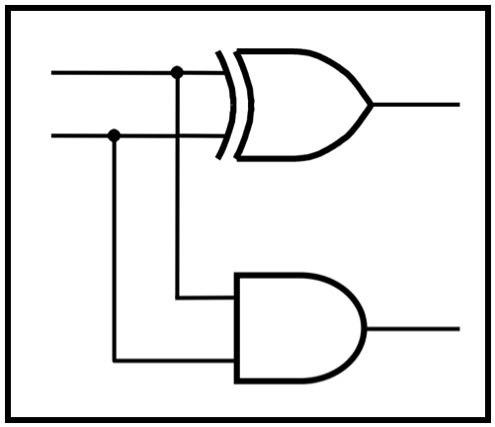
CprE 2810:
Digital Logic
Instructor: Alexander Stoytchev
http://www.ece.iastate.edu/~alexs/classes/

Slide 2
Addition of Unsigned Numbers
CprE 2810: Digital Logic
Iowa State University, Ames, IA
Copyright © Alexander Stoytchev

Slide 3
Administrative Stuff
We are now starting with Chapter 3

Slide 4
Administrative Stuff
HW5 is due today @ 10 pm

Slide 5
Administrative Stuff
No homework due next week
HW6 will be due on Monday, Oct 13

Slide 6
Administrative Stuff
The first midterm exam was last Friday

Slide 7
Quick Review

Slide 8

Number Systems

Slide 9
Number Systems
n-th digit
(most significant)
0-th digit
(least significant)

Slide 10
Number Systems
base
power
n-th digit
(most significant)
0-th digit
(least significant)

Slide 11

The Decimal System (Base 10)

Slide 12



The Decimal System

Slide 13
Another Way to Look at This
5
2
4

Slide 14
Another Way to Look at This
10²
10¹
10⁰
5
2
4

Slide 15
Another Way to Look at This
10²
10¹
10⁰
labels
boxes
5
2
4
Each box can contain only one digit and has only one label. From right
to left, the labels are increasing powers of the base, starting from 0.

Slide 16
Binary Numbers (Base 2)

Slide 17
Binary Numbers (Base 2)
base
power
most significant bit
least significant bit

Slide 18
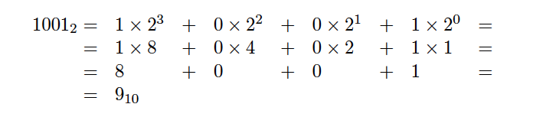
Binary Numbers (Base 2)

Slide 19
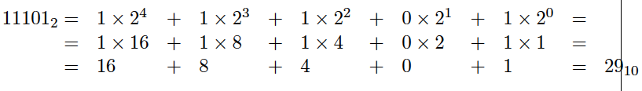
Another Example

Slide 20
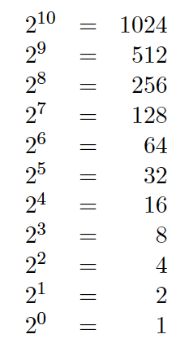
Powers of 2

Slide 21
What is the value of this binary number?
0 0 1 0 1 1 0 0
0 0 1 0 1 1 0 0
0*2⁷ + 0*2⁶ + 1*2⁵ + 0*2⁴ + 1*2³ + 1*2² + 0*2¹ + 0*2⁰
0*128 + 0*64 + 1*32 + 0*16 + 1*8 + 1*4 + 0*2 + 0*1
0*128 + 0*64 + 1*32 + 0*16 + 1*8 + 1*4 + 0*2 + 0*1
32+ 8 + 4 = 44 (in decimal)

Slide 22
Another Way to Look at This
2⁷
2⁶
2⁵
2⁴
2³
2²
2¹
2⁰
0
0
1
0
1
1
0
0

Slide 23
Another Way to Look at This
2⁷
2⁶
2⁵
2⁴
2³
2²
2¹
2⁰
0
0
1
0
1
1
0
0
32
8
4

Slide 24
Signed v.s. Unsigned Numbers

Slide 25
Signed v.s. Unsigned Numbers
positive
and
negative
integers
only
positive
integers

Slide 26
Signed v.s. Unsigned Numbers
positive
and
negative
integers
and zero
only
positive
integers
and zero

Slide 27
Two Different Types of Binary Numbers
Unsigned numbers
All bits jointly represent a positive integer.
Negative numbers cannot be represented this way.
Signed numbers
The left-most bit represents the sign of the number.
If that bit is 0, then the number is positive.
If that bit is 1, then the number is negative.
The magnitude of the largest number that can be represented in this way is twice smaller than the largest number in the unsigned representation.

Slide 28
Two Different Types of Binary Numbers
Unsigned numbers
All bits jointly represent a positive integer.
Negative numbers cannot be represented this way.
Signed numbers
The left-most bit represents the sign of the number.
If that bit is 0, then the number is positive.
If that bit is 1, then the number is negative.
The magnitude of the largest number that can be represented in this way is twice smaller than the largest number in the unsigned representation.
There are 3 different ways
to represent signed numbers.
They will be introduced next time.

Slide 29
Unsigned Representation
2⁷
2⁶
2⁵
2⁴
2³
2²
2¹
2⁰
0
0
1
0
1
1
0
0
This represents + 44.

Slide 30
Unsigned Representation
2⁷
2⁶
2⁵
2⁴
2³
2²
2¹
2⁰
1
0
1
0
1
1
0
0
This represents + 172.

Slide 31
Sign-and-Magnitude Representation
(using the left-most bit as the sign)
sign
2⁶
2⁵
2⁴
2³
2²
2¹
2⁰
0
0
1
0
1
1
0
0
This represents + 44.

Slide 32
Sign-and-Magnitude Representation
(using the left-most bit as the sign)
sign
2⁶
2⁵
2⁴
2³
2²
2¹
2⁰
1
0
1
0
1
1
0
0
This represents – 44.

Slide 33
Three ways to represent negative numbers
Sign and magnitude
1’s complement
2’s complement
sign
2⁶
2⁵
2⁴
2³
2²
2¹
2⁰
1
0
1
0
1
1
0
0
- 44
sign
2⁶
2⁵
2⁴
2³
2²
2¹
2⁰
1
1
0
1
0
0
1
1
- 44
sign
2⁶
2⁵
2⁴
2³
2²
2¹
2⁰
1
1
0
1
0
1
0
0
- 44

Slide 34
Today’s Lecture is About
Addition of Unsigned Numbers

Slide 35
Important Clarification:
There are two types of addition
Addition of Boolean variables, e.g.,
  x + y where x, y ∊ {0, 1}
Addition of n-bit Binary numbers, e.g.,
  x₄x₃x₂x₁x₀ + y₄y₃y₂y₁y₀ where each x_{k}, y_{k} ∊ {0, 1}

Slide 36
Important Clarification:
There are two types of addition
Addition of Boolean variables, e.g.,
  1 + 0 = 1
Addition of n-bit Binary numbers, e.g.,
  00101 + 00110 = 01011

Slide 37
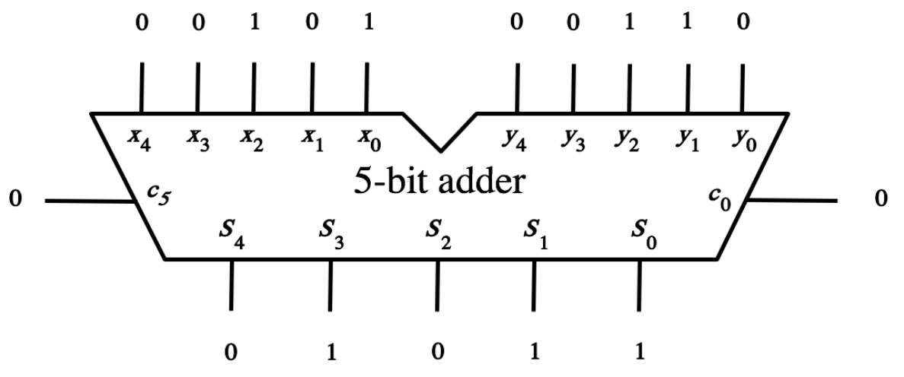
Important Clarification:
There are two types of addition
Addition of Boolean variables, e.g.,
Addition of n-bit Binary numbers, e.g.,
1
1
0

Slide 38
Important Clarification:
There are two types of addition
Addition of Boolean variables, e.g.,
Addition of n-bit Binary numbers, e.g.,
1
1
0
we will derive this
adder circuit today

Slide 39
Important Clarification:
There are two types of addition
Addition of two Boolean variables, e.g.,
  1 + 1 = 1 (according to the rules of Boolean algebra)
Addition of two 1-bit Binary numbers, e.g.,
  1 + 1 = 10 (because in decimal 1 + 1 = 2 )

Slide 40
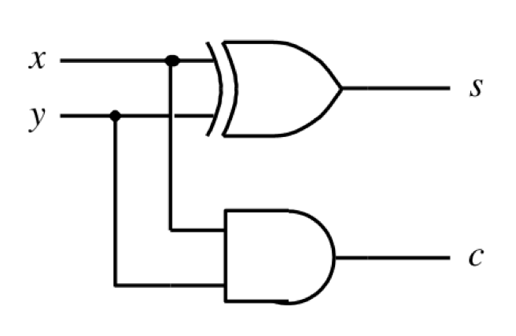
Important Clarification:
There are two types of addition
Addition of two Boolean variables, e.g.,
Addition of two 1-bit Binary numbers, e.g.,
1
1
1
In this case, the
adder circuit simplifies
to the half-adder.
1
0
1
1

Slide 41
Addition of 1-bit Unsigned Numbers

Slide 42
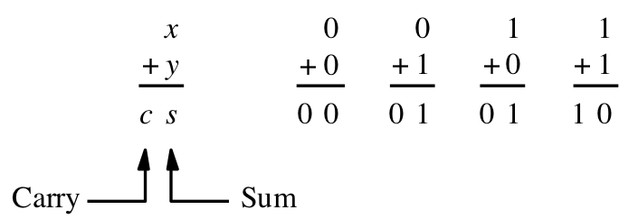
Addition of two 1-bit numbers
[ Figure 3.1a from the textbook ]

Slide 43
Addition of two 1-bit numbers
(there are four possible cases)
[ Figure 3.1a from the textbook ]

Slide 44
Addition of two 1-bit numbers
(there are four possible cases)
0₁₀
1₁₀
1₁₀
2₁₀
[ Figure 3.1a from the textbook ]

Slide 45
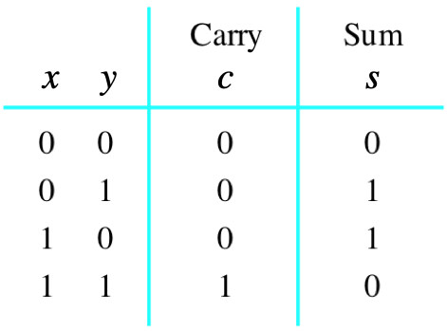
Addition of two 1-bit numbers
(the truth table)
[ Figure 3.1b from the textbook ]

Slide 46
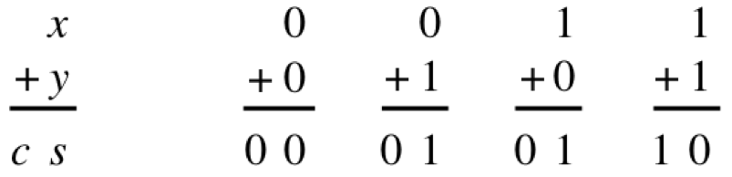
Addition of two 1-bit numbers
[ Figure 2.12 from the textbook ]

Slide 47
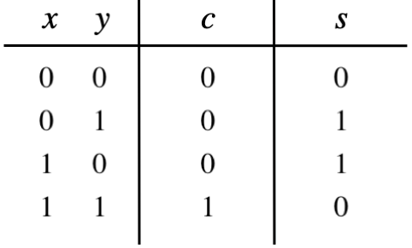
Addition of two 1-bit numbers

Slide 48
Addition of two 1-bit numbers

Slide 49
Addition of two 1-bit numbers

Slide 50
Addition of two 1-bit numbers

Slide 51
Addition of two 1-bit numbers

Slide 52
Addition of two 1-bit numbers

Slide 53
Addition of two 1-bit numbers

Slide 54
Addition of two 1-bit numbers

Slide 55
Addition of two 1-bit numbers

Slide 56
Addition of two 1-bit numbers

Slide 57
Addition of two 1-bit numbers

Slide 58
Addition of two 1-bit numbers

Slide 59
Addition of two 1-bit numbers

Slide 60
Addition of two 1-bit numbers

Slide 61
Addition of two 1-bit numbers
+
+
+
+
=
=
=
=
= 0₁₀
= 1₁₀
= 1₁₀
= 2₁₀

Slide 62
Addition of two 1-bit numbers
AND

Slide 63
Addition of two 1-bit numbers
XOR

Slide 64
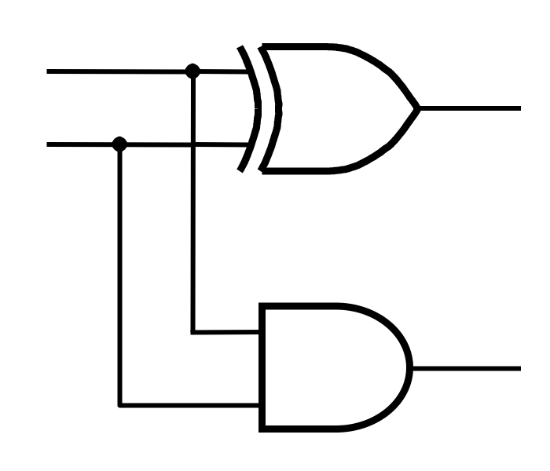
Addition of two 1-bit numbers
x
s
y
c

Slide 65
Addition of two 1-bit numbers
(the logic circuit)
[ Figure 3.1c from the textbook ]

Slide 66
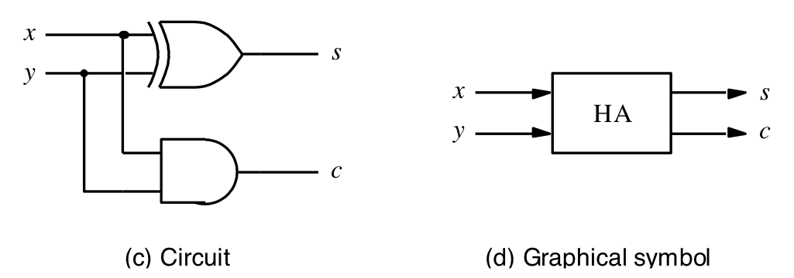
The Half-Adder
[ Figure 3.1c-d from the textbook ]

Slide 67
Addition of Multibit Unsigned Numbers

Slide 68
Analogy with addition in base 10
c₃ c₂ c₁ c₀
x₂ x₁ x₀
y₂ y₁ y₀
s₂ s₁ s₀
+

Slide 69
Analogy with addition in base 10
3 8 9
1 5 7
5 4 6
+

Slide 70
Analogy with addition in base 10
0 1 1 0
3 8 9
1 5 7
5 4 6
carry
+

Slide 71
Example in base 2
1 0 1
1 1 0
+

Slide 72
Example in base 2
1 0 0 0
1 0 1
1 1 0
1 0 1 1
carry
+

Slide 73
Example in base 2
1 0 0 0
1 0 1
1 1 0
1 0 1 1
carry
+
5₁₀
+
6₁₀
11₁₀

Slide 74
The general case in base 2
c₃ c₂ c₁ c₀
x₂ x₁ x₀
y₂ y₁ y₀
s₂ s₁ s₀
+

Slide 75
The general case in base 2
given these
3 inputs
c₃ c₂ c₁ c₀
x₂ x₁ x₀
y₂ y₁ y₀
s₂ s₁ s₀
+

Slide 76
The general case in base 2
given these
3 inputs
c₃ c₂ c₁ c₀
x₂ x₁ x₀
y₂ y₁ y₀
s₂ s₁ s₀
+
compute these
2 outputs

Slide 77
The general case in base 2
c₃ c₂ c₁ c₀
x₂ x₁ x₀
y₂ y₁ y₀
s₂ s₁ s₀
+

Slide 78
The general case in base 2
c₃ c₂ c₁ c₀
x₂ x₁ x₀
y₂ y₁ y₀
s₂ s₁ s₀
+

Slide 79
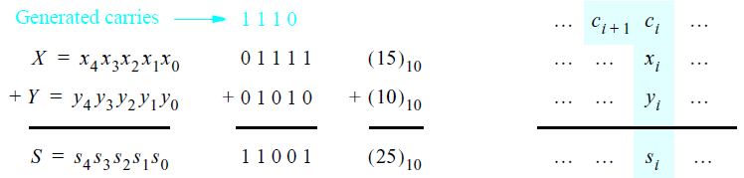
Addition of multibit numbers
Bit position i
[ Figure 3.2 from the textbook ]

Slide 80
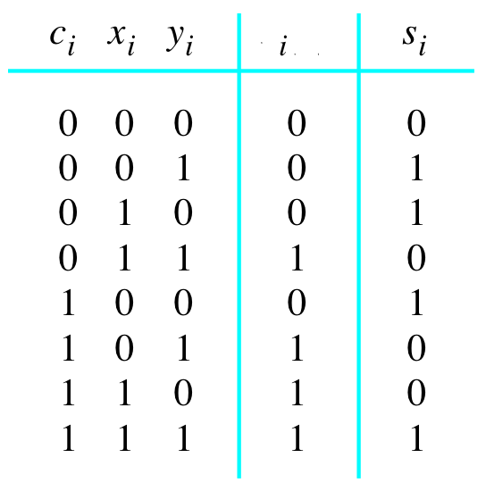

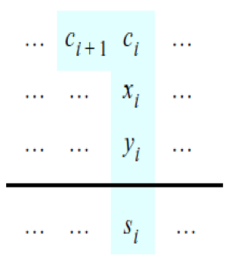
Problem Statement and Truth Table
[ Figure 3.2b from the textbook ]
[ Figure 3.3a from the textbook ]

Slide 81
Problem Statement and Truth Table
+
+
+
+
+
+
+
+
+
+
+
+
+
+
+
+
=
=
=
=
=
=
=
=
= 0₁₀
= 1₁₀
= 1₁₀
= 2₁₀
= 1₁₀
= 2₁₀
= 2₁₀
= 3₁₀
[ Figure 3.2b from the textbook ]
[ Figure 3.3a from the textbook ]

Slide 82
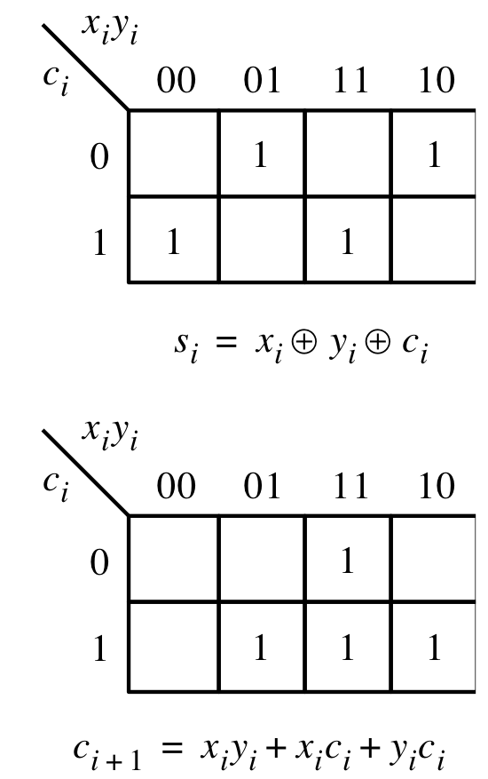
Let’s fill-in the two K-maps
[ Figure 3.3a-b from the textbook ]

Slide 83
Let’s fill-in the two K-maps
Note that the textbook switched
to the other way to draw a K-Map
[ Figure 3.3a-b from the textbook ]

Slide 84
Let’s fill-in the two K-maps
Note that the textbook switched
to the other way to draw a K-Map
[ Figure 3.3a-b from the textbook ]

Slide 85
Let’s fill-in the two K-maps
[ Figure 3.3a-b from the textbook ]

Slide 86
Let’s fill-in the two K-maps
3-input XOR
[ Figure 3.3a-b from the textbook ]

Slide 87
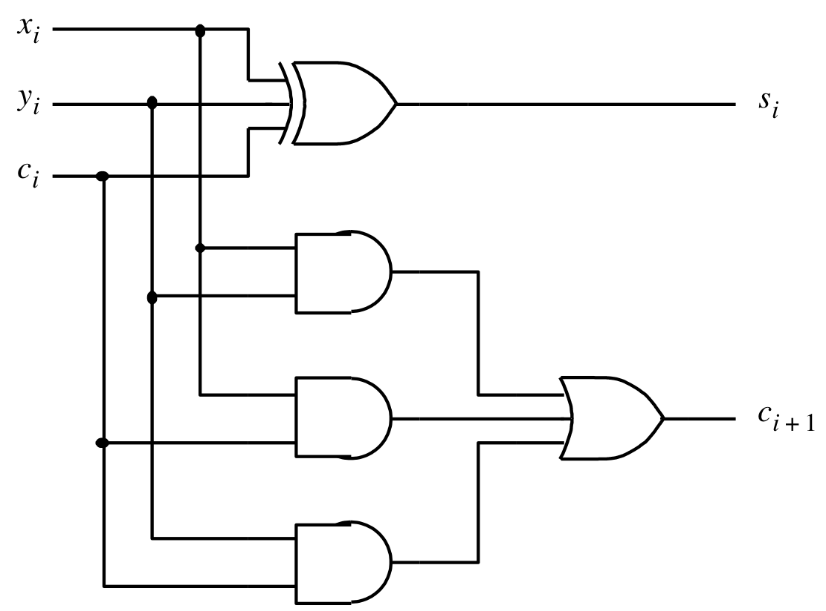


The circuit for the two expressions
[ Figure 3.3c from the textbook ]

Slide 88
This is called the Full-Adder
[ Figure 3.3c from the textbook ]

Slide 89
This is called the Full-Adder
Let's take a closer look at this.
[ Figure 3.3c from the textbook ]

Slide 90
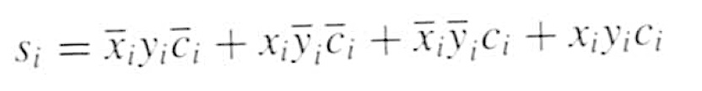
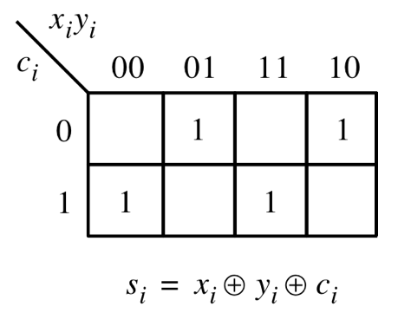
XOR Magic

Slide 91
XOR Magic

Slide 92

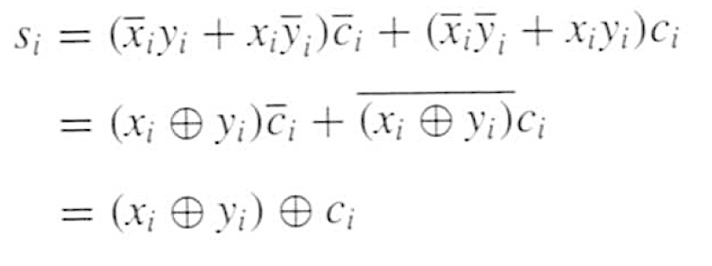
XOR Magic

Slide 93
XOR Magic
Can you prove this?

Slide 94
XOR Magic
x_{i} y_{i} + x_{i} y_{i} = x_{i} + y_{i}

Slide 95
XOR Magic
x_{i} y_{i} + x_{i} y_{i} = x_{i} + y_{i}
XNOR

Slide 96
XOR Magic
x_{i} y_{i} + x_{i} y_{i} = x_{i} + y_{i}
XOR

Slide 97
XOR Magic
x_{i} y_{i} + x_{i} y_{i} = x_{i} + y_{i}
XNOR

Slide 98
XOR Magic
x_{i} y_{i} + x_{i} y_{i} = x_{i} + y_{i}
You can also prove this using the theorems of Boolean algebra.
Try that at home.

Slide 99
The Full-Adder Circuit
Therefore, a 3-input XOR gate can be implemented with two 2-input XOR gates.
[ Figure 3.3c from the textbook ]

Slide 100

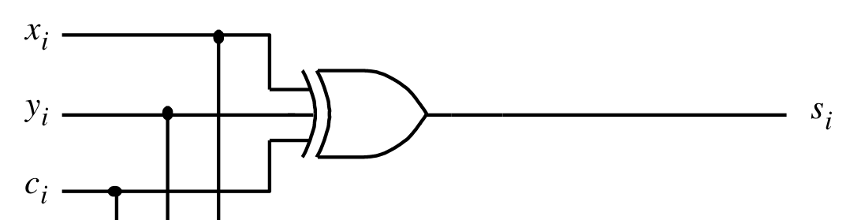
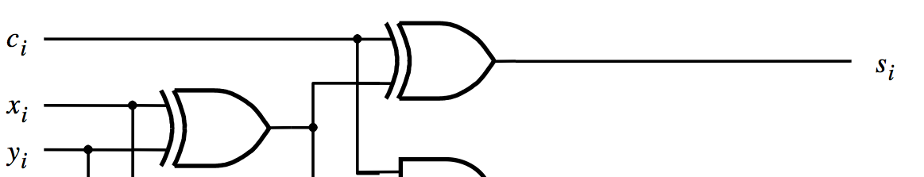
s_{i} can be implemented in two different ways
original version
alternative version

Slide 101
The Full-Adder Circuit
(alternative drawing)
c
i
s
i
x
i
y
i
c
i
+
1
[ Figure 3.4b from the textbook ]

Slide 102
The Full-Adder Circuit
(alternative drawing)
c
i
s
i
x
i
y
i
c
HA
i
+
1
HA
[ Figure 3.4b from the textbook ]

Slide 103
The Full-Adder Circuit
(alternative drawing)
c
s
s
i
s
HA
c
i
x
i
HA
c
c
y
i
+
1
i
(a) Block diagram
c
i
s
i
x
i
y
i
c
i
+
1
(b) Detailed diagram
[ Figure 3.4 from the textbook ]

Slide 104
The Full-Adder Circuit
(alternative drawing)
c
s
s
i
s
HA
c
i
x
i
HA
c
c
y
i
+
1
i
(a) Block diagram
c
i
s
i
x
( x_{i} + y_{i} )c_{i} + x_{i} y_{i}
i
y
i
c
i
+
1
Let's take a closer look at this.
(b) Detailed diagram
[ Figure 3.4 from the textbook ]

Slide 105
The Full-Adder Circuit
It must be equivalent to this.
[ Figure 3.3c from the textbook ]

Slide 106
Let’s Prove This
?
( x_{i} + y_{i} )c_{i} + x_{i} y_{i} =
x_{i} y_{i} + x_{i} c_{i} + c_{i} y_{i}

Slide 107
Let’s Prove This
( x_{i} + y_{i} )c_{i} + x_{i} y_{i} =

Slide 108
Let’s Prove This
( x_{i} + y_{i} )c_{i} + x_{i} y_{i} = ( x_{i} y_{i} + x_{i} y_{i} )c_{i} + x_{i} y_{i}

Slide 109
Let’s Prove This
( x_{i} + y_{i} )c_{i} + x_{i} y_{i} = ( x_{i} y_{i} + x_{i} y_{i} )c_{i} + x_{i} y_{i}
= x_{i} y_{i} c_{i} + x_{i} y_{i} c_{i} + x_{i} y_{i} + x_{i} y_{i}
double
this term

Slide 110
Let’s Prove This
( x_{i} + y_{i} )c_{i} + x_{i} y_{i} = ( x_{i} y_{i} + x_{i} y_{i} )c_{i} + x_{i} y_{i}
= x_{i} y_{i} c_{i} + x_{i} y_{i} c_{i} + x_{i} y_{i} + x_{i} y_{i}

Slide 111
Let’s Prove This
( x_{i} + y_{i} )c_{i} + x_{i} y_{i} = ( x_{i} y_{i} + x_{i} y_{i} )c_{i} + x_{i} y_{i}
= x_{i} y_{i} c_{i} + x_{i} y_{i} c_{i} + x_{i} y_{i} + x_{i} y_{i}
= ( x_{i} c_{i} + x_{i}) y_{i} + x_{i} ( y_{i} c_{i} + y_{i})

Slide 112
Let’s Prove This
( x_{i} + y_{i} )c_{i} + x_{i} y_{i} = ( x_{i} y_{i} + x_{i} y_{i} )c_{i} + x_{i} y_{i}
= x_{i} y_{i} c_{i} + x_{i} y_{i} c_{i} + x_{i} y_{i} + x_{i} y_{i}
= ( x_{i} c_{i} + x_{i}) y_{i} + x_{i} ( y_{i} c_{i} + y_{i})
use Theorem 16a twice
= (c_{i} + x_{i}) y_{i} + x_{i} (c_{i} + y_{i})

Slide 113
Let’s Prove This
( x_{i} + y_{i} )c_{i} + x_{i} y_{i} = ( x_{i} y_{i} + x_{i} y_{i} )c_{i} + x_{i} y_{i}
= x_{i} y_{i} c_{i} + x_{i} y_{i} c_{i} + x_{i} y_{i} + x_{i} y_{i}
= ( x_{i} c_{i} + x_{i}) y_{i} + x_{i} ( y_{i} c_{i} + y_{i})
= (c_{i} + x_{i}) y_{i} + x_{i} (c_{i} + y_{i})
= c_{i} y_{i} + x_{i} y_{i} + x_{i} c_{i} + x_{i} y_{i}

Slide 114
Let’s Prove This
( x_{i} + y_{i} )c_{i} + x_{i} y_{i} = ( x_{i} y_{i} + x_{i} y_{i} )c_{i} + x_{i} y_{i}
= x_{i} y_{i} c_{i} + x_{i} y_{i} c_{i} + x_{i} y_{i} + x_{i} y_{i}
= ( x_{i} c_{i} + x_{i}) y_{i} + x_{i} ( y_{i} c_{i} + y_{i})
= (c_{i} + x_{i}) y_{i} + x_{i} (c_{i} + y_{i})
= c_{i} y_{i} + x_{i} y_{i} + x_{i} c_{i} + x_{i} y_{i}
remove one copy of
this doubled term

Slide 115
Let’s Prove This
( x_{i} + y_{i} )c_{i} + x_{i} y_{i} = ( x_{i} y_{i} + x_{i} y_{i} )c_{i} + x_{i} y_{i}
= x_{i} y_{i} c_{i} + x_{i} y_{i} c_{i} + x_{i} y_{i} + x_{i} y_{i}
= ( x_{i} c_{i} + x_{i}) y_{i} + x_{i} ( y_{i} c_{i} + y_{i})
= (c_{i} + x_{i}) y_{i} + x_{i} (c_{i} + y_{i})
= c_{i} y_{i} + x_{i} y_{i} + x_{i} c_{i} + x_{i} y_{i}
= c_{i} y_{i} + x_{i} y_{i} + x_{i} c_{i}

Slide 116
Therefore, these circuits are equivalent
s_{i} = x_{i} + y_{i} + c_{i}
c
i
s
i
x
i
c_{i+1} =( x_{i} + y_{i} )c_{i} + x_{i} y_{i}
y
i
c
i
+
1

Slide 117
The Full-Adder Abstraction
c
s
i
i
x
FA
i
c
y
i
+
1
i

Slide 118
The Full-Adder Abstraction
c
s
i
i
x
FA
i
c
y
i
+
1
i

Slide 119
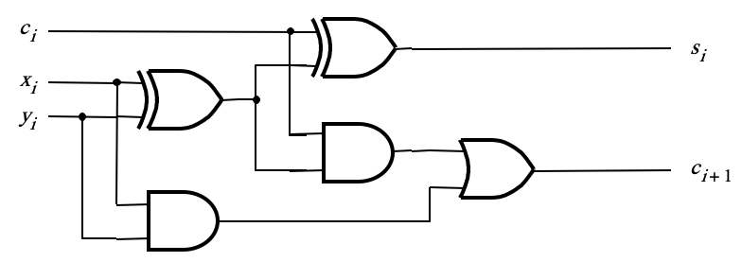
The Full-Adder Abstraction
c
s
i
i
x
FA
i
c
y
i
+
1
i

Slide 120
The Full-Adder Abstraction
c
s
i
i
x
FA
i
c
y
i
+
1
i

Slide 121
The Full-Adder Abstraction
c
s
s
i
HA
i
x
s
c
i
HA
c
y
c
i
+
1
i

Slide 122
The Full-Adder Abstraction
c
s
i
i
x
FA
i
c
y
i
+
1
i

Slide 123
We can place the arrows anywhere
x_{i}
y_{i}
c_{i+1}
FA
c_{i}
s_{i}

Slide 124
n-bit ripple-carry adder
x
n –
1
y
n
–
1
x
1
y
1
x
0
y
0
c
1
c
n
FA
c
n
-
1
c
2
FA
FA
c
0
s
n
–
1
s
1
s
0
MSB position
LSB position
[ Figure 3.5 from the textbook ]

Slide 125
n-bit ripple-carry adder abstraction
x
n –
1
y
n
–
1
x
1
y
1
x
0
y
0
c
1
c
n
FA
c
n
-
1
c
2
FA
FA
c
0
s
n
–
1
s
1
s
0
MSB position
LSB position

Slide 126
n-bit ripple-carry adder abstraction
x
n –
1
y
n
–
1
x
1
y
1
x
0
y
0
c
n
c
0
s
n
–
1
s
1
s
0

Slide 127
The x and y lines are typically
grouped together for better visualization,
but the underlying logic remains the same
x
x
1
x
0
y
y
y
n –
1
n
–
1
1
0
c
n
c
0
s
n
–
1
s
1
s
0

Slide 128
Example:
Computing 5+6 using a 5-bit adder

Slide 129
Example:
Computing 5+6 using a 5-bit adder
5 in decimal
6 in decimal
0 in decimal
11 in decimal

Slide 130
Example:
Computing 5+6 using a 5-bit adder
5 in decimal
6 in decimal
0
0
0 0 1 0 1
0 0 1 1 0
0 0 1 0 1 1
+
11 in decimal

Slide 131
Design Example:
Create a circuit that multiplies a number by 3

Slide 132
How to Get 3A from A?
3A = A + A + A
3A = (A+A) + A
3A = 2A +A

Slide 133
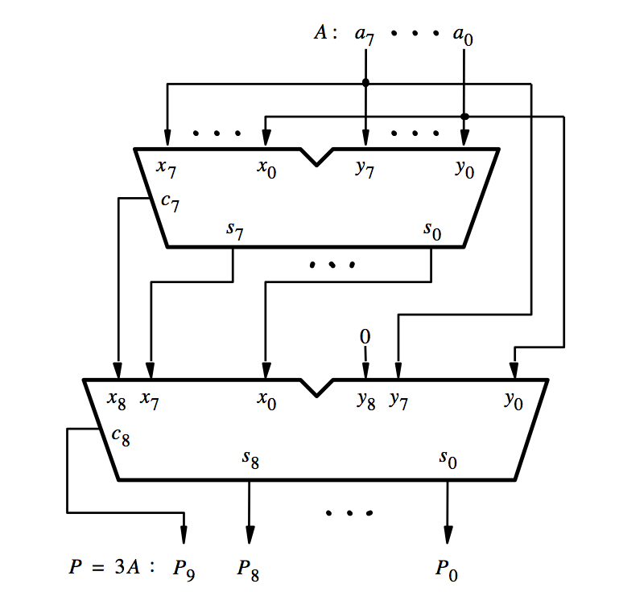
[ Figure 3.6a from the textbook ]

Slide 134
A
A
[ Figure 3.6a from the textbook ]

Slide 135
A
A
2A
[ Figure 3.6a from the textbook ]

Slide 136
A
A
2A
A
[ Figure 3.6a from the textbook ]

Slide 137
A
A
2A
A
3A
[ Figure 3.6a from the textbook ]

Slide 138
Decimal Multiplication by 10
What happens when we multiply a number by 10?
  4 x 10 = ?
542 x 10 = ?
1245 x 10 = ?

Slide 139
Decimal Multiplication by 10
What happens when we multiply a number by 10?
  4 x 10 = 40
542 x 10 = 5420
1245 x 10 = 12450

Slide 140
Decimal Multiplication by 10
What happens when we multiply a number by 10?
  4 x 10 = 40
542 x 10 = 5420
1245 x 10 = 12450
You simply add a zero as the rightmost number

Slide 141
Binary Multiplication by 2
What happens when we multiply a number by 2?
  011 times 2 = ?
101 times 2 = ?
110011 times 2 = ?

Slide 142
Binary Multiplication by 2
What happens when we multiply a number by 2?
  011 times 2 = 0110
101 times 2 = 1010
110011 times 2 = 1100110

Slide 143
Binary Multiplication by 2
What happens when we multiply a number by 2?
  011 times 2 = 0110
101 times 2 = 1010
110011 times 2 = 1100110
You simply add a zero as the rightmost number

Slide 144
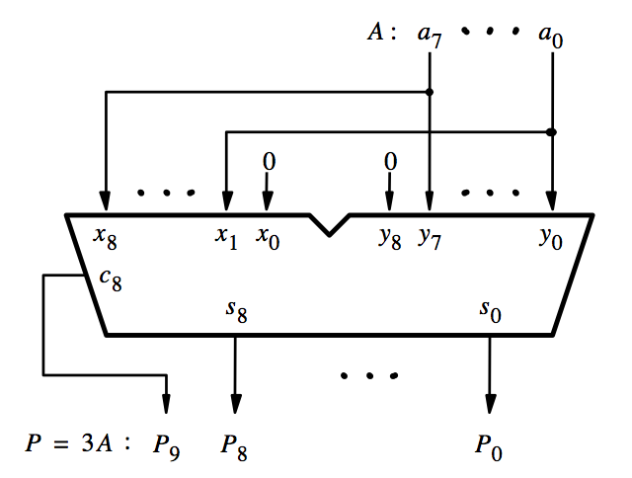
[ Figure 3.6b from the textbook ]

Slide 145
This is how we get 2A
[ Figure 3.6b from the textbook ]

Slide 146
2A
A
3A
[ Figure 3.6b from the textbook ]

Slide 147
Questions?

Slide 148
THE END

