Slide 1

HCI/CprE/ComS 575:
Computational Perception
Instructor: Alexander Stoytchev
http://www.ece.iastate.edu/~alexs

Slide 2
Binary Image Processing
HCI/CprE/ComS 575: Computational Perception
Iowa State University, Ames, IA
Copyright © Alexander Stoytchev

Slide 3
Matlab Access
http://www.it.iastate.edu/docs/matlab/
matlabsupport@iastate.edu

Slide 4
OpenCV Access

Slide 5
Binary Image Processing

Slide 6
Readings
Jain, Kasturi, and Schunck (1995). Machine Vision, ``Chapter 1: Introduction,'' McGraw-Hill, pp. 1-24.
Jain, Kasturi, and Schunck (1995). Machine Vision, ``Chapter 2: Binary Image Processing,'' McGraw-Hill, pp. 25-72.

Slide 7
Reading for Next Lecture
Haralick and Shapiro (1993). Computer and Robot Vision, "Chapter 5: Mathematical Morphology," Addison-Wesley.

Slide 8
What is an image?

Slide 9
Intensity Levels
2
32
64
128
256 (8 bits)
512
…
4096 (12 bits)

Slide 10
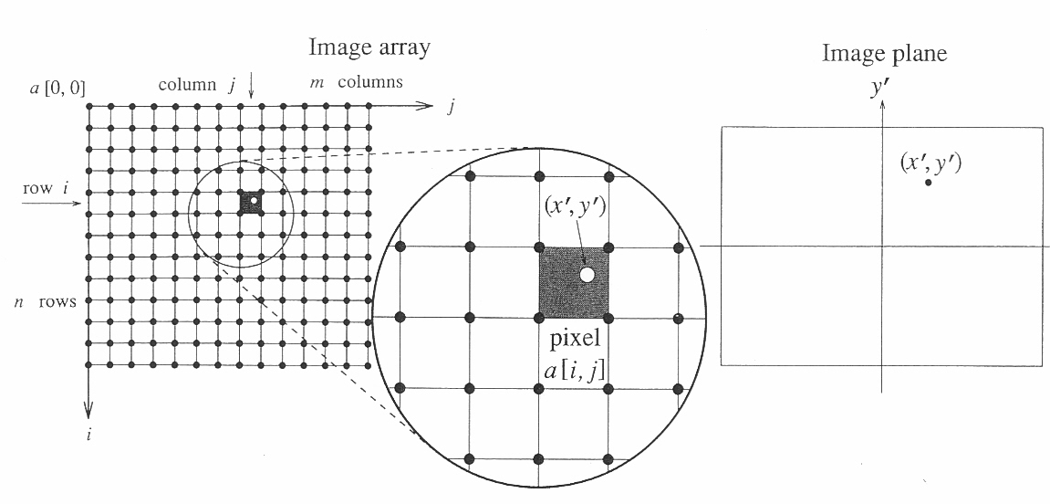
Image Plane v.s. Image Array
[Jain, Kasturi, and Schunck (1995). Machine Vision, Ch. 1]

Slide 11
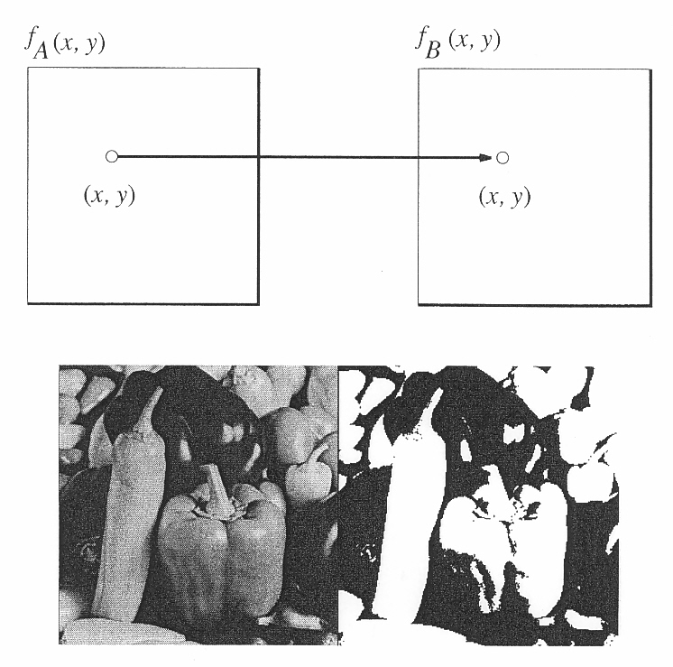
Point Operations
[Jain, Kasturi, and Schunck (1995). Machine Vision, Ch. 1]

Slide 12
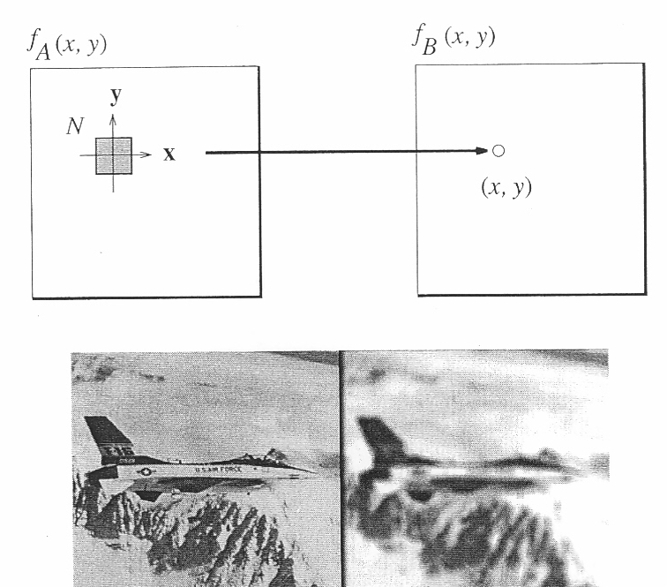
Local Operations
[Jain, Kasturi, and Schunck (1995). Machine Vision, Ch. 1]

Slide 13
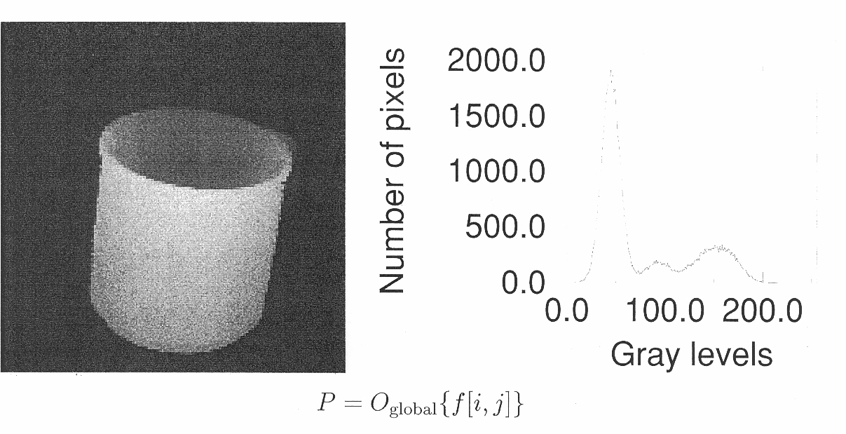
Global Operations
[Jain, Kasturi, and Schunck (1995). Machine Vision, Ch. 1]

Slide 14
Thresholding an Image
[Jain, Kasturi, and Schunck (1995). Machine Vision, Ch. 1]

Slide 15
Dark Image on a Light Background
[Jain, Kasturi, and Schunck (1995). Machine Vision, Ch. 2]

Slide 16
Selecting a range of intensity values
[Jain, Kasturi, and Schunck (1995). Machine Vision, Ch. 2]

Slide 17
Generalized Thresholding
[Jain, Kasturi, and Schunck (1995). Machine Vision, Ch. 2]

Slide 18
Thresholding Example (1)
[Jain, Kasturi, and Schunck (1995). Machine Vision, Ch. 2]

Slide 19
Thresholding Example (2)
Original grayscale Image
[Jain, Kasturi, and Schunck (1995). Machine Vision, Ch. 2]

Slide 20
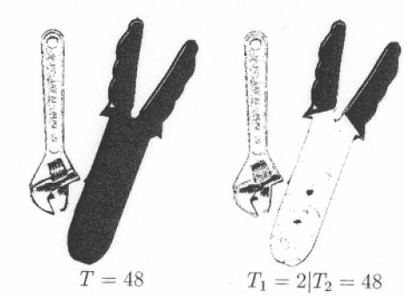
[Jain, Kasturi, and Schunck (1995). Machine Vision, Ch. 2]

Slide 21
[Jain, Kasturi, and Schunck (1995). Machine Vision, Ch. 2]

Slide 22
Area of a Binary Image
[Jain, Kasturi, and Schunck (1995). Machine Vision, Ch. 2]

Slide 23
This figure now becomes important
[Jain, Kasturi, and Schunck (1995). Machine Vision, Ch. 1]

Slide 24
Calculating the Position of an Object
[Jain, Kasturi, and Schunck (1995). Machine Vision, Ch. 2]

Slide 25
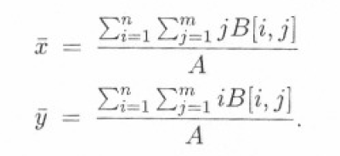
The center is given by
[Jain, Kasturi, and Schunck (1995). Machine Vision, Ch. 2]

Slide 26
Horizontal and Vertical Projections
[Jain, Kasturi, and Schunck (1995). Machine Vision, Ch. 2]

Slide 27
Horizontal and Vertical Projections
[Jain, Kasturi, and Schunck (1995). Machine Vision, Ch. 2]

Slide 28
Projection Formulas
[Jain, Kasturi, and Schunck (1995). Machine Vision, Ch. 2]

Slide 29
Diagonal Projection
[Jain, Kasturi, and Schunck (1995). Machine Vision, Ch. 2]

Slide 30
The area and the position can be computed form the H and V projections
[Jain, Kasturi, and Schunck (1995). Machine Vision, Ch. 2]

Slide 31
Run-Length Encoding
[Jain, Kasturi, and Schunck (1995). Machine Vision, Ch. 2]

Slide 32
Horizontal Projections Calculated from run-length code
[Jain, Kasturi, and Schunck (1995). Machine Vision, Ch. 2]

Slide 33
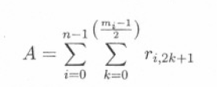
The area of an object can be obtained by summing the lengths of all 1 runs
[Jain, Kasturi, and Schunck (1995). Machine Vision, Ch. 2]

Slide 34
Neighbors and Connectivity

Slide 35
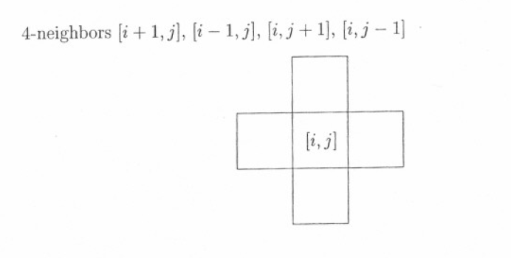
4-Connected
[Jain, Kasturi, and Schunck (1995). Machine Vision, Ch. 2]

Slide 36
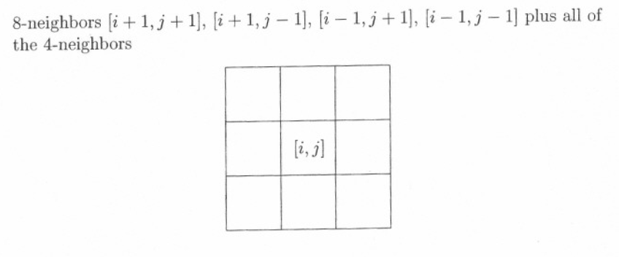
8-connected
[Jain, Kasturi, and Schunck (1995). Machine Vision, Ch. 2]

Slide 37
Examples of Paths
[Jain, Kasturi, and Schunck (1995). Machine Vision, Ch. 2]

Slide 38
Boundary, Interior, and Background
[Jain, Kasturi, and Schunck (1995). Machine Vision, Ch. 2]

Slide 39
An Image (a) and Its Connected Components (b)
[Jain, Kasturi, and Schunck (1995). Machine Vision, Ch. 2]

Slide 40
[Jain, Kasturi, and Schunck (1995). Machine Vision, Ch. 2]

Slide 41
[Jain, Kasturi, and Schunck (1995). Machine Vision, Ch. 2]

Slide 42
Thresholding by Size

Slide 43
Before and after a size filter (T=10)
[Jain, Kasturi, and Schunck (1995). Machine Vision, Ch. 2]

Slide 44
Before and after a size filter (T=25)
[Jain, Kasturi, and Schunck (1995). Machine Vision, Ch. 2]

Slide 45
Distance Metrics

Slide 46
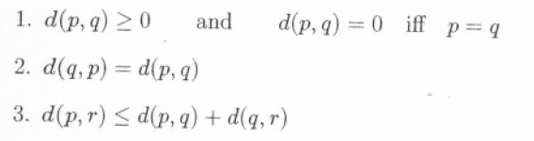
Properties of a Good Distance Metrics
[Jain, Kasturi, and Schunck (1995). Machine Vision, Ch. 2]

Slide 47
Examples
[Jain, Kasturi, and Schunck (1995). Machine Vision, Ch. 2]

Slide 48
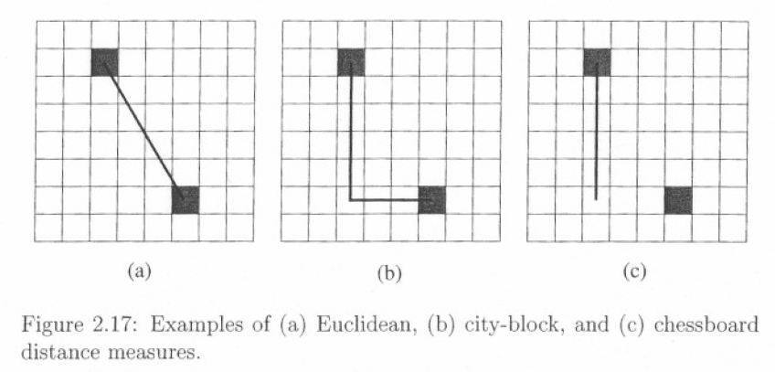
Examples (2)
[Jain, Kasturi, and Schunck (1995). Machine Vision, Ch. 2]

Slide 49
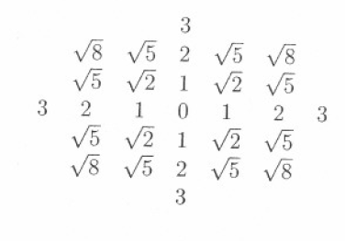
Euclidean Distance
[Jain, Kasturi, and Schunck (1995). Machine Vision, Ch. 2]

Slide 50
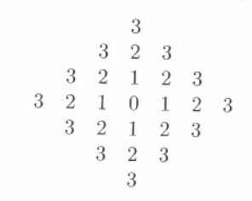
City-block Distance
[Jain, Kasturi, and Schunck (1995). Machine Vision, Ch. 2]

Slide 51
Chessboard distance
[Jain, Kasturi, and Schunck (1995). Machine Vision, Ch. 2]

Slide 52
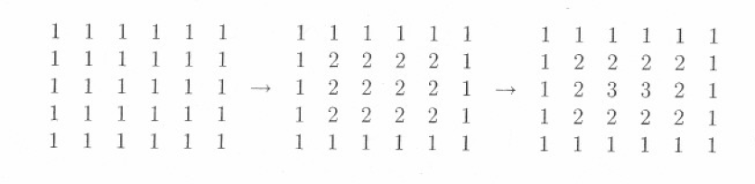
Iterative Distance Transorms
Original
1-st iteration
2-nd iteration
[Jain, Kasturi, and Schunck (1995). Machine Vision, Ch. 2]

Slide 53
Medial Axis Example
[Jain, Kasturi, and Schunck (1995). Machine Vision, Ch. 2]

Slide 54
[Jain, Kasturi, and Schunck (1995). Machine Vision, Ch. 2]

Slide 55
[Jain, Kasturi, and Schunck (1995). Machine Vision, Ch. 2]

Slide 56
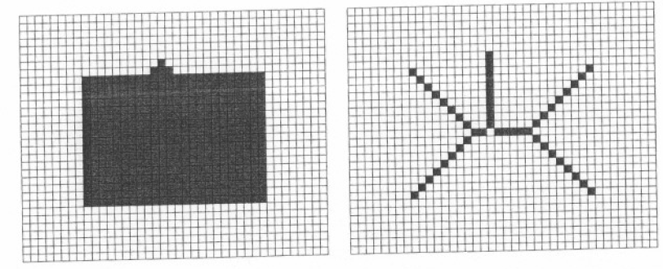
[Jain, Kasturi, and Schunck (1995). Machine Vision, Ch. 2]

Slide 57
Thinning
[Jain, Kasturi, and Schunck (1995). Machine Vision, Ch. 2]

Slide 58
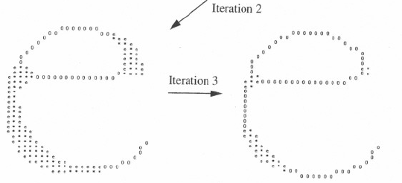
Thinning
[Jain, Kasturi, and Schunck (1995). Machine Vision, Ch. 2]

Slide 59
Stopping Condition
[Jain, Kasturi, and Schunck (1995). Machine Vision, Ch. 2]

Slide 60
[Jain, Kasturi, and Schunck (1995). Machine Vision, Ch. 2]

Slide 61
Expanding and Shrinking
Expanding: change a pixel from 0 to 1 if any neighbors of the pixel are 1.
Shrinking: change a pixel from 1 to 0 if any neighbors of the pixel are 0.

Slide 62
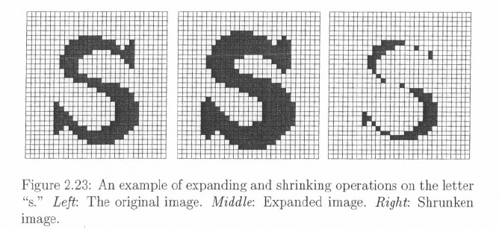
Expanding and Shrinking
[Jain, Kasturi, and Schunck (1995). Machine Vision, Ch. 2]

Slide 63
Properties and Notation
[Jain, Kasturi, and Schunck (1995). Machine Vision, Ch. 2]

Slide 64
Dilation
Original
Expanding
Followed By
Shrinking
[Jain, Kasturi, and Schunck (1995). Machine Vision, Ch. 2]

Slide 65
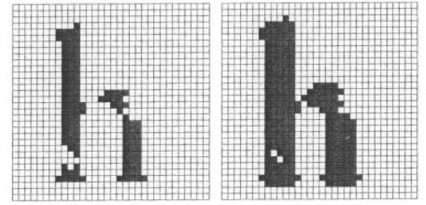
Original
Shrinking
Followed By
Expanding
[Jain, Kasturi, and Schunck (1995). Machine Vision, Ch. 2]

Slide 66
Morphological Operators

Slide 67
Intersection
Union
Complement
[Jain, Kasturi, and Schunck (1995). Machine Vision, Ch. 2]

Slide 68

Notation
Erosion
Dilation

Slide 69
Images and Structuring Elements
origin
[Jain, Kasturi, and Schunck (1995). Machine Vision, Ch. 2]

Slide 70

Images and Structuring Elements
origin
[Jain, Kasturi, and Schunck (1995). Machine Vision, Ch. 2]

Slide 71
Images and Structuring Elements
origin
[Jain, Kasturi, and Schunck (1995). Machine Vision, Ch. 2]

Slide 72
Images and Structuring Elements
origin
[Jain, Kasturi, and Schunck (1995). Machine Vision, Ch. 2]

Slide 73
Images and Structuring Elements
origin
[Jain, Kasturi, and Schunck (1995). Machine Vision, Ch. 2]

Slide 74
And so on …. until we reach the first pixel of the larger image

Slide 75
Images and Structuring Elements
origin
[Jain, Kasturi, and Schunck (1995). Machine Vision, Ch. 2]

Slide 76
Erosion
Erosion of an image by a structuring element results in an image that gives all locations where the structuring element is contained in the image.

Slide 77
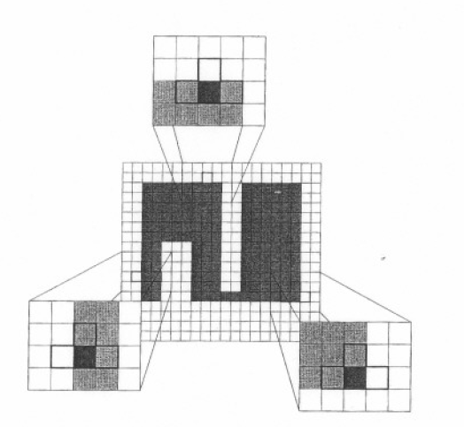
Examples of Pixels that will be deleted
[Jain, Kasturi, and Schunck (1995). Machine Vision, Ch. 2]

Slide 78
Examples of Pixels that will be deleted
[Jain, Kasturi, and Schunck (1995). Machine Vision, Ch. 2]

Slide 79
Erosion Results
[Jain, Kasturi, and Schunck (1995). Machine Vision, Ch. 2]

Slide 80
Dilation
The union of the translations of the image A by the 1 pixels of the image B is called the dilation of A by B.

Slide 81
Dilation Example
[Jain, Kasturi, and Schunck (1995). Machine Vision, Ch. 2]

Slide 82
Examples of pixels that will be added
[Jain, Kasturi, and Schunck (1995). Machine Vision, Ch. 2]

Slide 83
Examples of pixels that will be added
[Jain, Kasturi, and Schunck (1995). Machine Vision, Ch. 2]

Slide 84
Examples of pixels that will be added (in fact, all black pixels of the SE are added)
[Jain, Kasturi, and Schunck (1995). Machine Vision, Ch. 2]

Slide 85
Dilation Results

Slide 86
THE END

