Slide 1
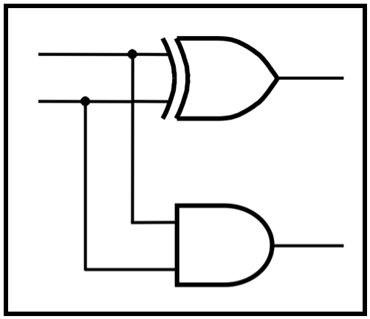
CprE 281:
Digital Logic
Guest Lecture by Ben Magstadt
http://www.ece.iastate.edu/~alexs/classes/

Slide 2
Verilog Tutorial
Ben Magstadt – btm573@iastate.edu
Master’s Student
Electrical Engineering
CprE 281: Digital Logic
Iowa State University, Ames, IA
Copyright © 2014

Slide 3
Agenda
Overview of Hardware Description Languages
Overview of Verilog
Simulating Verilog Examples

Slide 4
HDL – Hardware Description Language
Used to mirror the behavior of hardware
Used for
  Digital design
    Schematic
    Layout
  Digital timing
  Digital verification
  Mixed-signal verification

Slide 5
HDL – Hardware Description Language
Verilog
  Used more often
  More compatible with Cadence tools
    Timing
    Simulation
  Focused on at Iowa State University
VHDL
  Still used some in industry
  Usage is decreasing
System Verilog
Verilog-AMS
  Analog Mixed Signal

Slide 6
Verilog at Iowa State University
CprE281
  Lab
  Final Project
CprE381
  Lab
EE330
  Homework
  Lab
  Final Project
EE465/CprE465
  Lab
  Final Project
Possibly others

Slide 7
Verilog – Main Data types
Input
Output
Inout – Rarely Used (Tool Compatibility Issues)
Wires: No driving strength
  Just declare for internal
  Use with assigns or from a variable being driven from other module
Registers
  Output or just internal
  Used elsewhere when driving a variable
More data types
  System Verilog: real
  Verilog-AMS (Analog Mixed Signal): real, wreal, electrical

Slide 8
Verilog – Coding Styles
Structural
  Used to represent logic primitives
    not(A, B);
Behavioral
  Used to represent more complex logical statements easier
    A <= ~A & (B | C);
      Inside of an ‘always’ block
    assign A = ~A & (B | C);
      Outside of an ‘always’ block

Slide 9
Verilog – ‘initial’ Blocks
Used to define initial states of variables
  Not floating
Can’t be used when synthesizing a circuit
Used mostly in test benches
Will also work when programming FPGA
Also a ‘final’ block
  Seldom used, but good for verifying the final state of system

Slide 10
Verilog – ‘always’ Blocks
Used to produce an action on a variable change
Similar to a D Flip-Flop
always @(posedge clk) begin
  A <= B;
end
always @(B) begin
A <= B;
end

Slide 11
Verilog – Other useful functionality
If-else
  Only inside of an ‘always’ block
Case
  Only inside of an ‘always’ block
For
  Only inside of an ‘always’ block
  Careful with usage – can produce synthesis errors
Timescale
  `timescale 1ns/1ps
  reference/precision
Wait
  #10: Wait ten time units
  Units based on timescale
  Only use in test benches and for verification purposes

Slide 12
Verilog: Blocking vs. Non-Blocking Statements
Blocking
  Behaves like normal programming languages
    Values are instantly entered and can be used on the next line
  =
  Won’t synthesize if used in an always block
  Only for assigns
Non-blocking
  <=
  All statements are entered at the same time
Example Simulation Later

Slide 13
Verilog Simulation on Campus
Quartus to program FPGA
  Great for interactive learning
ModelSim
  Able see internal registers
  Can see full simulation waveforms
  Access from anywhere
Cadence & Cadence tools
  Schematic
  Layout
  Timing

Slide 14
Verilog Simulation: ModelSim Tutorial
On any Linux machine or remote Linux machine on campus
Download Model_Sim.env
Move to a new directory
Enter this new directory in a console
Type: source ModelSim_env.txt
Type: vsim &

Slide 15
Verilog Simulation: ModelSim Tutorial
Close IMPORTANT Information window
File -> New Project
Make a project name
Right Click -> New File
Make sure Add file as type is set to Verilog
Create Verilog file
  Name is usually same as the module name (Required in Quartus)
Create Verilog file test bench
Double Click file to open and edit

Slide 16
Verilog Simulation: ModelSim Tutorial
Compile -> Compile All
Green check mark for success/red X for error
Double click red X to see explanation of error
Simulate -> Start Simulation
Uncheck Enable Optimization
Under the work tab, find the test bench
Find wave tab or View -> New Window -> Wave
Right click in object window, then Add -> To Wave -> Signals in Design

Slide 17
Verilog Simulation: ModelSim Tutorial
Find and click the run icon next to the time display
  Change the simulation time if necessary
Control + mouse scroll is zoom
Right click on variables to switch radix from Binary, Decimal, Hex, etc.

Slide 18
Verilog Simulation: ModelSim Example
Simple AND gate and other logic
  3 Ways
8’bit Adder
  2 Ways
Blocking vs. Non-blocking
Choosing math operation
State machine with reset

Slide 19
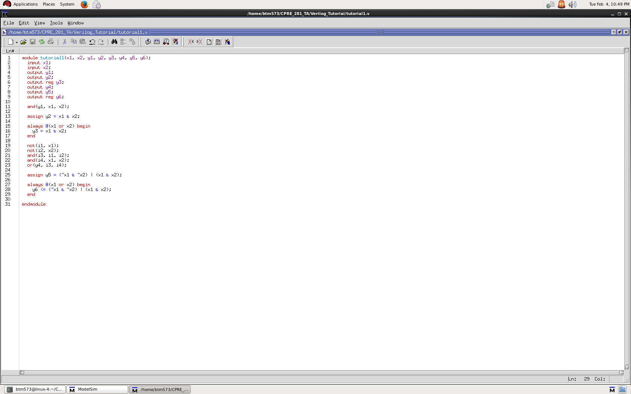
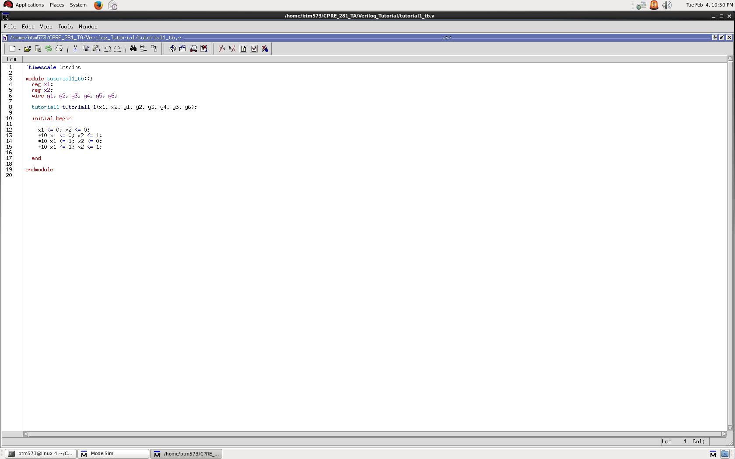
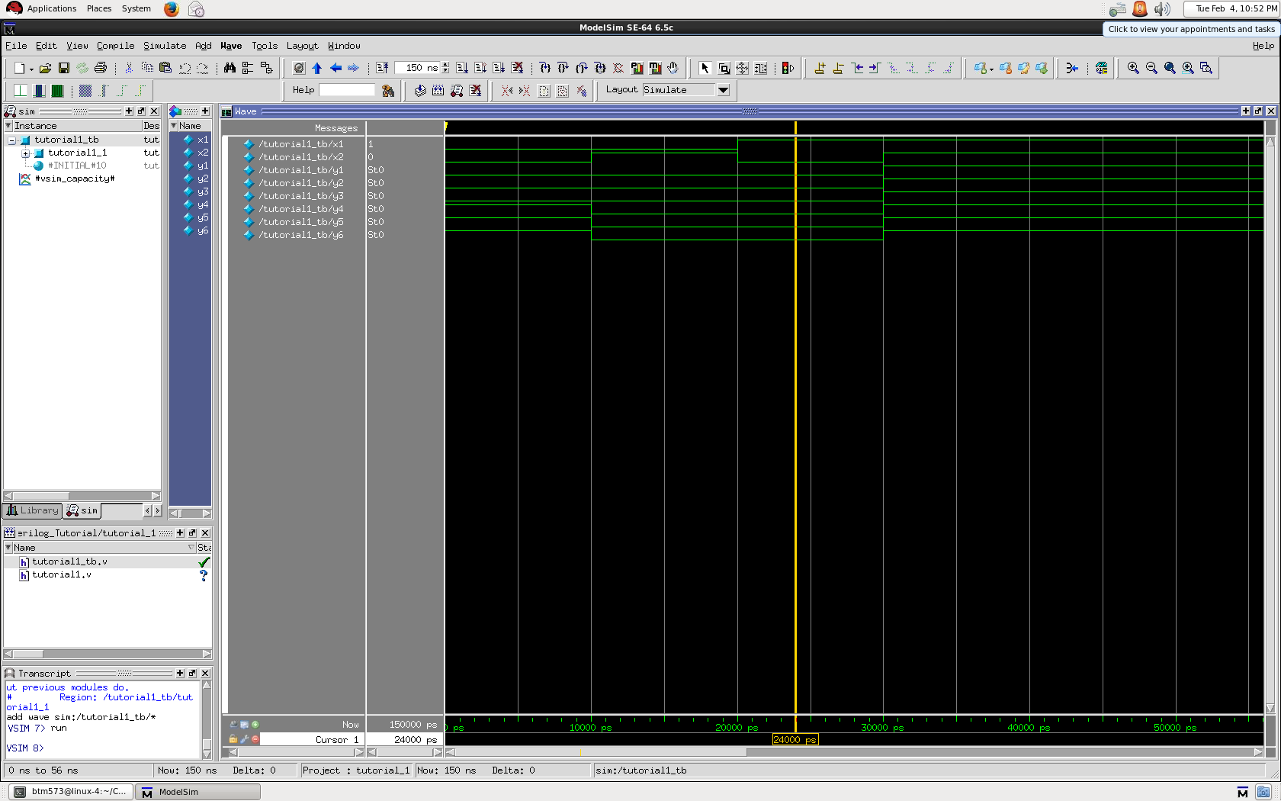

Slide 20
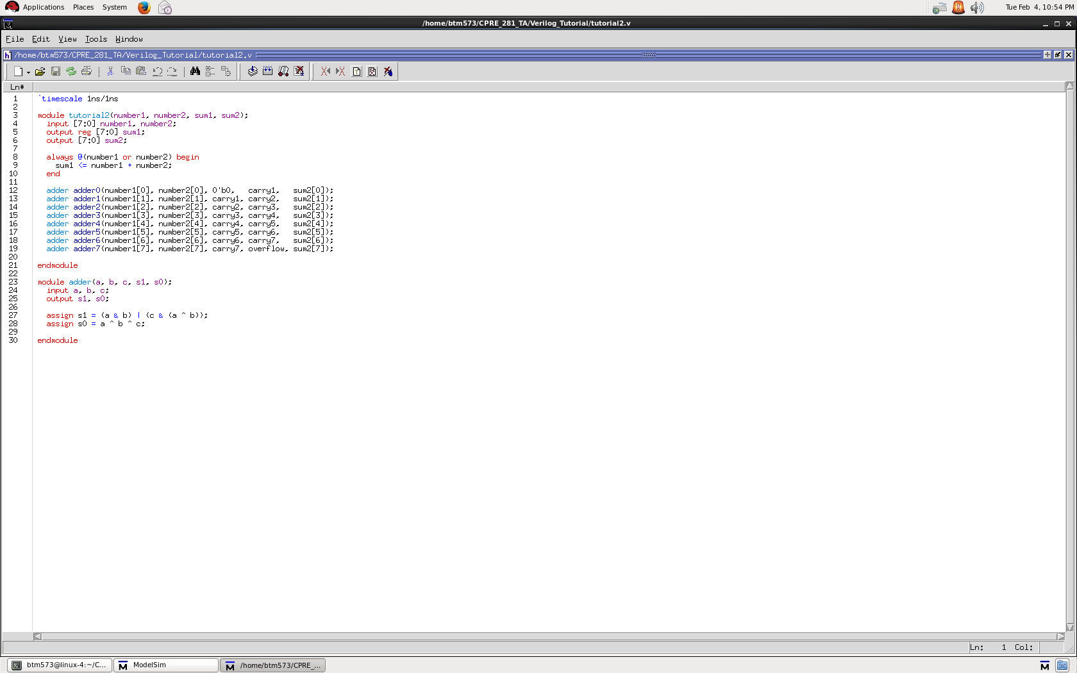
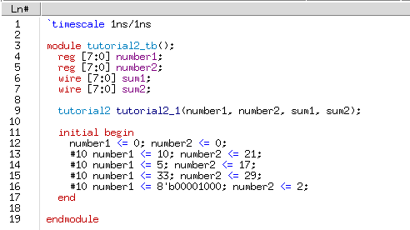
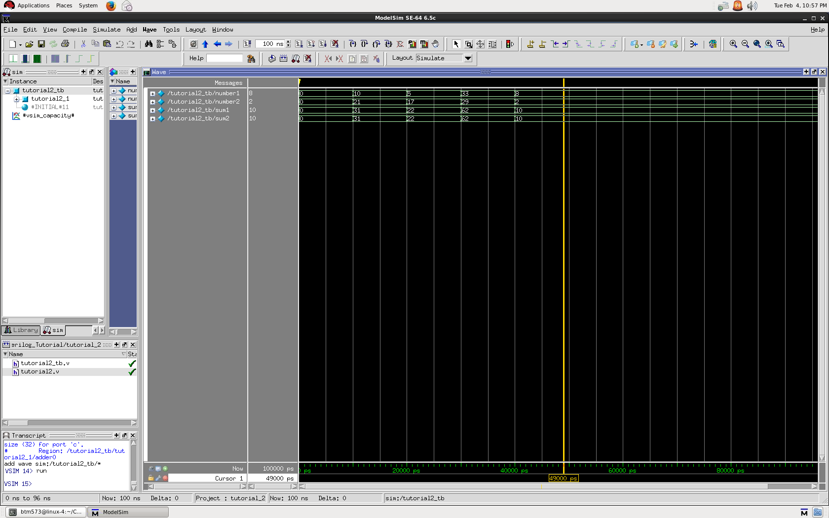

Slide 21
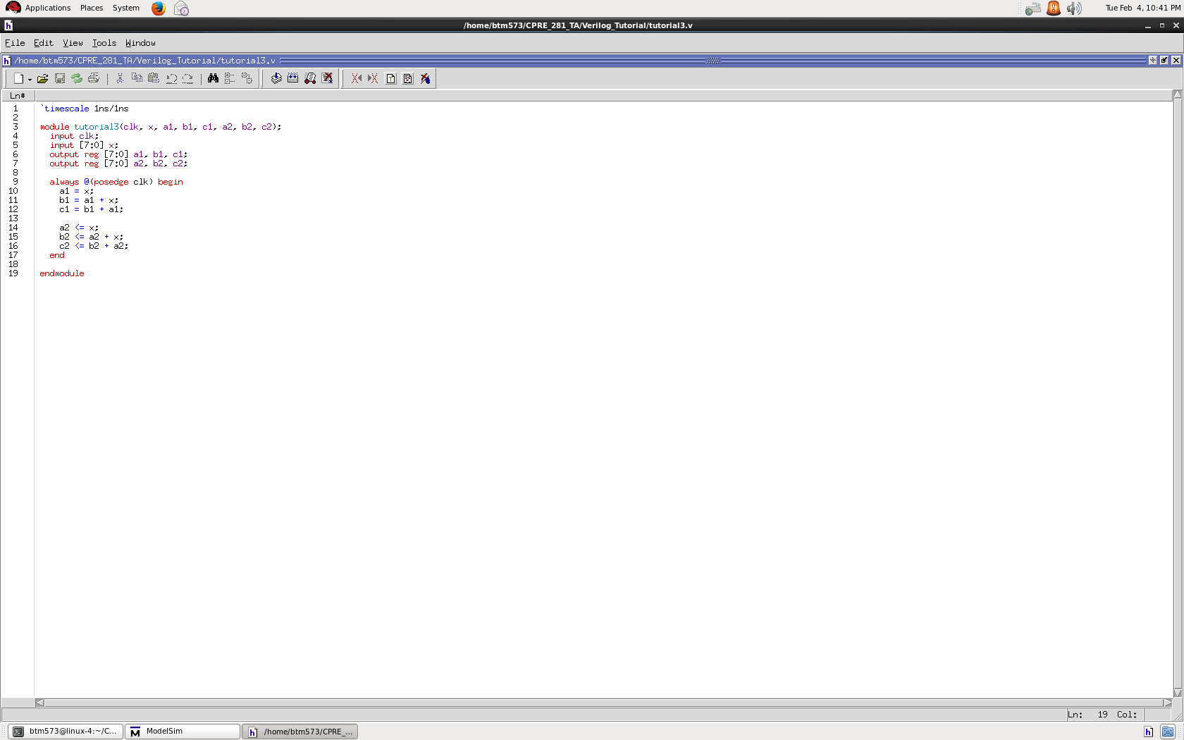
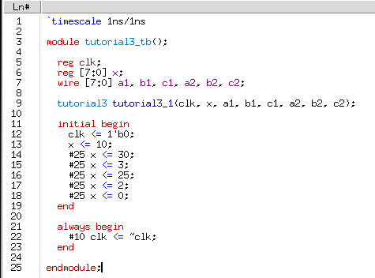
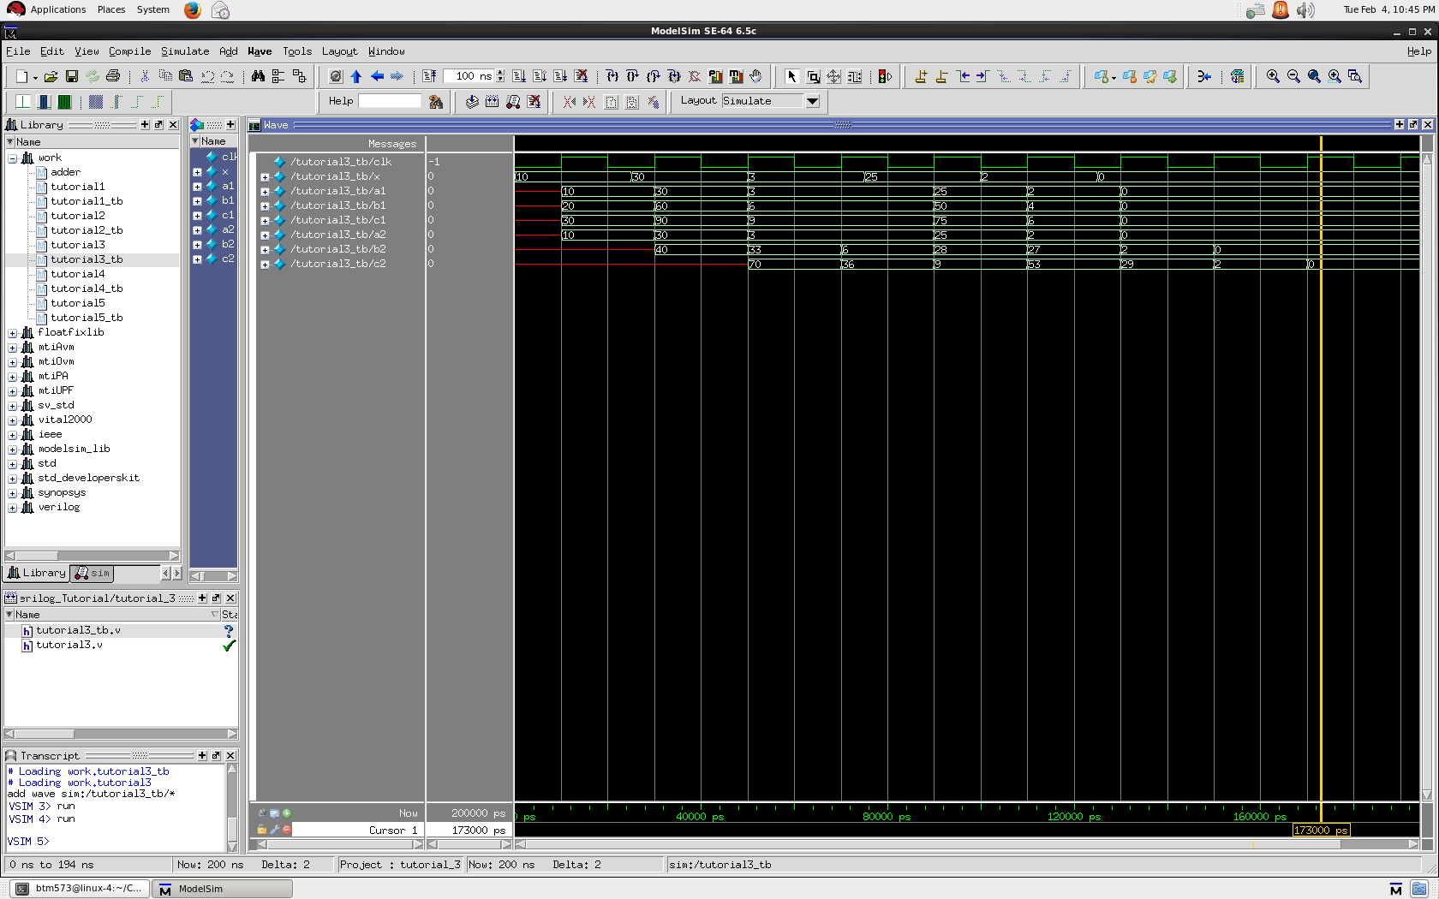

Slide 22
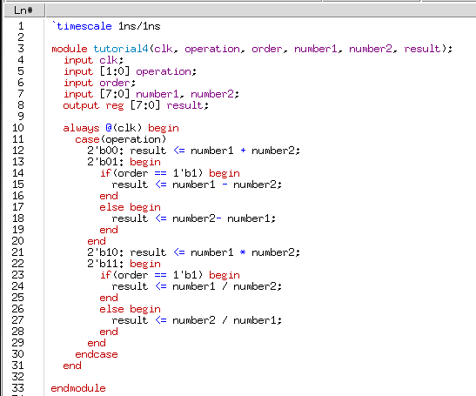
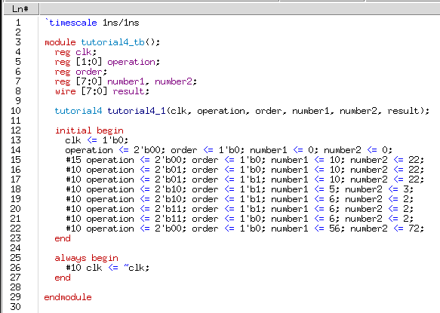
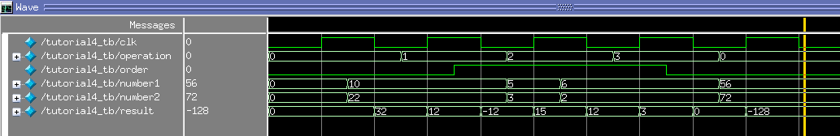

Slide 23
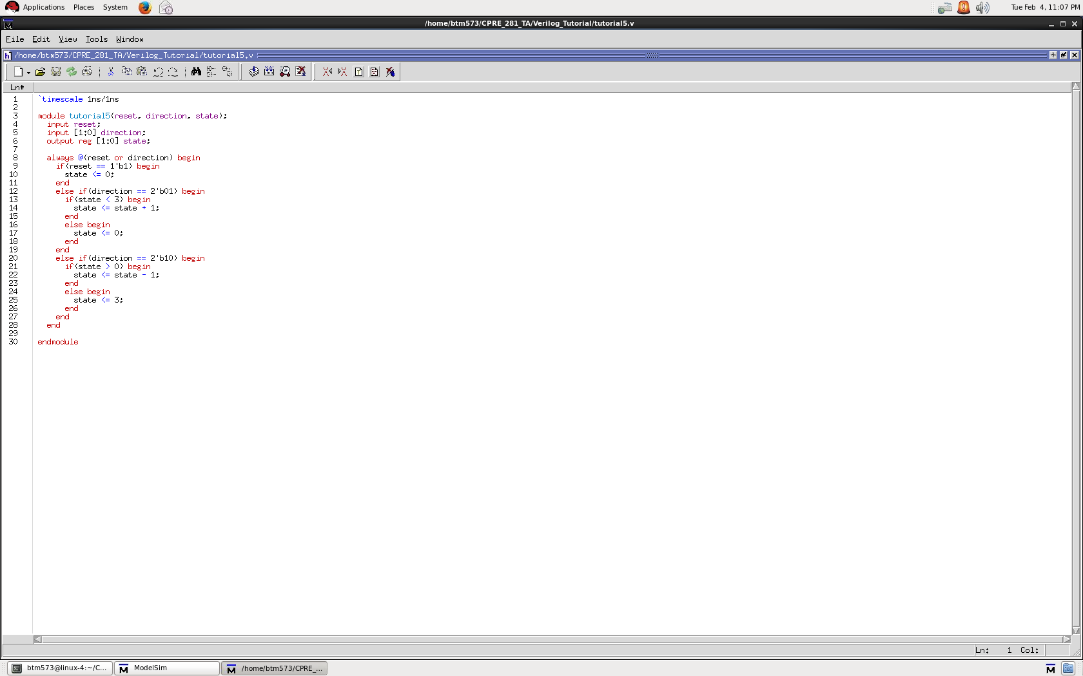
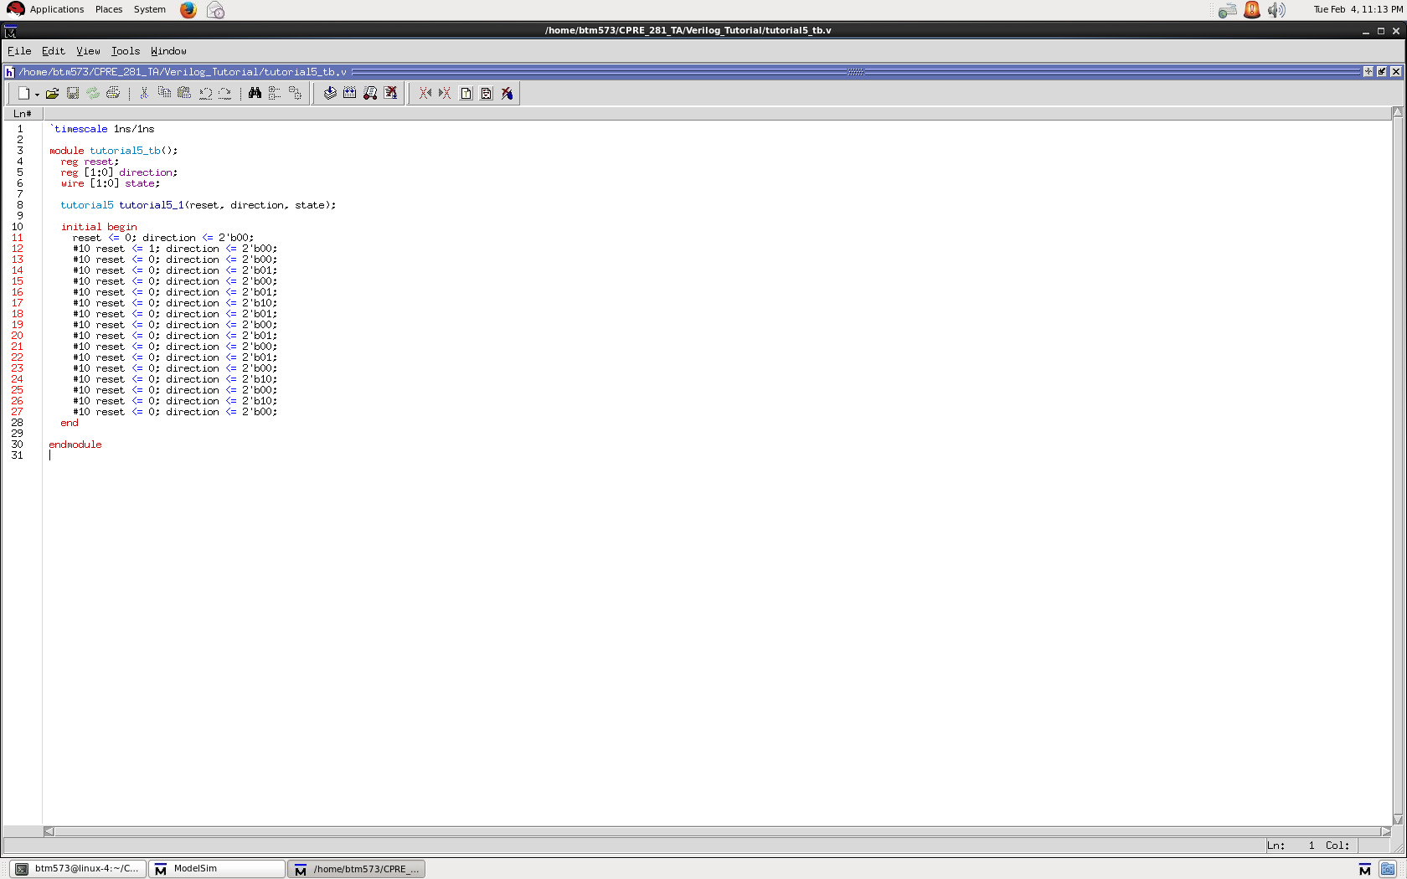
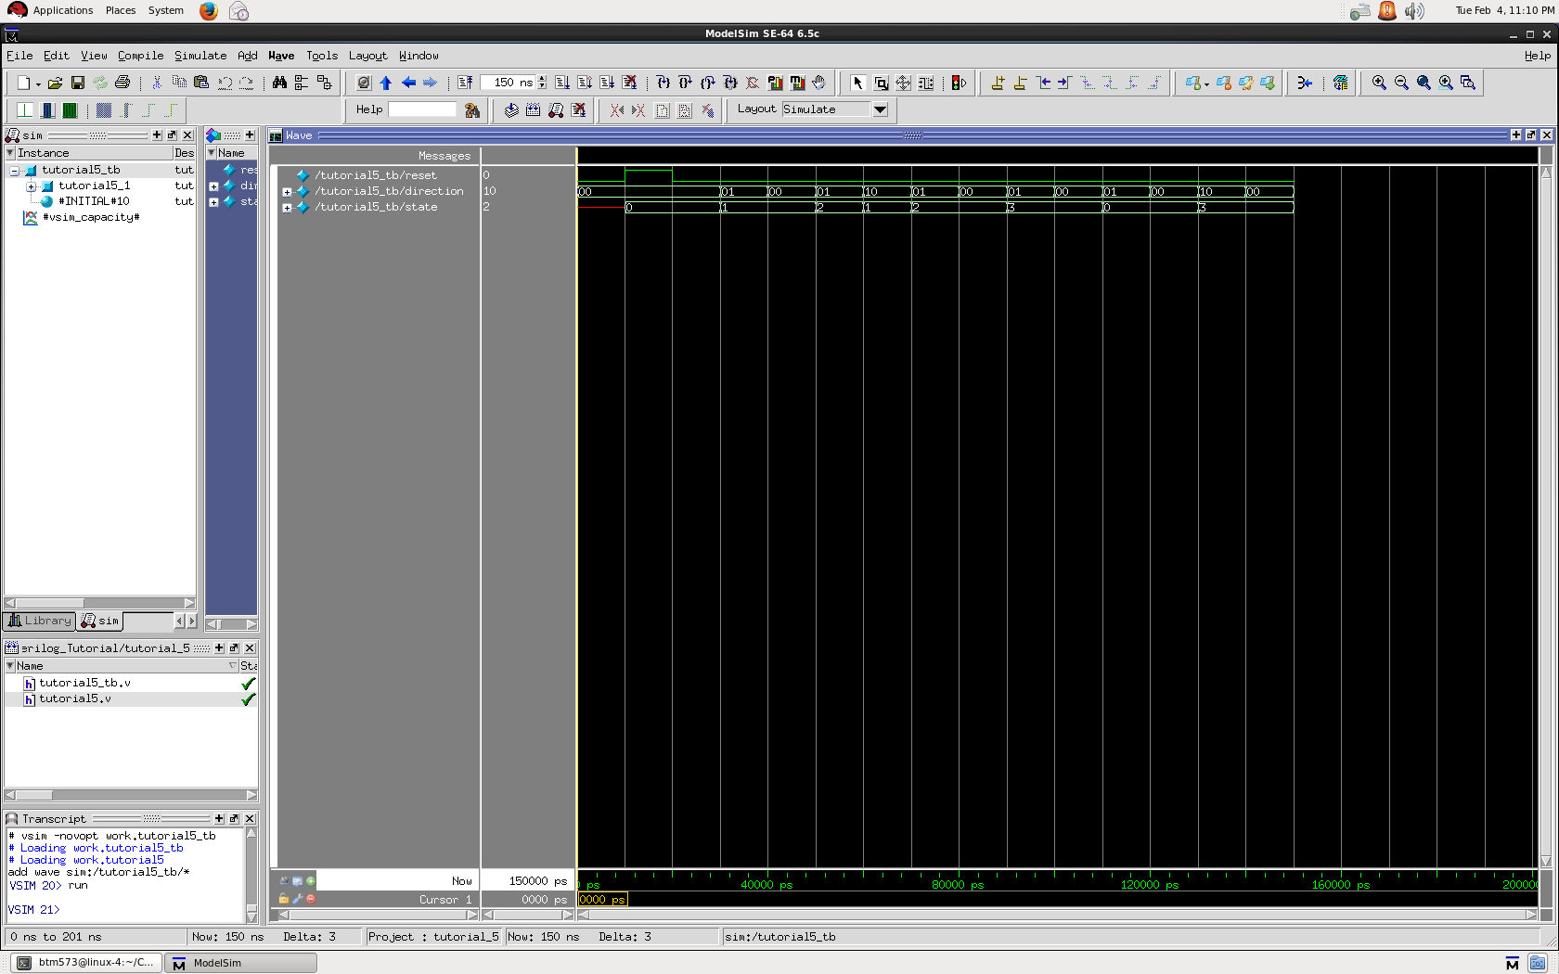

Slide 24
Contact Info
Ben Magstadt
  Email: btm573@iastate.edu
  Office: Coover 3133
  Website: http://benmagstadt.weebly.com/cpre-281-verilog-tutorial.html
    Presentation
    Instructions
    Source file
    Examples

Slide 25
Questions?

Slide 26
THE END

