Slide 1
OpenCV API
A Quick Introduction to the C Interface
By David Johnston

Slide 2
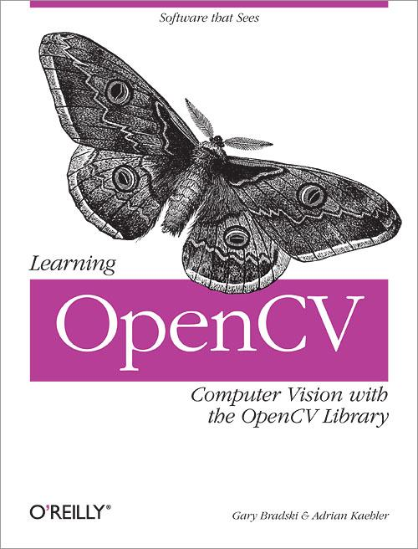

Slide 3
Warning: API Version 1.x

Slide 4
Primary OpenCV Interfaces
The 1.x API is based on C.
The 2.x API is based on C++.

Slide 5
Goals
Very briefly outline the OpenCV installation process on Windows, OS X, and Linux.
Walk through 4 example programs which should relevant to solving homework 2.
Point out some common API patterns and idioms.

Slide 6
Installing OpenCV

Slide 7
Windows 7 64-bit and
Visual C++ 2010 Express
Install Visual C++ 2010 Express Edition (or some other modern Visual Studio product).
Download prebuilt binaries and extract them to some desired location.
Set the OPENCV_DIR environment variable:
> setx -m OPENCV_DIR C:\opencv\build\x64\vc10

Slide 8
Windows 7 64-bit and
Visual C++ 10.0 Express
Add %OPENCV_DIR%\bin to your system path.
Modify Visual Studio properties to find necessary files. The following describes this process in great detail:
docs.opencv.org/doc/tutorials/introduction/windows_visual_studio_Opencv/windows_visual_studio_Opencv.html

Slide 9
Install on Mac OS X
Install XCode or the Apple Command Line Tools. Both are available with a (free) Apple ID.
Install a package manager such as macports or homebrew.
Install OpenCV.

Slide 10
Install on Linux
Install via native package manager (ie. apt-get, yum, etc.)

Slide 11
Build on UNIX-Like System
cc `pkg-config --cflags --libs\
opencv` -o foo foo.c

Slide 12
Four Code Demos

Slide 13
Some Constructors for
Important Data Structures
CvMat cvMat(...)
CvMat* cvCreateMat(...)
CvMat* cvCreateMatHeader(...)
IplImage* cvCreateImage(...)
CvSeq* cvCreateSeq(...)
Notes:
primary data structures

Slide 14
Ex 1: Image Workflow
Loading, modifying, saving, and closing an image file.
See filter.c.

Slide 15
Macros
OpenCV defines a lot of macros.
Most are prefixed with CV_*
Many are function-specific
The online documentation is usually pretty clear

Slide 16
In-Place Matrix Operations
cvNot(img, img);

Slide 17
Manual Memory Management
IplImage* img = cvLoadImage(...);
/* do something worthwhile */
cvReleaseImage(&img);

Slide 18
Ex 2: Basic Morphology
and Color
Creating basic structuring elements and calling cvErode() and cvDilate().
Using binary images (bit masks) and cvSet() to color regions of an image.
See noteSeg.c.

Slide 19
Constructors of Helper
Data Structures
Simple ideas wrapped inside a data type:
CvPoint cvPoint(int x, int y)
CvSize cvSize(int width, int height)
CvScalar cvScalar(double d0, double d1, double d2, double d3)
CvScalar cvScalarAll(double d)
CvScalar cvRealScalar(double d)
CvRect cvRect(int x, int y, int width, int height)
Notes:
Helper data structures

Slide 20
Ex 3: Horizontal and
Vertical Projections
Use cvGetRow(), cvGetCol(), and cvSum() to perform very simple projections.

Slide 21
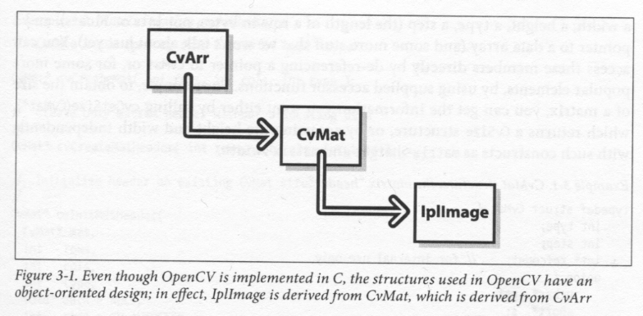
Sort of Object Oriented
The most important data structure is arguably IplImage.
- Page 33 of Learning OpenCV by Bradski and Kaehler

Slide 22
Sort of Object Oriented
The IplImage and CvMat data structures are just metadata which provide interfaces to the underlying image data.
See projections.c.

Slide 23
Ex 4: Custom Morphology
Creating custom structuring elements using cvCreateStructuringElementEx() and an int[].

Slide 24
Warning: Pointer Arithmetic
is Imminent!
Examples and discussion can be found in the text (highly recommended reading):
cvMat and IplImage: pp. 31 - 47
cvSeq: pp. 222 - 234
See customStructElem.c.

Slide 25
Questions?

Slide 26
Example
CvSize size = cvSize(600, 400);
IplImage* img = cvCreateImage(
size, IPL_DEPTH_8U, 3
);
cvSet(img, cvScalarAll(0), NULL);

Slide 27
Why isn't every call to these helper functions a memory leak?

Slide 28
Esoteric C99 Feature of the Day:
Inline Functions
"The keyword inline is a request to the compiler to insert a function's machine code wherever the function is called in the program."
- Page 106 of C in a Nutshell, by Prinz and Crawford
Automatic variables declared in an inline function become automatic variables in the calling function.

