Slide 1
Fundamentals of Real-Time Scheduling
Hongwei Zhang
hongwei@iastate.edu, 515 294 2143
http://www.ece.iastate.edu/~hongwei
Ref. book: Lee and Seshia, Introduction to Embedded Systems, A Cyber-Physical Systems Approach, 2017
Ack.: this lecture is prepared in part based on slides of Lee, Sangiovanni-Vincentelli, Seshia.
Notes:
Content from Chapter 12 of Lee & Seshia book + Hongwei & Yu paper on single-hop real-time scheduling

Slide 2

Source
This lecture draws heavily from:
Giorgio C. Buttazzo, Hard Real-Time Computing Systems, Springer, 2004.
Giorgio Buttazzo, Scuola Superiore Sant'Anna

Slide 3
Outline
Microkernel/OS
Rate Monotonic Scheduling
Earliest Deadline First
Scheduling Anomalies
From Real-Time Computing to Real-Time Networking

Slide 4
Outline
Microkernel/OS
Rate Monotonic Scheduling
Earliest Deadline First
Scheduling Anomalies
From Real-Time Computing to Real-Time Networking

Slide 5
Responsibilities of a Microkernel (a small, custom OS)
Scheduling of threads or processes
Creation and termination of threads
Timing of thread activations
Synchronization
Semaphores and locks
Input and output
Interrupt handling
Notes:
In computer science, a semaphore is a variable or abstract data type used to control access to a common resource by multiple processes in a concurrent system such as a multitasking operating system. A semaphore is simply a variable. This variable is used to solve critical section problems and to achieve process synchronization in the multi processing environment.
A trivial semaphore is a plain variable that is changed (for example, incremented or decremented, or toggled) depending on programmer-defined conditions.
A useful way to think of a semaphore as used in the real-world systems is as a record of how many units of a particular resource are available, coupled with operations to adjust that record safely (i.e. to avoid race conditions) as units are required or become free, and, if necessary, wait until a unit of the resource becomes available.
Semaphores are a useful tool in the prevention of race conditions; however, their use is by no means a guarantee that a program is free from these problems. Semaphores which allow an arbitrary resource count are called counting semaphores, while semaphores which are restricted to the values 0 and 1 (or locked/unlocked, unavailable/available) are called binary semaphores and are used to implement locks.
The semaphore concept was invented by Dutch computer scientist Edsger Dijkstra in 1962 or 1963,^{[1]} when Dijkstra and his team were developing an operating system for the Electrologica X8. That system eventually became known as THE multiprogramming system.

Slide 6
A Few More Advanced Functions of an OS (not discussed here)
Memory management
Separate stacks
Segmentation
Allocation and deallocation
File system
Persistent storage
Security
User vs. kernel space
Identity management
Networking
TCP/IP stack

Slide 7
Outline of a Microkernel Scheduler (1)
Main Scheduler Thread (Task):
set up periodic timer interrupts;
create default thread data structures;
dispatch a thread (procedure call);
execute main thread (idle or power save, for example).
Thread data structure:
copy of all state (machine registers)
address at which to resume executing the thread
status of the thread (e.g. blocked on mutex)
priority, WCET (worst case execution time), and other info to assist the scheduler

Slide 8
Timer interrupt service routine:
dispatch a thread.
Dispatching a thread:
disable interrupts;
determine which thread should execute (scheduling);
if the same one, enable interrupts and return;
save state (registers) into current thread data structure;
save return address from the stack for current thread;
copy new thread state into machine registers;
replace program counter on the stack for the new thread;
enable interrupts;
return.

Slide 9
The Focus in this Lecture: How to decide which thread to schedule?
Considerations:
Preemptive vs. non-preemptive scheduling
Periodic vs. aperiodic tasks
Fixed priority vs. dynamic priority
Scheduling anomalies: priority inversion, multi-process scheduling

Slide 10
When can a new thread be dispatched?
Under Non-Preemptive scheduling:
When the current thread completes
Under Preemptive scheduling:
Upon a timer interrupt
Upon an I/O interrupt (possibly)
When a new thread is created, or one completes
When the current thread makes any OS call
file system access
network access
…
Notes:
When the current thread blocks on or releases a mutex
When the current thread blocks on a semaphore
When a semaphore state is changed

Slide 11
Preemptive Scheduling
Assumptions:
1. All threads have priorities
either statically assigned (constant for the duration of the thread)
or dynamically assigned (can vary).
2. Kernel keeps track of which threads are “enabled” (able to execute, e.g. not blocked waiting for a semaphore or a mutex or for a time to expire).
Preemptive scheduling:
At any instant, the enabled thread with the highest priority is executing
Whenever any thread changes priority or “enabled” status, the kernel can dispatch a new thread

Slide 12
Outline
Microkernel/OS
Rate Monotonic Scheduling
Earliest Deadline First
Scheduling Anomalies
From Real-Time Computing to Real-Time Networking

Slide 13
Rate Monotonic Scheduling
Assume n tasks invoked periodically with:
periods T₁, … ,T_{n} (impose real-time constraints)
worst-case execution times (WCET) C₁, … ,C_{n}
assumes no mutexes, semaphores, or blocking I/O
no precedence constraints
fixed priorities
preemptive scheduling
Rate Monotonic Scheduling: Priorities ordered by period, with smallest period having the highest priority

Slide 14
Theorem: For a task set where the relative deadlines of tasks are proportional to their periods, if any fixed-priority assignment yields a feasible schedule (i.e., every task executes to completion once within its relative deadline), then RMS (smallest period has the highest priority) also yields a feasible schedule.
RMS is optimal in the sense of feasibility.
Liu and Layland, “Scheduling algorithms for multiprogramming in a hard-real-time environment,” Journal of ACM, 20(1), 1973.

Slide 15
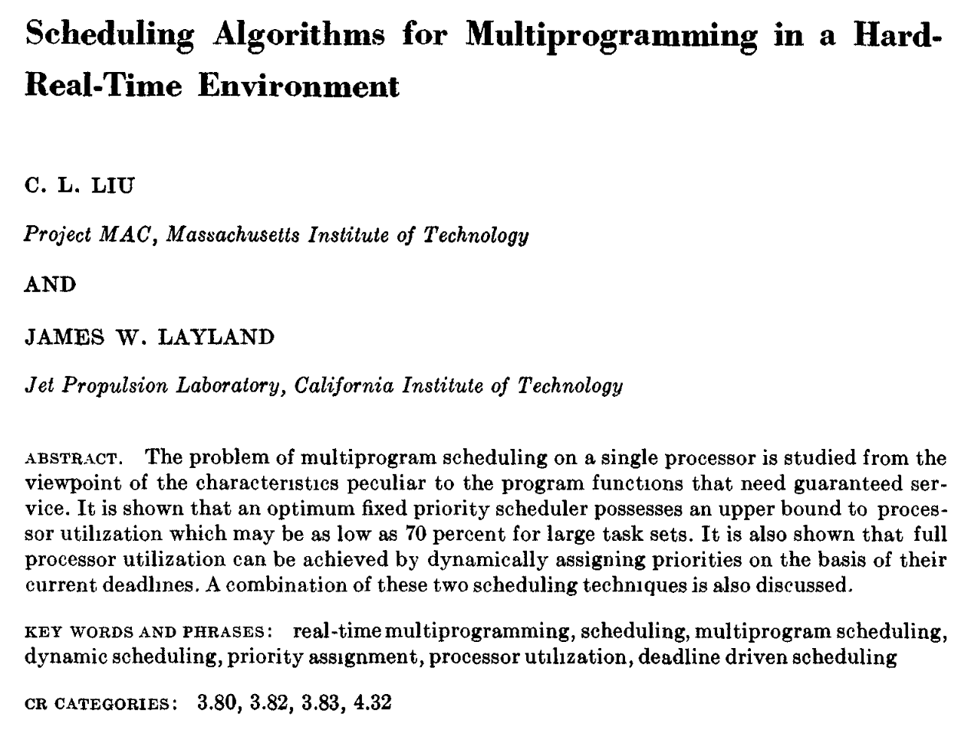
Liu and Layland, JACM, Jan. 1973

Slide 16
Showing Optimality of RMS: Consider two tasks with different periods
C₁
T₁
C₂
T₂
Is a non-preemptive schedule feasible?

Slide 17
Showing Optimality of RMS: Consider two tasks with different periods
C₁
T₁
C₂
T₂
Non-preemptive schedule is not feasible. Some instance of the Red Task (2) will not finish within its period if we do non-preemptive scheduling.

Slide 18
Showing Optimality of RMS: Consider two tasks with different periods
C₁
T₁
C₂
T₂
What if we had a preemptive scheduling with higher priority for the red task?

Slide 19
Showing Optimality of RMS: Consider two tasks with different periods
C₁
C₁
preempted
Preemptive schedule with the red task having higher priority is feasible. Note that preemption of the blue task extends its completion time.

Slide 20
Any Implicit Assumptions in Our Reasoning?
Assume zero time needed to switch between tasks.

Slide 21
Showing Optimality of RMS for 2 Tasks: Key Proof Ideas
1. Worst case: when both tasks arrive together.
2. For this case, show if non-RMS is feasible, then RMS is feasible.

Slide 22
Showing Optimality of RMS: Alignment of tasks
C₁
T₁
Completion time of the lower priority task is worst (latest) when its starting phase matches that of higher priority tasks.
Thus, when checking schedule feasibility, it is sufficient to consider only the worst case: All tasks start their cycles at the same time.

Slide 23
Showing Optimality of RMS: (for two tasks)
It is sufficient to show that if a non-RMS schedule is feasible, then the RMS schedule is feasible.
Consider two tasks as follows:
C₁
T₁
C₂
T₂

Slide 24
Showing Optimality of RMS: (for two tasks)
The non-RMS, fixed priority schedule looks like this:
C₁
C₂
T₂
From this, we can see that the non-RMS schedule is feasible if and only if
We can then show that this condition implies that the RMS schedule is feasible.
Actually: min(T1,T2)

Slide 25
Showing Optimality of RMS: (for two tasks)
The RMS schedule looks like this: (task with smaller period moves earlier)
C₂
C₁
T₂
The condition for the non-RMS schedule feasibility:
is clearly sufficient (though not necessary) for feasibility of the RMS schedule. QED.

Slide 26
Comments
This proof can be extended to an arbitrary number of tasks (though it gets much more tedious).
This proof gives optimality only w.r.t. feasibility. It says nothing about other optimality criteria.
Practical implementation:
Timer interrupt at greatest common divisor of the periods.
Multiple timers

Slide 27
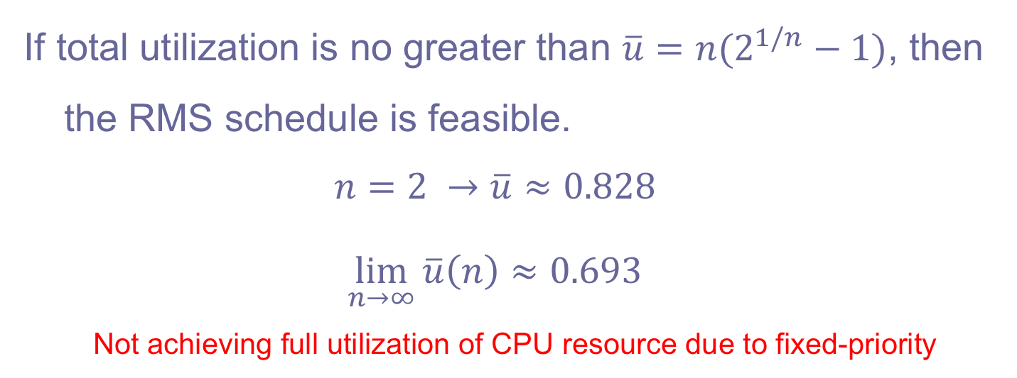
Utilization of RMS
If total utilization is no greater than $\overline{u}=n(2^{1/n}−1)$, then the RMS schedule is feasible.
$$n=2 →\overline{u}≈0.828$$
$$\lim_{n→∞}{\overline{u}\left(n\right)}≈0.693$$
Not achieving full utilization of CPU resource due to fixed-priority
RMS can achieve a full utilization of 1 for simply-periodic task set (i.e., periods of tasks are multiple of one-another)

Slide 28
Outline
Microkernel/OS
Rate Monotonic Scheduling
Earliest Deadline First
Scheduling Anomalies
From Real-Time Computing to Real-Time Networking

Slide 29
Scheduling Problem: minimize max. lateness
Given n independent one-time tasks with deadlines d₁ , … , d_{n}, schedule them to minimize the maximum lateness, defined as
where f_{i} is the finishing time of task i. Note that this is negative iff all deadlines are met.

Slide 30
Deadline Driven Scheduling: Jackson’s Algorithm: EDD (1955)
Earliest Due Date (EDD) algorithm: Execute them in order of non-decreasing deadlines.
Note that this does not require preemption.

Slide 31
Theorem: EDD is Optimal in the Sense of Minimizing Maximum Lateness
To prove, use an interchange argument. Given a schedule S that is not EDD, there must be tasks a and b where a immediately precedes b in the schedule but d_{a} > d_{b}.
We can prove that this schedule can be improved by interchanging a and b. Thus, no non-EDD schedule is achieves smaller max lateness than EDD, so the EDD schedule must be optimal.

Slide 32
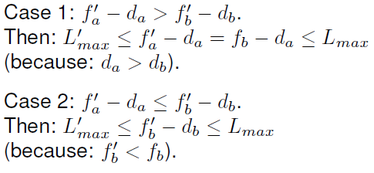

Consider a non-EDD Schedule S
There must be tasks a and b where a immediately precedes b in the schedule but d_{a} > d_{b}
time
a
b
f_{a}
f_{b}
b
a

Slide 33
Deadline Driven Scheduling: Horn’s algorithm: EDF (1974)
Extend EDD by allowing tasks to “arrive” (become ready) at any time.
Earliest deadline first (EDF): Given a set of n independent tasks with arbitrary arrival times, any algorithm that at any instant executes the task with the earliest absolute deadline among all arrived tasks is optimal w.r.t. minimizing the maximum lateness.
Proof uses a similar interchange argument.

Slide 34
Using EDF for Periodic Tasks
The EDF algorithm can be applied to periodic tasks as well as aperiodic tasks.
Simplest use: Deadline is the end of the period (a.k.a. implicit deadline)
Alternative use: Separately specify deadline (relative to the period start time) and period.

Slide 35
Comparison of EDF and RMS
Favoring RMS
Scheduling decisions are simpler (fixed priorities vs. the dynamic priorities required by EDF. EDF scheduler must maintain a list of ready tasks that is sorted by priority.)
Favoring EDF
Since EDF is optimal w.r.t. minimizing maximum lateness, it is also optimal w.r.t. feasibility.
RMS is optimal w.r.t. feasibility only for fixed-priority systems.
For infeasible schedules, RMS completely blocks lower priority tasks, resulting in unbounded maximum lateness.
EDF can achieve full utilization where RMS fails to do so
EDF results in fewer preemptions in practice, and hence less overhead for context switching
Notes:
EDF is dynamic priority because the absolute deadline of a task instance must be considered, which depends on the number of task instances that have gone before it.

Slide 36
Precedence Constraints
4
2
DAG, showing that task 1 must complete before tasks 2 and 3 can be started, etc.
1
5
3
6
A directed acyclic graph (DAG) shows precedences, which indicate which tasks must complete before other tasks start.

Slide 37

Example: EDF Schedule
C₄ = 1
d₄ = 3
C₂ = 1
d₂ = 5
4
2
C₅ = 1
d₅ = 5
1
5
C₁ = 1
d₁ = 2
3
C₃ = 1
d₃ = 4
6
C₆ = 1
d₆ = 6
Is this feasible?
Notes:
Task 4 misses deadline

Slide 38
EDF is not optimal under precedence constraints
C₄ = 1
d₄ = 3
C₂ = 1
d₂ = 5
4
2
C₅ = 1
d₅ = 5
1
5
C₁ = 1
d₁ = 2
3
C₃ = 1
d₃ = 4
6
C₆ = 1
d₆ = 6
The EDF schedule chooses task 3 at time 1 because it has an earlier deadline. This choice results in task 4 missing its deadline
deadline order vs. precedence relation
Is there a feasible schedule?

Slide 39

Latest Deadline First (LDF) (Lawler, 1973)
C₄ = 1
d₄ = 3
C₂ = 1
d₂ = 5
4
2
C₅ = 1
d₅ = 5
1
5
C₁ = 1
d₁ = 2
3
C₃ = 1
d₃ = 4
6
C₆ = 1
d₆ = 6
The LDF scheduling strategy builds a schedule backwards. Given a DAG, choose the leaf node with the latest deadline to be scheduled last, and work backwards.

Slide 40

Latest Deadline First (LDF) (Lawler, 1973)
C₄ = 1
d₄ = 3
C₂ = 1
d₂ = 5
4
2
C₅ = 1
d₅ = 5
1
5
C₁ = 1
d₁ = 2
3
C₃ = 1
d₃ = 4
6
C₆ = 1
d₆ = 6

Slide 41

Latest Deadline First (LDF) (Lawler, 1973)
C₄ = 1
d₄ = 3
C₂ = 1
d₂ = 5
4
2
C₅ = 1
d₅ = 5
1
5
C₁ = 1
d₁ = 2
3
C₃ = 1
d₃ = 4
6
C₆ = 1
d₆ = 6

Slide 42

Latest Deadline First (LDF) (Lawler, 1973)
C₄ = 1
d₄ = 3
C₂ = 1
d₂ = 5
4
2
C₅ = 1
d₅ = 5
1
5
C₁ = 1
d₁ = 2
3
C₃ = 1
d₃ = 4
6
C₆ = 1
d₆ = 6

Slide 43

Latest Deadline First (LDF) (Lawler, 1973)
C₄ = 1
d₄ = 3
C₂ = 1
d₂ = 5
4
2
C₅ = 1
d₅ = 5
1
5
C₁ = 1
d₁ = 2
3
C₃ = 1
d₃ = 4
6
C₆ = 1
d₆ = 6

Slide 44

Latest Deadline First (LDF) (Lawler, 1973)
C₄ = 1
d₄ = 3
C₂ = 1
d₂ = 5
4
2
C₅ = 1
d₅ = 5
1
5
C₁ = 1
d₁ = 2
3
C₃ = 1
d₃ = 4
6
C₆ = 1
d₆ = 6

Slide 45

Latest Deadline First (LDF) (Lawler, 1973)
C₄ = 1
d₄ = 3
C₂ = 1
d₂ = 5
4
2
C₅ = 1
d₅ = 5
1
5
C₁ = 1
d₁ = 2
3
C₃ = 1
d₃ = 4
6
C₆ = 1
d₆ = 6

Slide 46
LDF is optimal under precedence constraints
C₄ = 1
d₄ = 3
C₂ = 1
d₂ = 5
4
2
C₅ = 1
d₅ = 5
1
5
C₁ = 1
d₁ = 2
3
C₃ = 1
d₃ = 4
6
C₆ = 1
d₆ = 6
The LDF schedule shown at the bottom respects all precedences and meets all deadlines.
→ Also minimizes maximum lateness

Slide 47
Latest Deadline First (LDF) (Lawler, 1973)
LDF is optimal in the sense that it minimizes the maximum lateness.
It does not require preemption. (We’ll see that EDF can be made to work with preemption.)
However, it requires that all tasks be available and their precedences known before any task is executed.

Slide 48
EDF*: EDF with Precedences
With a preemptive scheduler, EDF can be modified to account for precedences and to allow tasks to arrive at arbitrary times. Simply adjust the deadlines and arrival times according to the precedences.
C₄ = 1
d₄ = 3
C₂ = 1
d₂ = 5
4
2
C₅ = 1
d₅ = 5
1
5
C₁ = 1
d₁ = 2
3
C₃ = 1
d₃ = 4
6
Recall that for the tasks at the left, EDF yields the schedule above, where task 4 misses its deadline.
C₆ = 1
d₆ = 6

Slide 49
EDF*: Modifying release time
Given n tasks with precedences and release times r_{i}, if task i immediately precedes task j, then modify the release time of taks j as follows:
assume:
C₄ = 1
d₄ = 3
r‘₄ = 2
r_{i} = 0
C₂ = 1
d₂ = 5
r‘₂ = 1
4
2
C₅ = 1
d₅ = 5
r‘₅ = 2
1
5
C₁ = 1
d₁ = 2
r'₁ = 0
3
C₃ = 1
d₃ = 4
r‘₃ = 1
6
C₆ = 1
d₆ = 6
r‘₆ = 2

Slide 50

EDF*: Modifying deadline
Given n tasks with precedences and deadlines d_{i}, if task i immediately precedes task j, then modify the deadline of task i as follows:
C₄ = 1
d₄ = 3
r‘₄ = 2
d'₄ = 3
assume:
C₂ = 1
d₂ = 5
r‘₂ = 1
d‘₂ = 2
r_{i} = 0
4
2
C₅ = 1
d₅ = 5
r‘₅ = 2
d‘₅ = 5
1
5
C₁ = 1
d₁ = 2
r'₁ = 0
d‘₂ = 1
3
C₃ = 1
d₃ = 4
r‘₃ = 1
d‘₃ = 4
6
Using the revised release times and deadlines, the above EDF schedule is optimal and meets all deadlines.
C₆ = 1
d₆ = 6
r‘₆ = 2
d‘₆ = 6

Slide 51
Optimality
EDF* is optimal in the sense of minimizing the maximum lateness.

Slide 52
Outline
Microkernel/OS
Rate Monotonic Scheduling
Earliest Deadline First
Scheduling Anomalies
From Real-Time Computing to Real-Time Networking

Slide 53
Scheduling can interact with other constraints/requirements in non-intuitive ways
Mutual exclusion
Priority inversion
Priority inheritance
Priority ceiling
Multiprocessor scheduling
Richard’s anomalies

Slide 54
Accounting for Mutual Exclusion
When threads access shared resources, they need to use mutexes to ensure data integrity.
Mutexes can also complicate scheduling.

Slide 55
Recall mutual exclusion mechanism in pthreads
#include <pthread.h>
...
pthread_mutex_t lock;
void* addListener(notify listener) {
pthread_mutex_lock(&lock);
...
pthread_mutex_unlock(&lock);
}
void* update(int newValue) {
pthread_mutex_lock(&lock);
value = newValue;
elementType* element = head;
while (element != 0) {
(*(element->listener))(newValue);
element = element->next;
}
pthread_mutex_unlock(&lock);
}
int main(void) {
pthread_mutex_init(&lock, NULL);
...
}
Whenever a data structure is shared across threads, access to the data structure must usually be atomic. This is enforced using mutexes, or mutual exclusion locks. The code executed while holding a lock is called a critical section.
Notes:
POSIX Threads, usually referred to as pthreads, is an execution model that exists independently from a language, as well as a parallel execution model. It allows a program to control multiple different flows of work that overlap in time. Each flow of work is referred to as a thread, and creation and control over these flows is achieved by making calls to the POSIX Threads API. POSIX Threads is an API defined by the standard POSIX.1c, Threads extensions (IEEE Std 1003.1c-1995).
Implementations of the API are available on many Unix-like POSIX-conformant operating systems such as FreeBSD, NetBSD, OpenBSD, Linux, Mac OS X, Android^{[1]}, Solaris and AUTOSAR Adaptive, typically bundled as a library libpthread. DR-DOS and Microsoft Windows implementations also exist: within the SFU/SUA subsystem which provides a native implementation of a number of POSIX APIs, and also within third-party packages such as pthreads-w32,^{[2]} which implements pthreads on top of existing Windows API.

Slide 56
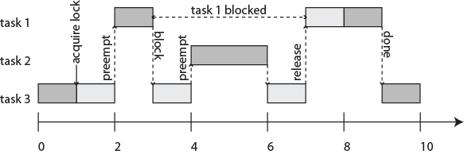
Priority Inversion: A Hazard with Mutexes
Task 1 has highest priority, task 3 lowest. Task 3 acquires a lock on a shared object, entering a critical section. It gets preempted by task 1, which then tries to acquire the lock and blocks. Task 2 preempts task 3 at time 4, keeping the higher priority task 1 blocked for an unbounded amount of time. In effect, the priorities of tasks 1 and 2 get inverted, since task 2 can keep task 1 waiting arbitrarily long.

Slide 57
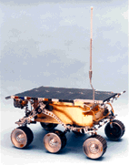
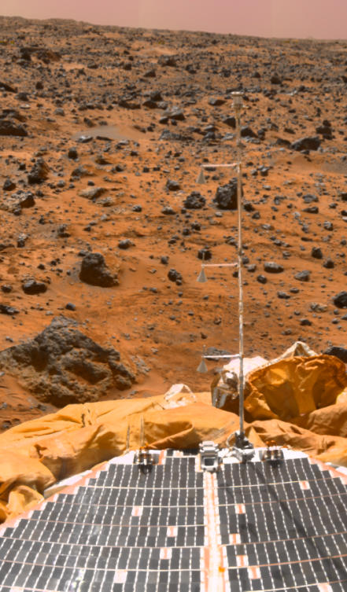
Mars Rover Pathfinder
The Mars Rover Pathfinder landed on Mars on July 4th, 1997. A few days into the mission, the Pathfinder began sporadically missing deadlines, causing total system resets, each with loss of data.
The problem was diagnosed on the ground as priority inversion, where a low priority meteorological task was holding a lock blocking a high-priority task while medium priority tasks executed.
Source: RISKS-19.49 on the comp.programming.threads newsgroup, December 07, 1997, by Mike Jones (mbj@MICROSOFT.com).

Slide 58
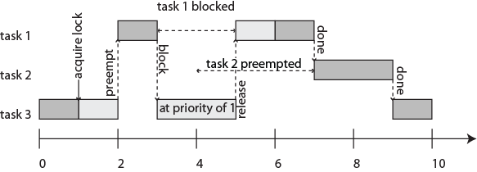
Priority Inheritance Protocol (PIP) (Sha, Rajkumar, Lehoczky, 1990)
Task 1 has highest priority, task 3 lowest. Task 3 acquires a lock on a shared object, entering a critical section. It gets preempted by task 1, which then tries to acquire the lock and blocks. Task 3 inherits the priority of task 1, preventing preemption by task 2.

Slide 59



John Lehoczky
Raj Rajkumar
CMU
Lui Sha
U. Illinois

Slide 60
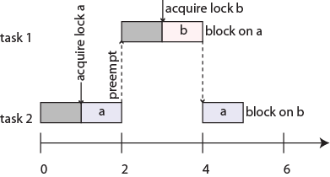
Deadlock
#include <pthread.h>
...
pthread_mutex_t lock_a, lock_b;
void* thread_1_function(void* arg) {
pthread_mutex_lock(&lock_b);
...
pthread_mutex_lock(&lock_a);
...
pthread_mutex_unlock(&lock_a);
...
pthread_mutex_unlock(&lock_b);
...
}
void* thread_2_function(void* arg) {
pthread_mutex_lock(&lock_a);
...
pthread_mutex_lock(&lock_b);
...
pthread_mutex_unlock(&lock_b);
...
pthread_mutex_unlock(&lock_a);
...
}
The lower priority task starts first and acquires lock a, then gets preempted by the higher priority task, which acquires lock b and then blocks trying to acquire lock a. The lower priority task then blocks trying to acquire lock b, and no further progress is possible.

Slide 61
Priority Ceiling Protocol (PCP) (Sha, Rajkumar, Lehoczky, 1990)
Every lock or semaphore is assigned a priority ceiling equal to the priority of the highest-priority task that can lock it.
A task T can acquire a lock only if the task’s priority is strictly higher than the priority ceilings of all locks currently held by other tasks
Intuition:
the task T will not later try to acquire these locks held by other tasks, thus avoiding deadlock
Locks that are not held by any task don’t affect the task
This prevents deadlocks
There are extensions supporting dynamic priorities and dynamic creations of locks (stack resource policy)
Notes:
Can one automatically compute the priority ceiling? Done by compiler?

Slide 62
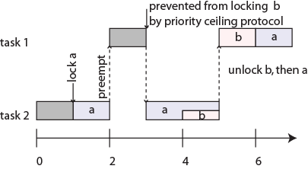
#include <pthread.h>
...
pthread_mutex_t lock_a, lock_b;
void* thread_1_function(void* arg) {
pthread_mutex_lock(&lock_b);
...
pthread_mutex_lock(&lock_a);
...
pthread_mutex_unlock(&lock_a);
...
pthread_mutex_unlock(&lock_b);
...
}
void* thread_2_function(void* arg) {
pthread_mutex_lock(&lock_a);
...
pthread_mutex_lock(&lock_b);
...
pthread_mutex_unlock(&lock_b);
...
pthread_mutex_unlock(&lock_a);
...
}
In this version, locks a and b have priority ceilings equal to the priority of task 1. At time 3, task 1 attempts to lock b, but it can’t because task 2 currently holds lock a, which has priority ceiling equal to the priority of task 1.

Slide 63
Brittleness
In general, all thread scheduling algorithms are brittle: Small changes can have big, unexpected consequences.
E.g., for multiprocessor (or multicore) schedules:
Theorem (Richard Graham, 1976): If a task set with fixed priorities, execution times, and precedence constraints is scheduled according to priorities on a fixed number of processors, then increasing the number of processors, reducing execution times, or weakening precedence constraints can increase the schedule length.

Slide 64
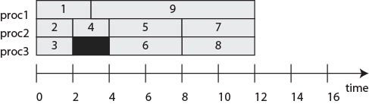
Richard’s Anomalies
C₁ = 3
1
9
C₉ = 9
9 tasks with precedences and the shown execution times, where lower numbered tasks have higher priority than higher numbered tasks. Priority-based 3 processor schedule:
C₂ = 2
2
8
C₈ = 4
C₃ = 2
3
7
C₇ = 4
C₄ = 2
4
6
C₆ = 4
5
C₅ = 4
What happens if you increase the number of processors to four?

Slide 65
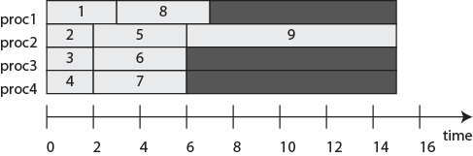
Richard’s Anomalies: Increasing the number of processors
C₁ = 3
1
9
C₉ = 9
9 tasks with precedences and the shown execution times, where lower numbered tasks have higher priority than higher numbered tasks. Priority-based 3 processor schedule:
C₂ = 2
2
8
C₈ = 4
C₃ = 2
3
7
C₇ = 4
C₄ = 2
4
6
C₆ = 4
5
C₅ = 4
The priority-based schedule with four processors has a longer execution time.

Slide 66
Greedy Scheduling
C₁ = 3
1
9
C₉ = 9
9 tasks with precedences and the shown execution times, where lower numbered tasks have higher priority than higher numbered tasks. Priority-based 3 processor schedule:
C₂ = 2
2
8
C₈ = 4
C₃ = 2
3
7
C₇ = 4
C₄ = 2
4
6
C₆ = 4
5
C₅ = 4
Priority-based scheduling is “greedy.” A smarter scheduler for this example could hold off scheduling 5, 6, or 7, leaving a processor idle for one time unit.

Slide 67
Greedy scheduling may be the only practical option.
C₁ = 3
1
9
C₉ = 9
9 tasks with precedences and the shown execution times, where lower numbered tasks have higher priority than higher numbered tasks. Priority-based 3 processor schedule:
C₂ = 2
2
8
C₈ = 4
C₃ = 2
3
7
C₇ = 4
C₄ = 2
4
6
C₆ = 4
5
C₅ = 4
If tasks “arrive” (become known to the scheduler) only after their predecessor completes, then greedy scheduling may be the only practical option.

Slide 68
Richard’s Anomalies
C₁ = 3
1
9
C₉ = 9
9 tasks with precedences and the shown execution times, where lower numbered tasks have higher priority than higher numbered tasks. Priority-based 3 processor schedule:
C₂ = 2
2
8
C₈ = 4
C₃ = 2
3
7
C₇ = 4
C₄ = 2
4
6
C₆ = 4
5
C₅ = 4
What happens if you reduce all computation times by 1?

Slide 69
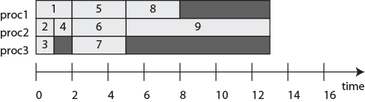
Richard’s Anomalies: Reducing computation times
C₁ = 2
1
9
C₉ = 8
9 tasks with precedences and the shown execution times, where lower numbered tasks have higher priority than higher numbered tasks. Priority-based 3 processor schedule:
C₂ = 1
2
8
C₈ = 3
C₃ = 1
3
7
C₇ = 3
C₄ = 1
4
6
C₆ = 3
5
C₅ = 3
Reducing the computation times by 1 also results in a longer execution time.

Slide 70
Richard’s Anomalies
C₁ = 3
1
9
C₉ = 9
9 tasks with precedences and the shown execution times, where lower numbered tasks have higher priority than higher numbered tasks. Priority-based 3 processor schedule:
C₂ = 2
2
8
C₈ = 4
C₃ = 2
3
7
C₇ = 4
C₄ = 2
4
6
C₆ = 4
5
C₅ = 4
What happens if you remove the precedence constraints (4,8) and (4,7)?

Slide 71
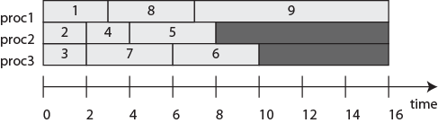
Richard’s Anomalies: Weakening the precedence constraints
C₁ = 3
1
9
C₉ = 9
9 tasks with precedences and the shown execution times, where lower numbered tasks have higher priority than higher numbered tasks. Priority-based 3 processor schedule:
C₂ = 2
2
8
C₈ = 4
C₃ = 2
3
7
C₇ = 4
C₄ = 2
4
6
C₆ = 4
5
C₅ = 4
Weakening precedence constraints can also result in a longer schedule.

Slide 72
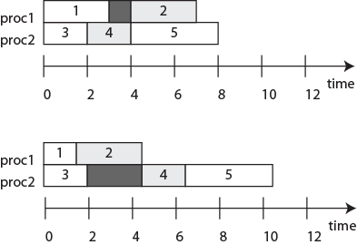
Richard’s Anomalies with Mutexes: Reducing Execution Time
Assume tasks 2 and 4 share the same resource in exclusive mode, and tasks are statically allocated to processors. Then if the execution time of task 1 is reduced, the schedule length increases:

Slide 73
Brittleness (contd.)
Timing behavior under all known task scheduling strategies is brittle. Small changes can have big (and unexpected) consequences.
Unfortunately, since execution times are so hard to predict, such brittleness can result in unexpected system failures.

Slide 74
Outline
Microkernel/OS
Rate Monotonic Scheduling
Earliest Deadline First
Scheduling Anomalies
From Real-Time Computing to Real-Time Networking

Slide 75
Probabilistic Per-Packet Real-Time Guarantee
Each communication pair i : (T_{i}, D_{i}, P_{i}, p_{i})
T_{i}: packet generate period
D_{i}: packet delivery deadline
D_{i} ≤ T_{i} (D_{i} = T_{i} by default)
P_{i}: minimum probability of delivering each packet before deadline
p_{i}: per-packet transmission success probability
Achieved by joint PRK-based scheduling and power & rate control
Yu Chen, Hongwei Zhang, Nathan Fisher, Le Yi Wang, George Yin, Probabilistic Per-Packet Real-Time Guarantees for Wireless Networked Sensing and Control, IEEE Transactions on Industrial Informatics, 14(5):2133-2145, 2018

Slide 76
Problem Definition & PRK-based Real-Time Scheduling
Three inter-related problems
Admission control
real-time schedulable?
Optimal real-time scheduling algorithm
deliver all admissible real-time traffic in time
Optimal congestion control
maximize network utility when given admission traffic sources
PRK-based real-time scheduling
Local interference relation enables local coordination among links/nodes
Notes:
Given a set of communication pairs in arbitrary networks

Slide 77

From Probabilistic Packet-Level Scheduling to Deterministic Scheduling
Required transmission opportunity for ensuring probabilistic per-packet delivery
Problem transformed to deterministic real-time scheduling: {(T_{i}, D_{i}, X_{i})}_{i}

Slide 78
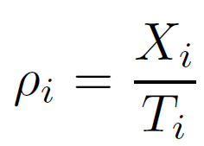
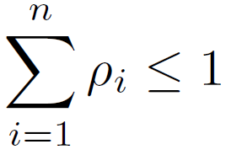
Real-time Scheduling and Admission Control
Earliest-deadline-first (EDF) scheduling is optimal;
Admission control
Work density:
When D_{i} = T_{i}, a set of n links is schedulable if and only if
When D_{i} < T_{i}, existing but more complex testing rules

Slide 79
Per-Packet Real-Time Guarantee Ratio
P_{i} = 90%, 95%, 99%
p_{i} = 0.6
T_{i} = D_{i} = 100 time slots
n = 16 links

Slide 80
Impact of Timescales of Real-Time Guarantee
Every K_{i} window of consecutive packets, probability of having r_{i} fraction of packets delivered before deadline is no less than q_{i}
r_{i} = 0.99
q_{i} = 99.99%
T_{i} = D_{i} = 100 time slots
m_{i}*: per-packet transmission opportunities

Slide 81
Summary
Microkernel/OS
Rate Monotonic Scheduling
Earliest Deadline First
Scheduling Anomalies
From Real-Time Computing to Real-Time Networking
Notes:
Exercise #12:
Chapter 12: 1, 2, 4, 6

